Slide 1
Quant Finance
Price Movement Strategy, Technical Indicators and momentum prediction using machine learning, Backtesting, Portfolio Optimization (Markowitz Portfolio theory )
Yash Adhiya - Presentation
HackRush’ 23 IIT Gandhinagar

Slide 2
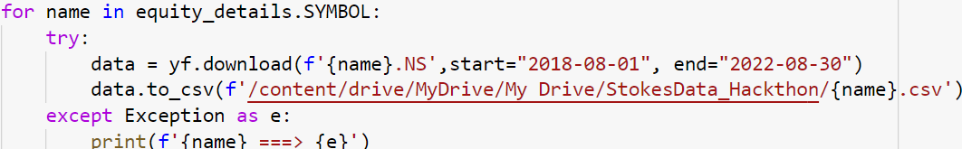
Collecting the Historical Price movement data
Library used: yfinance
Steps: Importing the library yfinance
Download the file form NSE which contains all the listed stocks
Extract the Equity Name from that file
Pass the names in the yfinance to the function call and we are done

Slide 3
Guess what ?
By this method I have downloaded 1800+ listed company’s data for the further Analysis.
For the Portfolio Analysis, The stocks for the analysis are as follows :
['RELIANCE.NS', 'TCS.NS', 'INFY.NS', 'SBIN.NS', 'HDFCBANK.NS', 'HDFC.NS', 'TITAN.NS', 'HEROMOTOCO.NS', 'TATAMOTORS.NS', 'BPCL.NS']
My entire Analysis would contain these stocks as my portfolio, but yes for backtesting and robustness check I have uses more than 20 stocks, surely.

Slide 4
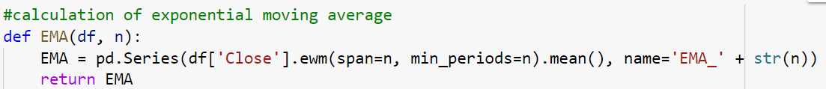
Momentum Prediction Using Machine Learning
Exponential Moving Average
EMA: Exponential Moving Average is a type of moving average that gives more weight to recent prices, and less weight to older prices. It is calculated by taking the average price of a security over a specified time period, with more weight given to the most recent data. The EMA is often used to identify trends in the market.
2. ROC: Rate of Change is a momentum oscillator
Rate of Change is a momentum oscillator that measures the percentage change in price between the current price and the price n periods ago. It is calculated by taking the difference between the current price and the price n periods ago, and dividing that by the price n periods ago. The ROC is often used to identify overbought and oversold conditions.

Slide 5
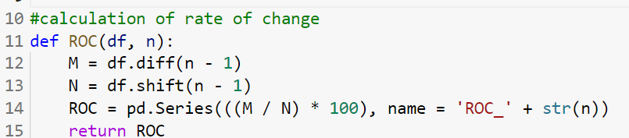
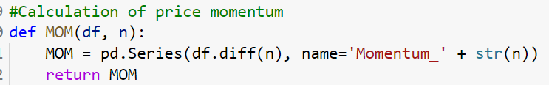
3. MOM: SImple Momentum
Momentum is a simple indicator that measures the difference between the current price and the price n periods ago. It is calculated by subtracting the closing price n periods ago from the current closing price. The momentum indicator is often used to identify trends in the market.

Slide 6
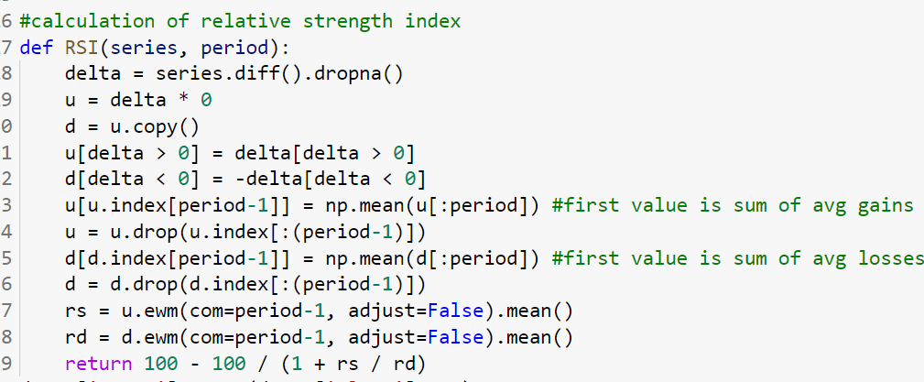
4. RSI: Relative Strength Index
is a momentum oscillator that measures the magnitude of recent price changes to evaluate overbought or oversold conditions. It is calculated by taking the average gain and loss over a specified time period and using that information to determine the strength of the price action. The RSI ranges from 0 to 100, with readings above 70 indicating overbought conditions and readings below 30 indicating oversold conditions.

Slide 7
5. STOK: Stochastic Oscillator is a momentum indicator that compares the closing price of a security to its price range over a specified time period. It is calculated by taking the difference between the current closing price and the lowest low over a specified time period, and dividing that by the difference between the highest high and the lowest low over the same period. The Stochastic Oscillator ranges from 0 to 100, with readings above 80 indicating overbought conditions and readings below 20 indicating oversold conditions.
6. STOD: Stochastic Oscillator %D is a three-period moving average of the Stochastic Oscillator %K. It is used to smooth out the Stochastic Oscillator %K line, making it easier to read and interpret. The Stochastic Oscillator %D is often used in conjunction with the Stochastic Oscillator %K to confirm price movements and identify potential buy and sell signals.
Notes:
Show the google colab (AI integration.ipynb) and showcase how have you added the different features to prepare the machine learning data

Slide 8
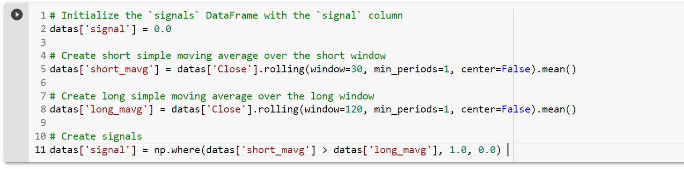
How am I creating the Signals ??

Slide 9
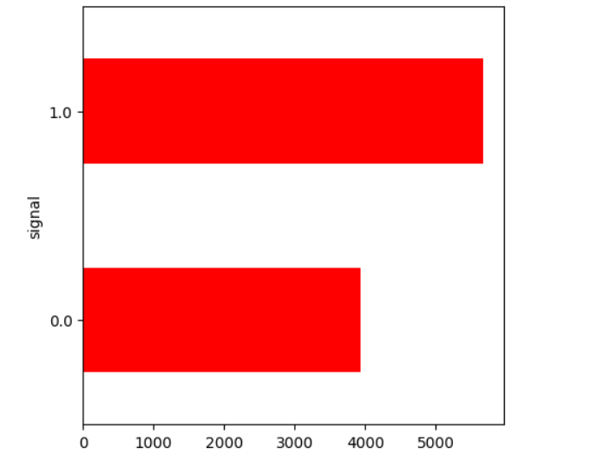
WOW ! I have prepared my target set for ML training

Slide 10
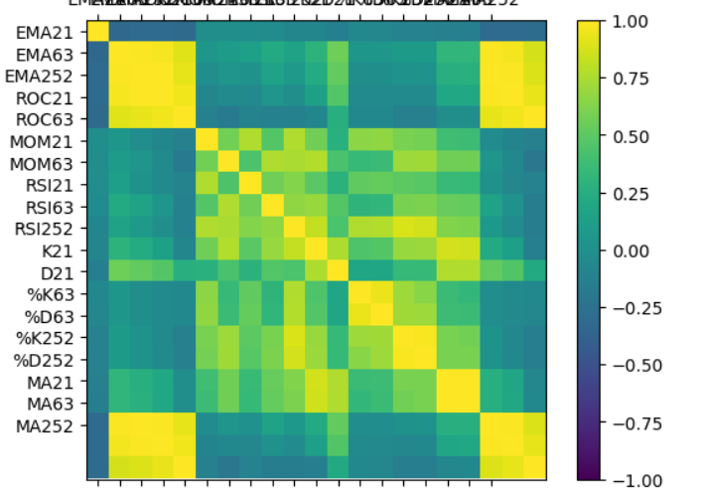
What Can we observe from this??
The Momentums are Correlated !!!
Which means what??
I can define a feature Importance of Random Forest Classifier and Rank Them?
Should I do that??
Nice, this project is driving me crazy

Slide 11
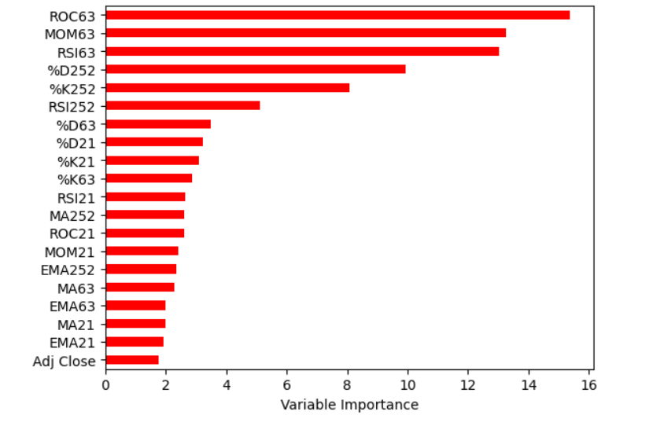
Result of Feature Importance VIsualization !
ANY GUESS WHAT NEXT ?
Yes! ROC63 Momentum Oscillators has the strongest promise towards our signal!
SO WHAT a Trader can do? Just Simply set ROC63 in his/her Trading Environment and GET the MONEY
YOU DON'T BELIEVE, WAIT !

Slide 12
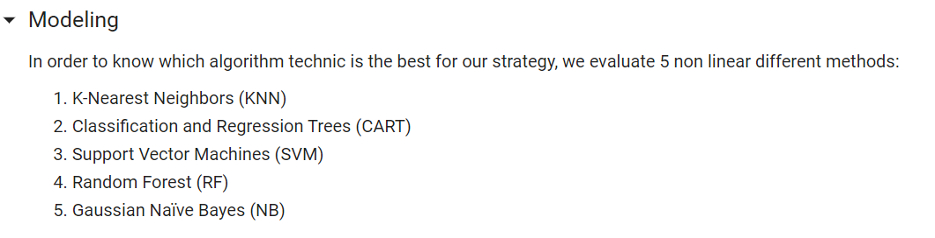
It’s Finally a time to let MACHINE LEARNING answer all our questions !

Slide 13
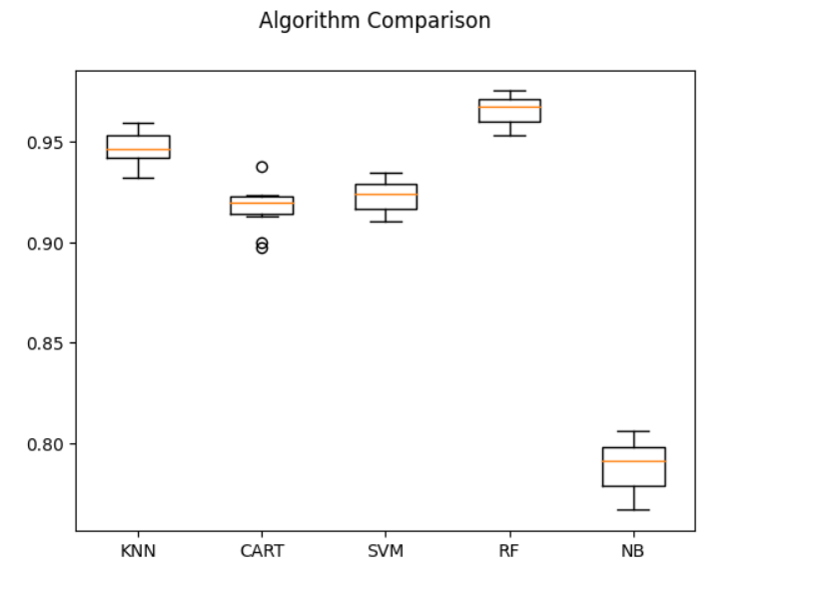
SEE, What Have I found ??

Slide 14
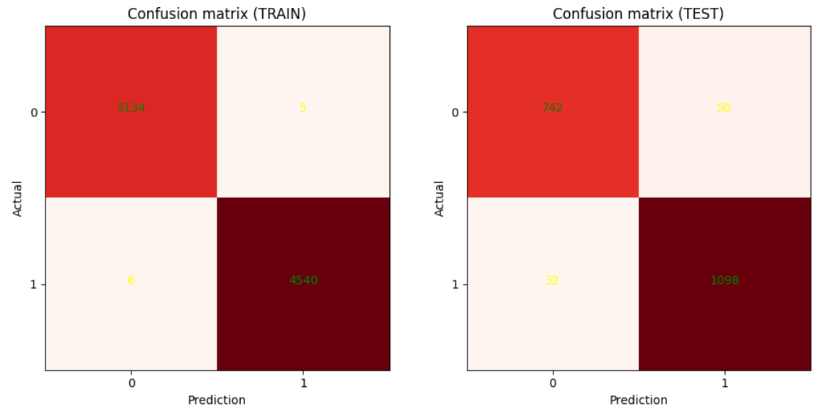
OKAY, Then Apply RF !

Slide 15
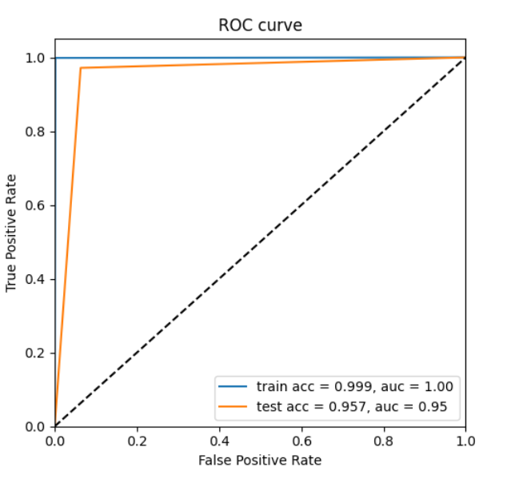
ALSO the AUC/ ROC curve, Please look it
What Inferences can be made?
It means whichever Feature we are training after feature Importance, it gives almost 99% accuracy and this Momentum Oscillators are Trustworthy Believe !! Machine Learning can’t lie!

Slide 16
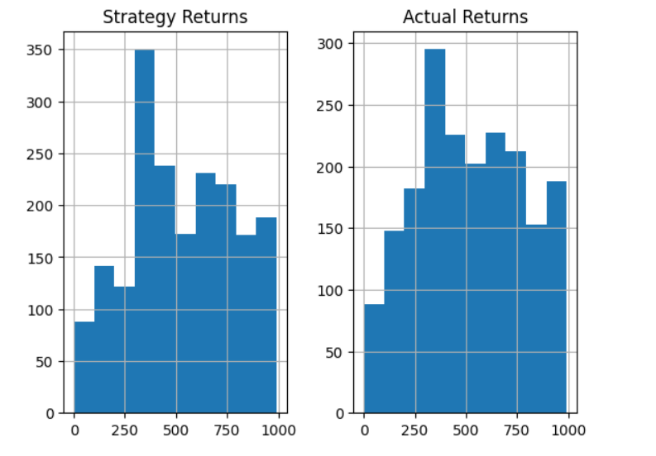
Final Result
Based on the return from our strategy, we do not deviate that much from the actual market return. Indeed, the achieved momentum trading strategy made us well predict the stock prices direction to invest/disinvest in order to make profits. However, as our accuracy is not 100% therefore, we made relatively few losses compared to the actual returns.

Slide 17
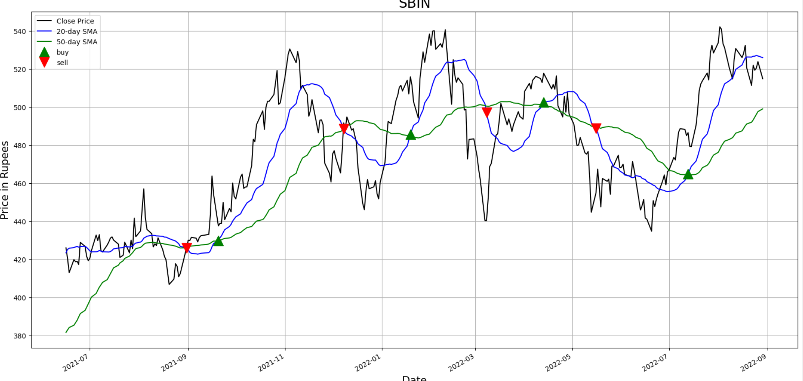
MY own Strategy : Generating Signals(Golden CrossOver) and Backtesting
Notes:
Show the Backtesting data results in the colab

Slide 18
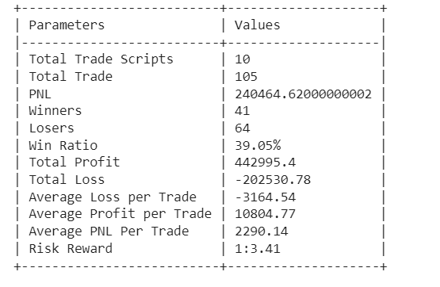
MY backtesting Results for 10 stocks
The Initial Capital with which I was trading was 50000. Commission of 0.002 was considered.

Slide 19
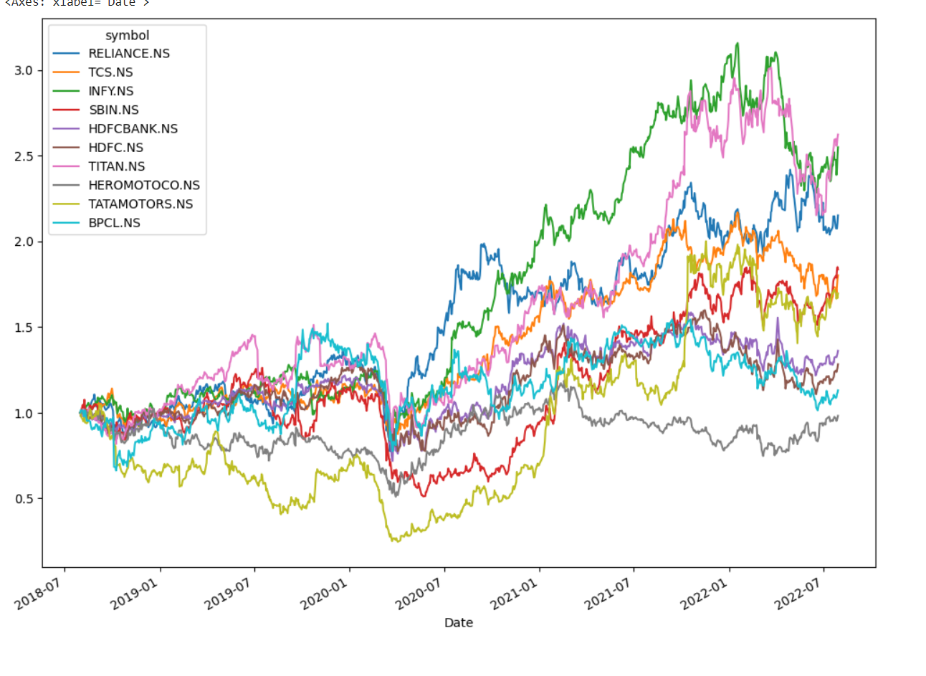
Portfolio Optimization - AGAIN THOSE 10 stocks
This is my portfolio! EQUITIES movement

Slide 20
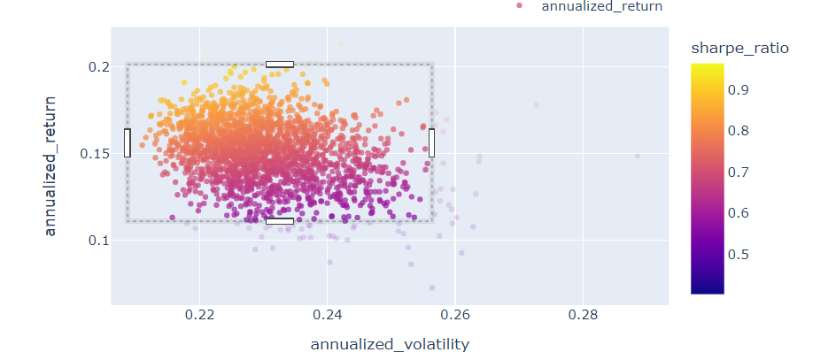
RISK - Return Graph for all the weights (Markowitz's Theory)

Slide 21
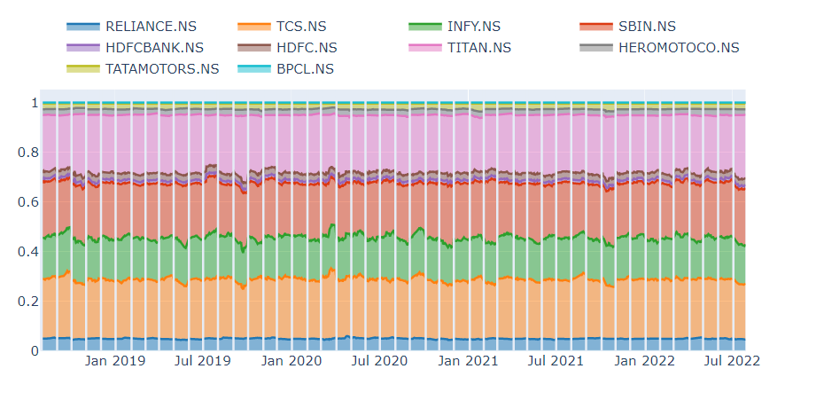

Slide 22
Thank you !
I am looking forward to winning this, and also wants to further continue it to give it a research shape.

