Slide 1
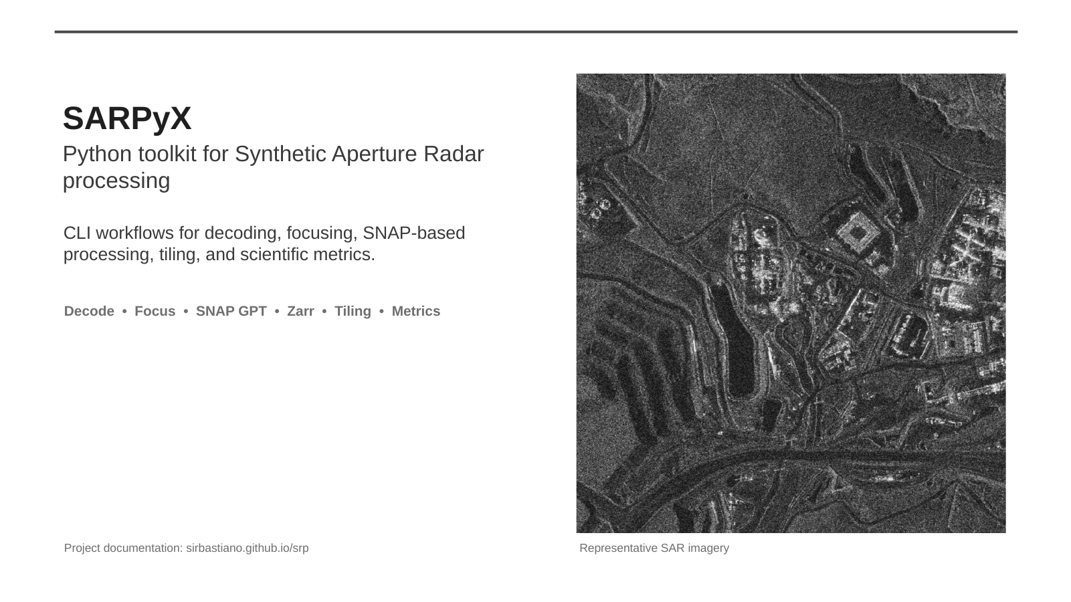
- made with love by sirbastiano -
Notes:
[Sources] - User-provided original presentation slide 1: /mnt/data/SARPyX_project_overview.pptx

Slide 2
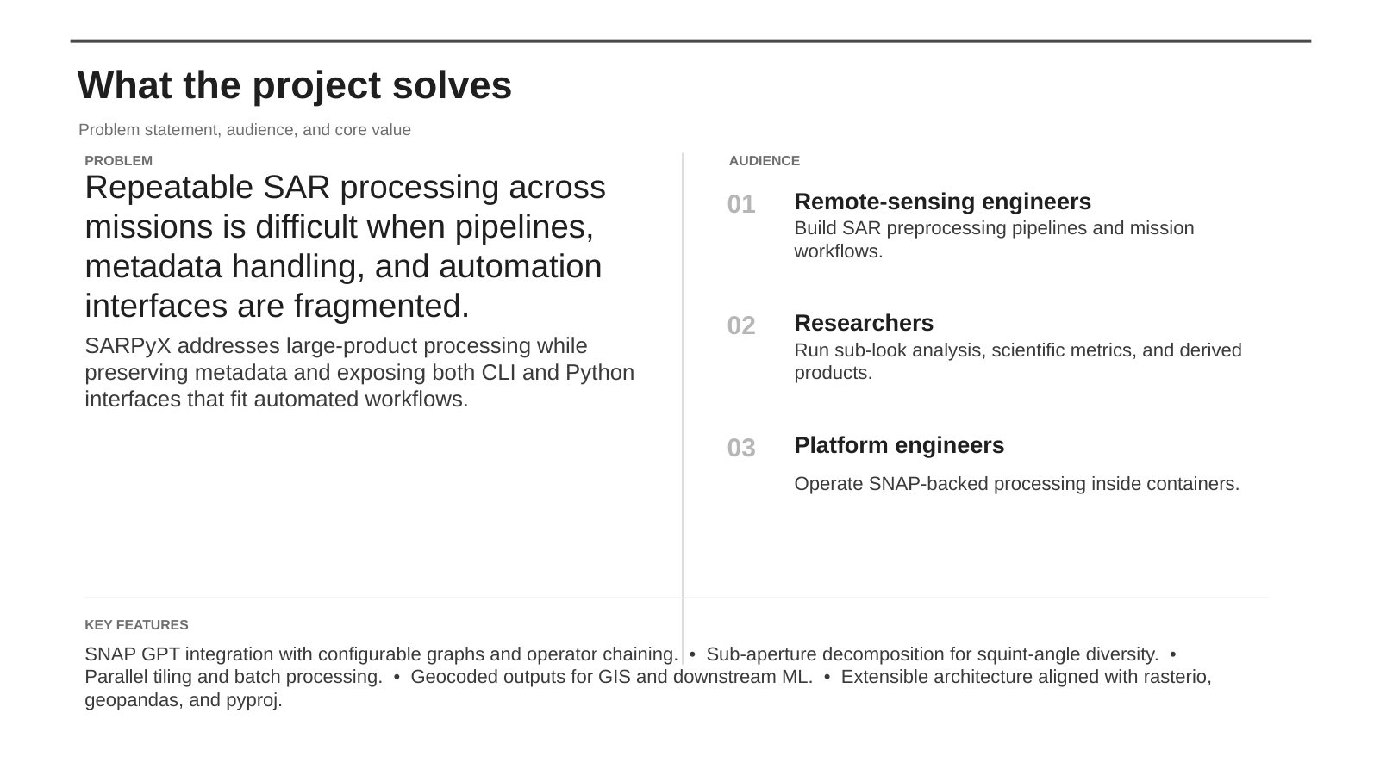
Notes:
[Sources] - User-provided original presentation slide 2: /mnt/data/SARPyX_project_overview.pptx

Slide 3
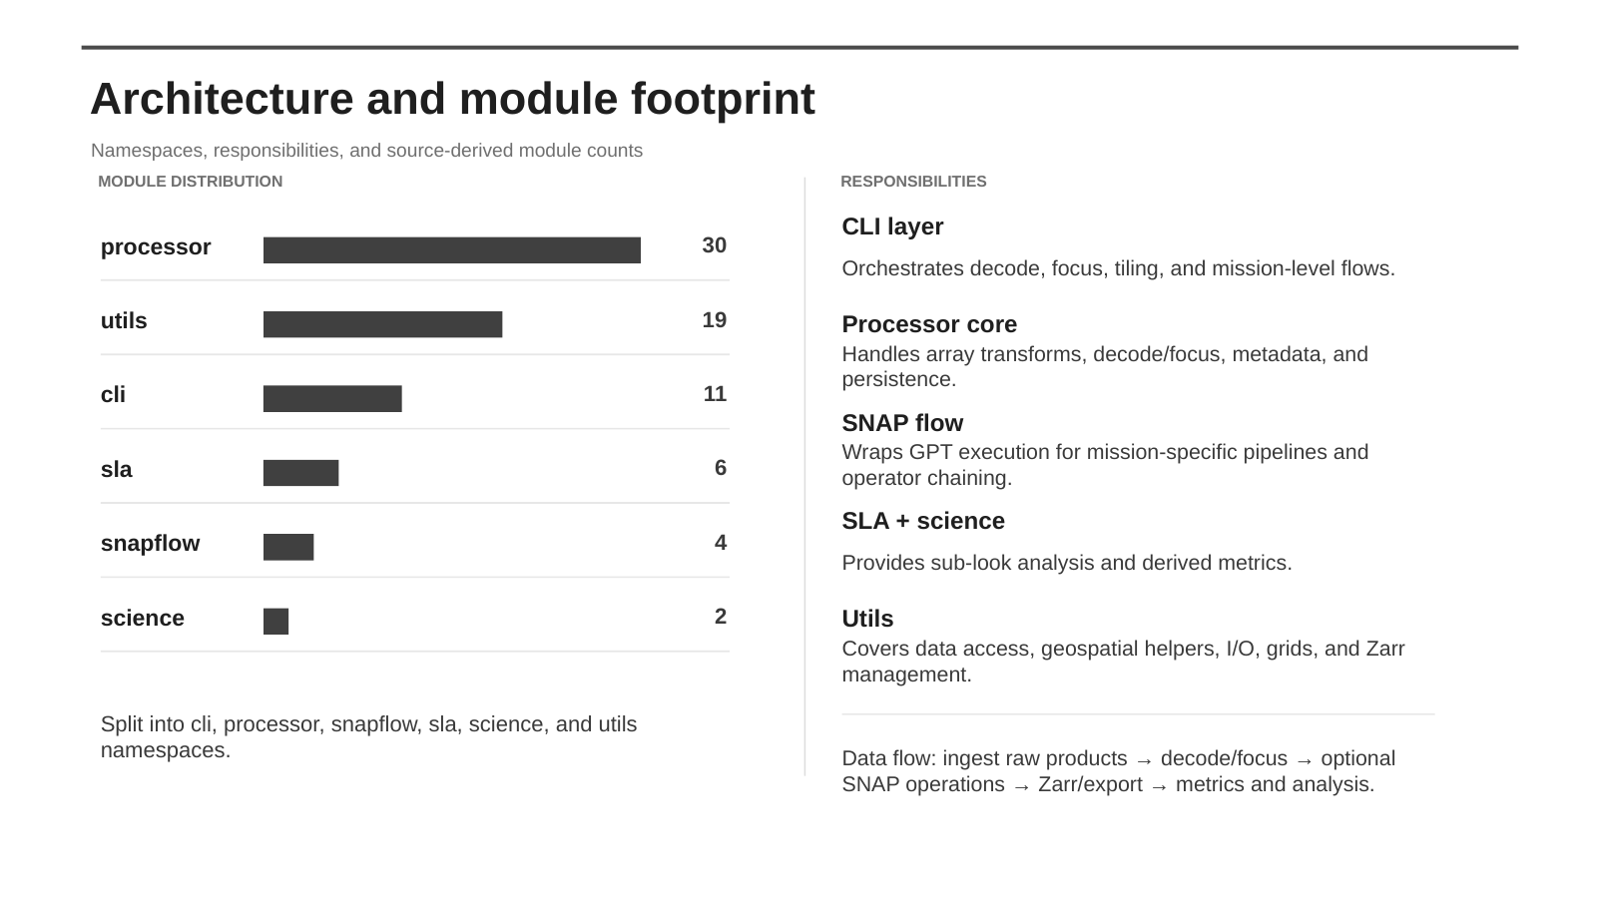
Notes:
[Sources] - User-provided original presentation slide 4: /mnt/data/SARPyX_project_overview.pptx

Slide 4
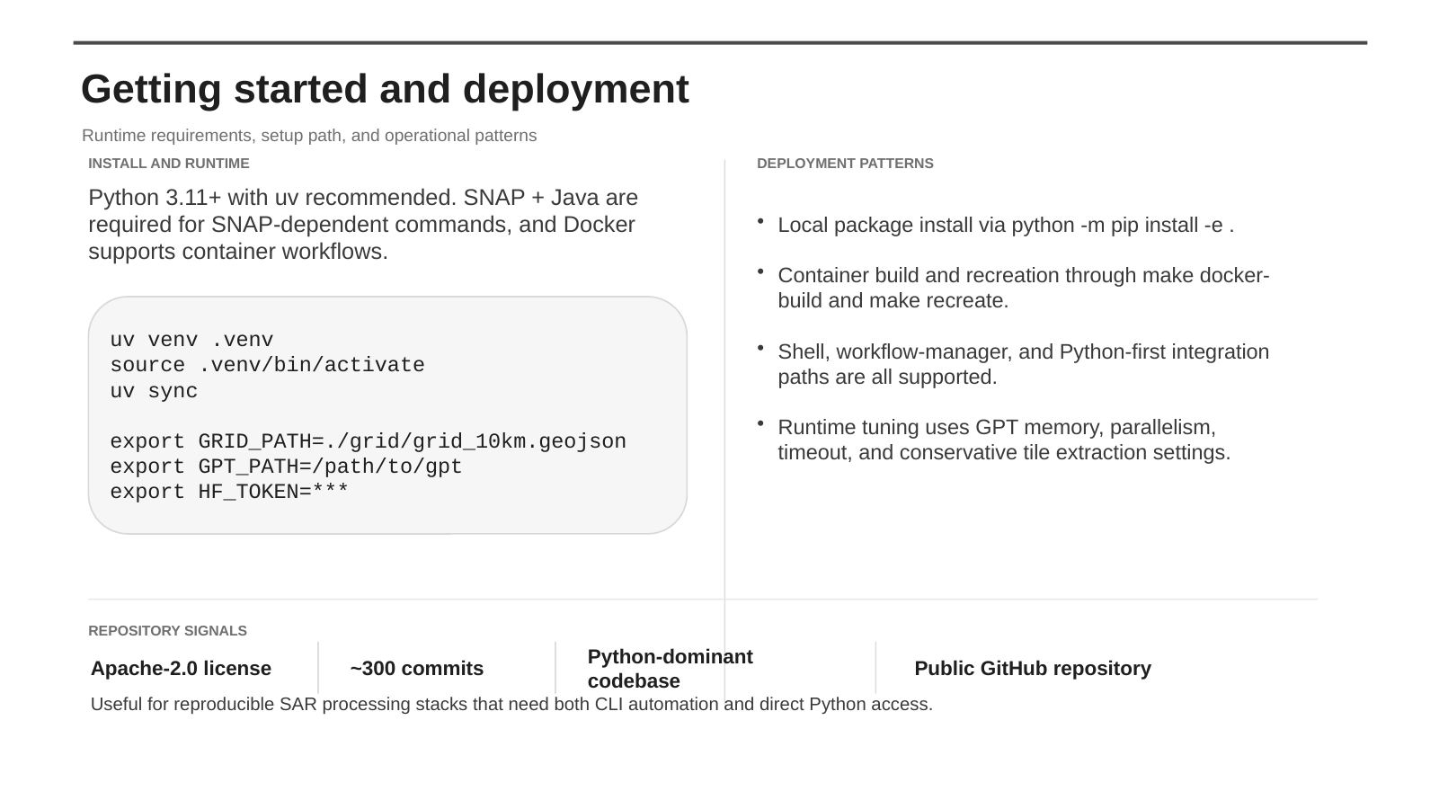
Notes:
[Sources] - User-provided original presentation slide 5: /mnt/data/SARPyX_project_overview.pptx

Slide 5
How SARPyX and WORLDSAR fit together
Operational framing for direct CLI use, reproducible execution, and mission-aware preprocessing
OPERATIONAL STACK
Input products
SARPyX toolkit
WORLDSAR repo
Execution outputs
SAFE archives, ZIP bundles, vendor-native SAR products
unzip · decode · focus · worldsar
CLI + Python API for processing primitives
Makefile + main.sh + worldsar.py coordinate runtime, tiling, logs, and indexing
BEAM-DIMAP intermediates, HDF5 tiles, parquet metadata DB, logs
USAGE SPLIT
Use SARPyX directly when the goal is algorithm work
Use WORLDSAR when the goal is a production-like run
1
You want single-product debugging, notebook-driven experiments, or a narrow CLI chain such as unzip → decode → focus.
1
You need a stable entry point for local VM and PBS/HPC execution, with explicit mode switching and asset management.
2
You need direct control of GPT paths, grid files, Zarr outputs, or custom Python imports from sarpyx.* modules.
2
You need mission routing, per-swath tiling, cut reports, parquet indexing, and path binding inside the Apptainer runtime.
3
You are validating one processing stage at a time before freezing an operational recipe.
3
You want the repo to operationalize SARPyX rather than re-implement it. The processing engine stays in SARPyX.
Operationally, the clean mental model is: SARPyX provides the processing primitives; WORLDSAR packages those primitives into a reproducible mission-level execution shell.
Notes:
[Sources] - SARPyX overview, architecture, and usage docs: https://github.com/sirbastiano/srp - SARPyX CLI usage examples: https://raw.githubusercontent.com/sirbastiano/srp/main/docs/usage.html - WORLDSAR introduction and execution model: https://sirbastiano.github.io/WORLDSAR/intro.html - WORLDSAR repository (apptainer branch): https://github.com/sirbastiano/WORLDSAR/tree/apptainer

Slide 6
WORLDSAR apptainer branch: bootstrap and first local run
Minimal sequence for staging dependencies, runtime assets, and a local VM execution
FIRST LOCAL EXECUTION
Repository bootstrap and local run command
uv sync installs the Python environment used for helper scripts and support-material download tooling.
git clone https://github.com/sirbastiano/WORLDSAR
cd WORLDSAR
git checkout apptainer
uv sync
make pull-sif
make pull-snap
# optional when product is not already local
make down PRODUCT=<product_name>.SAFE
WORLDSAR_MODE=vm make run \
PRODUCT=<product_name_or_full_path>.SAFE
# equivalent explicit target
WORLDSAR_MODE=vm make run-vm \
PRODUCT=<product_name_or_full_path>.SAFE
1
2
make pull-sif and make pull-snap stage the SIF container and the .snap userdir expected by the runtime.
3
For local validation, set WORLDSAR_MODE=vm explicitly. The documentation repeatedly recommends choosing the mode on purpose instead of relying on environment defaults.
4
PRODUCT can be a SAFE name under phidown_data or a full path containing a slash. main.sh resolves both cases.
For demos, prefer WORLDSAR_MODE=vm make run-vm first; keep make run for the same recipe once PBS/HPC execution is actually intended.
Notes:
[Sources] - WORLDSAR getting started docs: https://sirbastiano.github.io/WORLDSAR/getting-started.html - WORLDSAR runtime assets docs: https://sirbastiano.github.io/WORLDSAR/runtime-assets.html - WORLDSAR input and running docs: https://sirbastiano.github.io/WORLDSAR/input-and-run.html - WORLDSAR repository apptainer branch: https://github.com/sirbastiano/WORLDSAR/tree/apptainer

Slide 7
RUNTIME ENVIRONMENT
How the apptainer branch turns a PRODUCT argument into tiled, indexed, and logged outputs
ENTRY POINTS
Makefile
Inputs
Selects vm/hpc mode, stages SIF and .snap, injects runtime env, and dispatches run-vm or qsub.
BEAM-DIMAP
PRODUCT
GRID_PATH
SNAP_USERDIR
Intermediate products
main.sh
Resolves PRODUCT, validates paths, binds host directories to /work, and forwards GPT and grid settings.
HDF5 tiles
Subset outputs
pyscripts/worldsar.py
Parquet DB
Infers mission/mode, runs SNAP operators, subsets tiles, validates coverage, and writes parquet metadata.
Core metadata index
sarpyx.snapflow.GPT + utils
Logs
Operator wrappers plus geospatial helpers used by the mission pipelines inside the container runtime.
stdout/stderr or PBS logs
SNAP13
RUNTIME BINDING MODEL
main.sh binds scripts, data, output, cuts, DB, grid, and .snap into /work, then runs python /work/scripts/worldsar.py with /work/data/<PRODUCT_NAME>, the output roots, and the resolved GPT/grid/runtime arguments.
Notes:
[Sources] - WORLDSAR repository apptainer branch: https://github.com/sirbastiano/WORLDSAR/tree/apptainer - WORLDSAR raw main.sh (apptainer): https://raw.githubusercontent.com/sirbastiano/WORLDSAR/apptainer/main.sh - WORLDSAR raw Makefile (apptainer): https://raw.githubusercontent.com/sirbastiano/WORLDSAR/apptainer/Makefile - WORLDSAR raw worldsar.py (apptainer): https://raw.githubusercontent.com/sirbastiano/WORLDSAR/apptainer/pyscripts/worldsar.py

Slide 8
Sentinel-1 acquisition modes drive the router decision
Use the acquisition table as an operational guardrail before selecting the WORLDSAR path
SENTINEL-1 REFERENCE
ROUTING LOGIC
Mode
Swath / vignette
Nominal single-look resolution
Polarization
Operational reading
SAFE name / manifest token
SM
80 km swath
slightly better than 5 m × 5 m
single or dual
Stripmap branch
infer_product_mode(...) inspects S1 mode tokens and path patterns
IW
250 km swath
3 sub-swaths (TOPSAR)
5 m × 20 m
single or dual
TOPS branch
IW / SM ?
EW
400–410 km swath
5 sub-swaths (TOPSAR)
20 m × 40 m
single or dual
TOPS branch
WV
20 km × 20 km vignette
every 100 km
5 m × 5 m
single only
Validate separately
S1STRIP
S1TOPS
SM or S1…S6 modes
IW or EW
The current router explicitly IW to S1TOPS and SM/S1…S6 to S1STRIP. WV is listed in the acquisition tables but not exposed as a dedicated branch, and ambiguous Sentinel names fall back to S1TOPS in infer_product_mode.
Notes:
[Sources] - WORLDSAR acquisition modes table: https://sirbastiano.github.io/WORLDSAR/sar-acquisition-modes-tables.html - WORLDSAR raw worldsar.py router logic: https://raw.githubusercontent.com/sirbastiano/WORLDSAR/apptainer/pyscripts/worldsar.py

Slide 9
Sentinel-1 pipeline excerpt from worldsar.py
Repository-faithful excerpt of the Sentinel-1 router and post-chain, reformatted for slide readability
PIPELINE EXCERPT
Sentinel branch (presentation-ready excerpt)
What each step is doing
def _sentinel_post_chain(op):
op.ApplyOrbitFile()
op.Calibration(output_complex=True)
op.TopsarDerampDemod()
op.Deburst()
op.do_subaps(...)
op.polarimetric_decomposition(
decomposition="H-Alpha Dual Pol Decomposition",
window_size=5,
)
op.TerrainCorrection(
map_projection='AUTO:42001',
pixel_spacing_in_meter=10.0,
)
if is_TOPS:
for swath in ('IW1', 'IW2', 'IW3'):
sw_op.TopsarSplit(subswath=swath)
results[swath] = _sentinel_post_chain(sw_op)
else:
op.ApplyOrbitFile(); op.Calibration(output_complex=True)
op.do_subaps(...); op.polarimetric_decomposition(...)
op.TerrainCorrection(map_projection='AUTO:42001',
pixel_spacing_in_meter=10.0)
1
ApplyOrbitFile moves the product onto the refined orbit solution before any calibration or geocoding.
2
Calibration(output_complex=True) preserves complex signal content so phase-aware follow-up steps remain valid.
3
TopsarDerampDemod and Deburst exist only for TOPS data. They remove burst modulation and stitch bursts into a contiguous swath.
4
do_subaps is the SARPyX-specific stage: it creates sub-aperture products for directional diversity, motion sensitivity, and later science metrics.
5
H-Alpha Dual Pol Decomposition converts the calibrated signal into descriptive dual-pol features such as Entropy, Anisotropy, and Alpha.
6
TerrainCorrection projects the result to map space at 10 m pixel spacing, which is what makes grid-based tile cutting straightforward.
TOPS adds TopsarSplit, Deramp/Demod, and Deburst per subswath; STRIP keeps the same orbit → calibration → sub-aperture → decomposition → terrain-correction core without those TOPS-only steps.
Notes:
[Sources] - WORLDSAR raw worldsar.py (apptainer branch): https://raw.githubusercontent.com/sirbastiano/WORLDSAR/apptainer/pyscripts/worldsar.py - WORLDSAR Sentinel-1 metadata page for observed outputs and processing lineage: https://sirbastiano.github.io/WORLDSAR/sentinel1-metadata.html

Slide 10
EXECUTION GRAPH
TOPS and STRIP execute differently on purpose
The two Sentinel paths diverge only where the acquisition geometry demands it
STRIP lane (SM)
TOPS lane (IW / EW)
SAFE input
SAFE input
TopsarSplit
IW1 · IW2 · IW3
ApplyOrbitFile
Each subswath is processed independently so tiling can tolerate boundary effects and partial coverage.
No split, deramp, or deburst is needed because the input geometry is already strip-oriented.
ApplyOrbitFile
Calibration
Calibration
Deramp / Demod
Deburst
Sub-apertures
Sub-apertures
H-Alpha dual-pol
H-Alpha dual-pol
decomposition
Result shape: { IW1: path, IW2: path, IW3: path }
Result shape: path
TerrainCorrection
TerrainCorrection
Per-swath BEAM-DIMAP
outputs
Single BEAM-DIMAP
output
Notes:
[Sources] - WORLDSAR raw worldsar.py Sentinel routing and pipeline logic: https://raw.githubusercontent.com/sirbastiano/WORLDSAR/apptainer/pyscripts/worldsar.py - WORLDSAR acquisition modes table: https://sirbastiano.github.io/WORLDSAR/sar-acquisition-modes-tables.html

Slide 11
Tiling, coverage validation, and parquet indexing
What happens after preprocessing once the intermediate product exists
POST-PROCESSING FLOW
Product WKT
Grid lookup
Rectangles
Subset tiles
Cut report
Parquet DB
manifest/CDSE footprint
check_points_in_polygon
rectanglify
HDF5 + copy_metadata
SUCCESS / FAILURE txt
metadata[quickinfo]
IMPLEMENTATION NOTES
Geometry and grid selection
Actual tile extraction
TOPS-specific validation logic
If grid_10km.geojson is missing, the script can generate it via python -m sarpyx.utils.grid. Product coverage is intersected with grid points and then inflated into rectangles that become tile footprints.
For non-NISAR products the subset() helper calls SNAP with HDF5 output, output_name=tile_name, geo_region=WKT, and copy_metadata=True. Each successful cut becomes <tile>.h5 in the cuts directory.
TOPS swaths are tiled independently, so some boundary tiles can legitimately fail on a single swath. The aggregate coverage check raises only when the combined TOPS run produces zero tiles at all.
After tile creation, create_tile_database() scans all HDF5 tiles, reads metadata[quickinfo], and writes <tile-folder>_core_metadata.parquet for lightweight cataloging.
Notes:
[Sources] - WORLDSAR raw worldsar.py tiling and database helpers: https://raw.githubusercontent.com/sirbastiano/WORLDSAR/apptainer/pyscripts/worldsar.py - WORLDSAR Sentinel-1 metadata page for HDF5 tile structure: https://sirbastiano.github.io/WORLDSAR/sentinel1-metadata.html

Slide 12


Tiling, coverage validation, and parquet indexing
What happens after preprocessing once the intermediate product exists
POST-PROCESSING FLOW
Product WKT
Grid lookup
Rectangles
Subset tiles
Cut report
Parquet DB
manifest/CDSE footprint
check_points_in_polygon
rectanglify
HDF5 + copy_metadata
SUCCESS / FAILURE txt
metadata[quickinfo]
IMPLEMENTATION NOTES
Geometry and grid selection
If grid_10km.geojson is missing, the script can generate it via python -m sarpyx.utils.grid. Product coverage is intersected with grid points and then inflated into rectangles that become tile footprints.
Points in polygon
After tile creation, create_tile_database() scans all HDF5 tiles, reads metadata[quickinfo], and writes <tile-folder>_core_metadata.parquet for lightweight cataloging.
Notes:
[Sources] - WORLDSAR raw worldsar.py tiling and database helpers: https://raw.githubusercontent.com/sirbastiano/WORLDSAR/apptainer/pyscripts/worldsar.py - WORLDSAR Sentinel-1 metadata page for HDF5 tile structure: https://sirbastiano.github.io/WORLDSAR/sentinel1-metadata.html

Slide 13
Demo outputs: files, metadata, and lineage
What a successful Sentinel run leaves behind and why those artifacts matter
OUTPUT ARTIFACTS
Filesystem view
Representative HDF5 tile content
Lineage captured in metadata
OUT/
worldsar_output/
IW1/ ... or <strip>.dim
IW2/ ...
IW3/ ...
tiles/
IW1/<product>/<tile>.h5
IW2/<product>/<tile>.h5
IW3/<product>/<tile>.h5
DB/<product>_core_metadata.parquet
logs/*.stdout.log | *.stderr.log
1
Top-level groups: bands and metadata
Mission: SENTINEL-1A
Product type: SLC
Acquisition mode: SM
Pass: ASCENDING
Polarizations: VH, VV
Terrain-corrected flag: 1
CRS: WGS84 / Auto UTM
Pixel spacing: 10.0 m range, 10.0 m azimuth
2
Bands observed in the docs: Alpha, Anisotropy, Entropy, elevation, localIncidenceAngle
3
Example tile shape in the docs: 1000 × 1127 float32
4
Tile metadata preserves geospatial context and product quickinfo for later indexing.
Recorded processing graph in the docs: Apply-Orbit-File → Calibration → Polarimetric-Decomposition → Terrain-Correction → Subset → Write
Notes:
[Sources] - WORLDSAR Sentinel-1 metadata documentation: https://sirbastiano.github.io/WORLDSAR/sentinel1-metadata.html - WORLDSAR raw worldsar.py output, subset, and database logic: https://raw.githubusercontent.com/sirbastiano/WORLDSAR/apptainer/pyscripts/worldsar.py

Slide 14
Runtime tuning, monitoring, and deployment sequence
Use local VM mode to prove correctness, then move the unchanged recipe to PBS/HPC
MODE DEFAULTS
Mode
GPT memory
GPT parallelism
GPT timeout
Operational use
Monitoring commands + HPC defaults
vm
64G
16
3600 s
First local validation, low-risk debugging
make status | WORLDSAR_MODE=vm make status | make logs
tail -f logs/*.stdout.log | tail -f logs/*.stderr.log
HPC defaults: queue=cpu_std
select=1:ncpus=192:mem=160g | walltime=22:00:00
hpc
128G
164
7200 s
High-throughput cluster runs via PBS/qsub
DEPLOYMENT ORDER
1
Start with one Sentinel product in SARPyX or WORLDSAR vm mode. Validate the BEAM-DIMAP outputs, tile geometry, and metadata before scaling.
2
Tune only after correctness is proven: GPT memory, GPT parallelism, GPT timeout, grid density, and the exact paths mounted into the container.
3
Move the same recipe to hpc mode once logs are clean and coverage is acceptable. Keep PRODUCT, GRID_PATH, and output semantics identical between modes.
Correctness first in vm, then identical semantics in hpc. Switching mode before stabilizing the product recipe is how you lose traceability.
Notes:
[Sources] - WORLDSAR raw Makefile defaults (apptainer branch): https://raw.githubusercontent.com/sirbastiano/WORLDSAR/apptainer/Makefile - WORLDSAR input and running docs: https://sirbastiano.github.io/WORLDSAR/input-and-run.html - WORLDSAR operations docs: https://sirbastiano.github.io/WORLDSAR/operations.html

Slide 15
Use the tool entry for the right problem
Final decision rule for SARPyX-first experimentation and WORLDSAR-first operations
DECISION MATRIX
Choose SARPyX directly
Choose WORLDSAR
1
When you want to inspect decode/focus stages independently.
1
When the run must be reproducible across local VM and cluster environments.
2
When you are tuning algorithms, sub-aperture logic, or custom Python analysis.
2
When you need standardized tiling, cut reports, metadata DB creation, and run logs.
3
When you need fast CLI proofs on a small number of products.
3
When mission-specific routing and container assets must be part of the interface, not tribal knowledge.
4
When you want to import sarpyx.* directly in notebooks, scripts, or workflow managers.
4
When the same command must survive handoff from research to operations.
5
When the repo wrapper would add ceremony without increasing repeatability.
5
When scale and observability matter more than minimal setup.
Recommendation: validate the Sentinel pipeline with SARPyX on one product, then operationalize the exact same logic in the apptainer branch of WORLDSAR. That sequence preserves technical clarity and avoids scaling unstable assumptions.
Notes:
[Sources] - SARPyX usage and architecture docs: https://raw.githubusercontent.com/sirbastiano/srp/main/docs/usage.html - WORLDSAR introduction and running docs: https://sirbastiano.github.io/WORLDSAR/intro.html - WORLDSAR repository apptainer branch: https://github.com/sirbastiano/WORLDSAR/tree/apptainer

