Slide 1
LOGIC CARD GAME
BY FABRIC

Slide 2
TABLE OF CONTENTS
01
02
03
Our team
Stages of realisation
Used technologies

Slide 3
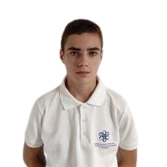
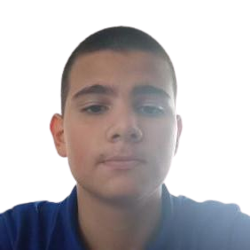
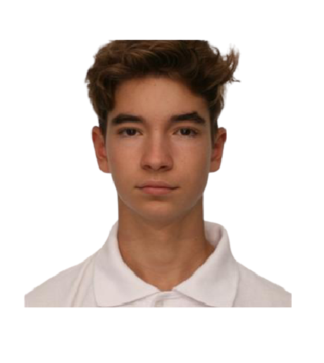

OUR TEAM
Raya
mavraganova
Emil
bogdanov
Stanislav
Yordanov
Eric
Ivanov
Scrum Trainer
Backend Developer
QA
Backend Developer

Slide 4
Stages of realisation
1.Design of the game
2. Backend
3. QA
4. Presentation and Documentation

Slide 5







Used technologies
Visual Studio
GitHub
Word
Excel
Power Point
MS Teams
Figma

Slide 6
Now, let’s see the game

