Slide 1

Portfolio
Project at HZ University

Slide 2
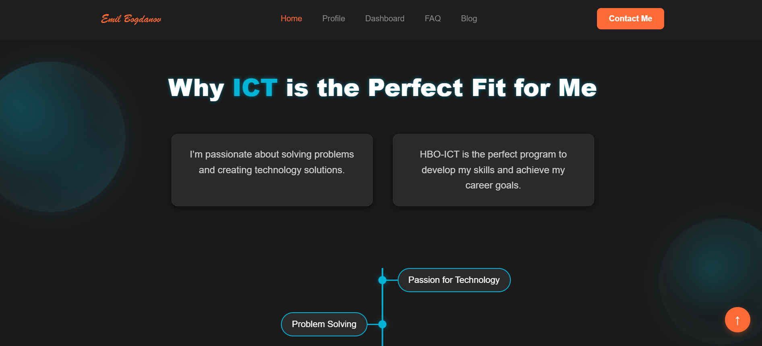
My Idea
We had a total of 14 days to build this project from scratch. The idea was to make a portfolio website with the aim of getting to know the concepts of html and css better.

Slide 3
STAGES OF DEVELOPMENT
1.
3.
2.

Slide 4












USED PROGRAMS

Slide 5
LET’S JUMP TO THE PROJECT!

