Slide 1
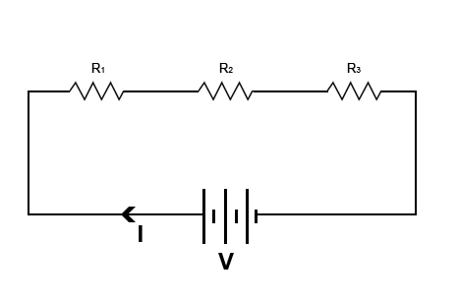
Channel
0
VDD
1
VRef
2
Aground
3
Clk
4
D out
5
D in
CS/ ShDN
D ground
ground
7
18
23
3.3
11
24
25
record
stop
Raspberry Pi
ground
29
31
32
33
35
36

