Slide 1
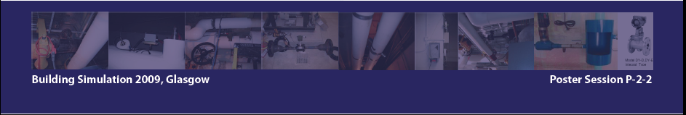
HVAC Basics
Bin Yan
HVAC – Heating, Ventilation, Air-conditioning

Slide 2
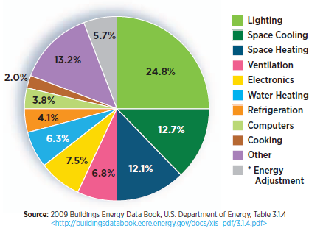



HVAC Energy Consumption
Annual Energy Use
Cooling 642 kWh/m²
Heating 623 kWh/m²
Electricity 414 kWh/m²
32%
>60%
DOE numbers
A lab building on campus

Slide 3
HVAC
HVAC – Heating, Ventilation, Air-conditioning
Temperature
68°F (20°C) and 75°F (25°C)
Humidity
30% relative humidity (RH) and 60% RH
A slightly positive pressure to reduce outside air infiltration.
Pressure
Rooms typically have several complete air changes per hour
Ventilation
Diagram of mechanical system on the blackboard

Slide 4
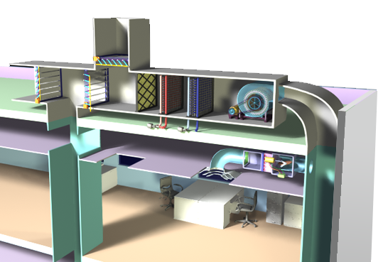
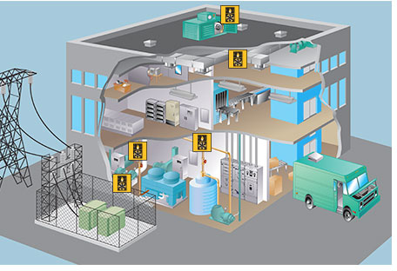
Where?
Mechanical Room: Boilers, chillers, pumps, heat exchangers…
Air Handling Units (AHUs): heat, cool, humidify, dehumidify, ventilate, filter and distribute the air.
Room Controls: thermostats and Variable Air Volume (VAV) boxes
Pictures from http://www.learnhvac.org/

Slide 5
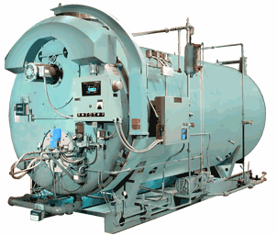
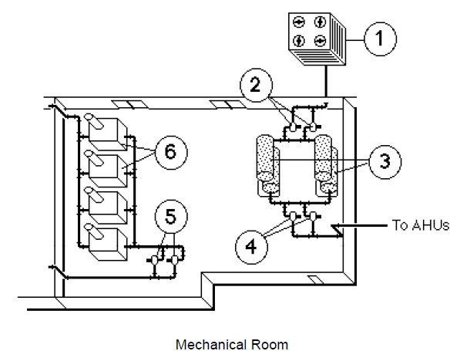
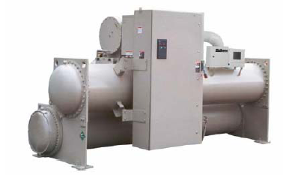
In the mechanical room
Boiler
Chiller
Pictures from https://rfd-training.tac.com/docs/HVAC.pdf

Slide 6
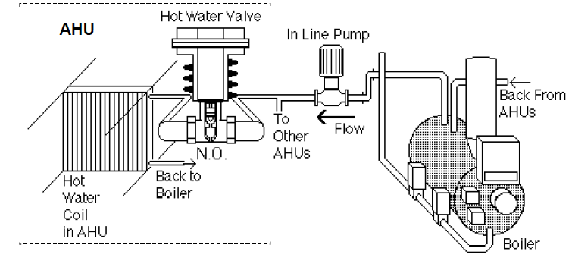
Heating
Also to radiators, terminal reheat, domestic hot water.
Pictures from https://rfd-training.tac.com/docs/HVAC.pdf

Slide 7
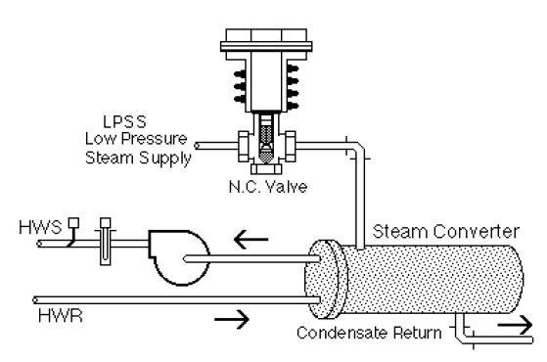
Heating
Pictures from https://rfd-training.tac.com/docs/HVAC.pdf

Slide 8
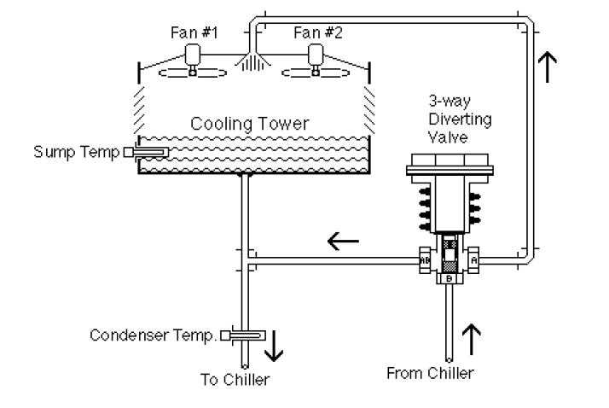
Cooling
Pictures from https://rfd-training.tac.com/docs/HVAC.pdf

Slide 9
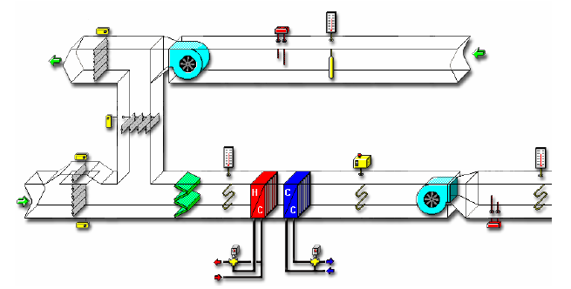
AHU – Air Handling Unit
Where does air come from and go to?
Exhaust air
Return air
Outside air
Supply air

Slide 10
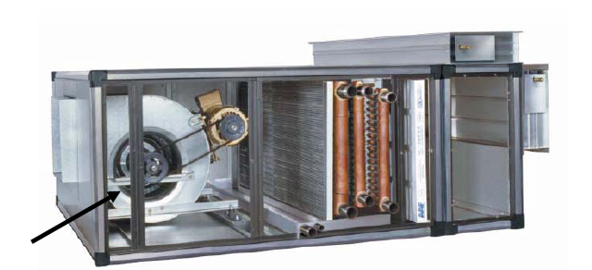
AHU
What’s in an AHU?
Sensor
Heating/Cooling Coil
Filter
Fan
Damper
Pictures from https://rfd-training.tac.com/docs/HVAC.pdf

Slide 11
AHU - Economizer
Linked
55°F
Minimum in summer
More outside air in winter
Economizer mode: Using outside air for cooling rather than mechanical cooling.
Pictures from https://rfd-training.tac.com/docs/HVAC.pdf

Slide 12
AHU – Heating and Cooling
55°F
dehumidification
Pictures from https://rfd-training.tac.com/docs/HVAC.pdf
Notes:
The AHU SAT = 55 all the time

Slide 13
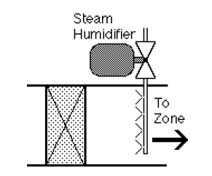
Humidification
Why before the cooling coil?
Pictures from https://rfd-training.tac.com/docs/HVAC.pdf

Slide 14
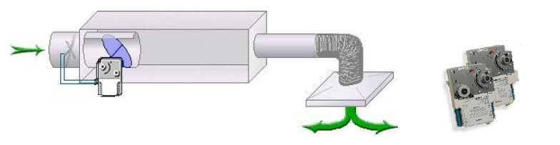
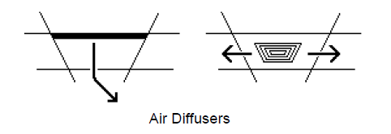
VAV
damper
Two variables – Temperature & Air Volume
The box you can see in the hallway.
IF temperature too high
First reduce reheat till fully closed
Then increase air volume
IF temperature too low
First reduce air volume till minimum
Then start reheat
Pictures from https://rfd-training.tac.com/docs/HVAC.pdf
Notes:
Add labels
If statement

Slide 15
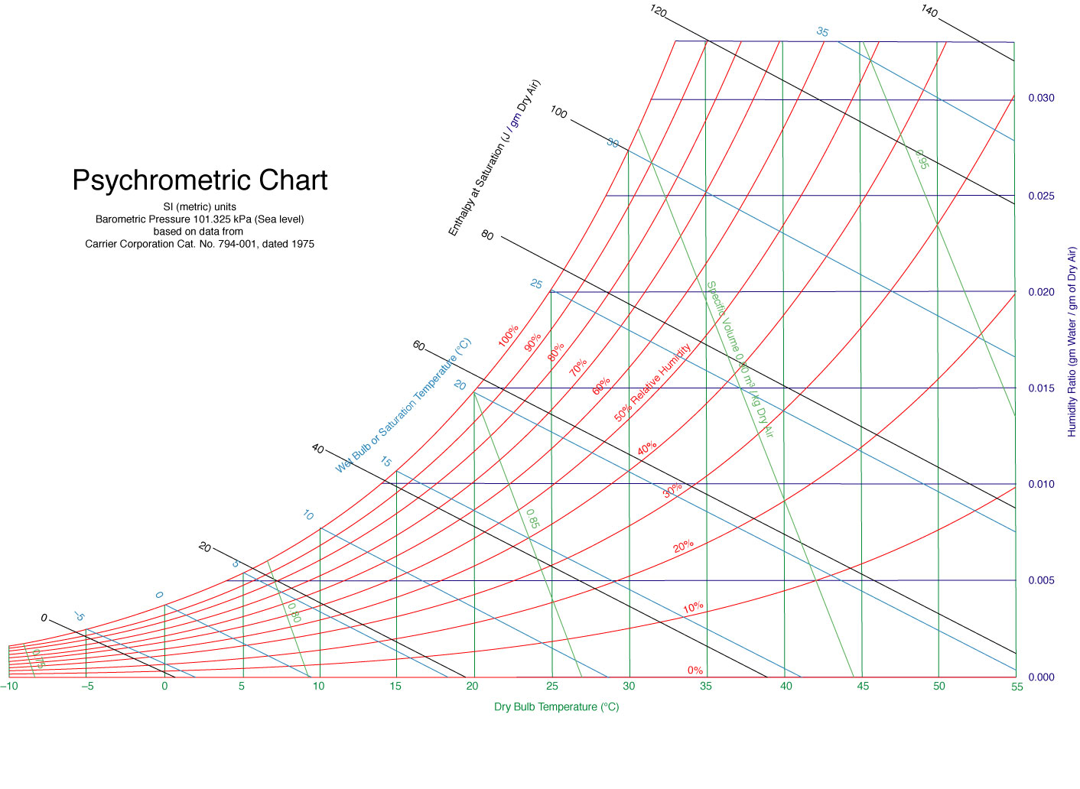
Winter
Return
Outside
Mixed

Slide 16
Summer
Outside
Cooled and dehumidified
Mixed
Return

Slide 17
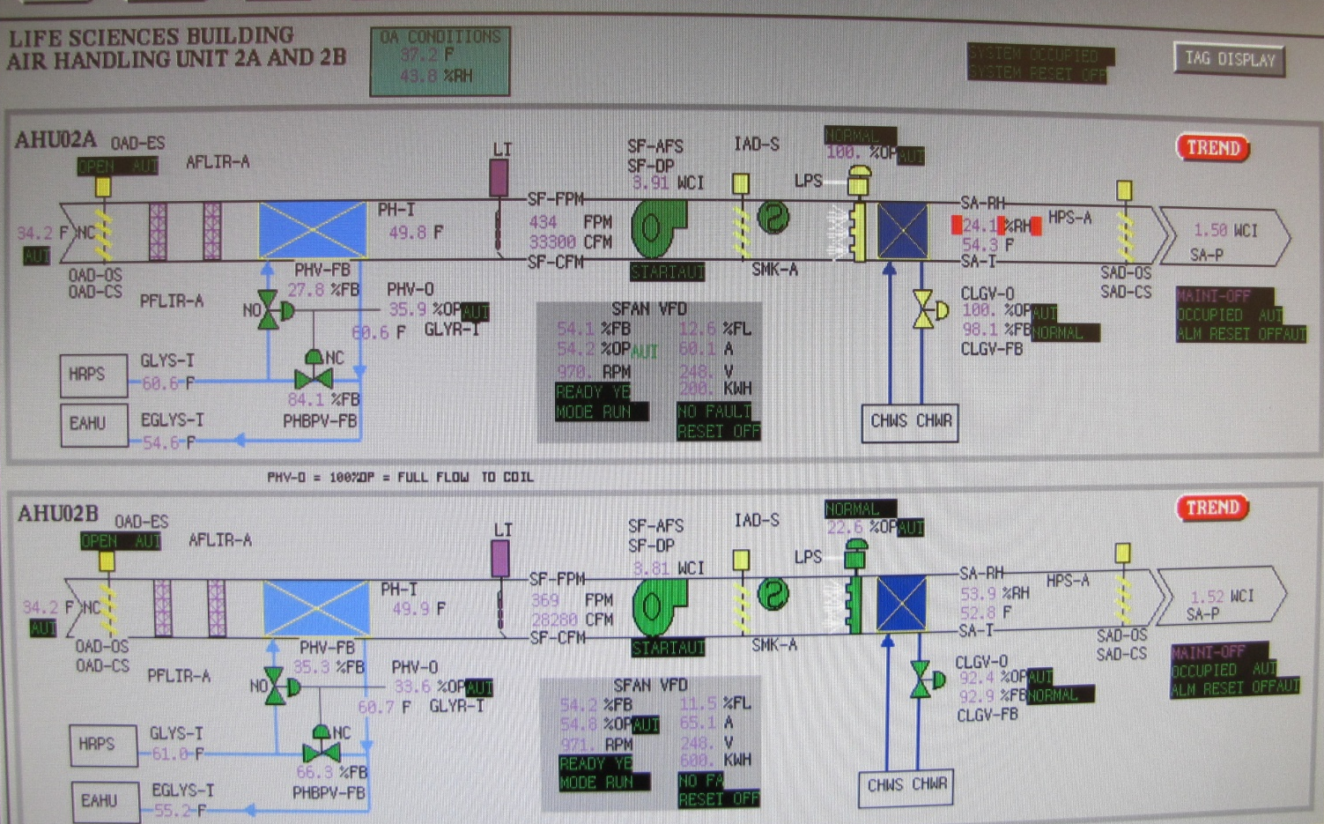
The Real World
52°F
Any difference? Anything wrong?

Slide 18
The Real World
52°F
Chilled water is still used when outside air is far below 52F
Temperature increased after humidification.
Sensor error.
Separate control caused counteraction.

Slide 19
What we have learned?
The system that ensures the thermal comfort.
What’s in the mechanical rooms.
What happens in air handling unit.
How VAV works.
What can happen in the real world.

Slide 20
Thanks!
binyan@design.upenn.edu

