Slide 1

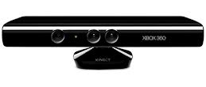
Physical Therapy Using Kinect
https://github.com/ESE519/Kinect-Physical-Therapy
Bo Yuan
Yiran Qin
Shalini Chawala
Mingfei Shao

Slide 2
Goal of the Project
Low cost solution to provide haptic feedback/visual guidance on the patient’s range of motion and the movements being performed.
Hardware used - Kinect, mbed,IMU, Vibrating motor, Xbee
Software - OpenNI, Java
GUI - for the user with different tabs for each exercise
Wearable and easy component to perform the exercises – Hand gloves

Slide 3
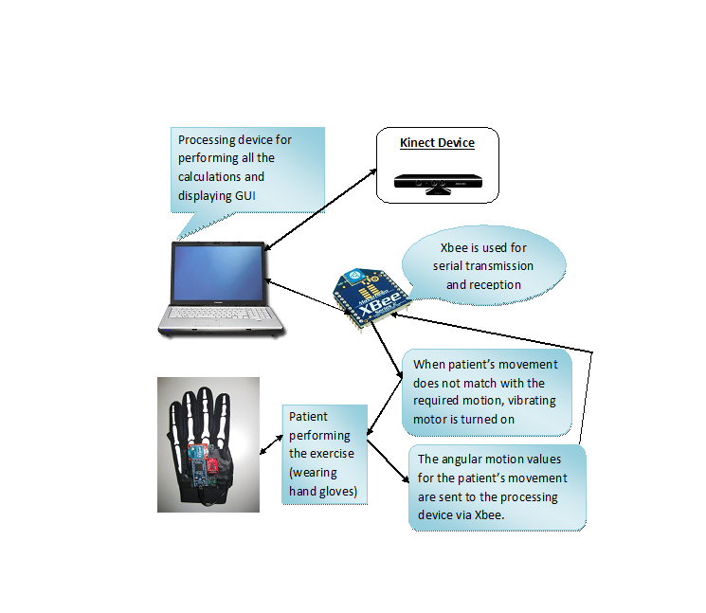
Architectural Diagram

Slide 4
Main Features
List of exercises covered – elbow, shoulder and the wrist exercises
Real-time feedback provided to the user
Haptic feedback using vibrating motors
Visual feedback on the screen
Easy to wear and portable hand glove
Convenient and low cost solution

Slide 5
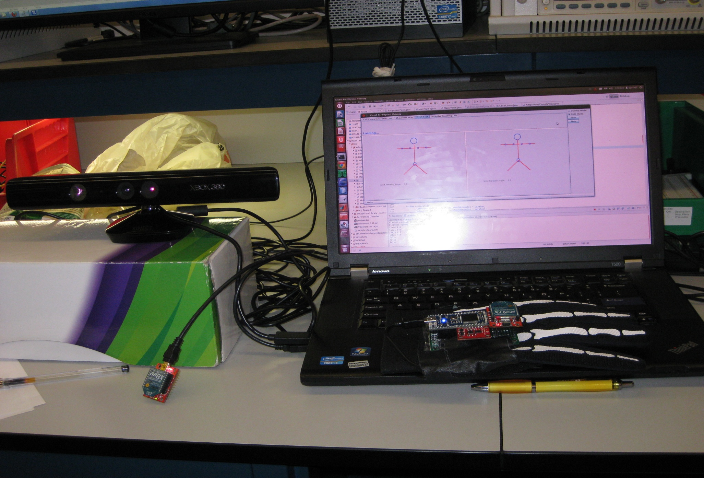

Slide 6
YouTube video link
http://www.youtube.com/watch?v=eIcRVeguWpc&feature=youtu.
be

