Slide 1



LemonAid
Car accidents happen….
Sung Pulah Huang

Slide 2
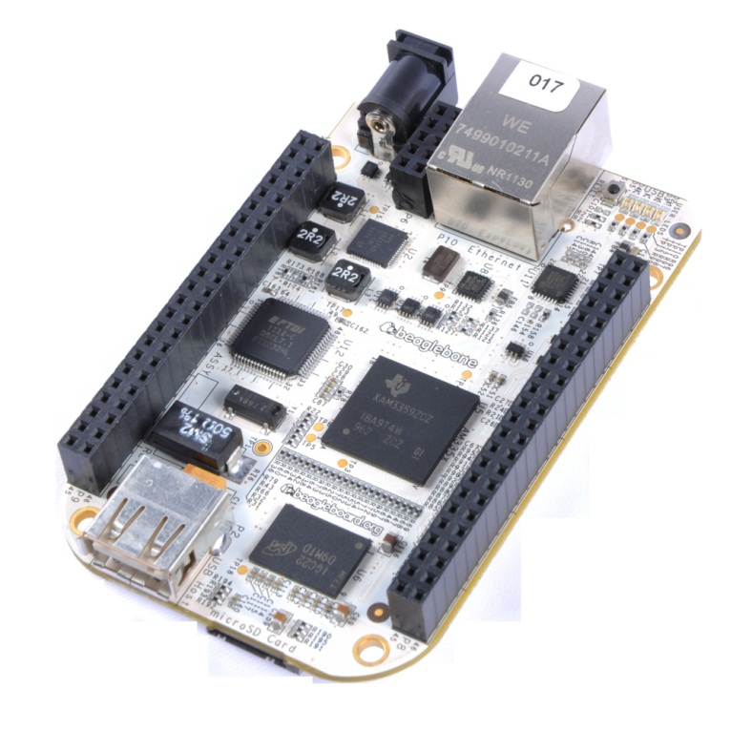

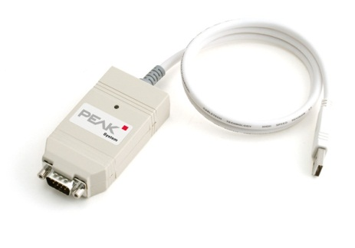
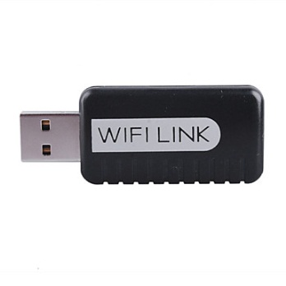





LemonAid Architecture

Slide 3
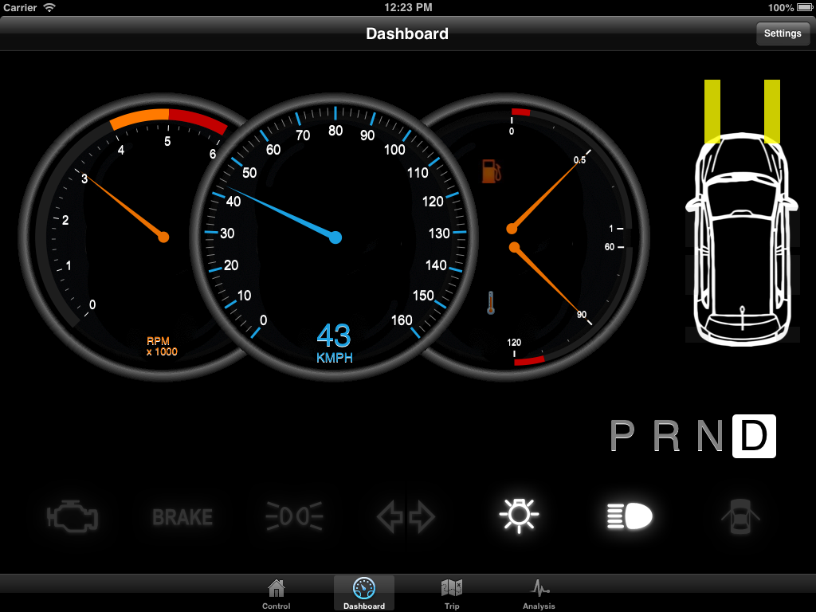
LemonAid Capabilities
Virtual Dashboard
Trip Observer
Analysis Platform

Slide 4
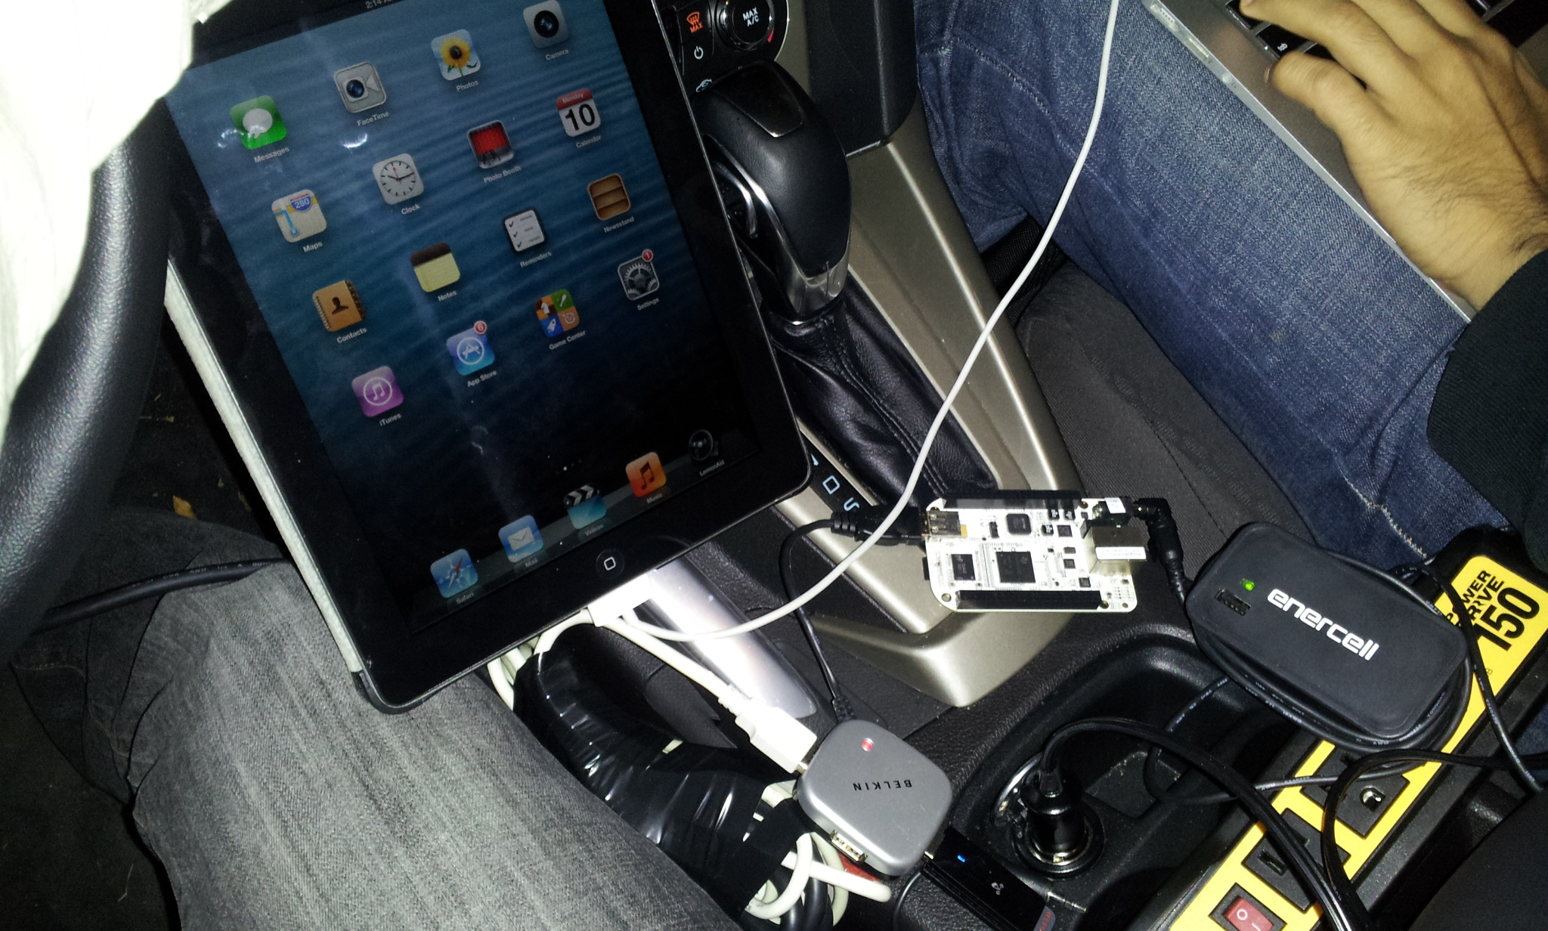
LemonAid System
Ford Focus
Beaglebone
iPad
Wifi dongle
OBDII/CAN-USB

Slide 5
LemonAid Potentials
Provide accurate accident scene report
Assist police officer and insurance companies
Ease the process of recording accident events
Works for different car models
Developers
Hobbyists

