Slide 1
My Lidar
- Nirmiti Mantri, Runyu Ma, Xiaochen Pan

Slide 2
Aim of the Project
Manually navigate the robot in an indoor environment to generate a 2- Dimensional map.
Use this generated map to autonomously navigate in the environment from the start point to the destination.
Application
Remote mapping of an unknown environment and autonomous navigation for safety and rescue operations

Slide 3
Remote Laptop
Laser
Hokuyo-URG-04LX-UG01
BeagleBoard
Wiimote
Motion Plus
UBUNTU + ROS
Mbed
MOTOR

Slide 4
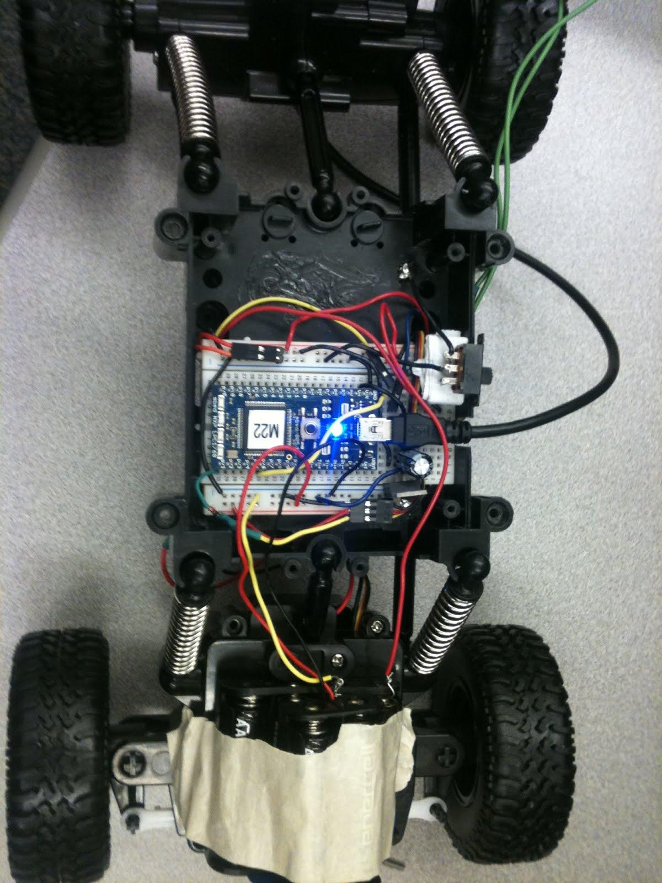
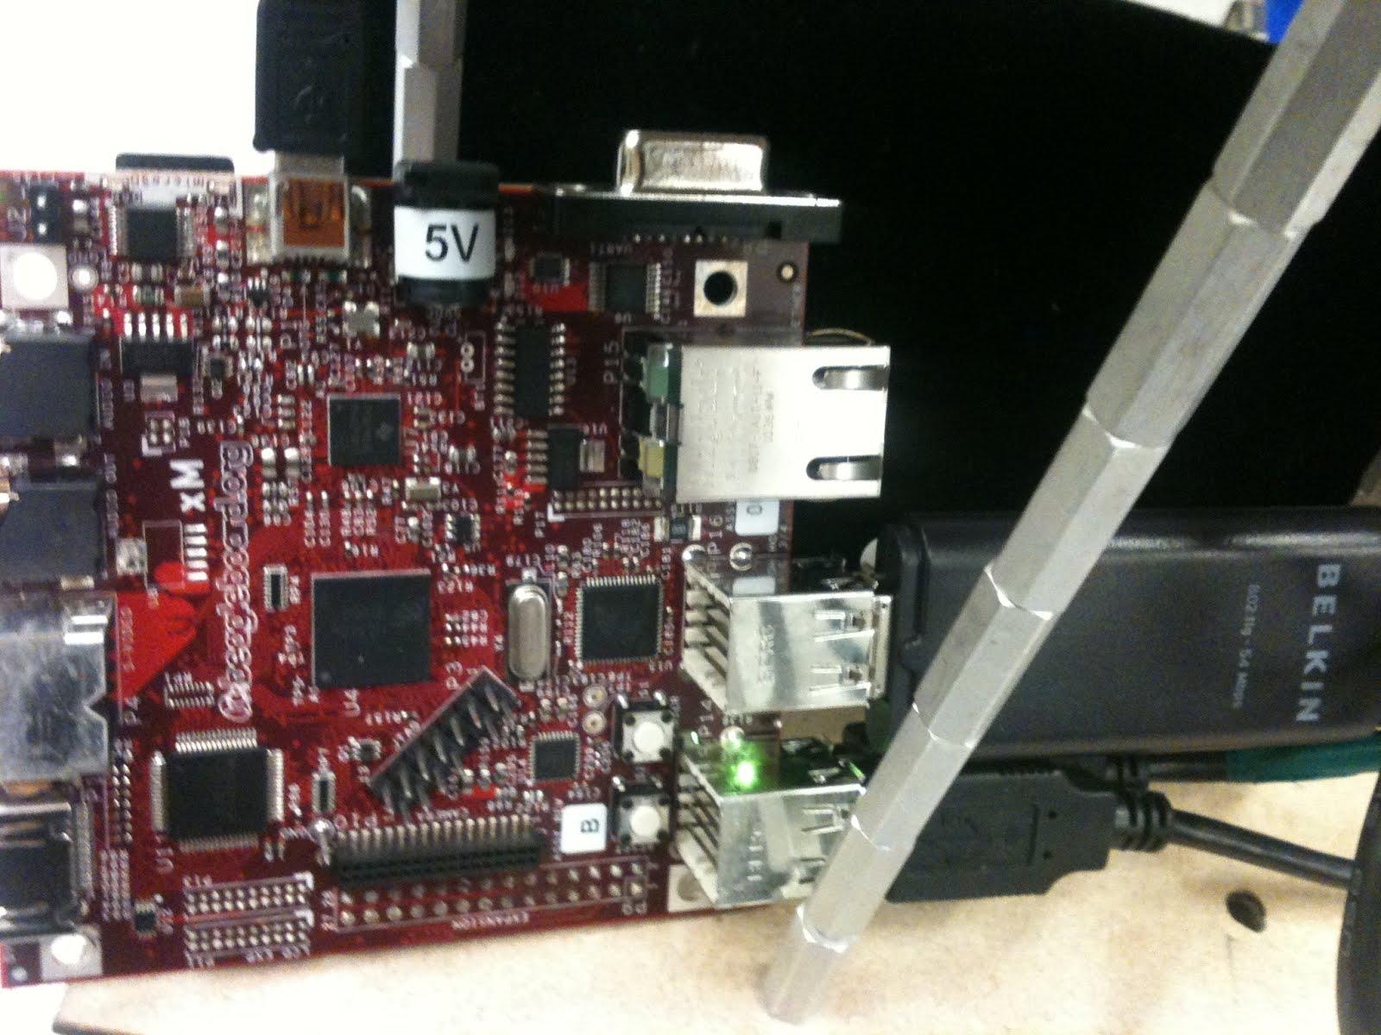
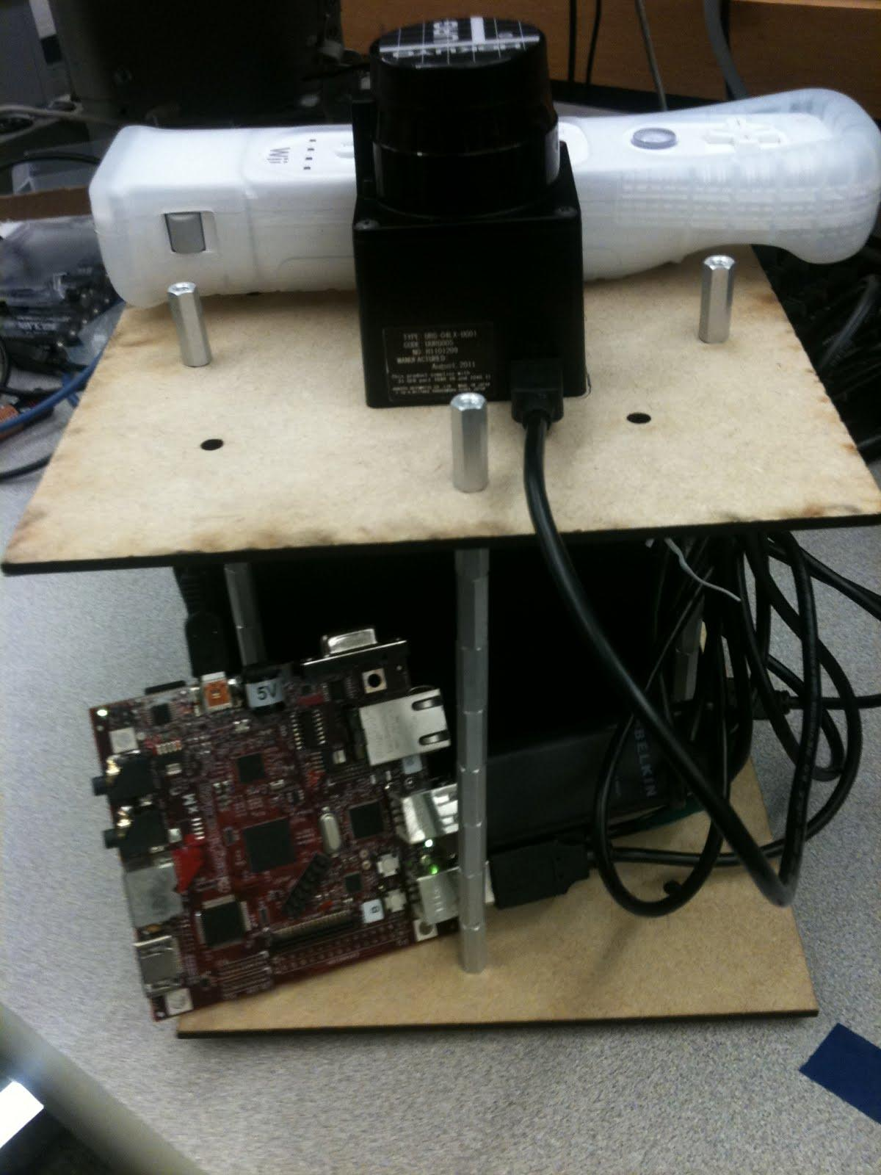
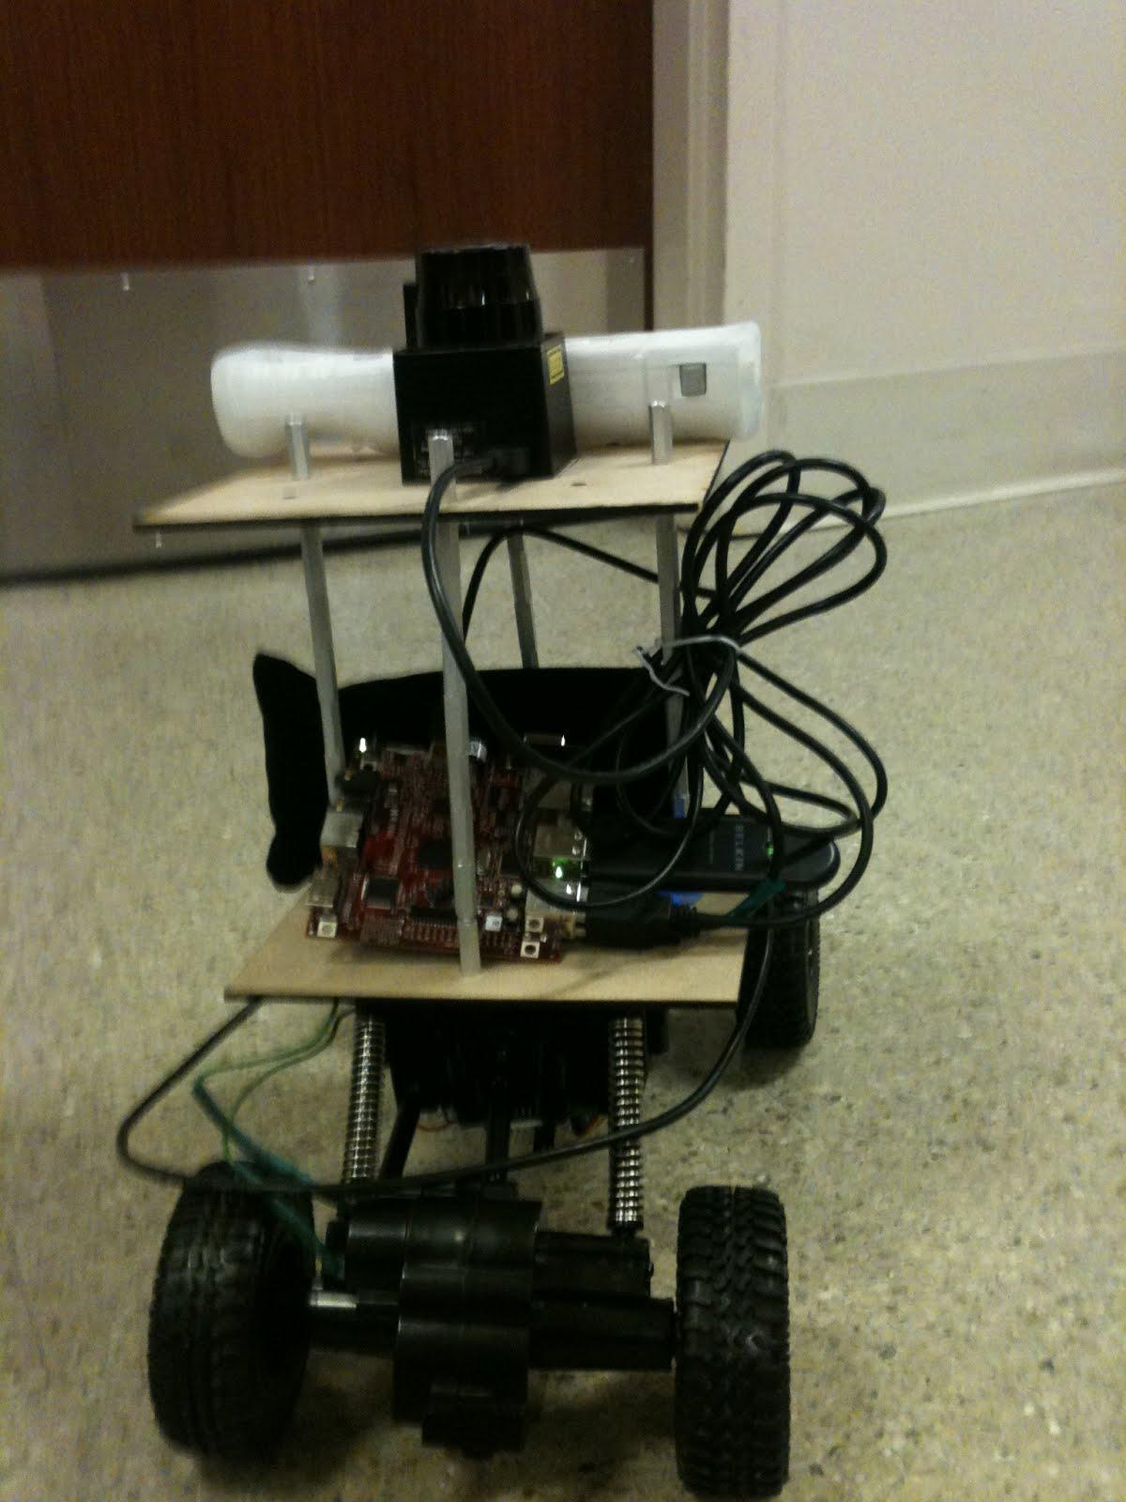
Hardware

Slide 5
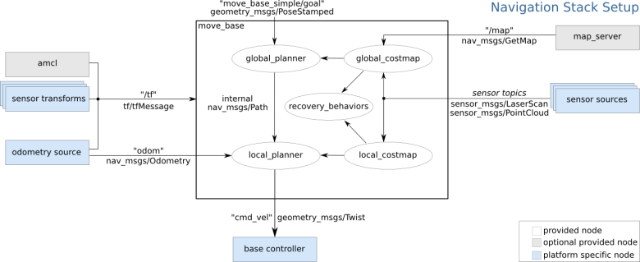
Software
Install Ubuntu and ROS on beagleboard and get ROS to work on it.
Set up master-slave between beagleboard and remote laptop

Slide 6
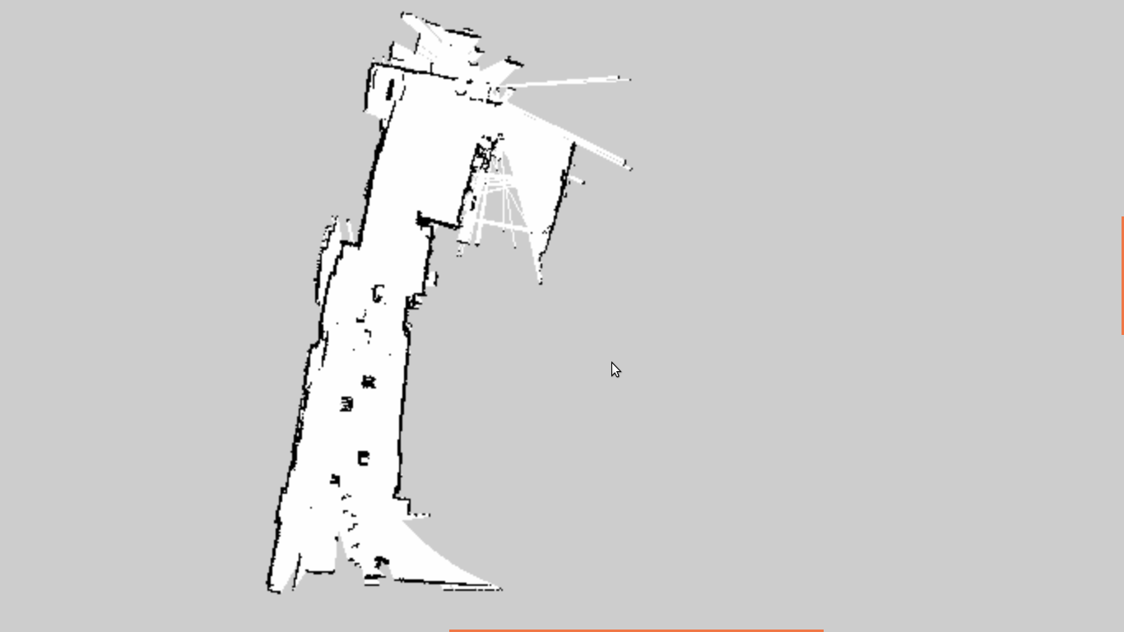
Staircase
Obstacles
Ketterer Lab

Slide 7
DEMO

