Slide 1

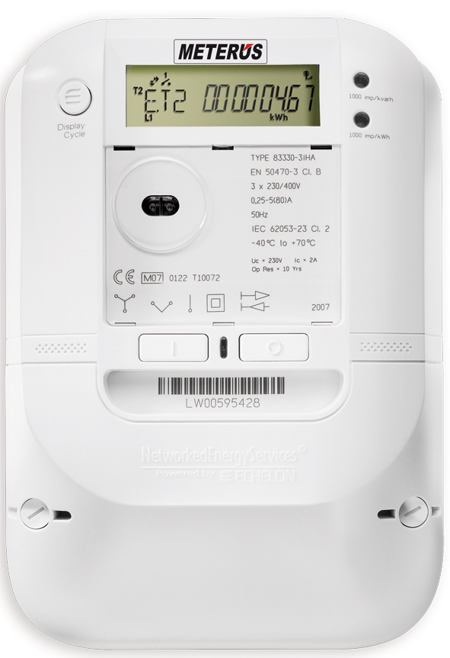
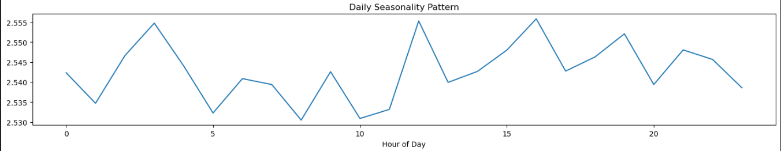
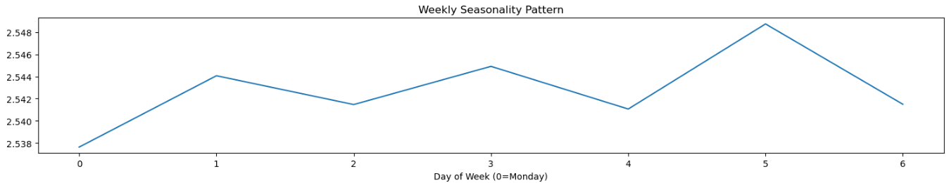
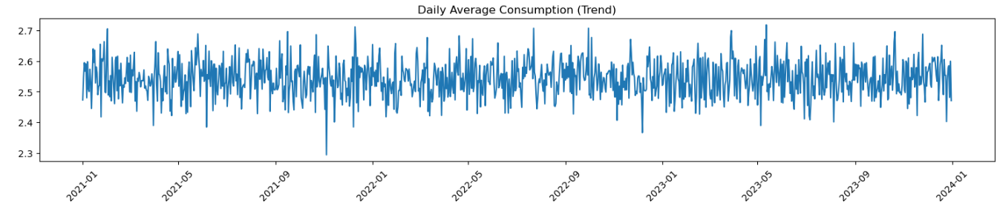
Load Forecasting for Energy Utilities
Business Context
The Energy Landscape is Evolving
Data Deluge
Market Opportunity
Objective
Enhance Operational Efficiency
Improve Customer Engagement & Service
Drive Data-Driven Decision Making

Slide 2
Model Workflow
Data Processing
LSTM Model Architecture and Model Training
Prediction and Inverse Scaling and Model Evaluation
Result Visualization
Identifying the Business Need
Using the Smart Meter data for Data Source
Business Insights
Recommendations

Slide 3
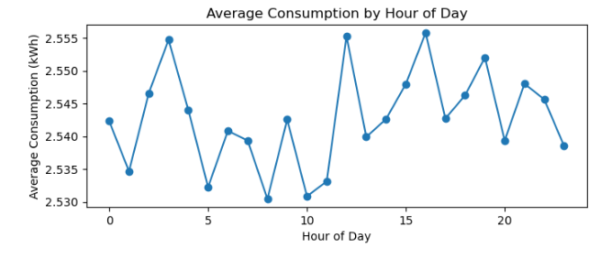
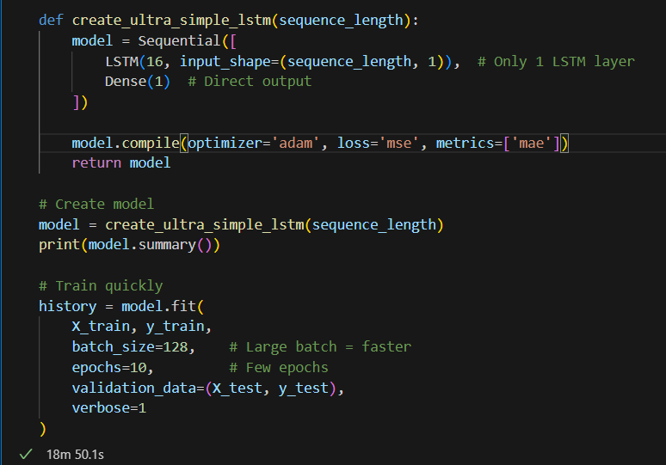
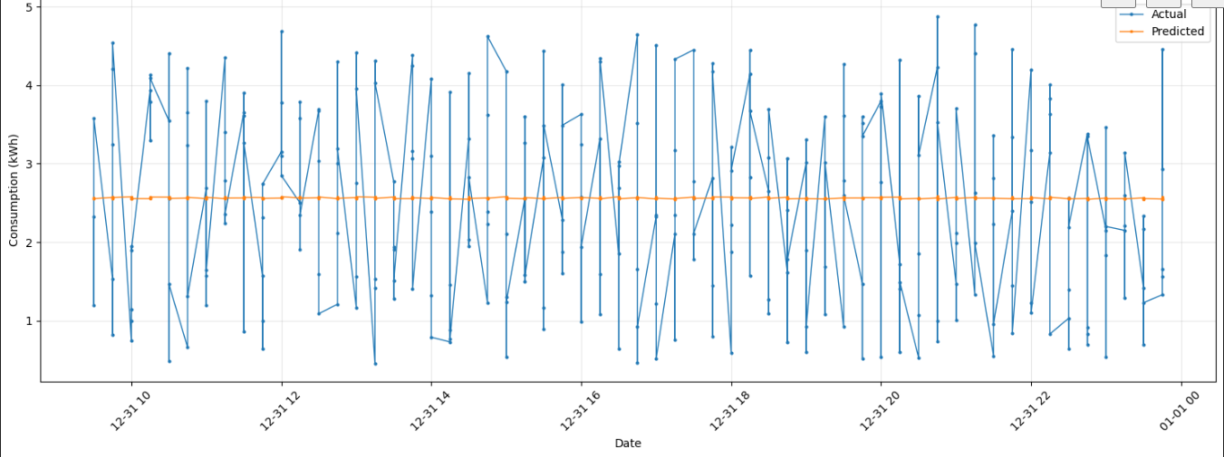
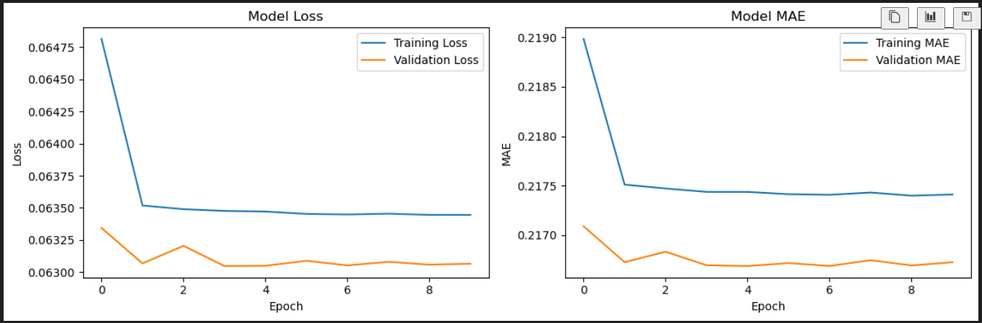
Approach and Model Overview
Finding KPI for our use case
Daily consumption load
Energy supplied by the utilities
Training a LSTM model for the available time series data
Model Architecture:

Slide 4
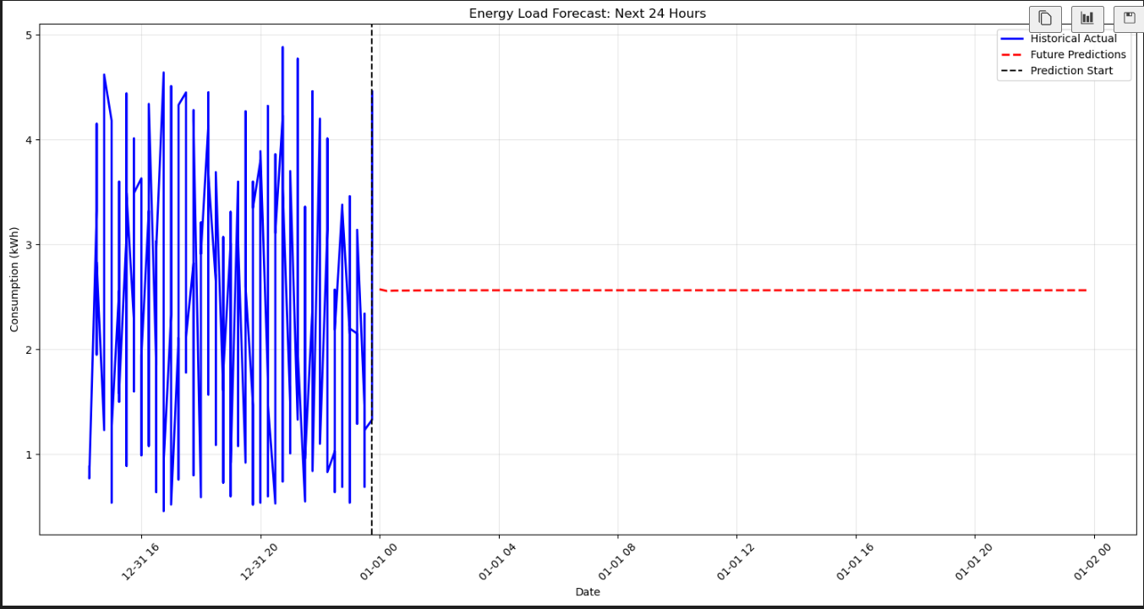
Result
Average Predicted Consumption: The expected average consumption is 2.56 kWh
Consumption Stability: The predicted consumption is highly stable, with very little variation
Maximum: The highest predicted consumption is only slightly higher at 2.57 kWh
Minimum: The lowest predicted consumption is 2.56 kWh, matching the average

Slide 5

Business Impact

Slide 6
Recommendations
The model suggest that the consumption pattern would remain static for the upcoming 3 days in the month of January for the next year.
Few more general recommendations:
Buy extra power in advance when we predict high demand
Send simple alerts to customers about high-demand days
Develop better pricing plans that reward off-peak usage

Slide 7


Relaunch the add-in
Microsoft Power BI
After you install the add-in, you can launch it by choosing the add-in button on the Insert tab
On the Insert tab
Insert
My Add-ins
Need more help?
Return to your internet browser or copy this link into your browser:
https://pages.store.office.com/addinsinstallpage.aspx?rs=en-US&assetid=WA200003233&isWac=True&ui=en-US&ad=US

