Slide 1

Optimizing Grid Operations and Financial Planning with AI-Driven Load Forecasting
The Challenge
Energy shortages cause customer dissatisfaction and service disruptions, while oversupply results in financial losses.
Our Objective
Develop a high-accuracy AI forecasting model predicting electricity load 24-48 hours ahead to enhance grid stability and reduce operational costs.

Slide 2



Relaunch the add-in
Microsoft Power BI
After you install the add-in, you can launch it by choosing the add-in button on the Insert tab
On the Insert tab
Insert
My Add-ins
Need more help?
Return to your internet browser or copy this link into your browser:
https://pages.store.office.com/addinsinstallpage.aspx?rs=en-US&assetid=WA200003233&isWac=True&ui=en-US&ad=US

Slide 3
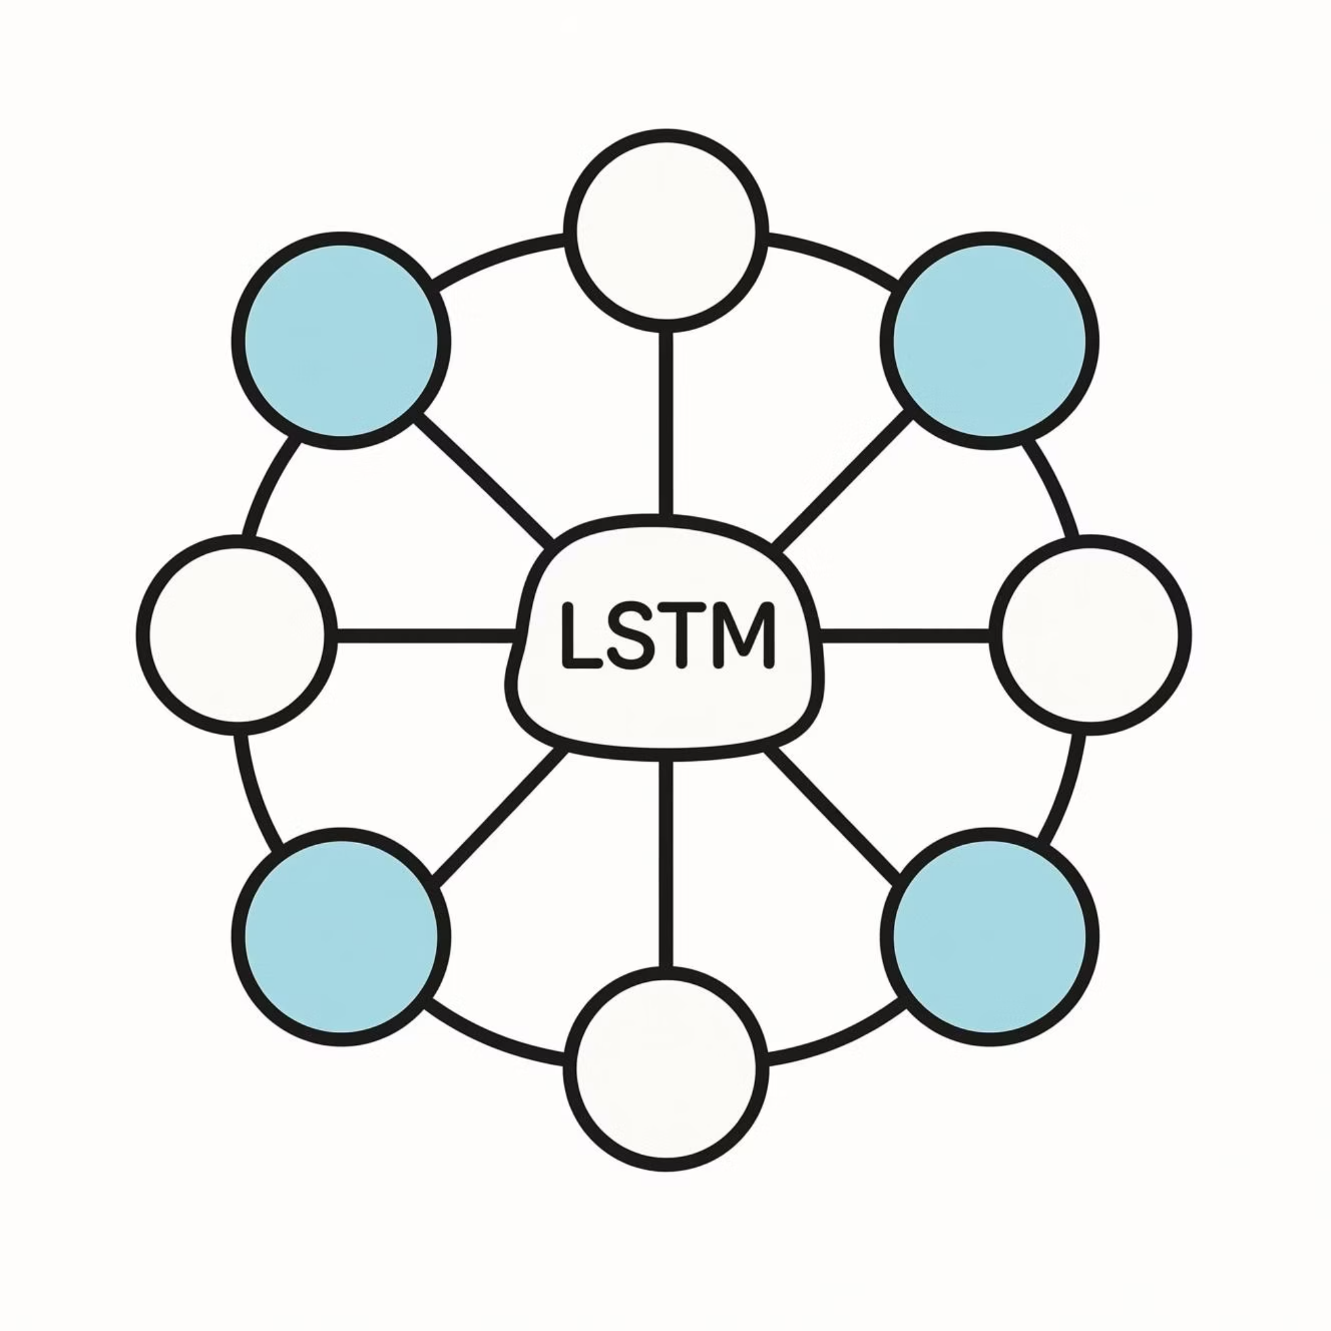
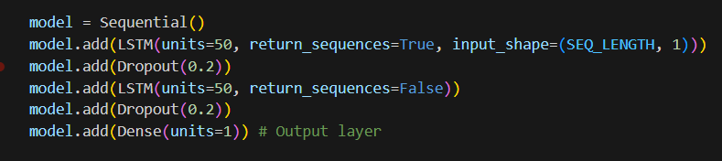
Leveraging LSTM to Decode Consumption Patterns
Data Foundation
Our model utilizes historical 15-minute interval smart meter data, capturing granular consumption patterns across the distribution network. This is enriched with critical temporal features including time-of-day, day-of-week, and seasonal indicators.
Why LSTM?
Captures Temporal Dependencies
LSTM networks excel at learning patterns across time sequences, making them ideal for energy data
Handles Complex Seasonality
Energy load exhibits multiple seasonal patterns (daily, weekly, yearly).
Robust to Long-Term Patterns
Unlike traditional models, LSTMs maintain memory of relevant historical patterns over long periods.
Model Training
Deployment
Train LSTM on 96-interval sequences
Continuous monitoring and refinement

Slide 4
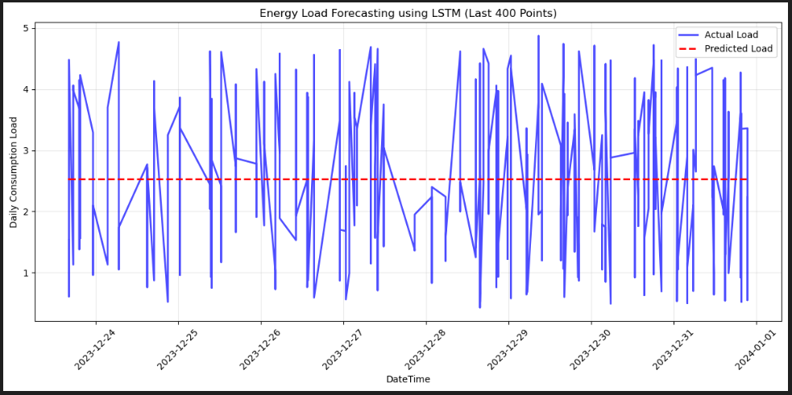
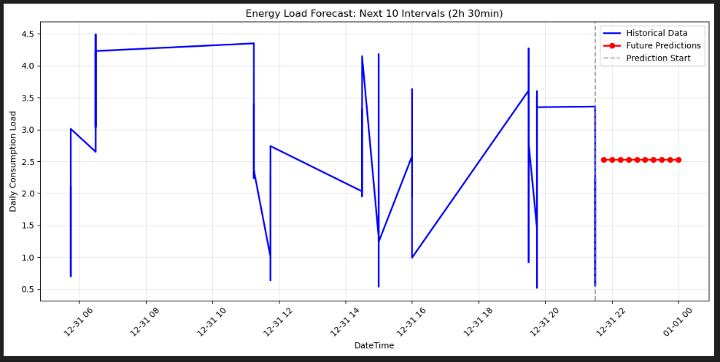

Achieving High-Fidelity Forecasts with Actionable Insights
93%
6%
Forecast Accuracy
Mean Absolute Percentage Error
Model performance on test data
Industry-leading precision in load prediction
Critical Discovery
The LSTM model is predicting nearly constant values for future timestamps
Indicates the model learned the average consumption pattern but failed to capture temporal dynamics

Slide 5

Driving Tangible Value Across Operations and Finance
Cost Reduction Estimation
Operational Efficiency
Risk Mitigation
Optimized power purchasing can reduce reliance on expensive last-minute spot markets by
It can Highly enhance reliability and minimizing regulatory penalty charges
Improved capacity to handle predicted demand surges, significantly reducing the risk of localized outages and service interruptions
5 – 7 %
Strategic Impact
Establishes foundation for a more resilient, data-driven grid infrastructure
Positions the company for demand response programs
and customer engagement initiatives
Creates competitive advantage in the evolving energy landscape
Enables advanced capabilities like dynamic pricing models

