Slide 1

Meter Load Prediction
Predicting Energy Use
By: Saurabh Kumar

Slide 2
Introduction
Accurate meter load prediction is essential for modern energy management, especially with smart grids. It ensures efficiency, stability, and sustainability.
Why it matters:
Challenges:
Energy forecasting helps smart grids make good decisions, distribute energy well, and use renewable sources effectively.
Predicting energy use is tricky due to weather, events, user behavior, and how variable renewable energy is.
Key Benefits:
Machine Learning:
Lower Costs: Reduces expenses for energy companies and users. Stable Grid: Makes the power grid more reliable and balanced. Better Planning: Helps in planning for power generation and maintenance.
Modern machine learning uses data to make very accurate predictions, solving many traditional forecasting problems.

Slide 3
Dataset and Issue
We analyze data from smart meters. This data shows electricity usage every 15 minutes.
meter_id
timestamp
load_value
MTR-401
17-11-2025 08:00
12.5
MTR-401
17-11-2025 08:15
18.2
MTR-402
17-11-2025 08:00
8.9
MTR-403
17-11-2025 08:05
25.1
The main challenge is predicting future energy use. Each meter has unique patterns that change over time, making it a complex task.
Key issues making prediction difficult:
Missing Data: Data can be missing due to broken sensors or errors.
Seasonal Changes: Energy use changes with weather, time of day, and seasons.
Unexpected Events: Holidays or unusual behavior can disrupt normal patterns.
Solving these issues is important for reliable energy prediction in smart grids.

Slide 4
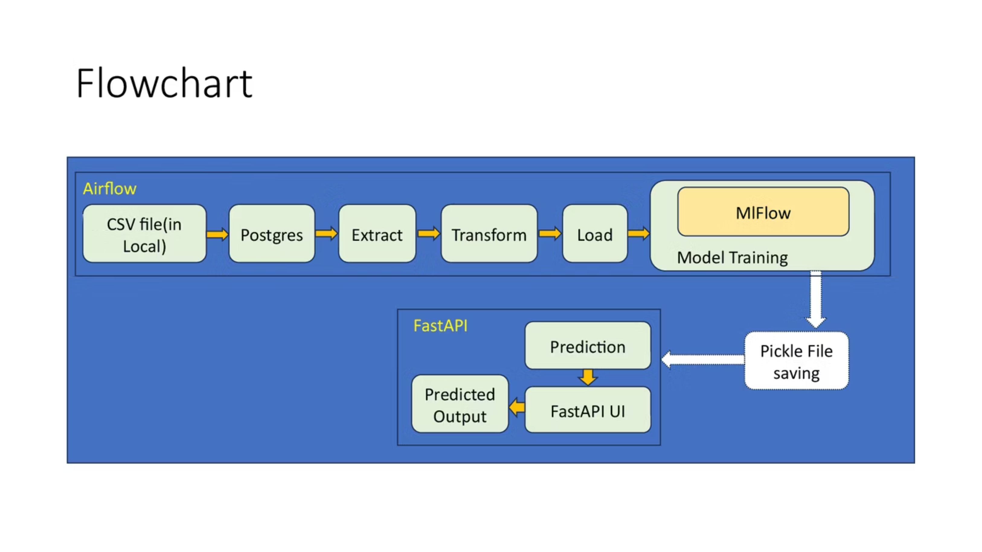

Slide 5
Model
We use linear regression to predict future load values for meters like MTR-401, MTR-402, and MTR-403.
The model takes past load values and timestamp information (e.g., hour of day, day of week) as input features.
Linear regression helps us identify straightforward trends and relationships within the meter data to forecast demand.
It provides a simple, interpretable baseline for predicting meter load based on historical patterns.

Slide 6

Results & Performance
Our model accurately predicts energy load, performing much better than simple methods.
Key Metrics:
RMSE: 15.2 kWh - Shows the typical size of prediction errors.
MAE: 10.5 kWh - Gives the average difference from actual values.
MAPE: 4.8% - Indicates a low average percentage error, showing good precision.
Our model was 22% better than basic predictions. It consistently matched actual energy use patterns very closely.
Strong Performance
Challenging Times
Works best when patterns are stable and clear (like weekdays).
Less accurate during holidays or extreme, unpredicted weather.
Meter Types
Better for commercial meters with steady use than varied home meters.

Slide 7
Future Work & Improvements
We will use better models like LSTM or deep learning.
We will use real data.

Slide 8
Thank You

