Slide 1



covid_dashboard
View in Power BI
Last data refresh:
10/28/2025 4:53:48 AM UTC
Downloaded at:
10/28/2025 4:59:22 AM UTC

Slide 2
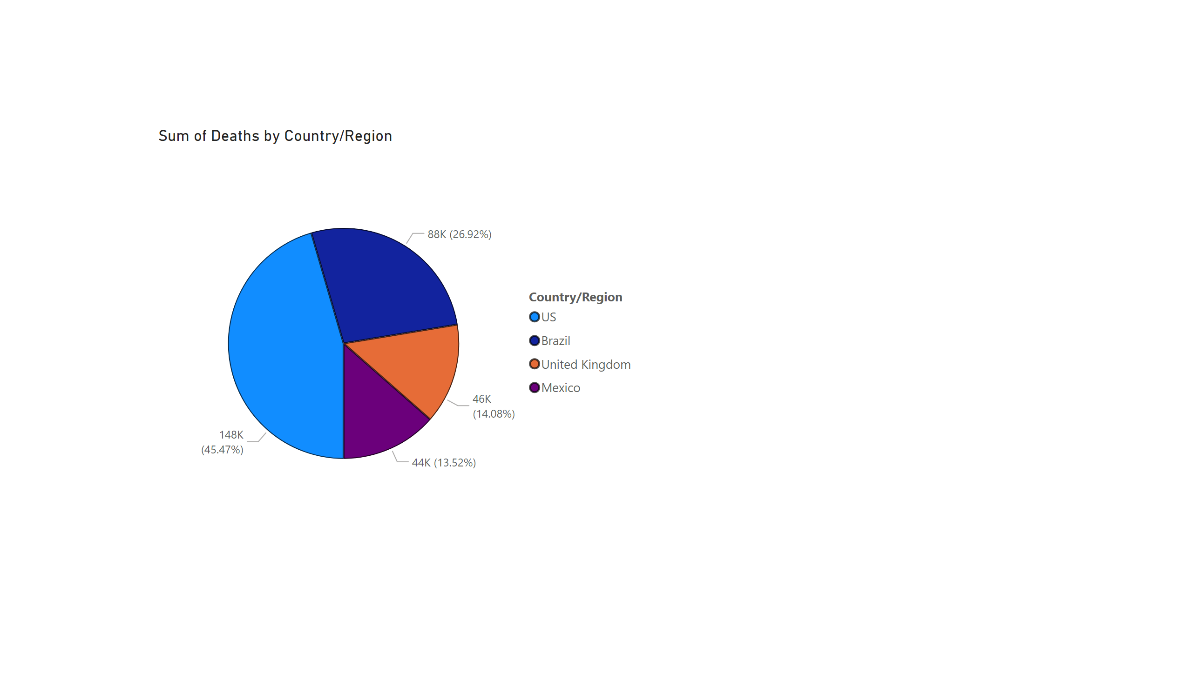
Page 1
Notes:
pieChart
No alt text provided

Slide 3
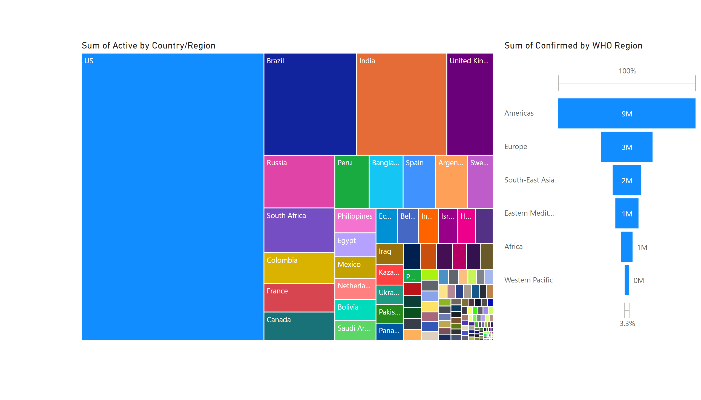
Page 2
Notes:
treemap
No alt text provided
funnel
No alt text provided

Slide 4
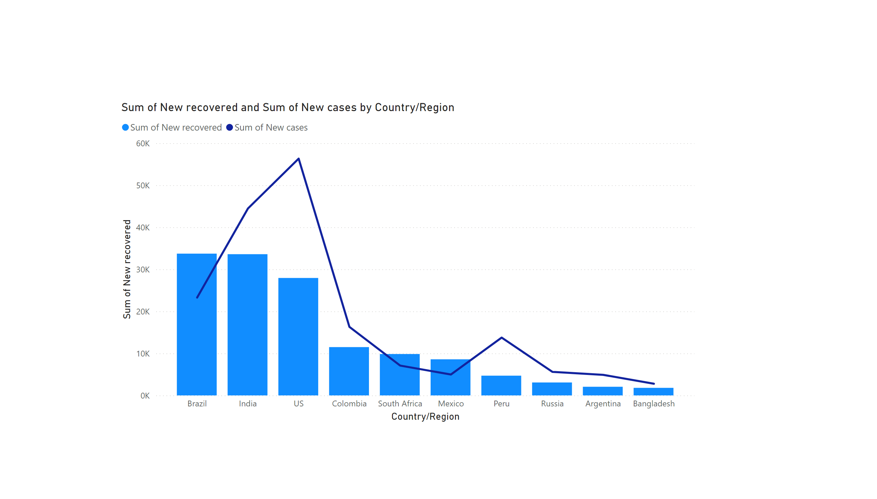
Page 3
Notes:
lineStackedColumnComboChart
No alt text provided

Slide 5
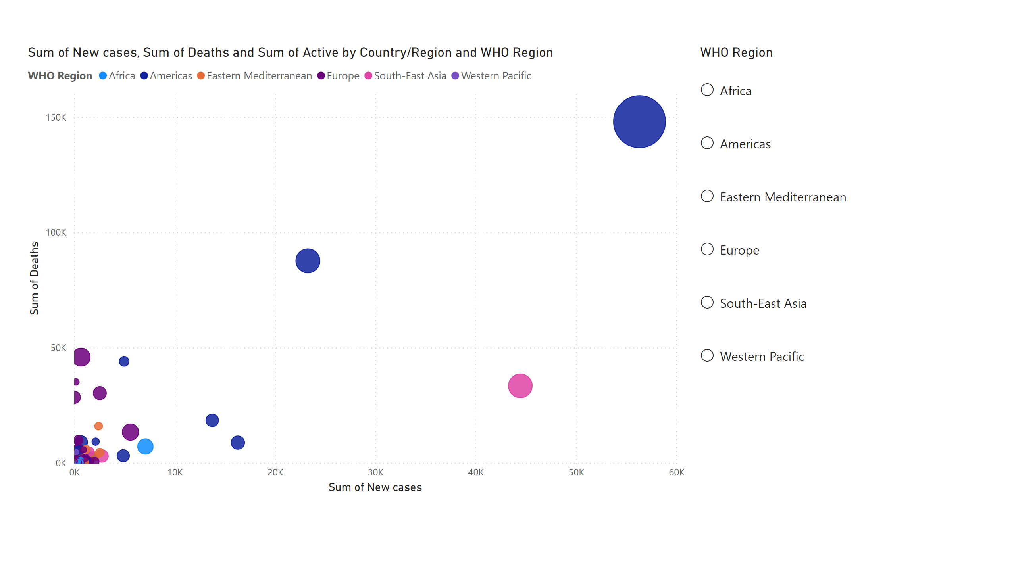
Page 4
Notes:
scatterChart
No alt text provided
listSlicer
No alt text provided

Slide 6
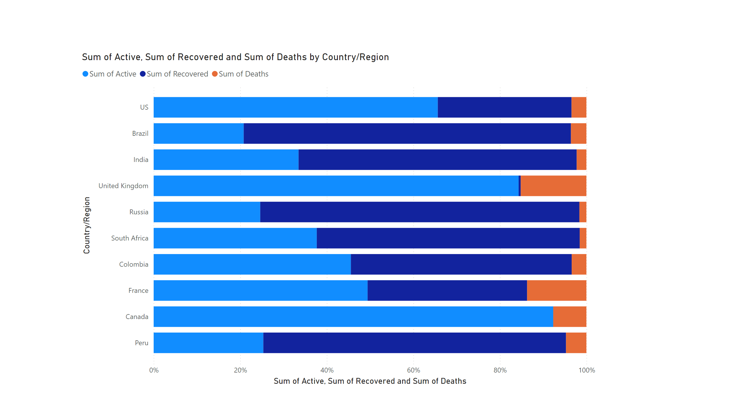
Page 5
Notes:
hundredPercentStackedBarChart
No alt text provided

Slide 7
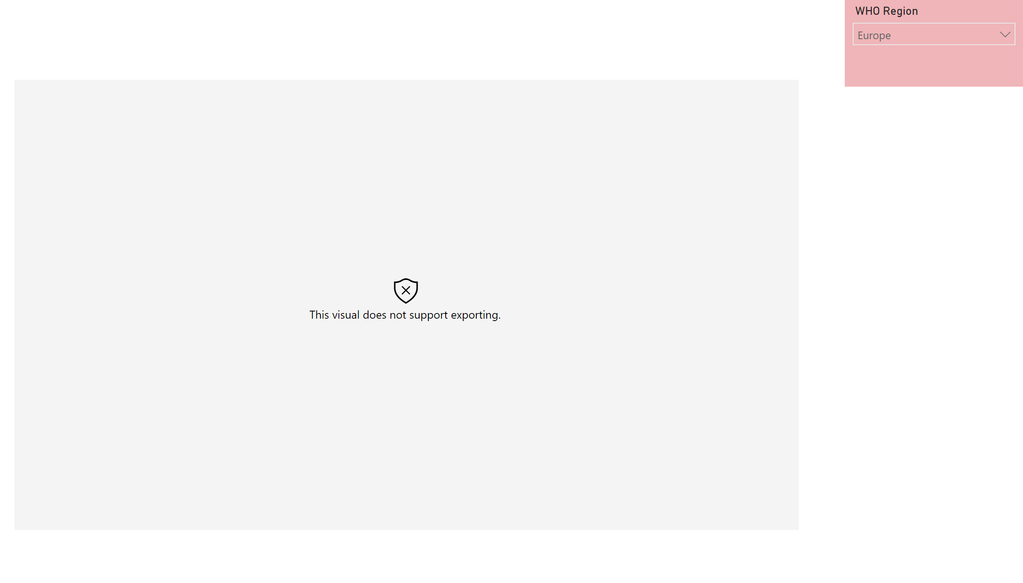
Page 6
Notes:
esriVisual
No alt text provided
slicer
No alt text provided

Slide 8
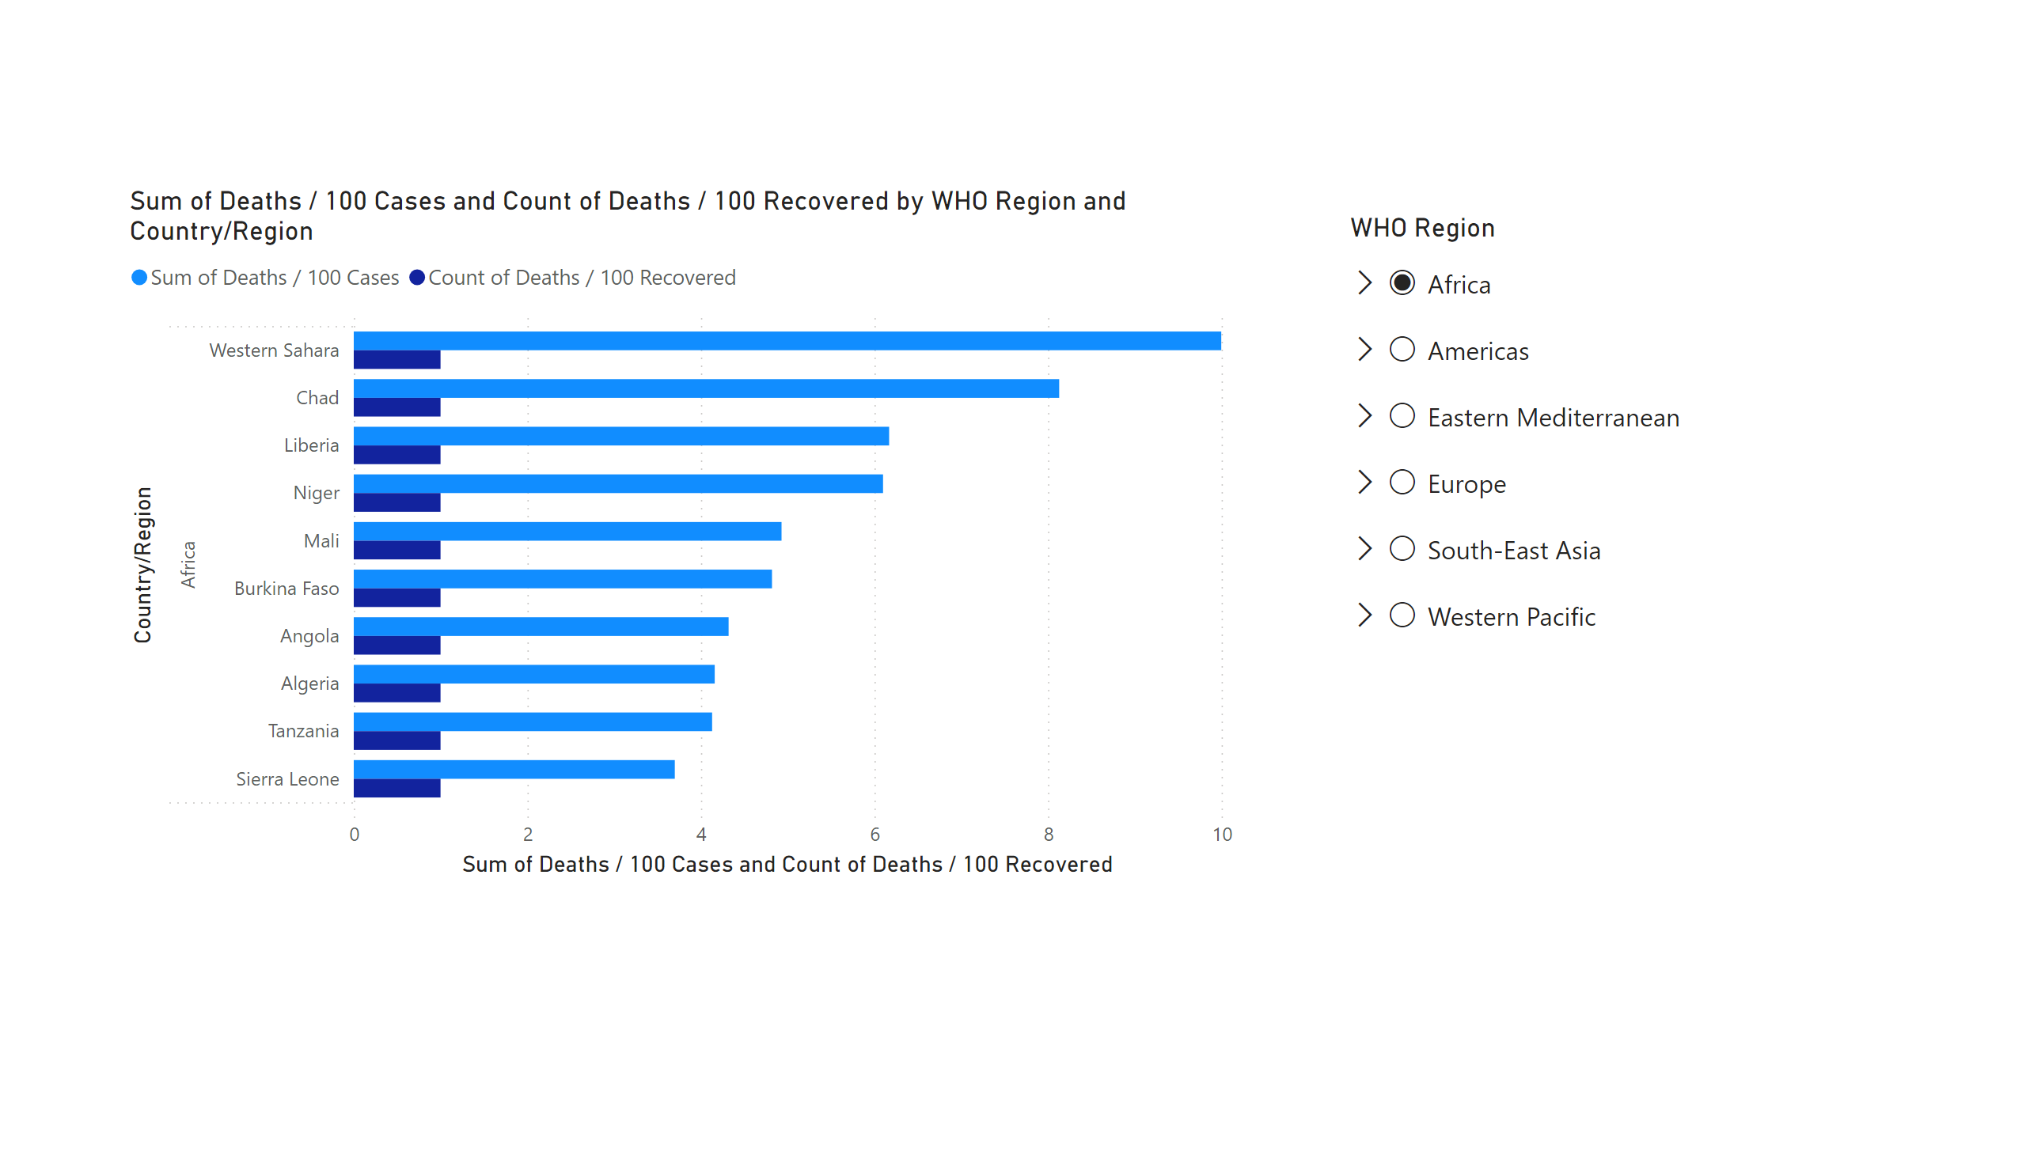
Page 7
Notes:
clusteredBarChart
No alt text provided
listSlicer
No alt text provided

Slide 9
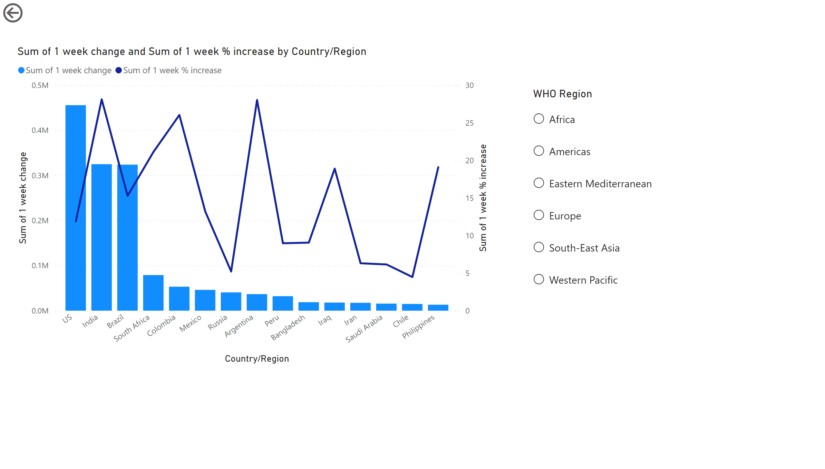
Page 8
Notes:
listSlicer
No alt text provided
actionButton
No alt text provided
lineStackedColumnComboChart
No alt text provided

Slide 10
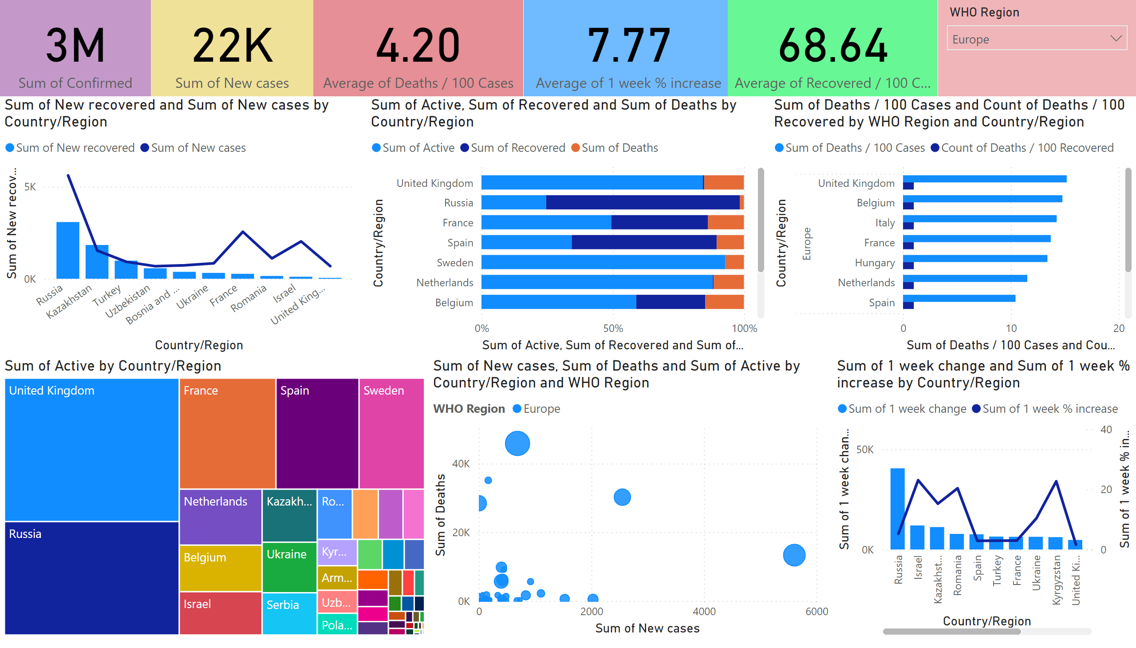
Page 9
Notes:
treemap
No alt text provided
lineStackedColumnComboChart
No alt text provided
scatterChart
No alt text provided
hundredPercentStackedBarChart
No alt text provided
clusteredBarChart
No alt text provided
lineStackedColumnComboChart
No alt text provided
card
No alt text provided
card
No alt text provided
card
No alt text provided
slicer
No alt text provided
card
No alt text provided
card
No alt text provided

