Slide 1
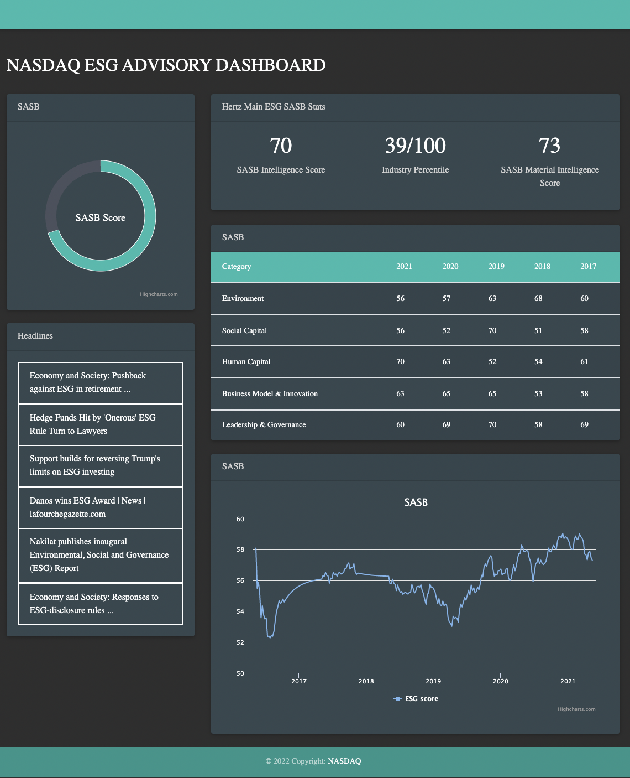

ESG Performance Dashboard
Companies
All Companies
Search

Slide 2
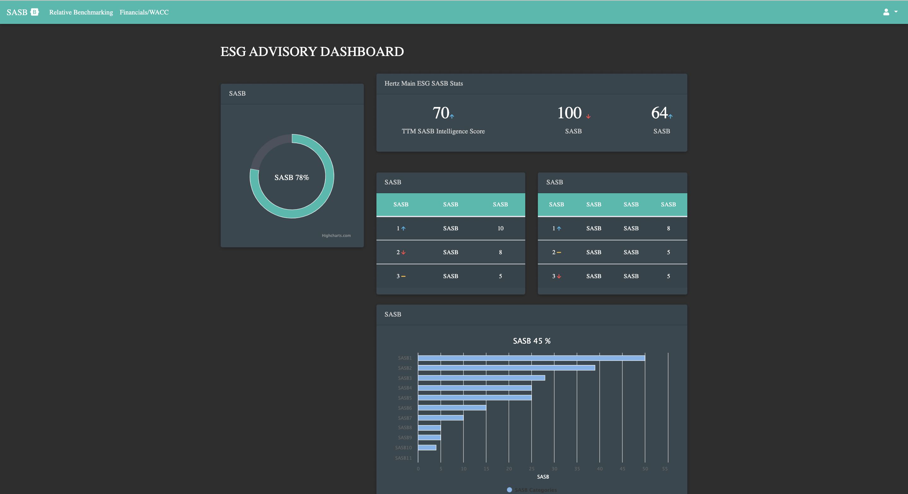
Esi berenq aj eli miqich
{Company_name} ESG DASHBOARD
Stex tive grenq uxxaki 70
Stex karanq inchvor bacvox dropdown dnenq amen meki take
+
+
+
+
+
{Company_name} Historical ESG Score

Slide 3
Competitor List
63
63
63
63
63
63
63
63
63

Slide 4
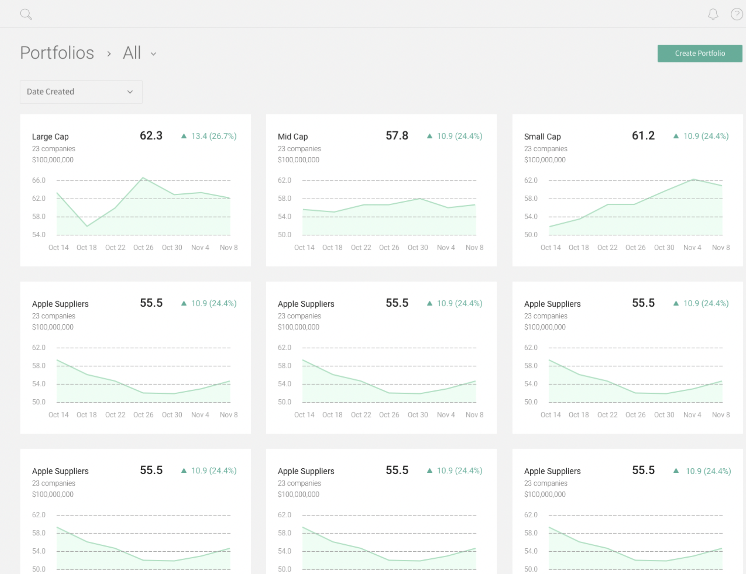
Competitor List

Slide 5
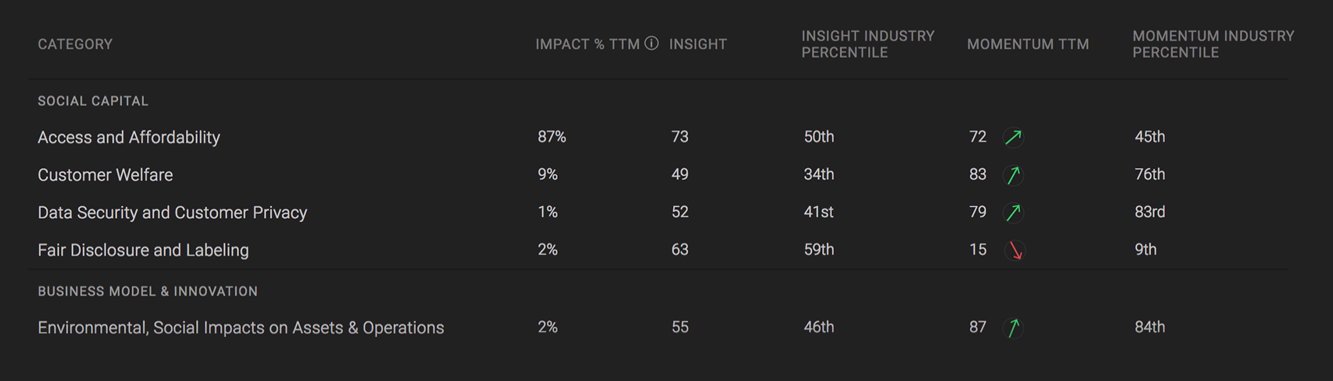
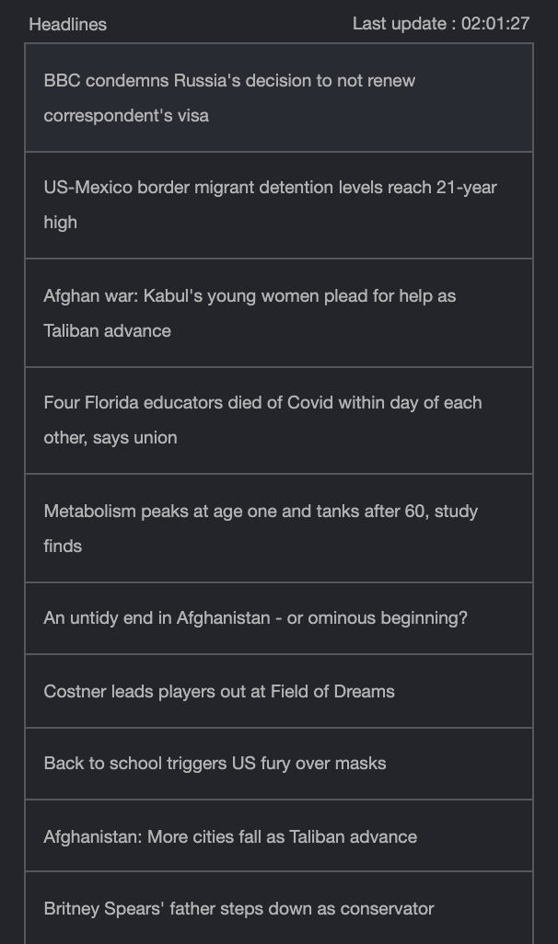
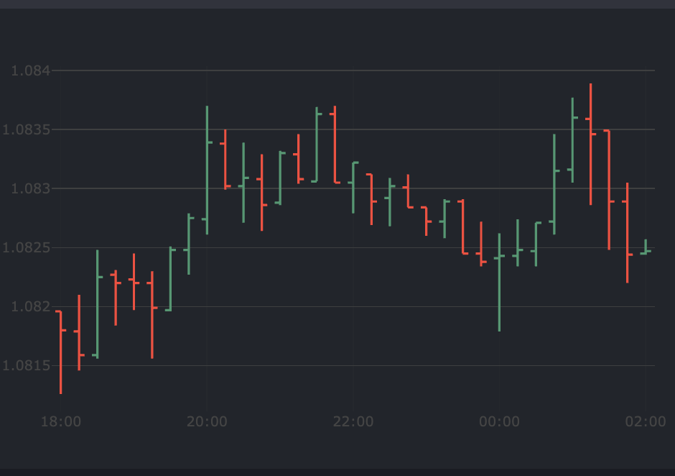
Three Separate Text Pieces
News Articles

Slide 6
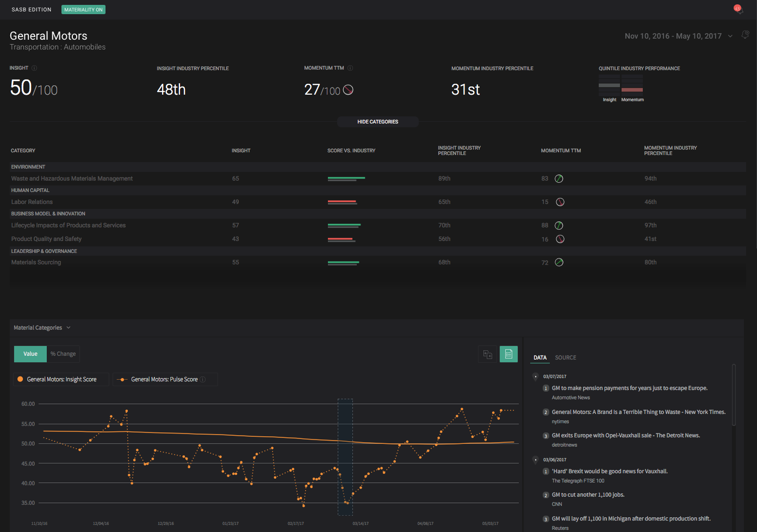
Example Platform: TruvalueLabs

Slide 7
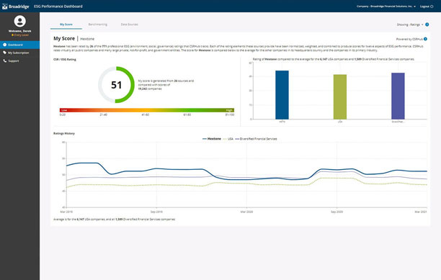
Example Platform: Broadridge

