Slide 1
Identity, Entitlement and Access Management Working Team
Face to Face Meeting, December 2015
Philip Kershaw, CEDA Rachana Ananthakrishnan, University of Chicago
Face to Face Meeting 2015

Slide 2
Team membership
Luca Cinquini
Aashish Chaudhary
Antonio Cofino
Katharina Berger
Carsten Ehbrecht
Georgi Kostov
Kleanthis Tsaousis
James McEnerney
Mark Greenslade
Philip Kershaw
Rachana Ananthakrishnan
Sandro Fiore
Maarten Pliger
Dean N. Williams
Face to Face Meeting 2015

Slide 3
Review of …
Requirements
Operations
Development efforts
Roadmap
OAuth pilot work
Face to Face Meeting 2015

Slide 4
Requirements
Changing landscape for ESGF:
New model for data access for CMIP6
Compute node enables access to computational resources: definitely needs access control!
Levels of assurance need to be re-thought for access to compute resources
e.g. automated registration for access rights inadequate to protect resources

Slide 5
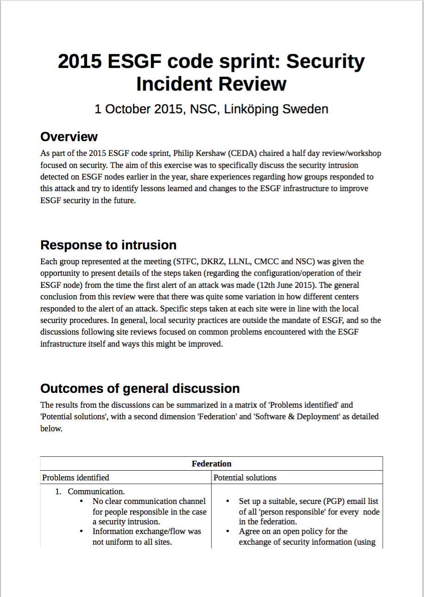
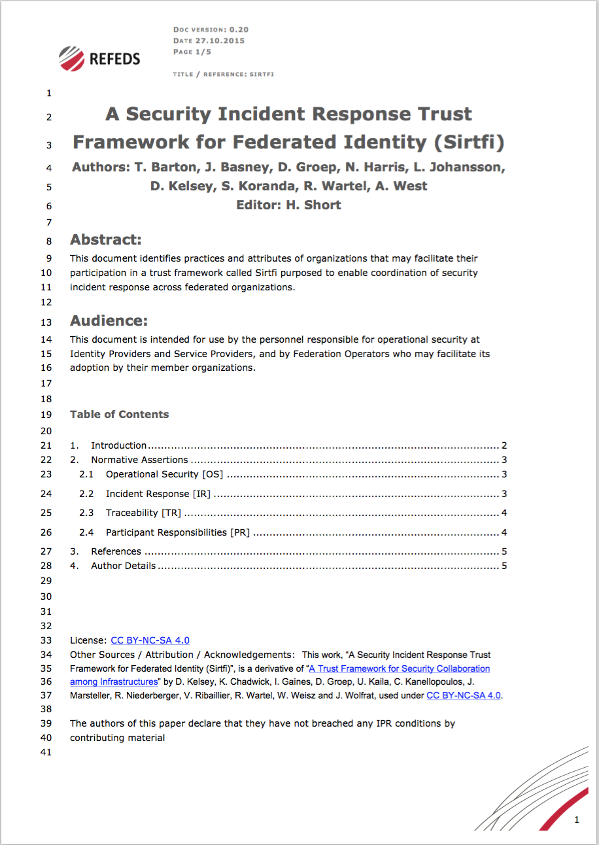
Operations
ESGF Code Sprint: Security Incident Review
Best practice to draw upon from experts in federated identity management
REFEDS - SIRTFI Framework: A Security Incident Response Trust Framework for Federated Identity (Sir-T-Fi)
https://wiki.refeds.org/download/attachments/6619254/Sirtfi-0.2.pdf?version=1&modificationDate=1446555782617&api=v2
Face to Face Meeting 2015

Slide 6
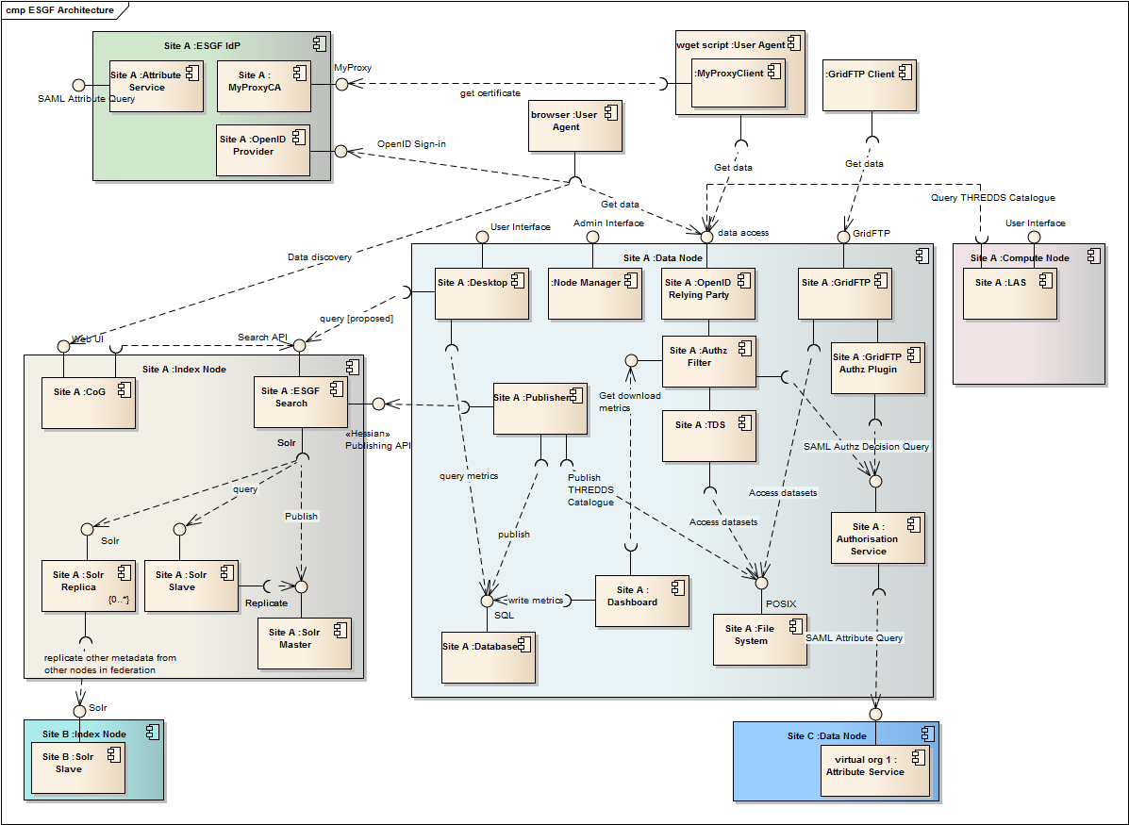
ESGF Architectural Overview
Nb. number of services and interfaces

Slide 7
Operations – Policies for IdPs
We propose to reduce the number of IdPs in the federation to a few core centres
To reduce overall operational burden
Each service that is run adheres to a robust operational requirements
Nb. Federations like ESA’s and Umbrella (Synchrotron community) have only one IdP
Use institutional identities from external providers e.g. InCommon or other national federations
Remove IdP service components from default installation in theESGF installer
Face to Face Meeting 2015

Slide 8
Development
New work halted this year as efforts diverted to necessary patching
Highlights the problems associated with legacy code base with multiple components
Need for a programme of active, continuous development
Requires development effort together with domain expertise
Enhancements such as OAuth migration provide an opportunity for wholesale replacement of code
Face to Face Meeting 2015

Slide 9
Recap - Roadmap 2014
✔
Simplify trust roots
Replace MyProxyCA and integrate OAuth
Create an Attribute Registration web service interface
Improve usability for browser-based sign-in
Simplify security for Wget
Integrate OpenID Connect to simplify sign-in and user attribute release
Provide support for external IDs to the federation
Review the use of central Virtual Organisation-wide attribute services
Provide support for multiple Levels of Assurance (LoA)
✔
✔
✔
✔
- Mirror Attribute services replicating registration entries
Face to Face Meeting 2015

Slide 10
OAuth 2.0 Integration
Why OAuth? – recap
Provides a solution for user delegation – important for compute node use cases
A path to OpenID Connect, the replacement to OpenID 2.0 which is being deprecated
Face to Face Meeting 2015

Slide 11


How Does OAuth 2.0 work?
The user visits a website
The site needs to access data on the user’s behalf with a certificate
It redirects the user to an Authorisation server in order to get their permission to obtain a certificate
The user logs in with the authorisation server and grants permission
The website can now get a token permitting it to get a certificate on the user’s behalf
Access Token
Website
OAuth Client
OAuth Authorisation Server
Access Token
OAuth Resource Server
Resources
Short-lived Credential Service
Face to Face Meeting 2015

Slide 12
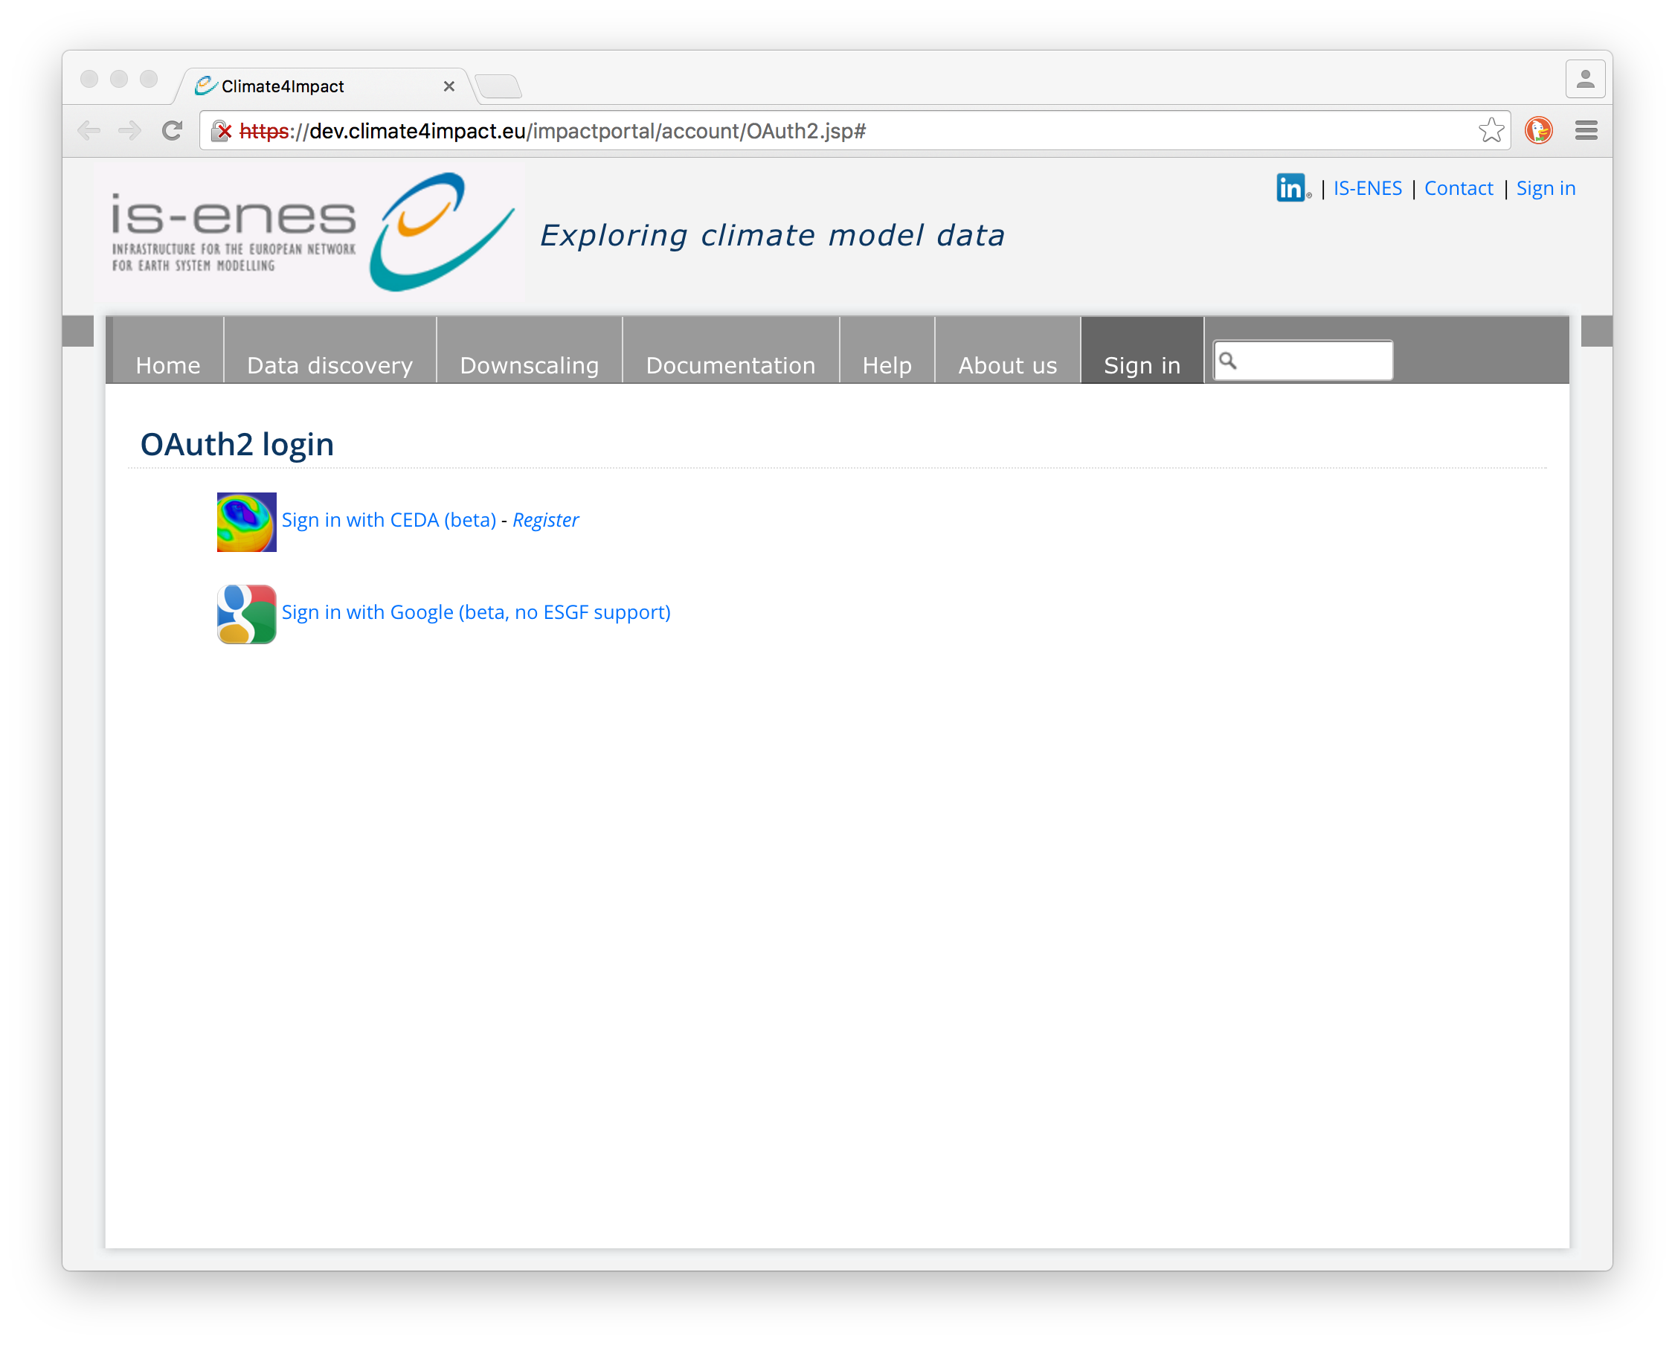
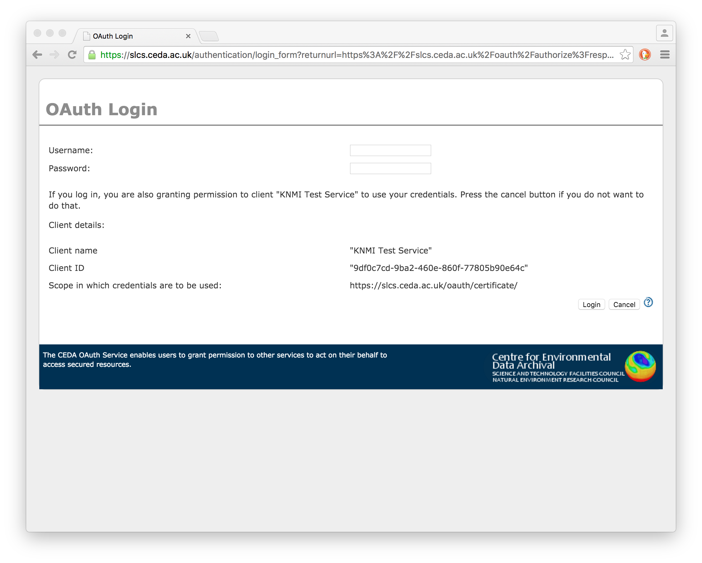
OAuth 2.0 Pilots
Using CEDA test OAuth service
CEDA ⬄ KNMI Climate4Impacts
Complete in dev version
CEDA ⬄DKRZ Birdhouse WPS
Initial token access step tested
CEDA ⬄ Globus
Planned for January
Face to Face Meeting 2015

Slide 13
Summary
Operations
Centres need to adhere to a set of minimum requirements
Limit the number of IdPs to ease operational burden
Development work
Diverted to patching this year
Legacy code base is a problem
We need a continuous programme of development effort
OAuth pilots have shown potential to deliver real improvements
The initial development is done, integration is needed
Face to Face Meeting 2015

