Slide 1
ESGF-QCWT Quality Control WT Report

Slide 2




QCWT Overview
The QCWT aims to improve the quality of ESGF user services with regard to external documentations.
Integration of data-related information into the ESGF CoG portal:
Referenced Metadata:
Completely independent developments, loosely connected
Registered Metadata:
Core metadata registered in ESGF
REGISTERED
METADATA Errata
REFERENCED
METADATA Data Citation
DATA
Data Preparation
CMOR
Metadata Ingest
External repository
Metadata Ingest
External repository
Data Ingest
ESGF data node
Implementation of WIP concepts on:
Data Citation:
Citation information are accessible in the ESGF portal based on the external citation service
Errata Annotations:
Errata information are accessible in the ESGF Service based on information registered in the Handle Service (PIDs) and in an external “Issue Manager”
ESGF Publication
ESGF index node
Core Metadata
Registration
Metadata
Publication
Long-Term Archival
Stable data enriched with metadata

Slide 3
QCWT Members
Name | Affiliation | Responsibility
Martina Stockhause | DKRZ | Data Citation Service
Guillaume Levavasseur | IPSL | Errata Service
Katharina Berger | DKRZ | ESGF Implementation
Jeff Painter | LLNL/DOE
Claire Trenham | ANU
Jingbo Wang | ANU
Dean N. Williams | LLNL/DOE

Slide 4
Working Packages
Persistence of ESGF metadata (Katharina with ESGF-RVWT)
Integration of the Versioning Approach (all)
Errata Service (Guillaume)
Data Citation Service (Martina)
Display information out of external repositories for ESGF users (Guillaume - Frontend, Katharina - Backend)
Communication (Martina)

Slide 5
Report and Status for 2015 (1)
Persistence of Metadata and Version Support
– Katharina with ESGF-RVWT –
Concept development at ESGF Publication Sprint in Paris (October 2015)
Name of version directory used as default version for ESGF publication
Persistence of ESGF metadata in work

Slide 6
Report and Status for 2015 (2)
Errata Service
– Guillaume –
During CMIP5 it was difficult for scientists:
to know easily whether the data in hands is deprecated and/or replaced and corrected by a newer version,
to have access to a description of this issue.
The Quality Control Working Team aims to define and establish a stable and coordinated procedure to collect and provide access to errata information related to datasets hosted by ESGF.
PYTHON/DJANGO MODULE
PID(s)

Slide 7
Report and Status for 2015 (3)
Errata Service
– Guillaume –
Concept development at ESGF Publication Sprint in Paris (October 2015)
WIP paper review to fix Errata Service architecture and ESGF dependencies
Exploiting the PID (un)/publication chains and standardized issues information, the Errata Service records and tracks reasons for datasets version changes.
For more details see “CMIP6 errata as a new ESGF service” poster

Slide 8
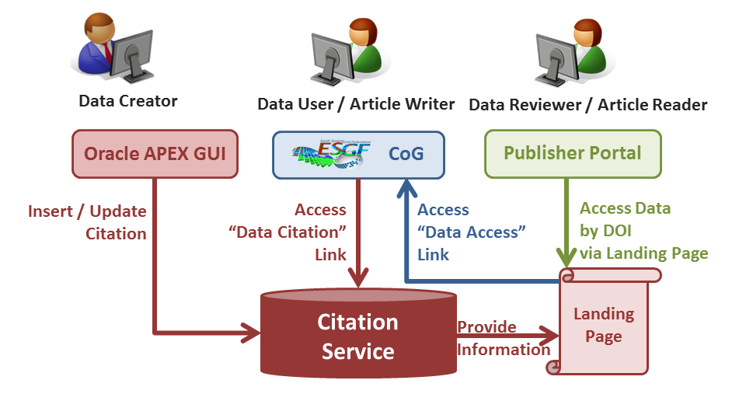

Report and Status for 2015 (4)
Data Citation Service
– Martina –
Credit use case
Evidence use case
Data Citations are provided on model and simulation granularities.

Slide 9
Report and Status for 2015 (5)
Data Citation Service
– Martina –
Concept development and description in a WIP paper
Repository set-up:
Definition of use cases for insert/update, export/dissemination of citation information
Development of the Database schema to store citation information
Testing of use cases
Start of implementation:
Development of GUI for data creators started
Export and display of citation information (“landing page”) started
Integration of “Data Citation” link template in ESGF CoG portal
On Schedule
Poster on “Data Citation Service” tomorrow

Slide 10
Plans for 2016
– Versioning –
Continue implementation (together with ESGF-RVWT)
Version history service planned
– Errata Service –
Concept development and description in a WIP paper (in review)
Discuss and finalize the issue registration process/form
Development of
An Issue Manager
The errata module for ESGF CoG front-end
APIs to request Handle Service and Issue Manager
Deployment on ESGF index nodes
– Data Citation Service –
Discuss ESGF version support with CoG / Search API
Discuss/define interfaces with ESGF and ES-DOC
Release the citation GUI for data creators
Provide citation XML for CMIP6 on the OAI Server
Discuss and finalize landing page design and content
Start the integration of DataCite DOI and LTA services

Slide 11
Timeline for 2016
12/2015 | Errata Service: Fix errata concept Citation Service: ESGF test implementation + discuss version support at ESGF F2F
01/2016 | Errata Service: Fix Issue information design Citation Service: Beta release of GUI for testing + consolidation of ESGF test implementation
02/2016 | Errata Service developments
03/2016 | Citation Service: Release of GUI for data creators + discuss landing page content
06/2016 | Errata Service: Operable issue registration Citation Service: Operable early citation part Draft on recommendations for the integration of external information into ESGF
09/2016 | Errata Service: Full operability Citation Service: Integration of early citations into LTA/IPCC-DDC and DataCite DOI processes Final version of recommendations for the integration of external information into ESGF
(source: https://acme-climate.atlassian.net/wiki/display/ESGF/ESGF-QCWT+Charge)

Slide 12
Risks and Planned Co-operations (1)
Data Citation Service
Credit use case
Evidence use case
Data Citations are provided on model and simulation granularities.

Slide 13
Risks and Planned Co-operations (2)
– Risks –
Data Citation - Critical requirement on version support (evidence use case):
Operable CoG/Search for datasets ≤ version/access date → display metadata for unpublished datasets
Fall back: Display information on creators, funders, title etc. for use in acknowledgements. Data is not formally citable (not in the reference list), because of non-compliance with Force 11’s ‘Joint Declaration of Data Citation Principles’ .
– Planned Co-operations –
ES-DOC and QC teams:
Add applications as use cases for the integration of external information into ESGF,
Develop recommendations
ESGF :
CoG and RVWT on version support
PWT on the integration of the errata service

Slide 14
Summary
– Status –
Errata Service concept finalization: WIP review + ESGF F2F feedbacks
Data Citation Service on schedule and open issues to be discussed at ESGF F2F
– Future Plans and Risks –
IPSL hires Atef Bennasser for developing missing components and API for Errata Service deployment/operability (first half of 2016)
Operable Data Citation Service with basic functionality planned for 06/2016. Version support for Data Citation Service is currently unclear.
Prepare recommendations for the integration of external information into ESGF in cooperation with ES-DOC.

Slide 15
– References –
ESGF-QCWT:
http://acme-climate.atlassian.net/wiki/display/ESGF/ESGF-QCWT+Charge
Errata Service IPSL PoC:
http://errata.ipsl.upmc.fr/
Data Citation Service:
http://cmip6cite.wdc-climate.de
WIP Papers:
G. Levavasseur, S. Denvil (2015): Errata system for CMIP6.
http://www.earthsystemcog.org/projects/wip/resources
M. Stockhause, F. Toussaint, M. Lautenschlager (2015): CMIP6 Data Citation and LTA.
http://www.earthsystemcog.org/projects/wip/resources

