Slide 1
Replication and Versioning
Working Group
(esgf-rvwt)
Members:
DKRZ: Stephan Kindermann, Tobias Weigel, Katharina Berger
BADC: Matt Pritchard
LLNL/DOE: Dean Williams
IPSL: Jerome Raciazek
Esnet: Eli Dart, Mary Hester ←→ ICNWG
NCI: Joseph Antony, Claire Trenham, Jingbo Wang

Slide 2
Interactions / Connections
Publication WG
WIP
CDNOT
(CMIP6)
Replication and Versioning WG
PID effort
Network WG (ICNWG)
Data Transfer WG
Quality WG

Slide 3
Achieved in 2015:
A) WIP paper for CMIP6:
WIP
Replication and Versioning WIP paper:
see https://earthsystemcog.org/projects/wip/resources/
CDNOT
(CMIP6)
Replication and Versioning WG
Key Aspects:
Supervision of replication and versioning by CDNOT
Set up a CMIP6 replication team
Software support: ESGF publisher integration, Replication SW (synda, globus online?)
B) Improvement of synda replication tool
Support for gridftp
..

Slide 4
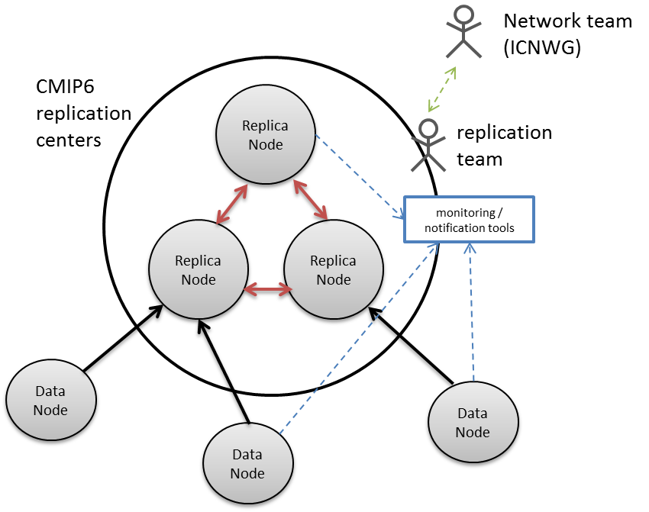
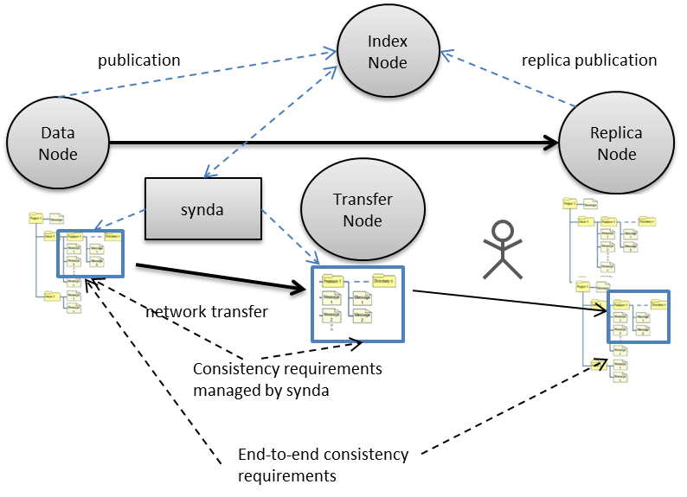
Replication
„dark“ Replica Node

Slide 5
Achieved in 2015
Publication WG
C) Improvement of versioning support
in publisher
→ living requirements document
(https://docs.google.com/document/d/1tOaFQEXFyjqAOOlvcdiaX3XrXuxIv_nlE5_FCme1id4/edit)
Replication and Versioning WG
PID effort
Integration status in ESGF publisher:
Version info in mapfile (future default): done
Stable versions (remove update and replace publisher options): work in progess
Version check as part of publication: planed
→ PID python API for integation in publisher supporting versioning

Slide 6
Road Map / Discussion
Early 2016, after ESGF relaunch:
Setup replication test bed between sites
(initially LLNL, DKRZ, BADC, NCI ?)
Discuss/Synchronise replication tests with ICNWG team
Discuss/Synchronise with data transport WP
Test integration of PID API in publisher (supporting versioning)
Later 2016
Replication and Versioning Best Practice Document (together with Publisher WG)
Discuss steps towards automatic replication
Engage with groups planing to host „hidden“ ESGF replica caches

Slide 7
Open Issues
Globus online role in replication
(API based usage ..)
Consistent versioning at directory layout level
„latest“ link etc.

