Slide 1
ESGF-SWT
Part 2
ESGF-SWT Members
Katharina Berger
Nicolas Careton
Prashanth Dqarakanath
Matthew Harris
Georgi Kostov
Torsten Rathmann
Karl Taylor
Frank Toussiant
Claire Trenham
Dean Williams
LLNL-PRES-679831
This work was performed under the auspices of the U.S. Department of Energy by Lawrence Livermore National Laboratory under Contract DEAC52-07NA27344.

Slide 2
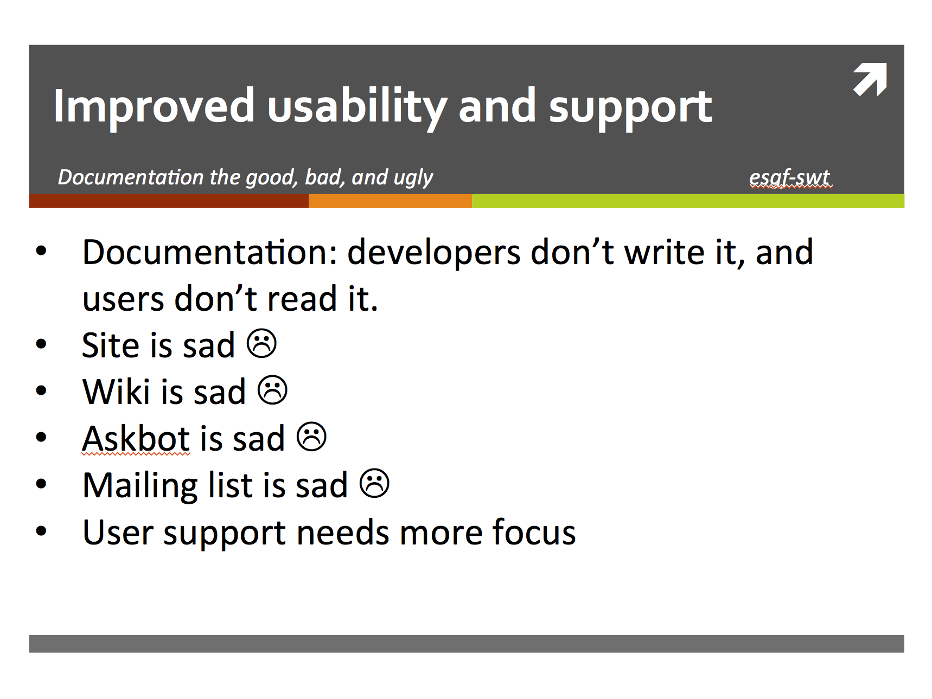
Last Year

Slide 3
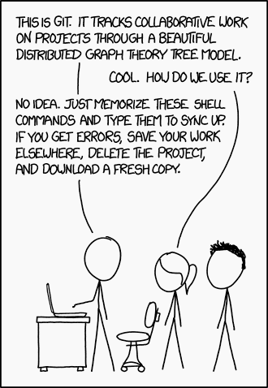
This Year
Documentation:
Developers are writing it!
Users can get it.
Site is better ☺
http://esgf.llnl.gov
Wiki is improving ☺
http://esgf.llnl.gov/wiki
Askbot is dead ☺
New support FAQ site
http://esgf.github.io/esgf-swt
Mailing list is working! ☺ *
User support has more focus ☺ *
* Thank you Torsten and Team!

Slide 4
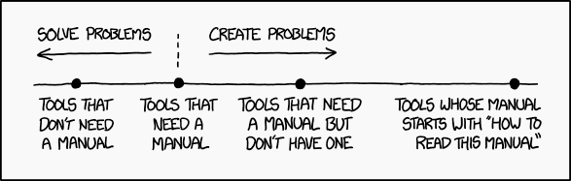
Documentation
“I wish I knew where to find documentation about X.”
http://esgf.github.io/esgf-swt/links/
“I have a simple question about X.”
http://esgf.github.io/esgf-swt/index.html
“I can’t log in because of X.”
see step 1
see step 2 (a whole page on this topic http://esgf.github.io/esgf-swt/login/)
email the support list [esgf-user@lists.llnl.gov]
“What is this new CoG?”
https://earthsystemcog.org
https://github.com/EarthSystemCoG/COG
Manuals

Slide 5
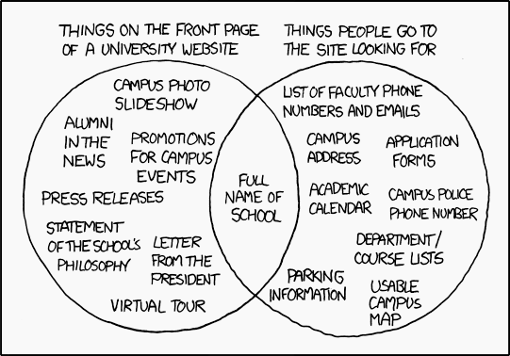
Site, wiki, email
New site was released late 2014
Updated regularly
Still feel it’s missing something? Please let us know
https://github.com/ESGF/esgf.github.io/issues
Wikis still under construction
New project specific wikis
Slowly removing developer info from user
Transitioning to new FAQ
Email is being archived
Since last years F2F
Not public

Slide 6
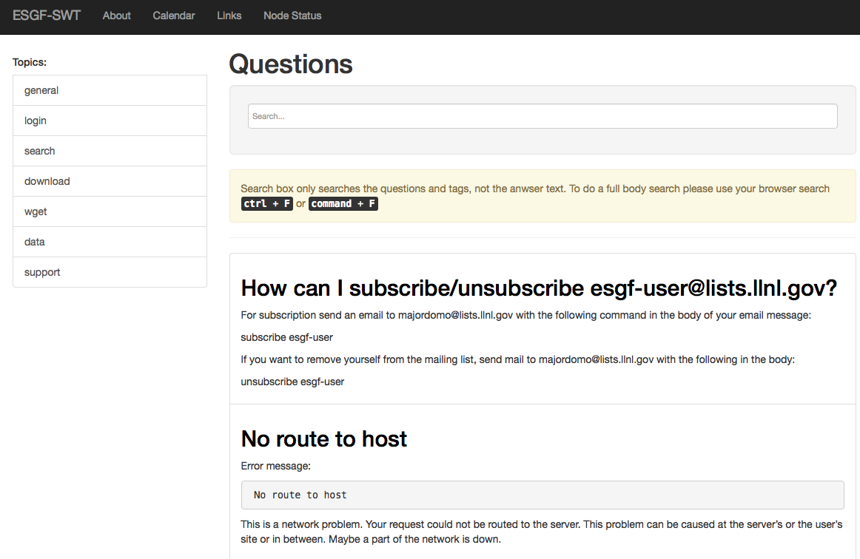
New FAQ
http://esgf.github.io/esgf-swt/
Features
Quick Topics
Quick Search
Full Text Search
About Page ☺
Links Page to docs
Node Status
(Not working until ESGF back online)

Slide 7
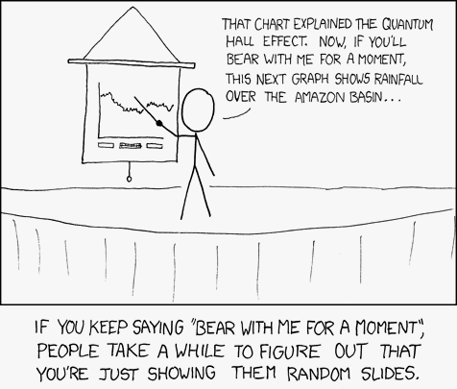
2016 Road Map
More front line support
Improve second leave support
Over haul wiki / remove 85% of old info
Consolidate documentation
Integrate with CoG front end
Separate User, Developer, Admin info

Slide 8

Conclusion / Face to face thus far
Observations so far
Being down sucked
Lets not be down again
ESGF 2.0 is going to rock
Data is large and expensive to move
Move compute to data, not data to compute

Slide 9
Thank you
Links
http://esgf.llnl.gov
http://esgf.llnl.gov/wiki
https://github.com/ESGF
http://esgf.github.io/esgf-swt/
ESGF-SWT Members
Katharina Berger
Nicolas Careton
Prashanth Dqarakanath
Matthew Harris
Georgi Kostov
Torsten Rathmann
Karl Taylor
Frank Toussiant
Claire Trenham
Dean Williams

