Slide 1
An update on Obs4MIPs: Opportunities and requirements
Peter J. Gleckler
ESGF F2F
Monterey, October 7-11, 2015
Program for Climate Model Diagnosis and Intercomparison, LLNL

Slide 2


Talk outline
Brief background and status report
Reliance on ESGF and related capabilities
Moving ahead: project technical and scientific requirements
Greater possibilities
Summary

Slide 3
obs4MIPs leverages key protocols and infrastructure
Experiment protocol (MIP experiments) and standard output
Climate Forecast (CF) Convention (as applied in CMIP)
Software to ensure data complies to CMIP structure: CMOR
Distribution: ESGF, technically aligned with CMIP data
CoG: Project information and interconnectedness with others
Designed for model output

Slide 4
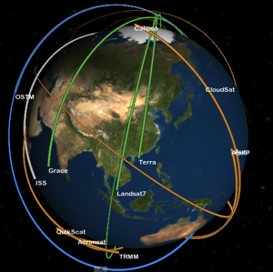
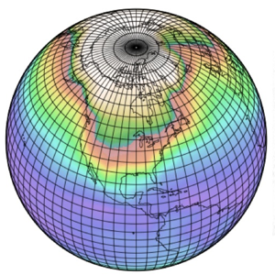
obs4MIPs: the 4 commandments
Obs4MIPs
Target Quantities
Use the CMIP Standard Model Output as guideline for selecting observations
Observations to be structured the same as CMIP model output
Hosted on the ESGF with CMIP output
Include a technical note for each dataset
Strive to have observational experts connected to the process
Model Output
Variables
Satellite Retrieval
Variables
Modelers
Observation
Experts
Analysis
Community
Initial Target
Community

Slide 5

Launched by NASA and DOE, obs4MIPs is now overseen by the WCRP’s Data Advisory Council (WDAC) to expand the effort
WDAC Observations for Model Evaluation Task Team Members
Peter Gleckler, co-chair, PCMDI Duane Waliser, co-chair, JPL Sandrine Bony, IPSL
Mike Bosilovich, GSFC
Helene Chepfer, IPSL Veronika Erying, DLR Robert Ferraro, JPL Pierre Phillipe Mathieu, ESA
Jerry Potter, GSFC Roger Saunders, UKMO Jörg Schulz, EUMETSAT Karl Taylor, PCMDI Jean-Noël Thépaut, ECMWF
Ex-Officio Tsengdar Lee, NASA Renu Joseph, DOE
Otis Brown, NOAA
Mitch Rixen, WCRP

Slide 6







obs4MIPs: Current Set of Satellite Observations
Sorted by CF Variable Long Name
~50 monthly mean datasets
Air Temperature
Ambient Aerosol Optical Thickness at 550 nm
CALIPSO 3D Clear fraction
CALIPSO 3D Undefined fraction
CALIPSO Clear Cloud Fraction
CALIPSO Cloud Fraction
CALIPSO High Level Cloud Fraction
CALIPSO Low Level Cloud Fraction
CALIPSO Mid Level Cloud Fraction
CALIPSO Scattering Ratio
CALIPSO Total Cloud Fraction
Cloud Fraction retrieved by MISR
CloudSat 94GHz radar Total Cloud Fraction
CloudSat Radar Reflectivity CFAD
Fraction of Absorbed Photosynthetically Active Radiation
ISCCP Cloud Area Fraction (Joint histogram of opt thickness and CTP)
ISCCP Mean Cloud Albedo (Cloud-fraction weighted & daytime)
ISCCP Mean Cloud Top Pressure (Cloud-fraction weighted & daytime)
ISCCP Mean Cloud Top Temperature (Cloud-fraction weighted & daytime)
ISCCP Total Cloud Fraction (daytime only)
Leaf Area Index
Mole Fraction of O3
Near-Surface Wind Speed
PARASOL Reflectance
Precipitation*
Sea Surface Height Above Geoid
Sea Surface Temperature
Specific Humidity
Surface Downwelling Clear-Sky LW
Surface Downwelling Clear-Sky SW
Surface Downwelling LW
Surface Downwelling SW
Surface Upwelling Clear-Sky SW
Surface Upwelling LW
Surface Upwelling SW
TOA Incident SW
TOA Outgoing Clear-Sky LW
TOA Outgoing Clear-Sky SW
TOA Outgoing LW
TOA Outgoing SW
Total Cloud Fraction
Water Vapor Path
*Available 6hrly also
Current status of completeness criteria
Datasets Currently Hosted at obs4MIPs
(Variable Long Name)
Air Temperature
Ambient Aerosol Optical Thickness at 550 nm
CALIPSO 3D Clear fraction
CALIPSO 3D Undefined fraction
CALIPSO Clear Cloud Fraction
CALIPSO Cloud Fraction
CALIPSO High Level Cloud Fraction
CALIPSO Low Level Cloud Fraction
CALIPSO Mid Level Cloud Fraction
CALIPSO Scattering Ratio
CALIPSO Total Cloud Fraction
Cloud Fraction retrieved by MISR
CloudSat 94GHz radar Total Cloud Fraction
CloudSat Radar Reflectivity CFAD
Eastward Near-Surface Wind
Eastward Wind
Fraction of Absorbed Photosynthetically Active Radiation
ISCCP Cloud Area Fraction (Joint histogram of optical thickness and cloud top pressure)
ISCCP Mean Cloud Albedo (Cloud-fraction weighted & daytime only)
ISCCP Mean Cloud Top Pressure (Cloud-fraction weighted & daytime only)
ISCCP Mean Cloud Top Temperature (Cloud-fraction weighted & daytime only)
ISCCP Total Cloud Fraction (daytime only)
Leaf Area Index
Mole Fraction of O3
Near-Surface Wind Speed
Northward Near-Surface Wind
Northward Wind
PARASOL Reflectance
Precipitation
Sea Surface Height Above Geoid
Sea Surface Temperature
Specific Humidity
Surface Downwelling Clear-Sky Longwave Radiation
Surface Downwelling Clear-Sky Shortwave Radiation
Surface Downwelling Longwave Radiation
Surface Downwelling Shortwave Radiation
Surface Upwelling Clear-Sky Shortwave Radiation
Surface Upwelling Longwave Radiation
Surface Upwelling Shortwave Radiation
TOA Incident Shortwave Radiation
TOA Outgoing Clear-Sky Longwave Radiation
TOA Outgoing Clear-Sky Shortwave Radiation
TOA Outgoing Longwave Radiation
TOA Outgoing Shortwave Radiation
Total Cloud Fraction
Water Vapor Path

Slide 7
A high bar: completeness criteria for documenting obs4MIPs datasets (current status set by Task Team)
Current status of completeness criteria

Slide 8
obs4MIPs planning for CMIP6 – future “scientific requirements”
Consensus recommendations from meeting (2014; NASA HQ):
Expand the inventory and include higher frequency satellite data
Push for reliable and defendable error characterization/estimation
Include datasets in support of off-line simulators
Collocated observations, including in-situ datasets, particularly valuable for diagnosing certain processes
Ferraro et al., Evolving obs4MIPs to Support CMIP6, BAMS 2015

Slide 9
Requirements
Preparing obs4MIPs data
Preparing initial NASA data for obs4MIPs required extra effort because CMOR is designed for model data
This is currently a bottleneck for advancing the project
An “EZ-CMOR” is being tested to resolve this
(Denis Nadeau, Thur AM)

Slide 10
Requirements
Publishing obs4MIPs data on ESGF
obs4MIPs data are typically published one or several datasets at a time
As EZ-CMOR makes it easier to produce “little” datasets, methods to make it easier to publish them will be needed
Should inexperienced observational experts be enabled to publish data on ESGF or should they be providing their data (and other info need for publishing) to experiences publishers?

Slide 11
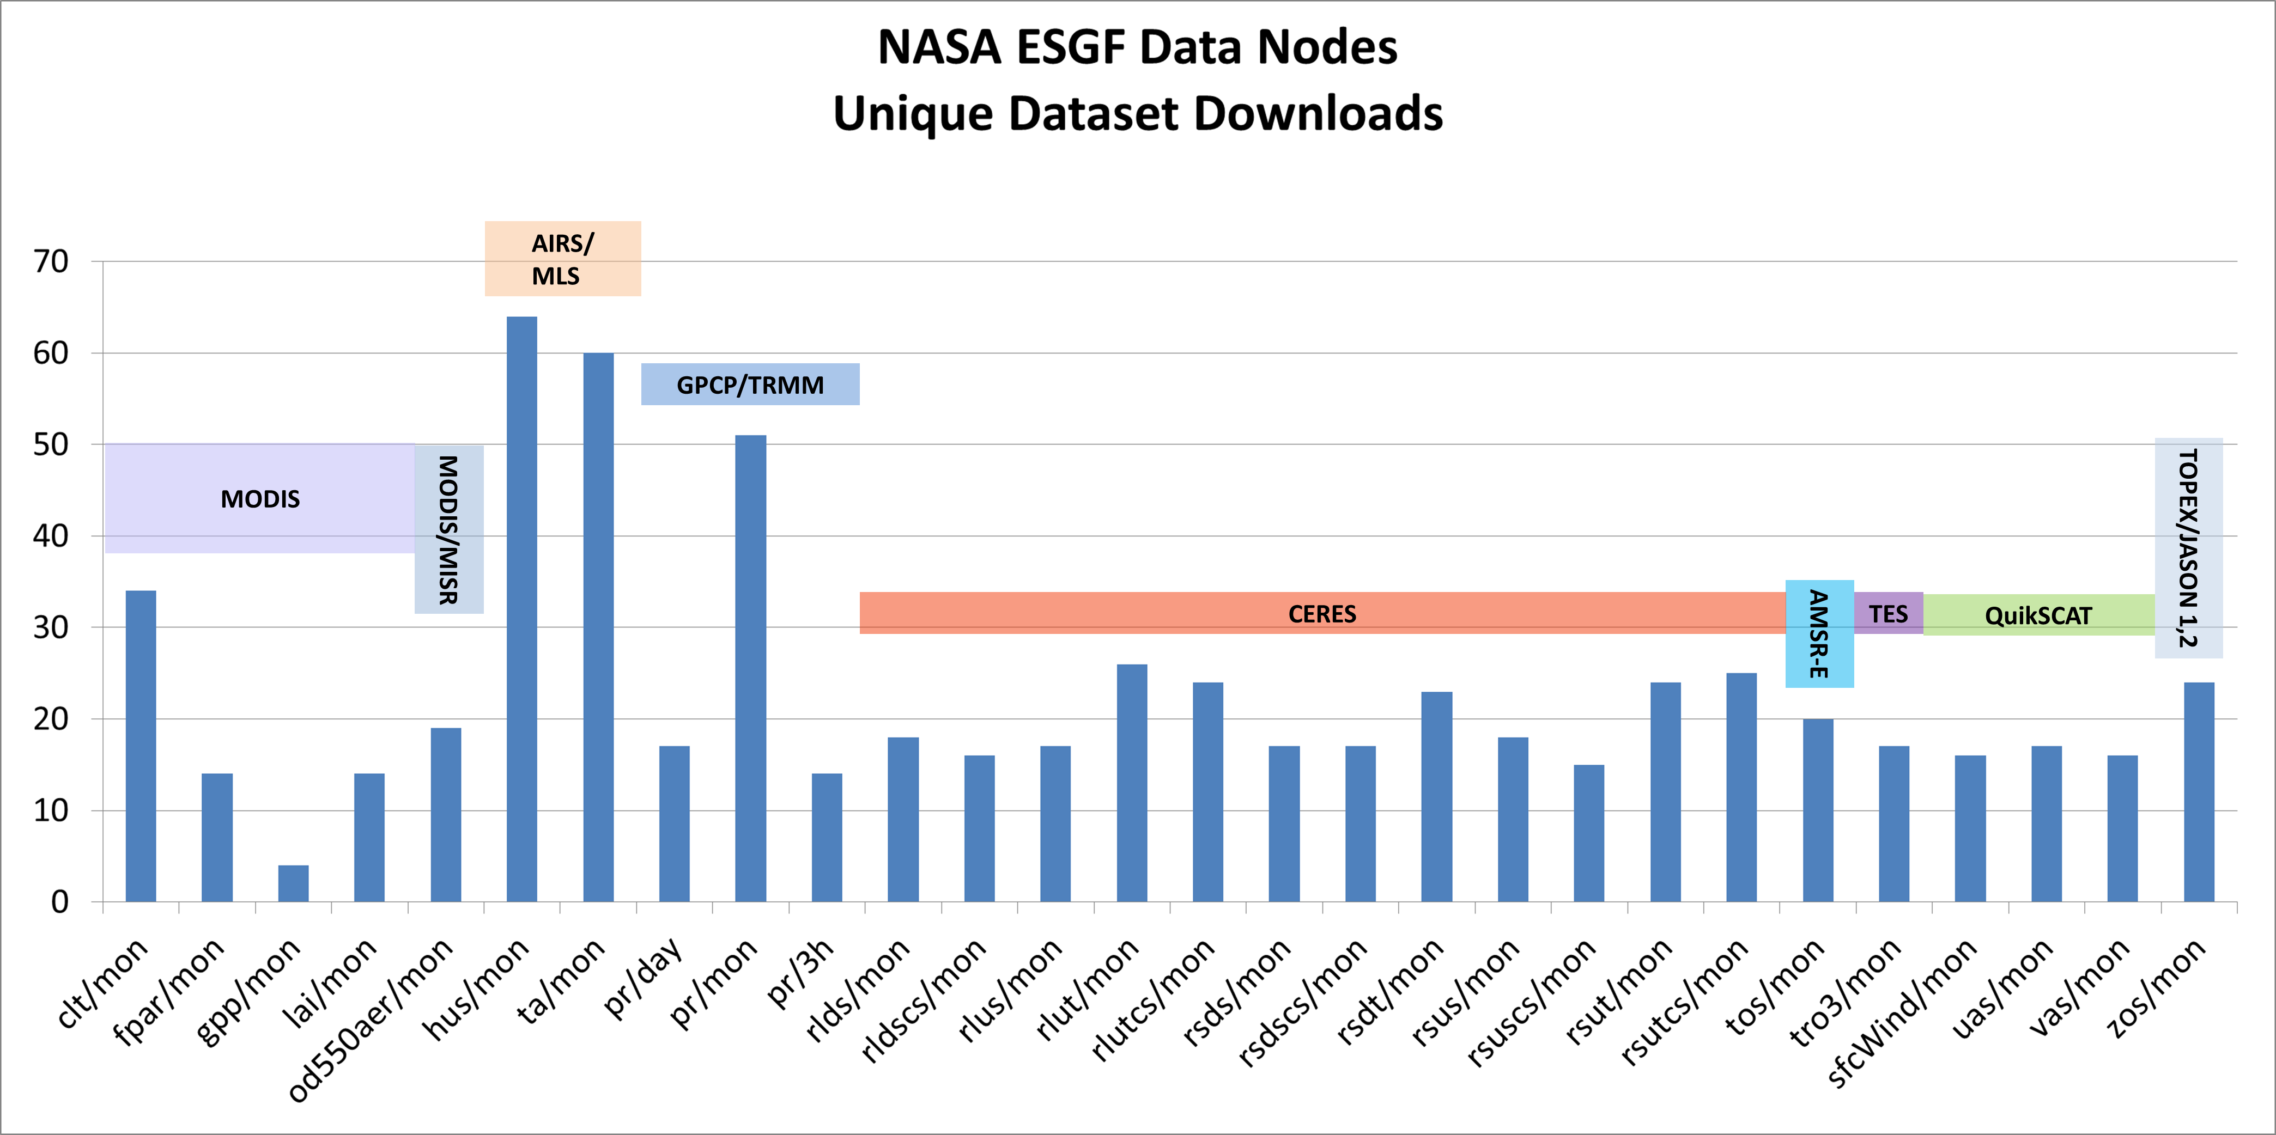
Requirements
Monitoring usage
The diverse collection of data providers needs access statistics to confirm the usefulness of the effort
These need to be easy to generate on relatively short notice

Slide 12
Possibilities
Requests for greatly expanding obs4MIPs coming from many directions
Disparate metadata standards across different classes of observational
It might seem reversed, but it appears possible to bring together many observational communities with the developed MIP data structures

Slide 13
Summary
Commitments to contribute new datasets: NASA, NOAA, ESA, EUMETSAT
Available through CoG-ESGF; peer-projects ana4MIPs, CMIP
WCRP/WDAC encouragement for activity to extend beyond satellite data
CMOR3 will accommodate observational data, including an “EZ” package to make the process much easier
Other requirements include: Making data publishing more efficient, automated monitoring of data access, finessing CoG options
Work for WDAC task team: need to clearly define metadata for different classes of data (e.g., in-situ); keeping it aligned CMIP

