Slide 1
Provenance Research
Bibi Raju, Todd Elsethagen, Eric Stephan
Pacific Northwest National Laboratory, Richland, WA

Slide 2
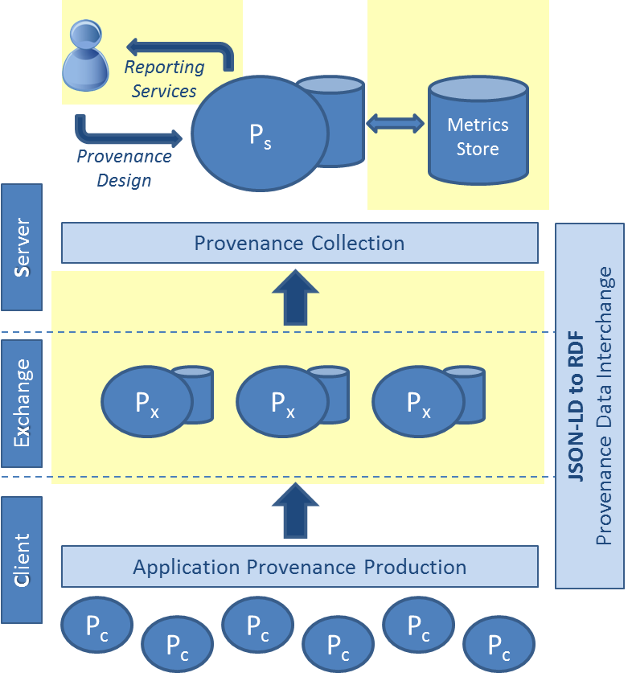

Provenance Goals
Provenance Overarching Goals
Provide thorough results explanation
Reuse, repeat, or reproduce workflows
Enable performance optimization
Provenance Work in FY15
Developed a provenance capture ontology
Provenance infrastructure build out
Scalable provenance capture mechanism
Developed a Client API that aids in production of provenance
Notes:
Provenance working team focuses on
Development of provenance solutions in support of reproducibility and performance investigations.
Development of a provenance format that can capture sufficient information to enable scientists to reproduce their previous calculations correctly
Extending the provenance format so that it can also capture and link to performance information for specific workflows and model runs to enable in-depth performance analysis
Developing a provenance capture mechanism that can handle the high-velocity provenance information
Implemented an initial version of the OPM-WFPP, a provenance store, and a provenance capture mechanism
Provenance Environment (ProvEn) – A provenance production and collection framework.
Provides services and libraries to collect provenance produced in a distributed environment
ProvEn Client API aids in the production of provenance from client applications
The following types of provenance are collected:
Time series-based information from a system/host perspective
Performance metrics tracking from an application/workflow perspective

Slide 3
Provenance for Reproducibility and Performance Provenance
Provenance for Reproducibility
Work towards achieving numerical, experimental and execution reproducibility.
Performance Provenance
Augment/replace existing strategies with the Open Provenance Model-based WorkFlow Performance Provenance (OPM-WFPP):
Capture empirical performance information from workflows and systems
Links provenance information and performance metrics
Input
Workflow
WFM
WFM
WFM
Input
Appl.
Output
Appl.
Output
Access Protocol
Access Protocol
Protocol
OS
Protocol
OS
Protocol
System Software
Storage
Network
Core
Inter
connect
Core
Network
Storage
Systems
Notes:
Reproducibility
‘the ability of an entire experiment or study to be reproduced, either by the researcher or by someone else working independently. It is one of the main principles of the scientific method and relies on ceteris paribus (other things being equal)’
Types of Reproducibility
Numerical reproducibility i.e. has the algorithm been numerically designed to create the same results if replicated,
Experiment Reproducibility i.e. do we have all the information about the simulation to repeat it and
Execution Reproducibility i.e. can we recreate the execution environment, execution conditions (including system events) and system architectures.
Enable the structured analysis of workflow performance characteristics and variability
Existing Workflow provenance data models
Focus exclusively on the workflow graph
Do not describe the workflow components or their performance-determining properties in sufficient detail
Do not include system or system software level information
OPM –WFPP: Comprehensive workflow performance data model
Developed a provenance capture ontology and system that enables the capture of provenance from the high-level workflow through all relevant system levels in one integrated environment.
Treats workflows as an evolving process
Provenance is represented as a time series of potentially correlated events
The model enables the formation of causal relationships throughout the software and hardware stack
Workflows and their tasks described in detail in the context of their Execution Environment
Detailed time series-based events describing the evolution of workflow and execution environment for system/host behavior in a distributed environment.

Slide 4
Status
Roadmap for FY16
Incorporate time-series system environment metrics store (In Progress)
Add provenance capture mechanism that can handle the high-velocity provenance information – scalability (In Progress)
Develop different language bindings for ProvEn Client API
Design services supporting the harvesting of provenance from native source types
Performance metrics reporting user interface

Slide 5
ACME – IPPD – Panorama Collaboration
Joint route forward, where the Panorama Pegasus workflow is used to implement an ACME workflow and capture provenance.
ACME workflow with ASCR Integrated end-to-end Performance Prediction and Diagnosis for Extreme Scientific Workflows (IPPD) provenance model adapted for ACME
IPPD developed provenance store instance for ACME.
Notes:
Panorama: Predictive Modeling and Diagnostic Monitoring of Extreme Science Workflow – Deelman, et.al. (USC/ISI)
Describe joined work ACME workflow with IPPD provenance model adapted for ACME and IPPD developed provenance store instance for ACME. ACME specific provenance analysis.

Slide 6
Thank You! bibi.raju@pnnl.gov

