Slide 1
Globus and ESGF
Rachana Ananthakrishnan
University of Chicago
ranantha@uchicago.edu
Notes:
ESGF F2F December 2015

Slide 2


Reliable, secure, high-performance file transfer and synchronization
“Fire-and-forget” transfers
Automatic fault recovery
Seamless security integration
Powerful GUI and APIs
2
Globus
moves and replicates files
Data
Source
Data
Destination
1
User initiates transfer request
3
Globus
notifies user

Slide 3
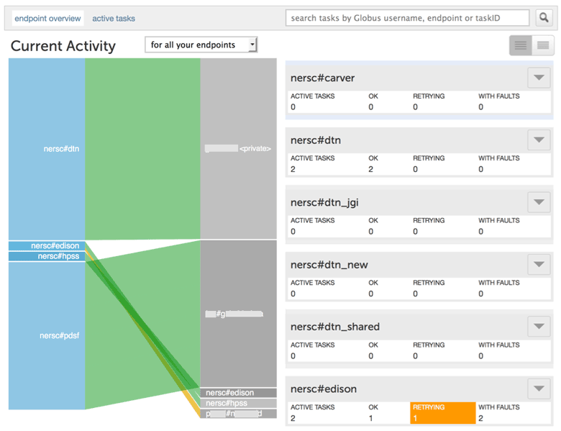
Recent Transfer Features
Network manager plug-in
Management console
Task monitoring, cancellation, pause/resume
Network use controls
Various Storage systems:
HPSS, Amazon S3, OpenStack Ceph*, SpectraLogic BlackPearl*

Slide 4

Simple, secure sharing off existing storage systems
Easily share large data with any user or group
No cloud storage required
2
Globus tracks shared files; no need to move files to cloud storage!
Data
Source
1
User A selects file(s) to share, selects user or group, and sets permissions
3
User B logs in to Globus and accesses shared file

Slide 5
Manage shared endpoint access
Administrators configure:
Sharing as an option
Parts of file system to share from
Users who can create share
Permissions on share (e.g read-only)
User configure per folder
Share to user, group or all
Invite via email
Level of access: read-only or read/write

Slide 6
COG use of Globus Sharing
NASA JPL has a Globus endpoint on their ESGF data node
Shared endpoint off folder with public data
Set permission for public access
COG redirects users to Globus webapp for destination with shared endpoint as source

Slide 7









Globus Platform-as-a-Service
Globus APIs
…
Globus Connect
Sharing Service
Transfer Service
Identity, Group, Profile Management Services
Globus Toolkit

Slide 8
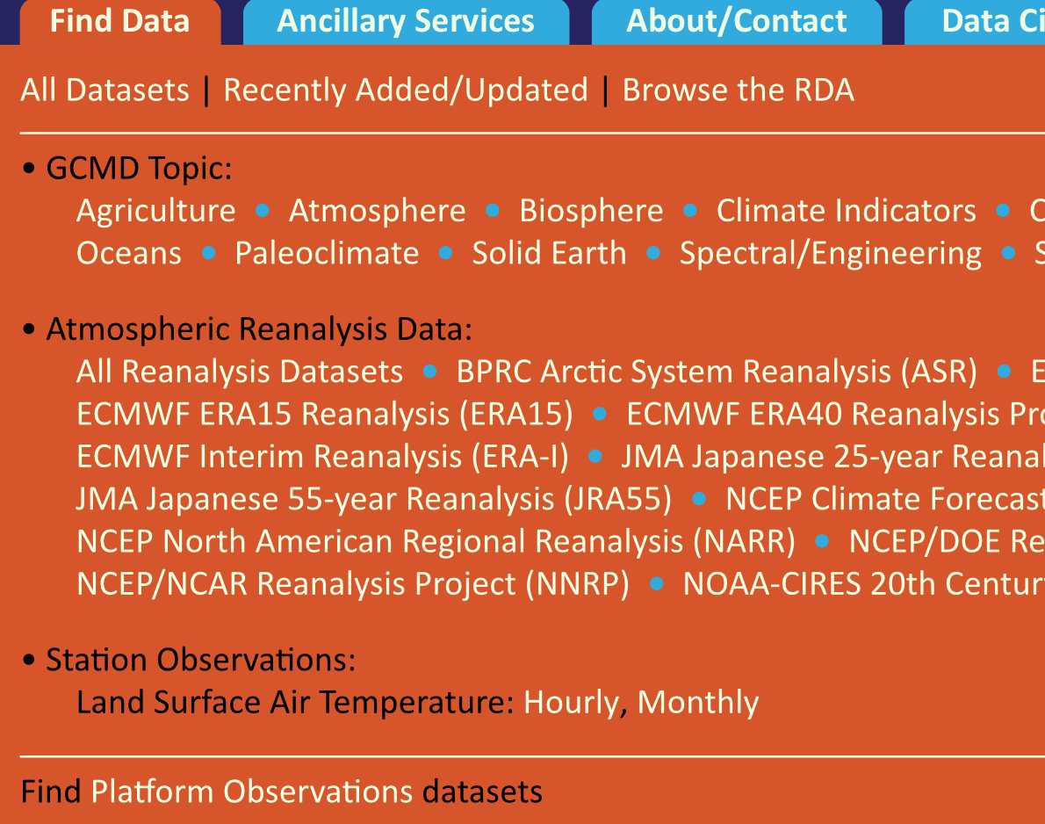

NCAR RDA
Integrate Globus for data distribution
Shared endpoint with subfolder per request
Single sign on via streamlined account provisioning

Slide 9

Curated publication of data, with relevant metadata for discovery
Identify
Describe
Curate
Verify
Access
Preserve
Published
Data
Store
Metadata
2
Curator reviews and approves; data set published on campus or other storage
1
Researcher assembles data set; describes it using metadata (Dublin core and domain-specific)
3
Peers, public search and discover data sets; transfer using Globus

Slide 10
Upcoming Globus Features
HTTP/S access to files
Globus sharing option for anonymous access
Streamlined account provisioning
No need for Globus username/password
Support for OIDC and OAuth 2.0

Slide 11
ESGF use of Globus
User data download
Integration with COG for restricted data
Requires all data to be published with GridFTP URLs
OAuth 2.0 for credential delegation
Replication
Globus Transfer as an option in Synda
Performance tuning
Installation of Transfer node for DTNs
Publication
Ingestion service as part of installer
COG front end to service

Slide 12
Opportunities to leverage Globus
ESGF IdP as alternate IdP
Seamlessly use Globus features
Facilitate federated IdP use in ESGF
Globus support ~157 federated identities
Use HPSS endpoints for data access
Notes:
Work done by team at LANL; code added to GridFTP server by Globus team
Enable GridFTP to provide information for dynamically facilitating network changes
Information passed via callbacks during GridFTP server execution on local DTNs
Supplements transfer information available via the Globus API

Slide 13
Thank You

Slide 14
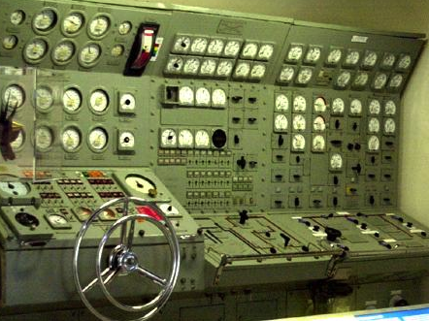
Globus Subscriptions
Provider
Host shared endpoints
Management console
Data publication
Amazon S3 endpoints
Usage reports
Priority support
Branded Web Site
Alternate Identity Provider (InCommon is standard)
Mass Storage System optimization
globus.org/provider-plans

