Slide 1
DKRZ
Data center requirements and services

Slide 2
Overview
Update: the new data infrastructure hosting environment at DKRZ
ESGF: DKRZ data life cycle services
LTA / WDCC – ESGF integration
Quality assurance
Data near processing
Towards PID based services
CMIP6 at DKRZ

Slide 3
DKRZ data center update
Migration to new integrated HPC / data system
separate DTNs (starting 2016)
establishment of a „national MIP data analysis cache“
data cloud to support data ingest process
until end 2015
from 2016
from mid 2015
(pre-shutdown) ESGF infrastructure
HH: 2x10 GB
DFN: 2x3..5 GB
4 data nodes
Openstack
cloud
GPFS
all: behind firewall
Index node
Mistral
No separate DTNs
2 DTNs
LUSTRE
2 data nodes
1 CERA/ESGF data node
ro
NFS
VMs
(XEN)
HPC +
Interactive nodes + visualization nodes
CERA / ESGF portal
CERA LTA infrastructure
LTA data node
CERA portal
LTA (Oracle)
Oracle DB cluster
HPSS
„national MIP data cache“
management etc. tbd

Slide 4
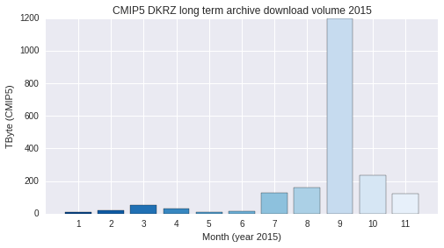
DKRZ long term archival and data citation
Mayor use case
Replication
Support data evaluation
Quality Assurance
Long Term Archival
DOI assignment
Exposure as ESGF data node
ESGF shutdown
CERA Portal / DDC..
WPS
ESGF
Data node
COG portal
Data near
processing
replication
versioning
ESGF
National climate data node (MIP cache )
QA
DOI
Process
CERA
(Oracle)
container
server
ingest
LTA
(HPSS)
container
cache

Slide 5
WDCC / CERA / HPSS ←→ ESGF integration
Operational for CMIP5
CERA metadata (Oracle) → ESGF index
Thredds server with ESGF security filter + HPSS data container server → ESGF data node
Improved system for CMIP6:
FUSE based mounting of DKRZ HPSS/cache legacy system
Extraction of CERA metadata for ESGF mapfile
„standard“„standard“ ESGF publication in an „offline mode“
LTA ESGF Datanode
Postgres/ THREDDS
ESGF Indexnode
Mapfile generation
ESGF Publisher
ESGF Solr index
COG
portal
FUSE
CERA
(Oracle)
container
server
Future COG portal visibility of (non CMIP)
WDCC LTA project data
LTA
(HPSS)
container
cache

Slide 6
(CMIP data) Quality Assurance Software
Completely re-structured and modularized:
Flexible configuration
Used heavily for CORDEX – will support CMIP6
Separate cf-checker module
NetCDF File
main
File
NC-API
Annotations
M-D Store
CF Conv.
Checks
Consistency between sub-temporal files
CF Conventions Tables
User-modified Directives
CF Conventions Check
Versions: 1.4 - 1.6
8-9 Chapters of rules
table based config (area-type, cf-standard-name, stand-region-name, ..)
QA
DRS CV
Project
Rules
Data
Variable Requirements (CMOR)
Time
Project Configuration & Tables
Source code: https://github.com/h-dh/QA-DKRZ
Pre-packaged versions: conda based, docker based
Documentation: http://qa-dkrz.readthedocs.org/en/latest/qa-user-manual.html

Slide 7
National MIP data analysis cache / node
„Ad hoc“ approach → transparent solution:
Data needed → help desk → data manager
RO mounted on HPC data analysis nodes
Support for data analysis VM deployment
Support for tool dependency management (install recipes, conda, docker)
WPS framework to support web service deployments
Birdhouse (https://github.com/bird-house )
conda/docker support
Support for home institution (test-) deployments
WPS
Data near
processing
replication
versioning
ESGF
National climate data node (MIP cache )
ingest

Slide 8
Stable file/collection management !?
WPS
ESGF
Data node
COG portal
CERA Portal / ..
Data near
processing
replication
versioning
ESGF
National climate data node (MIP cache )
QA
DOI
Process
CERA
(Oracle)
container
server
ingest
LTA
(HPSS)
container
cache
08.12.2015
8

Slide 9
Towards PID based services
Motivation: Stable ESGF data space based on PID infrastructure
Collaborations:
ePIC: DKRZ partner → prefix registration
EUDAT: DKRZ leads PID task → API
RDA: DKRZ co-chairs PIT and collections WGs
Envri+: PIDs in environmental sciences
Next ESGF steps:
Test-Environment (PID system + publisher)
Scalable, stable PID assigment:
CMOR integration, CDNOT involvement
PID API / ESGF publisher integration
High available message queuing system integration

Slide 10
Summary
Long term archival use case
ESGF integration
Quality Assurance
PID assigment early in data life cycle
early citation and DOI assignment
future PID based data management services
future PID based end user services
future PID based provenance support

Slide 11
..
Thank You

Slide 12
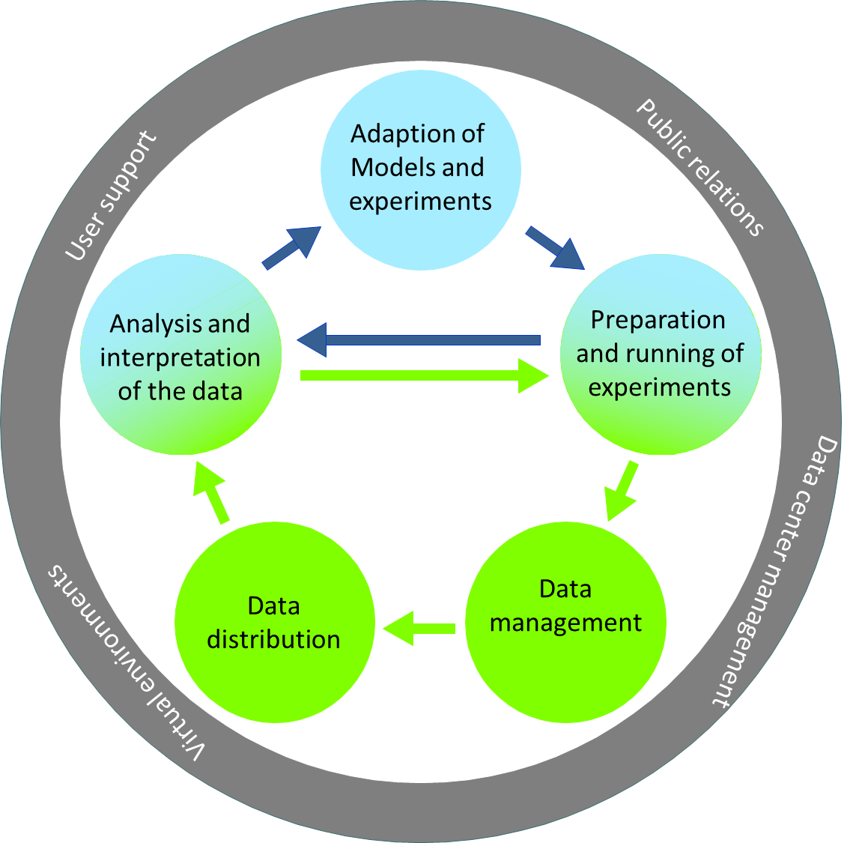
DKRZ services
New developments
New integrated HPC/Data System installed in 2015, ~ 50 PByte Lustre
Storage cloud (openstack)
Community data analysis
cache and platform
ESGF:
WDCC/HPSS/ESGF data node
WPS compute platform birdhouse
Towards PID / early citation services
data ingest

Slide 13
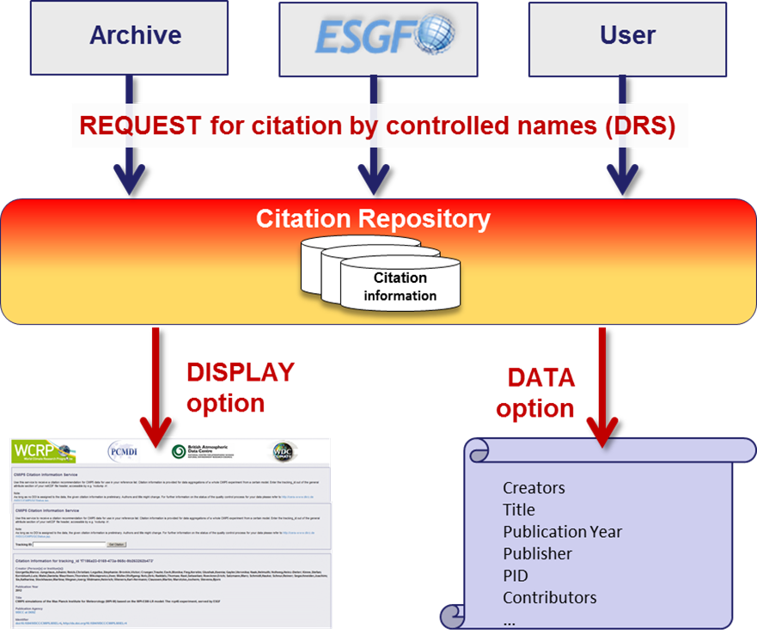
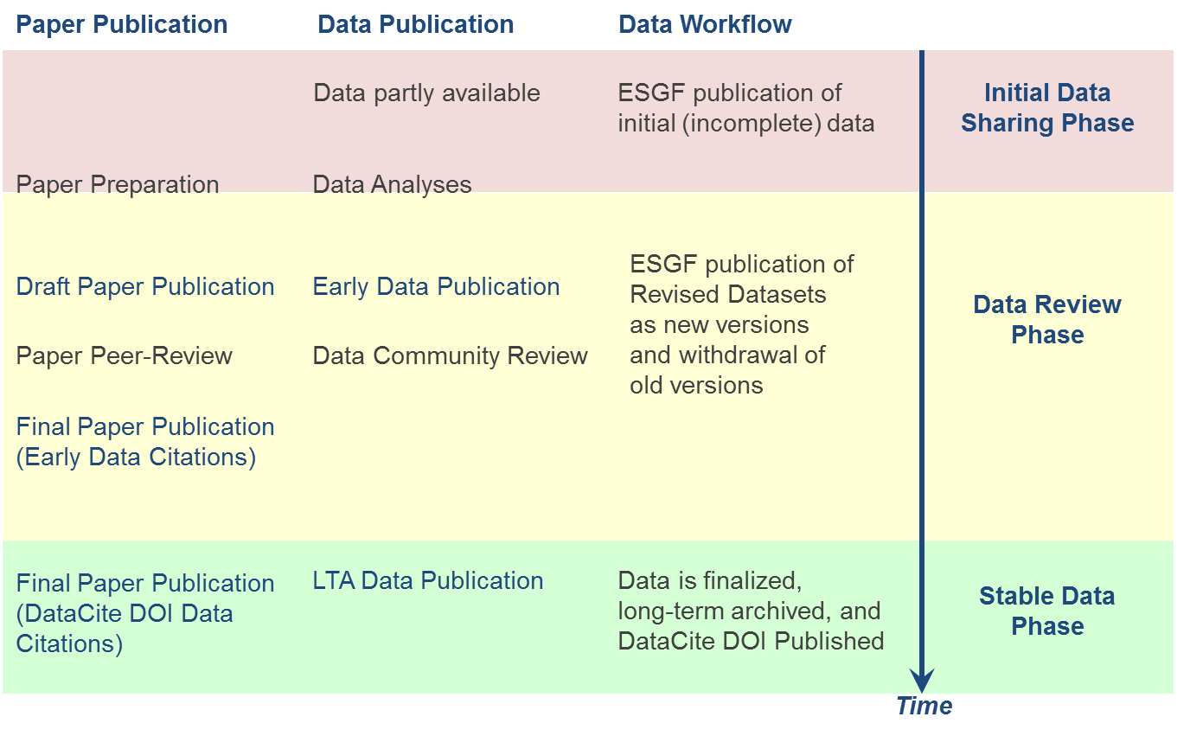
(Early) Data Citation (DM + ESGF)
Impact on CMIP6 data management (DM) and ESGF governance (ESGF)
Request from modelling groups for a data citation reference just after ESGF data publication
CMIP6 data publication workflow:
CMIP6 citation granularities are collection levels:
Simulation
Model
08.12.2015
13

