Slide 1
ESGF PID Services for CMIP6
ESGF F2F conference, Dec 2015
Monterey, CA

Slide 2
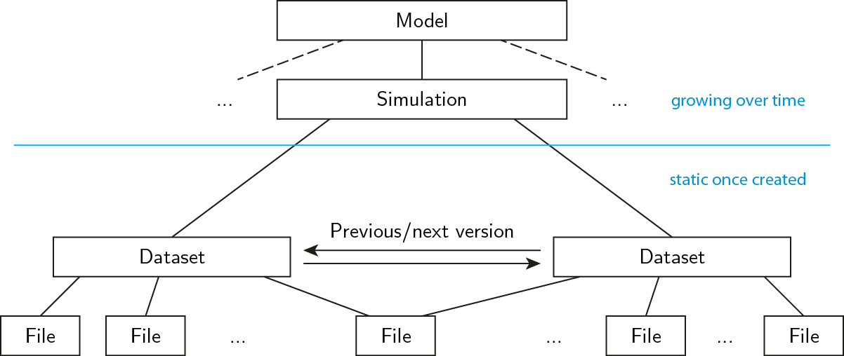
What is this all about?
21.14100/<UUID>
IDENTIFIER
Object
Properties
URL
creation_date
tracking_ID
checksum
checksum_method
parent
DRS_ID
...

Slide 3
Properties stored in Handle records
Files | Datasets
URL | URL
creation_date | replaced_by
tracking_ID | preceded_by
checksum | aggregation_level
checksum_method | Tombstone flag
parent | children
DRS_ID | DRS_ID
+ Errata information

Slide 4
Implementation plan
Agreements – as per WIP white paper (Weigel, Lautenschlager, Juckes)
All CMIP6 files bear Handle-compatible tracking_IDs
Additional Handles for aggregation levels
New component – designed to be not a blocker
Technical components
Modifications to CMOR
RabbitMQ-based deployment
Additional tools and web services

Slide 5


Operative deployment
ESGF nodes,
publisher with local PID library
Central Rabbit exchange
Queue Consumer services
Handle Server
Highly Available,
not located at one of the nodes
solr

Slide 6
Consumer library
Python library, used by the publisher
Interface agreements
Some checks/decisions can be done locally
Actions are devised and sent to the Rabbit queue
If queue is unreachable, the process will not be blocked
Mechanism to dump actions to local queue file
First version ready by end of December
Notes:
Checks tbd by the library:
for republication/replication: check against central Handle-Solr server (not ESGF solr)

Slide 7
Rabbit queue
Specific details on queue implementation still depend on High Availability deployment
n Nodes talk to 1 Rabbit exchange with 1 consumer service
Queue is one way only – no feedback
Performance trade-off
Message consumption may take time; publisher may be already finished when feedback is sent

Slide 8
Queue consumer and Handle server
Consumer talks directly to Handle server through its native Java interface
Increase performance – avoid network communication
If consumer is broken, messages will not be lost, but will be held at the central exchange
Notes:
Consumer will notice if files are illegitimately replicated on same node; since we do not want to have a back channel (consumer -> library), this will not stop the publication, but rather only end up as a warning in a log or similar.

Slide 9
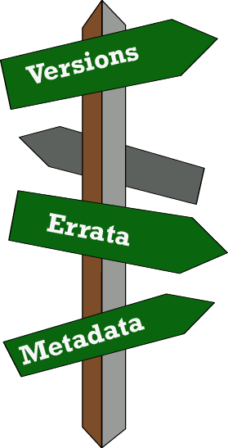
Direct end-user value: Checking tool
Check file(s) for new versions – in user‘s workspace (command line tool)
Report on metadata
Have metadata or data changed?
If available: Reported errata
Possible direct download of new file(s)

Slide 10
Thank you for your attention
weigel@dkrz.de
buurman@dkrz.de
berger@dkrz.de

