Slide 1
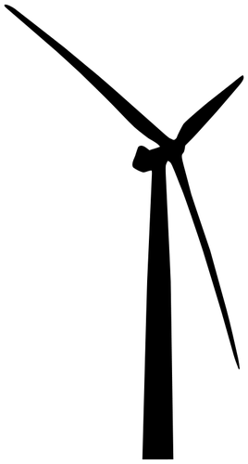


Project
Spine and Mopo
Spine
Mopo
Wind turbine
Unit
Wind turbine
Nuclear power plant
Nuclear power plant
https://publicdomainvectors.org/

Slide 2
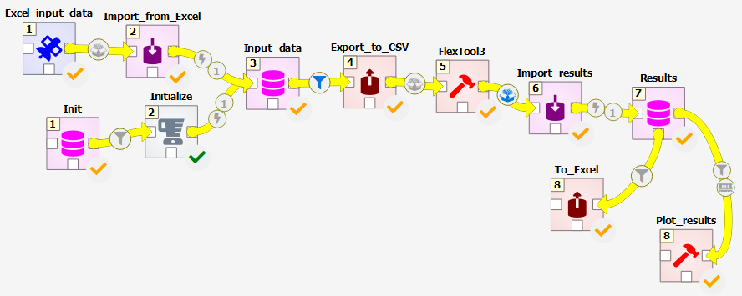
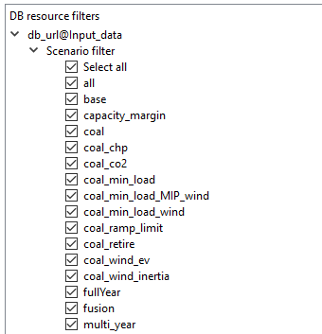
Spine Toolbox
Manage workflows: from inputs to outputs
Manage scenarios: define in data, execute in parallel

Slide 3
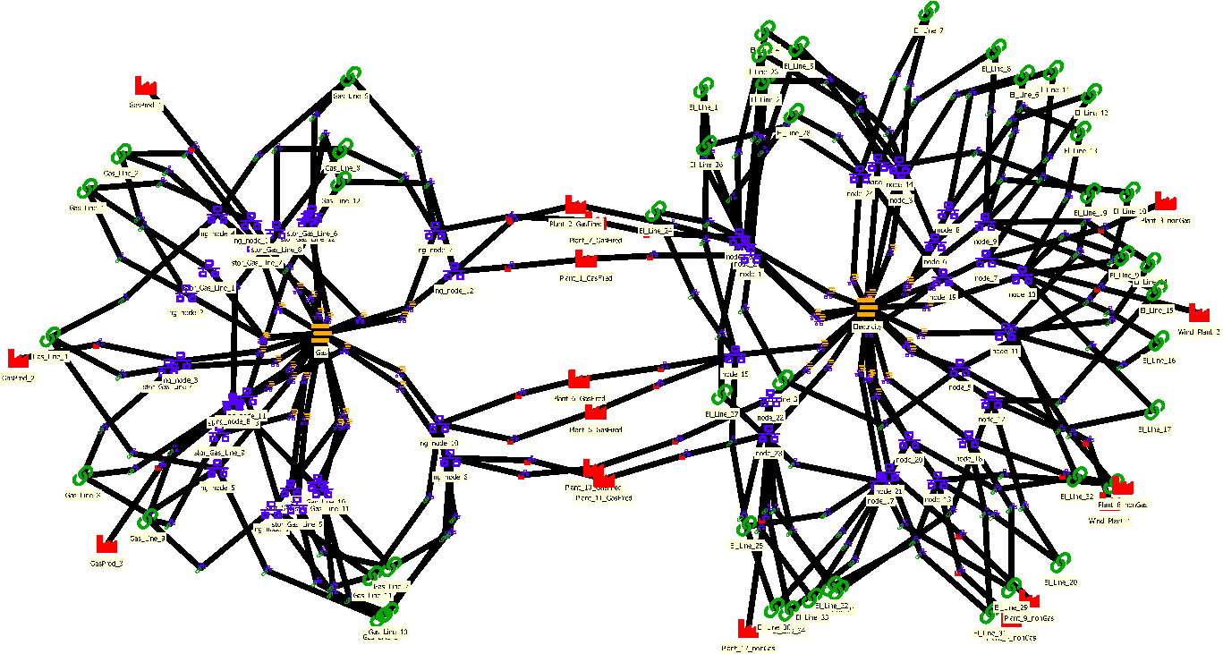
SpineOpt
Flexible temporal and
spatial structures
Gas network:
6-hour resolution
Pressure driven gas flows
Electricity network:
30 minute resolution
DC power flow
Gas-fired
power plants
Allows different resolutions across the model
Time resolution can vary over time (e.g. lower resolution further in the time horizon)
Stochastics only where you need them (e.g. power system)

Slide 4
Partners
VTT, Finland
DTU, Denmark
TNO, Netherlands
KU Leuven, Belgium
KTH, Sweden
UCD, Ireland
eScience, Netherlands
VITO, Belgium
Energy Reform, Ireland
EPRI, Ireland
PBL, Netherlands
Fluxys, Belgium
Fortum, Finland
ICONS, Italy

