Slide 1
Spine Tools - workshop
Tars Verschelde, KU Leuven
@ ESI-far, Amsterdam, 2024-01-31
Views and opinions expressed are however those of the author(s) only and do not necessarily reflect those of the European Union or CINEA. Neither the European Union nor the granting authority can be held responsible for them.

Slide 2
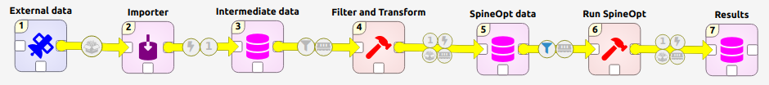

Slide 4
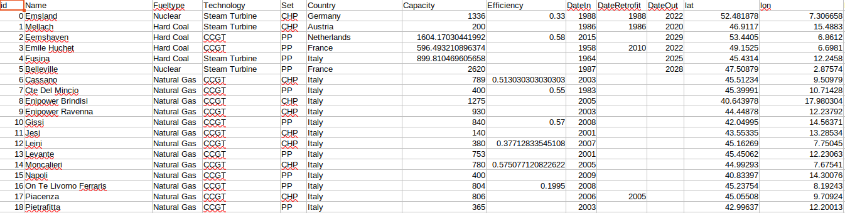
PyPSA -> Powerplants.csv

Slide 6
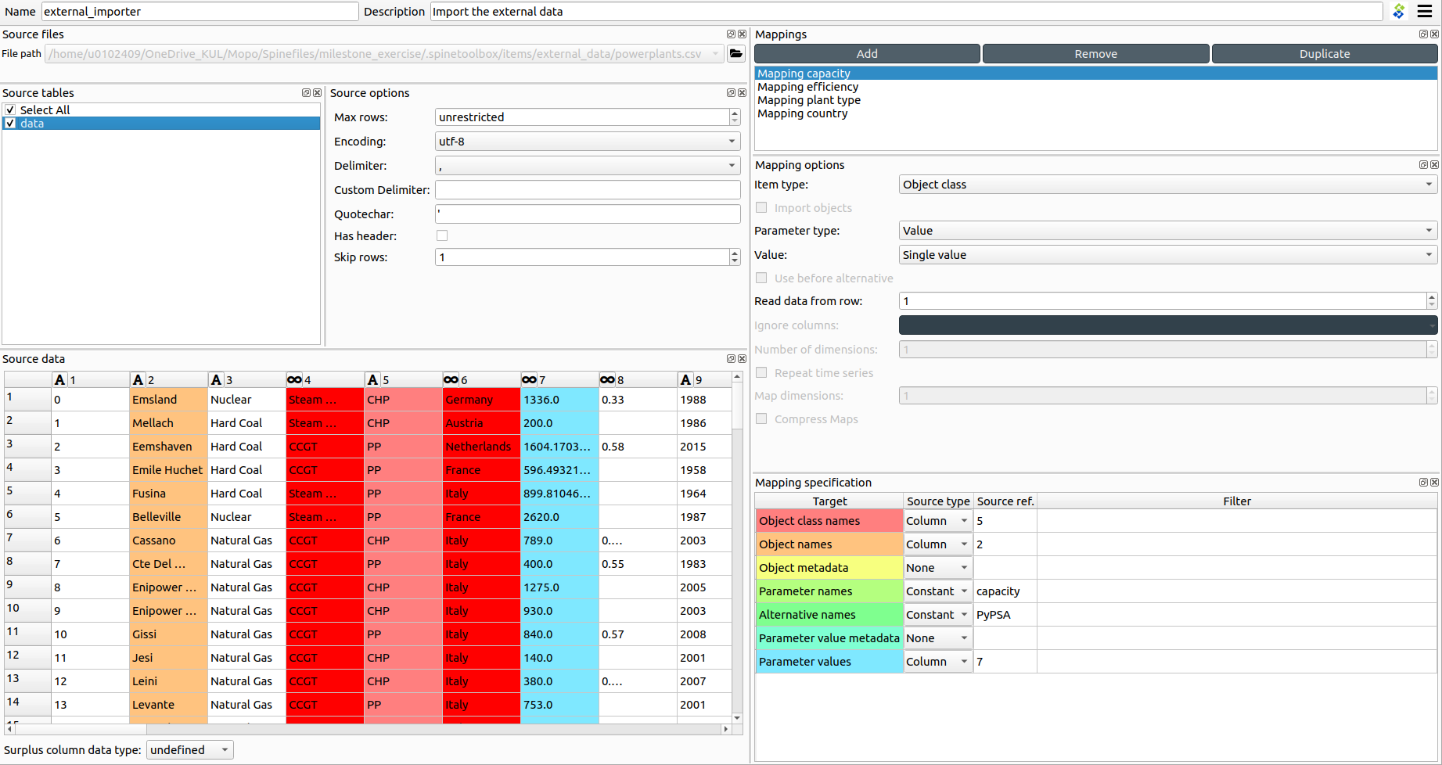

Slide 9
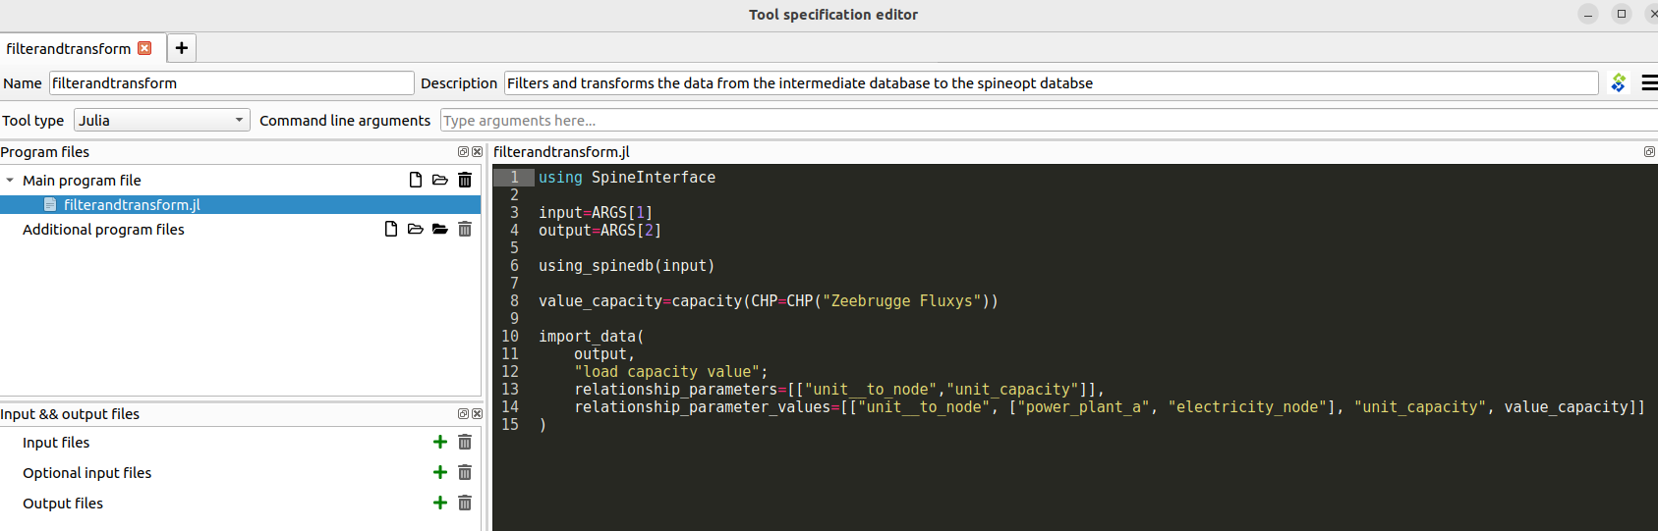

Slide 11
