Slide 1
ESIP Lab prov challenge
Tom Narock and Doug Fils

Slide 2
Project Scope
Project looked at provenance challenges from both the user and the creators perspective
We created a prototype system for
-- sharing data generation provenance
-- receiving usage provenance from community
-- looking at generic cross-organization visualization
The goal of this project is not to create a production ready end-to-end system.
Rather, we aim to identify impedance points.
An impedance point is any point along the data lifecycle in which provenance generation/capture is ambiguous due to lack of standards and/or loosely defined specifications.

Slide 3
PROV-AQ
The W3C Provenance Access and Query (PROV-AQ) Working Group is developing specifications to define how to locate, retrieve, and query provenance records.
The component that we are interested in here is the "ping-back" mechanism
The “ping-back” mechanism can be used to register related provenance information that the data creator does not otherwise know about; e.g. provenance describing how it is used after it has been created.
A “ping-back” feature extends the capabilities of PROV by addressing questions such as:
What new resources are based on this resource?
What has this resource been used for?
Who has used it?
What other resources are derived from the same sources as this resource?
Recommendation 1: PROV-AQ provides a standard for capturing downstream provenance

Slide 4
Data Providers Perspective
Advertising a PROV-AQ service
Considerations for generating provenance records
Receiving provenance records via pingback

Slide 5
Advertising a PROV-AQ service
PROV-AQ is based on Linked Data and Semantic Web principles.
Earth Science data systems are not there yet
We don’t have URIs for all our datasets
The “typical” geoscientist shouldn’t be bothered to learn them anyway
Recommendation 2: Adopt an advertising convention based on recognizable identifiers such as DOIs
In our summary document we have details for using
Dataset landing pages to advertise PROV-AQ services
JSON-LD to include PROV-AQ service details in a machine understandable format
Using REST with a DOI to send downstream provenance info back to a data provider

Slide 6
Considerations for Generating Provenance Records
Provenance can exist in many encodings. The W3C PROV Data Model (PROV-DM) provides the generic structure of provenance and offers multiple encodings for this structure such as XML, XML-RDF, and Turtle.
Recommendation 3: We recommend the Earth science community adhere to semantic documents even if underlying systems are not fully Linked Data compliant. We also recommend data providers supporting PROV-AQ adhere to:
Providing a PROV-O description of how each of their datasets were generated.
Using rdfs:label throughout their PROV documents. The W3C Provenance Data Model (PROV-DM) stipulates that each provenance item have a label. PROV-O suggests that rdfs:label be used to implement such a label; however, the use of rdfs:label is not required. We suggest that it should be required.
Every provenance document returned from a PROV-AQ system should utilize the notion of prov:Bundle. In PROV-O terminology, a Bundle is a collection of related provenance statements, the grouping of which may have provenance itself. PROV-AQ systems should return all provenance as a prov:Bundle providing return date, time, and associated service information as provenance of the bundle.

Slide 7
Considerations for Generating Provenance Records
We are aware of at least four “dialects” of provenance within the Earth sciences: PROV-M, PROV-ONE, OGC, and PROV-ES.
Recommendation 4.
All provenance documents within the Earth science ping-back environment should adhere to one of these dialects. In other words,
All attempts should be made to conform to existing dialects of PROV-O.
Any new implementations should first be vetted via open forum - potentially via ESIP.
Don’t just use PROV-O base concepts of Entity and Activity.
For example, use
:dataset a prov:Entity, eos:product; rdfs:label "Some dataset from USGS"^^xsd:string;
Instead of
:dataset a prov:Entity; rdfs:label "Some dataset from USGS"^^xsd:string;
Where eos:product refers to the Product concept in PROV-ES, which is a subclass of prov:Entity
We believe the W3C Shapes Constraint Language (SHACL) can be used to detect which dialect is being used (and validate its conformity), although we have not tested this yet.

Slide 8
Receiving Provenance via Ping-Back
The PROV-AQ spec stipulates that provenance should be sent (ping-backed) as URIs.
In other words, one does not send the entire provenance record. Instead, one simply sends a URI, which at a future point can be dereferenced to retrieve the full provenance description.
Submitting only a URI requires that the full provenance document be stored online indefinitely awaiting deference.
Infeasible for individual researchers who create derivative datasets,
Recommendation 5.
The Earth science community commits to building and maintaining a provenance service that can host provenance long term and provide users with URIs.
PROV-AQ stipulates that a service is not required to do anything with the URIs it receives. Further, the spec does not indicate in which form a PROV-AQ system should return provenance.
Recommendation 6.
When queried for a dataset a PROV-AQ service should
Return the provenance of how the dataset was created along with each URI it received via pingback. The URIs should be enclosed within a prov:Collection. (examples in the final report)

Slide 9
User’s Perspective
Easy to use tools for exploring provenance
Incentivizing provenance generation and scope

Slide 10
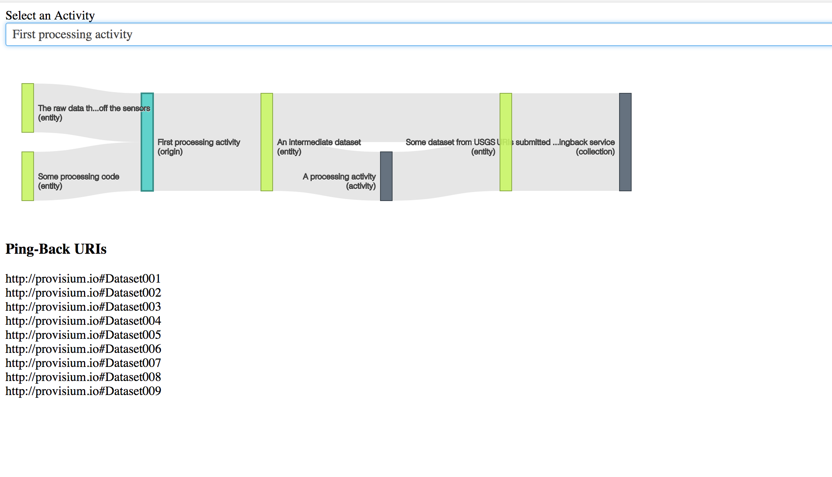
Easy to use tools
End-users need easy to use tools
Cross-organization tools are difficult to build currently given ambiguity
We’ve built a prototype viz tool using PROV-O-VIZ (http://provoviz.org/)

Slide 11
Incentivizing provenance and scope
It’s obvious why data providers would adopt PROV-AQ
It’s not clear what would incentivize people to send ping-backs
In addition, what does it mean to be a “new resource based on this resource”?
Posters?, data analysis?, etc.?
Maybe a good place to start is limiting ping-backs to
Notifying a data provider regarding the creation of a new derivative dataset that is publicly available to the community
Notifying a data provider regarding errors and usage issues in a dataset
Is this an annotation? Does it matter?

Slide 12
Final Thoughts
We needed to create additional PROV subclasses for our work
These don’t currently have a home - we’re thinking PROV-ES
ESIP is currently managing SWEET ontology. Has an ontology portal. Would be a good place for community prov development.
GitHub repo: https://github.com/esipfed/provisium
Full report, visualization and prov-aq code, example provenance

