Slide 1
Data to decisions Provenance
Technical components

Slide 2
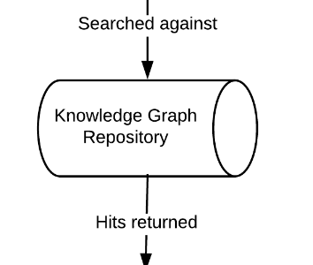
Knowledge graph repository
We need a Knowledge Graph Repository capable of
Accepting new decision provenance documents
Storing those documents indefinitely
Searching/comparing those documents
Here, we’ll look at the technical details of this
How we might encode decision provenance
How a repository might operate
Connections to existing ESIP projects

Slide 3
Encoding decision prov
There have been several attempts to model decisions in PROV
Decision-Making Ontology (DMO) (Kornyshova and Deneckère 2010)
Decision Ontology (Nowara 2012)
DecPROV (Car 2017)
There are pros and cons to each
DMO is UML-based and not represented in OWL (although USGS may be working on this)
Even when DMO is encoded in OWL there is no mapping to PROV
Decision Ontology adds extra non-PROV classes and properties
DecPROV is entirely in PROV (subclasses)
Tools that understand PROV will understand DecPROV

Slide 4
Balancing act
We wanted to balance the level of detail with how much effort it is to encode the information
DMO captures lots of detail and encodes decision theory
But, this requires significant effort to populate the ontology
On the other hand, DecPROV enables discovery and comparison, but additional info available via human readable links

Slide 5
Extending decPROv
DMO was out of scope for us with no existing OWL encoding
We looked at 2 types of use cases to identify commonalities not in DecPROV
Crystal Power’s CRT scenario
Environmental Impact Statements and Record of Decision documents
Decision components missing from DecPROV
Methodology
Stakeholders (more subclasses of prov:Agent specific to our domain)
Impact Factors – what/who are impacted by the decision, e.g. cow/calf, feedlot cattle
Driving forces, variables, and uncertainty – e.g. temperature change, precipitation change, growing season length
Data Parameters (datasets being used)
Background Materials
Outcome – e.g. analytical tool, action plan
Validation – did vetting and validation occur?
Application – has the decision been applied? If so, where?

Slide 6
Agent
PROV Class
CoreTeam
Funder
DecPROV
Class
Advisor
Decision
Implementor
Our Proposed Subclass
Subclass

Slide 7
Entity
PROV Class
Question
Answer
DecPROV
Class
Geoscience Decision
Analytical Tool
Action Plan
Our Proposed Subclass
Climate Action Decision
Subclass

Slide 8
Decision Making
Activity
Option Selection
PROV Class
DecPROV
Class
Methodology
Driving Forces
Our Proposed Subclass
Impact Factors
Data Parameters
Subclass
Background Materials
Validation and Vetting

Slide 9
Activity
PROV Class
Decision Application
prov:used
DecPROV
Class
Entity
Answer
Our Proposed Subclass
Analytical Tool
Action Plan
Subclass

Slide 10
Ontology Term Search
We also need to think about balancing high-quality manually curated PROV documents with lower-quality automatically generated PROV documents
The former are highly desirable, but time-consuming and costly to develop
The latter are easier to generate, but difficult to produce at the same quality and depth
Environmental Impact Statements (EIS) and Records of Decision (ROD)
We looked at semantic tagging of EIS and RODs
Using NLP we found all occurrences of terms from ENVO to help classify and extract context
Still a ways to go, but it showed promise for automating PROV generation from existing decision documents

Slide 11

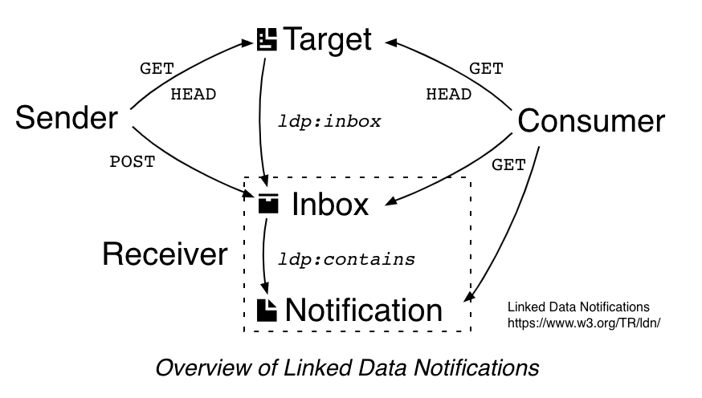
Submitting decision prov
Linked Data Notifications are
A W3C Recommendation
Simple GET and POST based standard
Use JSON-LD, which is familiar to most people and aligns well with ESIP schema.org efforts
Provides the same benefits of PROV-AQ, but easier to implement
Although, this does not address the comparison of decision provenance, which could be built on top of this and is outside of our current scope

Slide 12
Services on top of submission
What we’ll ultimately need in addition to a submission service like Linked Data Notifications
Sender verification – who is allowed to submit provenance
I’d say anyone, but you should have to register and get an API key
Based on JSON-LD, which has @context (schema)
Multiple schema for decision provenance?
Make this a general purpose provenance system by providing schema for dataset creation and other prov generating activities?
Defining community consensus on inboxes,
LDN has the notion of an ”inbox” – address to POST prov to
Need to define and publish these

Slide 13
Existing pieces
Semantic Technologies Committee
Some Earth science ontologies, e.g. ENVO, have concepts we can reuse
Community Ontology Repository could be a place to develop and host URIs for people, organizations, datasets, and concepts we don’t yet have.
They are looking at Linked Data as a Platform and may be able to host Linked Data Notifications
Provisium – previous ESIP Lab project exploring PROV-AQ, minimal code base, but has the beginnings of an API for accepting PROV POSTs
EarthCube Project 418 network map of datasets, people, and organizations
Many groups in ESIP working with schema.org and PROV who are interested in common tooling

Slide 14
References
Car, N. (2017), Modelling causes for actions with the Decision and PROV Ontologies, 22nd International Congress on Modelling and Simulation, Hobart, Tasmania, Australia, 3-8 December 2017, paper: https://www.mssanz.org.au/modsim2017/C2/car.pdf ontology: http://promsns.org/def/decprov
Kornyshova, Elena, and Rébecca Deneckère. 2010. “Decision-Making Ontology for Information System Engineering.” In Conceptual Modeling – ER 2010, 104–17. Lecture Notes in Computer Science. Vancouver, BC, Canada: Springer. doi:10.1007/978-3-642-16373-9_8.
Nowara, Piotr. 2012. Decision Ontology OWL ontology. Katowice, Poland. http://promsns.org/def/do.

