Slide 1


Variables and the Variable Cascade
DDI Training Library
Version 1.0
DDI Alliance, DDI Train the Trainer Workshop, DDI Training Working Group
This work is licensed under Creative Commons Attribution 4.0 International License.

Slide 2
Contents
The Variable Cascade: Simple Example
Benefits of the Variable Cascade Structure
England and Wales Census – Tenure Example

Slide 3
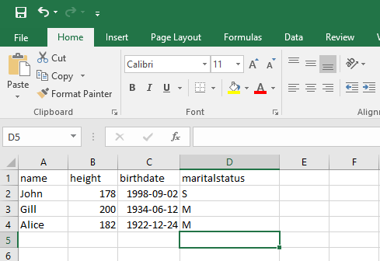
Example Spreadsheet
Notes:
What is a variable in DDI?
We will start by looking at a small example dataset in excel

Slide 4
Example: Dataset 1
name | height | birthdate | maritalstatus
John | 178 | 1998-09-02 | S
Gill | 200 | 1934-06-12 | M
Alice | 182 | 1922-12-24 | M
Notes:
The data is devdied into columns where each represent a recorded value.
The whole purpose is to tie the variables together which are measuring a comparable topic.
Should we list what other domain use to describe a variable e.g. column in excel, relational database, attribute in object-oriented programing etc.
Start with a table of data- a variable is a column of data.
When people are approaching DDI they think of data as records of data
Are we missing info unless we explain why we have a rectangular file? How do you say that each row is related to the same column? Are we making an assumption– show an example and explain that we asked each people there marital status each row is a person.
We can visualise this as a table
Discuss as item type level in relation to other items rather than details about each.
Repeated measures in a column (not associated these measures with anything yet)

Slide 5
Variable Example
name | height | birthdate | maritalstatus
John | 178 | 1998-09-02 | S
Gill | 200 | 1934-06-12 | M
Alice | 182 | 1922-12-24 | M
Notes:
A example of a variable is e.g. ”height” where each persons height is recorded

Slide 6
Different Variable Representation Types
text | numeric | date | code
name | height | birthdate | maritalstatus
John | 178 | 1998-09-02 | S
Gill | 200 | 1934-06-12 | M
Alice | 182 | 1922-12-24 | M
Notes:
The variables have three obviously different types- text, numbers, dates and codes.
There are several more types, but in the following examples of a variable cascade we will use code, text and numeric

Slide 7
Variable with Code Representation
name | height | birthdate | maritalstatus
John | 178 | 1998-09-02 | S
Gill | 200 | 1934-06-12 | M
Alice | 182 | 1922-12-24 | M
Notes:
Maritalstatus has a coded representation

Slide 8
Variable – Code Representation
maritalstatus codes
code | category
S | Single
M | Married
maritalstatus (variable)
Notes:
maritalstatus point to a code list with the enumerated value.
The variable have a code list:
S = Single
M = Married

Slide 9
Three Similar Datasets
dataset1
name | height | birthdate | maritalstatus
John | 178 | 1998-09-02 | S
Gill | 200 | 1934-06-12 | M
Alice | 182 | 1922-12-24 | M
dataset2
firstname | personheight | dateofbirth | maritalstatus2010
Bob | 70 | 1995-09-02 | S
Lars | 76 | 1954-06-21 | M
Gerald | 66 | 1972-11-23 | S
dataset3
firstname | imperialheight | dateofbirth | maritalstatus2018
Lisa | 69 | 1995-09-02 | S
Bart | 75 | 1954-06-21 | M
Homer | 68 | 1972-11-23 | D
Notes:
Three datasets with similar variables.
Note: some variable names are different and the values are a bit different

Slide 10
Three Similar Datasets – Code Representation
dataset1
name | height | birthdate | maritalstatus
John | 178 | 1998-09-02 | S
Gill | 200 | 1934-06-12 | M
Alice | 182 | 1922-12-24 | M
dataset2
firstname | personheight | dateofbirth | maritalstatus2010
Bob | 70 | 1995-09-02 | S
Lars | 76 | 1954-06-21 | M
Gerald | 66 | 1972-11-23 | S
dataset3
firstname | imperialheight | dateofbirth | maritalstatus2018
Lisa | 69 | 1995-09-02 | S
Bart | 75 | 1954-06-21 | M
Homer | 68 | 1972-11-23 | D
Notes:
Two datasets sharing same code list and the third have a new code list.
They are related in some way, but how do we relate these together- the variable cascade helps us do this.

Slide 11
Variables Re-Using Sets of Codes
maritalstatus (variable)
maritalstatus codes
code | category
S | Single
M | Married
maritalstatus2010 (variable)
maritalstatusplus codes
code | category
S | Single
M | Married
D | Divorced
martitalstatus2018 (variable)
Notes:
The first two datasets share the same codes while the third have its own sets of codes

Slide 12
Documenting Comparabilities among Variables
maritalstatus (conceptual variable)
Conceptual variable Common variable specification without a representation
Represented variable
Common variable specification with a code representation
maritalstatus (represented variable)
maritalstatusplus (represented variable)
Variable
Variable specification within a dataset context
maritalstatus (variable)
maritalstatus2010 (variable)
maritalstatus2018 (variable)
Notes:
What is variable cascade?
Three Different (distinct) sets of data with a different variables all measuring marriage status.
Represented variables link variables which are directly comparable.
Same representation of the value domain. It doesn’t care about the question asked- only the value domain.
The represented variable is a way to measure marriage and so links to the marriage conceptual variable.
Represented variable means that they are not directly comparable but can be made to be comparable.
The third dataset has a different code list (i.e. value domain) and so it needs a new representative variable which then links to the conceptual variable.
Concept variable defines a measure without defining the measurement.
Value domain = Variable representation in DDI

Slide 13
Three Similar Datasets – Text Representation
dataset1
name | height | birthdate | maritalstatus
John | 178 | 1998-09-02 | S
Gill | 200 | 1934-06-12 | M
Alice | 182 | 1922-12-24 | M
dataset2
firstname | personheight | dateofbirth | maritalstatus2010
Bob | 70 | 1995-09-02 | S
Lars | 76 | 1954-06-21 | M
Gerald | 66 | 1972-11-23 | S
dataset3
firstname | imperialheight | dateofbirth | maritalstatus2018
Lisa | 69 | 1995-09-02 | S
Bart | 75 | 1954-06-21 | M
Homer | 68 | 1972-11-23 | D
Notes:
All datasets have a text variable for name

Slide 14
Variables with the Same Text Representation Type
name (variable)
text representation
firstname (variable)
property | value
length | 50
firstname (variable)

Slide 15
Documenting Comparabilities among Variables
name (conceptual variable)
Conceptual variable Common variable specification without a representation
Represented variable
Common variable specification with a text representation
name (represented variable)
Variable
Variable specification within a dataset context
name (variable)
firstname (variable)
firstname (variable)
Notes:
All three variables share the same text representation and is linked to the same represented variable

Slide 16
Three Similar Datasets – Numeric Representation
dataset1
name | height | birthdate | maritalstatus
John | 178 | 1998-09-02 | S
Gill | 200 | 1934-06-12 | M
Alice | 182 | 1922-12-24 | M
dataset2
firstname | personheight | dateofbirth | maritalstatus2010
Bob | 70 | 1995-09-02 | S
Lars | 76 | 1954-06-21 | M
Gerald | 66 | 1972-11-23 | S
dataset3
firstname | imperialheight | dateofbirth | maritalstatus2018
Lisa | 69 | 1995-09-02 | S
Bart | 75 | 1954-06-21 | M
Homer | 68 | 1972-11-23 | D
Notes:
The height is meassured in all three datasets but in different units

Slide 17
Variables with Different Unit of Measure
numeric representation
height (variable)
property | value
measurementUnit | cm
personheight (variable)
numeric representation
property | value
measurementUnit | in
imperialheight (variable)
Notes:
The first variable have the measurement in centimeter
In the second and third dataset the measurement was changes to inches and share the same numeric representation

Slide 18
Documenting Comparabilities among Variables
height (conceptual variable)
Conceptual variable Common variable specification without a representation
Represented variable
Common variable specification with a text representation
heightcm (represented variable)
heightinches (represented variable)
Variable
Variable specification within a dataset context
height (variable)
personheight (variable)
imperialheight (variable)

Slide 19
Benefits of the Variable Cascade Structure
Specifying comparability across variables allows comparison across datasets
Structure for facilitating harmonization across datasets / studies
Variable names and representations can change
Documenting changes over time
Planning for future data collection to ensure comparability
Notes:
Benefits
Comparability and provenance.
Lineage of the data/provenance
Identify comparable data
Compare how the response values have changed over time or over different sources
Used to manage to change and comparability
Supports people working on harmonisation (gives you the structure to describe the variables and decide whether you can harmonise them or not)
Useful resources
Daniel Gillman EDDI 2017: The DDI-4 Variable Cascade and Datum-Centered Approach
Colectica docs site - https://docs.colectica.com/designer/manage-content/data/harmonize-variables/
Questions/answers
What level do we publish?
it depends on how you want to display the datasets.
All the variables could have the same variable name, but in DDI they will have a different identifier. It is up to you which you see.
We should always have the conceptual and represented in place, even if there is no change in the code value.
DDI separates the conceptual variables and representative variable is so that someone can query the relationships without having to look at every variable and value domain which is time consuming and also not reliant on a machine- as it is shows that person has decided that these are comparable.
Should there always be a new variable for each data collection- can they be the same variable?
It depends on how you describe the dataset- there is lots more info about a dataset then just its type e.g. who it’s measured about e.g. universe. If you have different datasets the people/household changes. If you have new dataset then it is usually a new instance variable. Specific to a datasets as the it contains other metadata e.g. time of collection. If you publish data every quarter the variable instance will be different each time.
If there is only one dataset- whey would you use represented and conceptual variables- If you want people to re-use it or to use with other study’s data then it is valuable to including the represented and conceptual variable.
Ideal world- create a concept then create a question for that. Which is linked to the represented and conceptual variable. – questions to be discussed elsewhere.

Slide 20
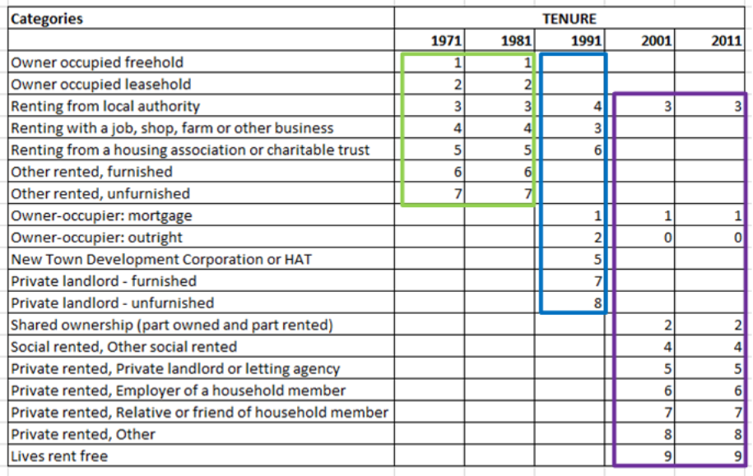
England and Wales Census – Tenure*
* the conditions under which land and buildings are held or occupied

Slide 21
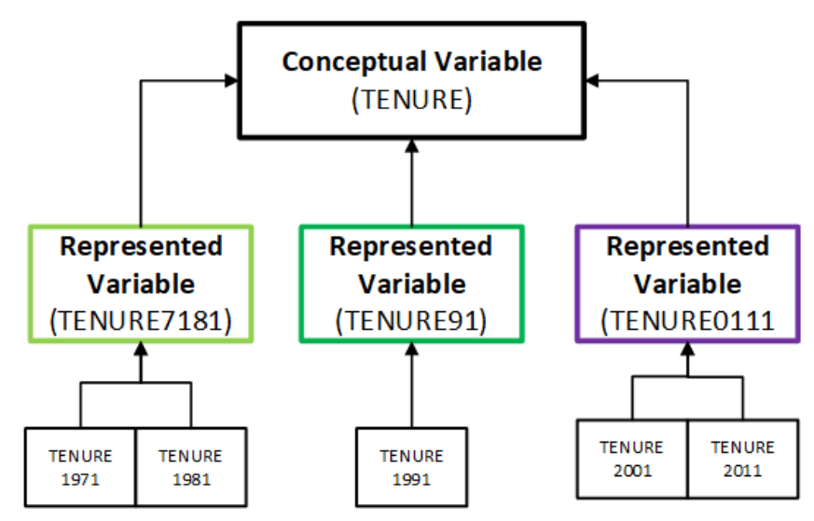
England and Wales Census – Variable Cascade

Slide 22
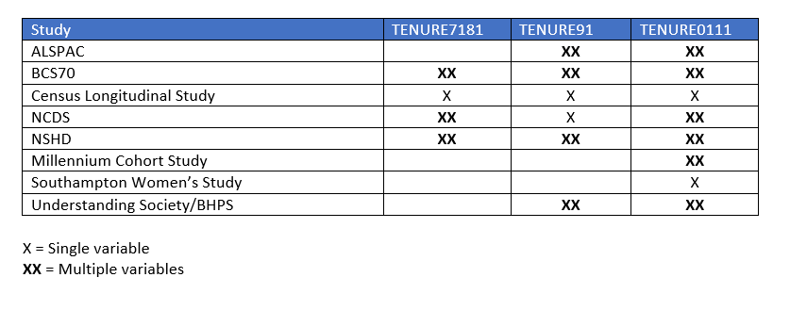
Tenure in Longitudinal Studies*
* Simplified

Slide 23
Variable Lineage
Describes the origin of a variable
Relationship between concept, question and variable
Document derived variables and see how it has been computed

Slide 24
Variable Lineage
eisced
Highest level of education
(short)
eisced (derived variable)
edulvlb (variable)
edulvlb
Highest level of education
(long)
What is the highest...? (question)
Educational attainment (sub-concept)
Education (concept)
Notes:
All three variables share the same text representation and is linked to the same represented variable

