Slide 1




Semantic MEDLINE:
Knowledge Discovery and Hypothesis Generation from Biomedical Research Literature
Halil Kılıçoğlu
National Library of Medicine
National Institutes of Health

Slide 2
Disclaimer
The views and opinions expressed do not necessarily state or reflect those of the U.S. Government, and they may not be used for advertising or product endorsement purposes.
2

Slide 3
Data to Knowledge in Biomedicine
Biomedical “big data”
Clinical measurements, environmental data, phenotypic data, genomic data
Research articles, clinical notes
Considerable effort on data infrastructure
Structured, curated information resources
Mechanisms and structures for data sharing, integration
Less attention on how to use these resources
For knowledge discovery and hypothesis generation
3

Slide 4
Biomedical Research Literature
Information overload
More than 26 million abstracts in PubMed
Need for natural language processing (NLP)
Transform text into computable semantic representations
Allow aggregation at large scale
Effective, automatic access to information
Biological database curation
Systematic review support
4

Slide 5
Overview
SemRep
Relationship extraction from biomedical research articles
Semantic MEDLINE
Advanced knowledge management, literature-based discovery, hypothesis generation
5

Slide 6
SemRep
Extracts semantic predications
Subject-predicate-object triples
Linguistically-oriented
Relies on domain knowledge
Unified Medical Language System (UMLS)
Metathesaurus
Semantic Network
specialist Lexicon
Rindflesch TC and Fiszman M. "The interaction of domain knowledge and linguistic structure in natural language processing: interpreting hypernymic propositions in biomedical text." Journal of biomedical informatics 36, no. 6 (2003): 462-477.
6

Slide 7

Semantic Predications
… Exemestane after non-steroidal aromatase inhibitor for post-menopausal women with advanced breast cancer
treats
Aromatase Inhibitor
Breast Carcinoma
Semantic Network
Relation
Metathesaurus
Concept
Metathesaurus
Concept
Unified Medical Language System
7

Slide 8
SemRep Predicates
Clinical: administered_to, complicates, diagnoses, predisposes, prevents, occurs_in, manifestation_of, process_of, treats
Molecular biology: associated_with, augments, converts_to, disrupts, inhibits, interacts_with, stimulates
General: affects, causes, coexists_with, isa, location_of, method_of, part_of, precedes, produces, uses

Slide 9
SemRep Processing
Syntactic analysis
Lexical look-up (specialist Lexicon)
Tagging
Underspecificied parser (chunker)
Concept recognition
MetaMap (map text to Metathesaurus)
Special processing for genes and proteins
Predication construction
Indicator rules (map text to Semantic Network)
Syntactic and semantic constraints
9

Slide 10
SemRep Evaluation
Focused on biomedical subdomains
Clinical treatment, genetic etiology of disease, pharmacogenomics
Focused on linguistic structure
Hypernymic relations, comparatives, nominalizations
Overall
Precision is around 75% (lower for molecular biology)
Recall is around 60%
10

Slide 11
SemMedDB
Semantic predications from titles and abstracts of all PubMed articles
~26M articles, ~91M predications (June 30, 2017)
Updated biannually
Made available to the research community
MySQL database
http://skr3.nlm.nih.gov/SemMedDB/
Kilicoglu H, Shin D, Fiszman M, Rosemblat G, and Rindflesch TC. "SemMedDB: a PubMed-scale repository of biomedical semantic predications." Bioinformatics 28, no. 23 (2012): 3158-3160.
11

Slide 12
Semantic MEDLINE
Helps navigate through the research literature
Combines document retrieval, semantic predications, summarization and network visualization
Make connections which might go unnoticed
Literature-based discovery, hypothesis generation
Swanson’s A-B-C discovery model
Discovery browsing
A-B-C-D-….
Kilicoglu H, Fiszman M, Rodriguez A, Shin D, Ripple A, Rindflesch TC. Semantic MEDLINE: a web application for managing the results of PubMed Searches. In Proceedings of the third international symposium for semantic mining in biomedicine 2008 (pp. 69-76).
12

Slide 13
Semantic MEDLINE Overview
PubMed
MEDLINE abstracts
SemMedDB
Semantic predications
Automatic summarization
Graphical summary
Biomedical information management
13

Slide 14
Summarization
All Predications
Salient Predications
Reduction
Specify a topic and summary view
Retain predications on the topic using a schema (Relevance, Connectivity)
Eliminate uninformative predications (Novelty)
Retain most frequent predications (Saliency)
14

Slide 15
Summarized Predications
treats
Aromatase Inhibitors
Breast carcinoma
treats
Tamoxifen
Breast carcinoma
associated_with
CDKN1A gene
Breast carcinoma
stimulates
CDKN1A gene
BARD1 gene
… … …
treats
Tamoxifen
Patients
process_of
Breast carcinoma
Individual
15

Slide 16
Semantic MEDLINE: Visualization
Aromatase Inhibitors
Tamoxifen
treats
treats
Breast carcinoma
associated_with
CDKN1A gene
stimulates
BARD1 gene
16

Slide 17
Semantic MEDLINE: Link to Text
Tamoxifen
treats
Breast carcinoma
17

Slide 18
Semantic MEDLINE: Link to Text
Tamoxifen
treats
Breast carcinoma
18

Slide 19
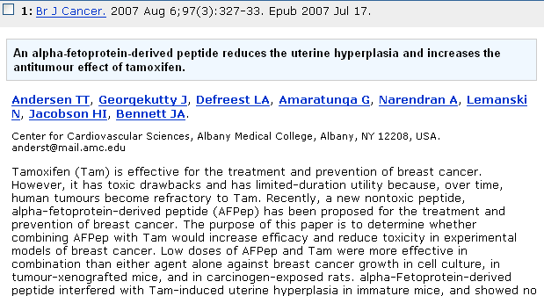
Semantic MEDLINE: Research
ESTRONE
Tamoxifen
treats
3-lucoronide
Sulfate
O
ESTRADIOL-17β
HO
NAD(P)H+H⁺
OH
Breast carcinoma
NAD(P)⁺
HO
19

Slide 20
Semantic MEDLINE Applications
Hypothesis generation
Closed discovery model
“Cortisol as part of a mechanistic link between decreased testosterone in aging men and diminished sleep quality.”
A
B
C
Testosterone
Cortisol
Sleep
Miller CM, Rindflesch TC, Fiszman M, Hristovski D, Shin D, Rosemblat G, Zhang H, Strohl KP. A closed literature-based discovery technique finds a mechanistic link between hypogonadism and diminished sleep quality in aging men. Sleep. 2012 Feb 1;35(2):279-85.
20
Notes:
Supports a systems approach to health care and public health

Slide 21
Semantic MEDLINE Applications
Discovery browsing
Increased obesity predicts decreased mortality and morbidity at ICU (“Obesity paradox”)
“PPAR-γ is greatly expressed in fat tissue and its activation is anti-inflammatory”
“DEHP activates PPAR-γ”
“DEHP is commonly used in PVC and is leached from lines and bags at therapeutic doses in standard interventions in ICU patients”
Cairelli MJ, Miller CM, Fiszman M, Workman TE, Rindflesch TC. Semantic MEDLINE for discovery browsing: using semantic predications and the literature-based discovery paradigm to elucidate a mechanism for the obesity paradox. In AMIA Annual Symposium Proceedings 2013 (Vol. 2013, p. 164). American Medical Informatics Association.
21
Notes:
Supports a systems approach to health care and public health

Slide 22
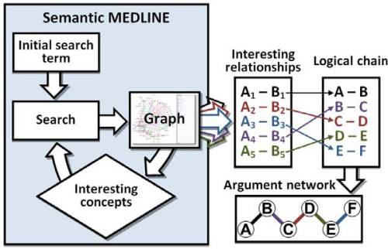
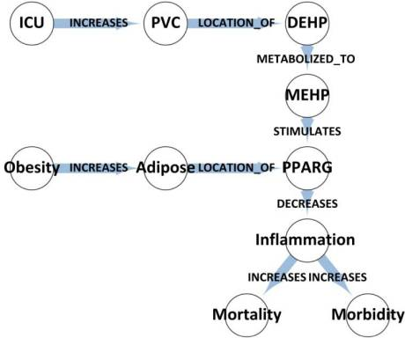
Semantic MEDLINE Applications
Discovery browsing
Cairelli MJ, Miller CM, Fiszman M, Workman TE, Rindflesch TC. Semantic MEDLINE for discovery browsing: using semantic predications and the literature-based discovery paradigm to elucidate a mechanism for the obesity paradox. In AMIA Annual Symposium Proceedings 2013 (Vol. 2013, p. 164). American Medical Informatics Association.
22
Notes:
Supports a systems approach to health care and public health

Slide 23
Acknowledgments
Thomas C. Rindflesch, Ph.D.
Michael J. Cairelli, D.O.
Marcelo Fiszman, M.D., Ph.D.
Graciela Rosemblat, Ph.D.
Dongwook Shin, Ph.D.
T. Elizabeth Workman, Ph.D., M.L.I.S.

