Slide 1
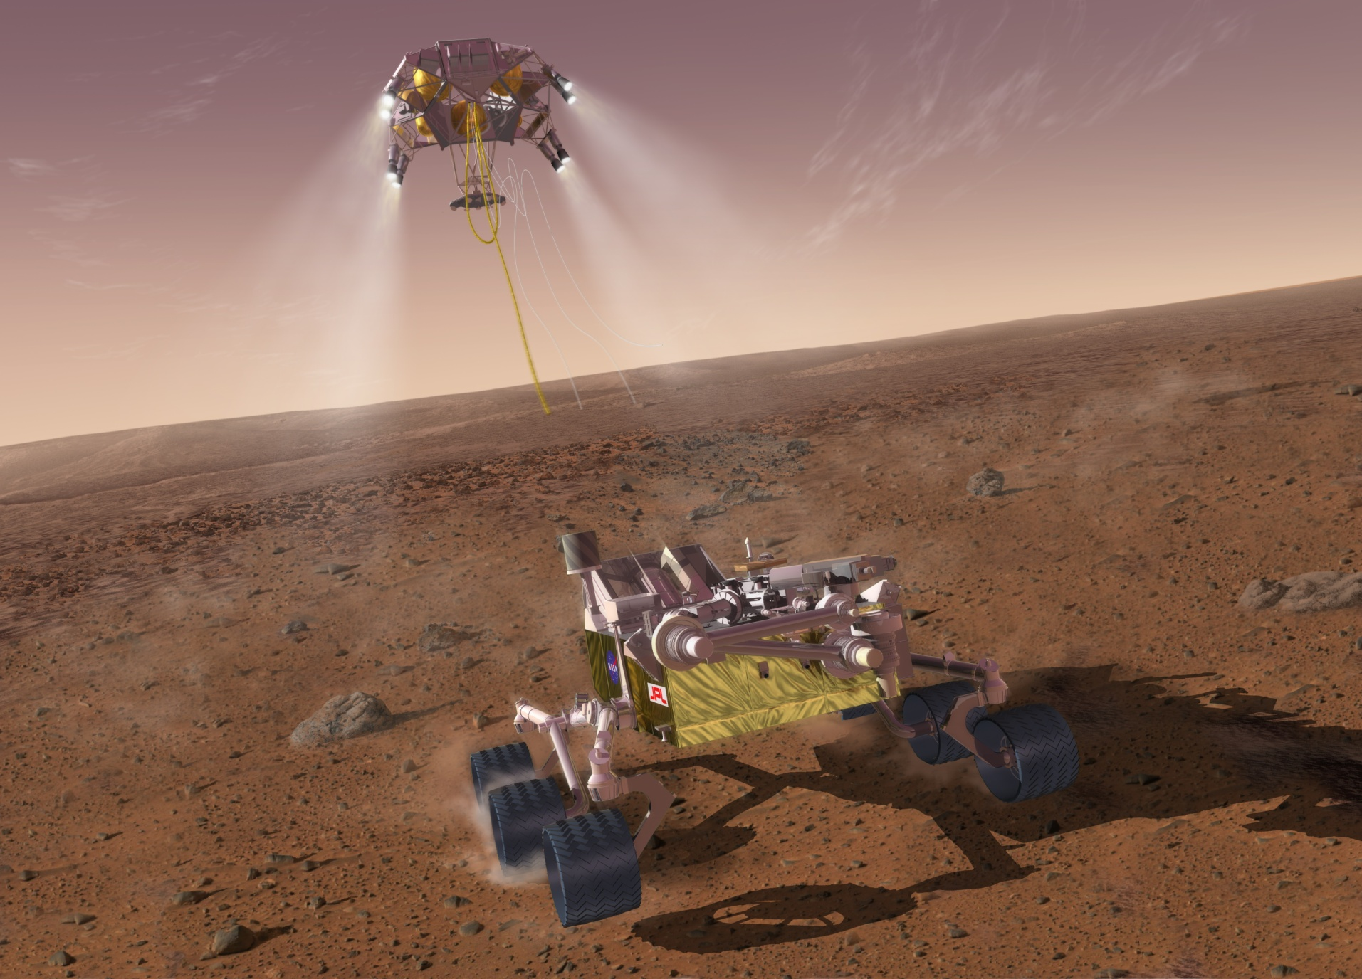
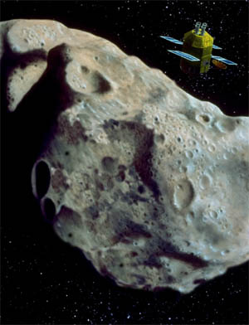
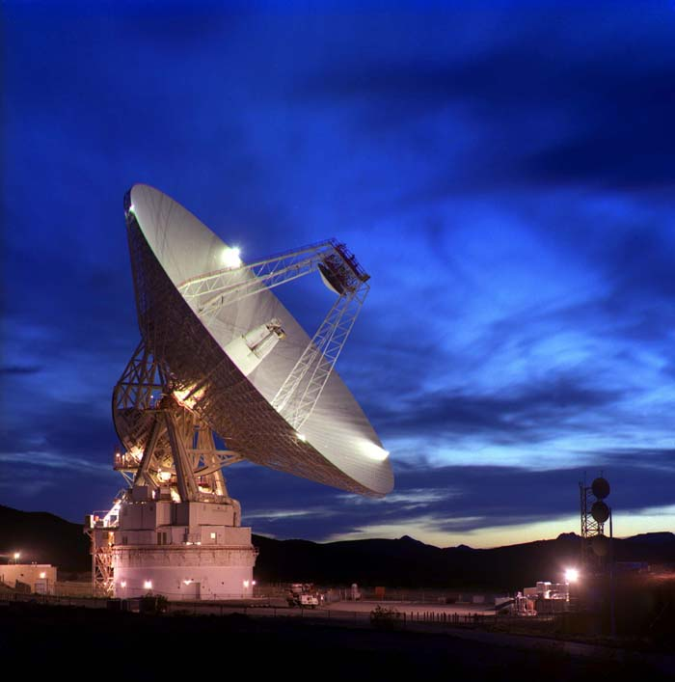
A Reference Model for Science Data Archives
J. Steven Hughes
steve.hughes@jpl.nasa.gov
NASA Jet Propulsion Laboratory (JPL)
California Institute of Technology
Earth Science Information Partners (ESIP)
Winter Meeting 2018
January 9-11th, 2018 – Bethesda, MD
2018 Geosemantics Symposium
Monday January 8, 2018

Slide 2
Overview
The Consultative Committee for Space Data Systems (CCSDS) Data Archive Interoperability (DAI) working group has developed the core elements for the underlying processes for digital preservation.
Reference Model for an Open Archival Information System (OAIS) – ISO 14721, CCSDS 650.0-M-2
Information Preparation to Enable Long Term Use (IPELTU)
The DAI working group is now addressing interoperable protocols and interface specifications.
Enable the access, merging and interoperable re-use of the data
Support for the fundamental scientific technique of checking reproducibility of results.

Slide 3
Abstract Protocol Architecture²
²Data Archive Ingest (DAI) WG Report to the CCSDS Management Council (CMC), Figure 2: Notional Data Archive Architecture, March 2017

Slide 4
Data Archive Architecture Reference Model
The Data Archive Architecture Reference Model (DAARM) is an implementable model for trusted digital repositories¹.
Trusted Digital Repository - A repository whose mission is to provide usable, long-term access to digital resources for a designated community.
The model is an integration of concepts and standards from:
Open Archival Information System (OAIS) Reference Model¹
ISO/IEC 11179 Metadata Registry (MDR) standard
Three decades of digital repository development for science research.
The intended scope of the reference model is for digital archives in general.
¹ ISO 14721:2012 (CCSDSS 650.0-P-1.1) Open archival information system (OAIS) -- Reference model

Slide 5
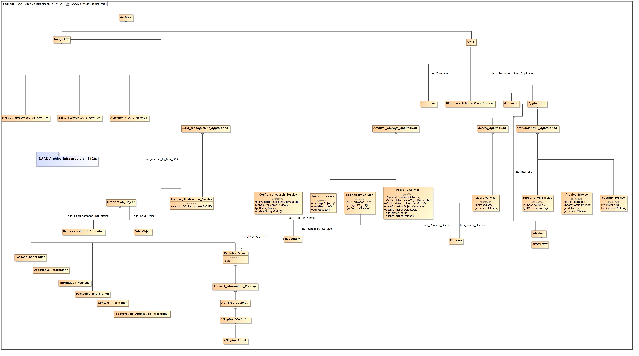
Draft UML Model

Slide 6
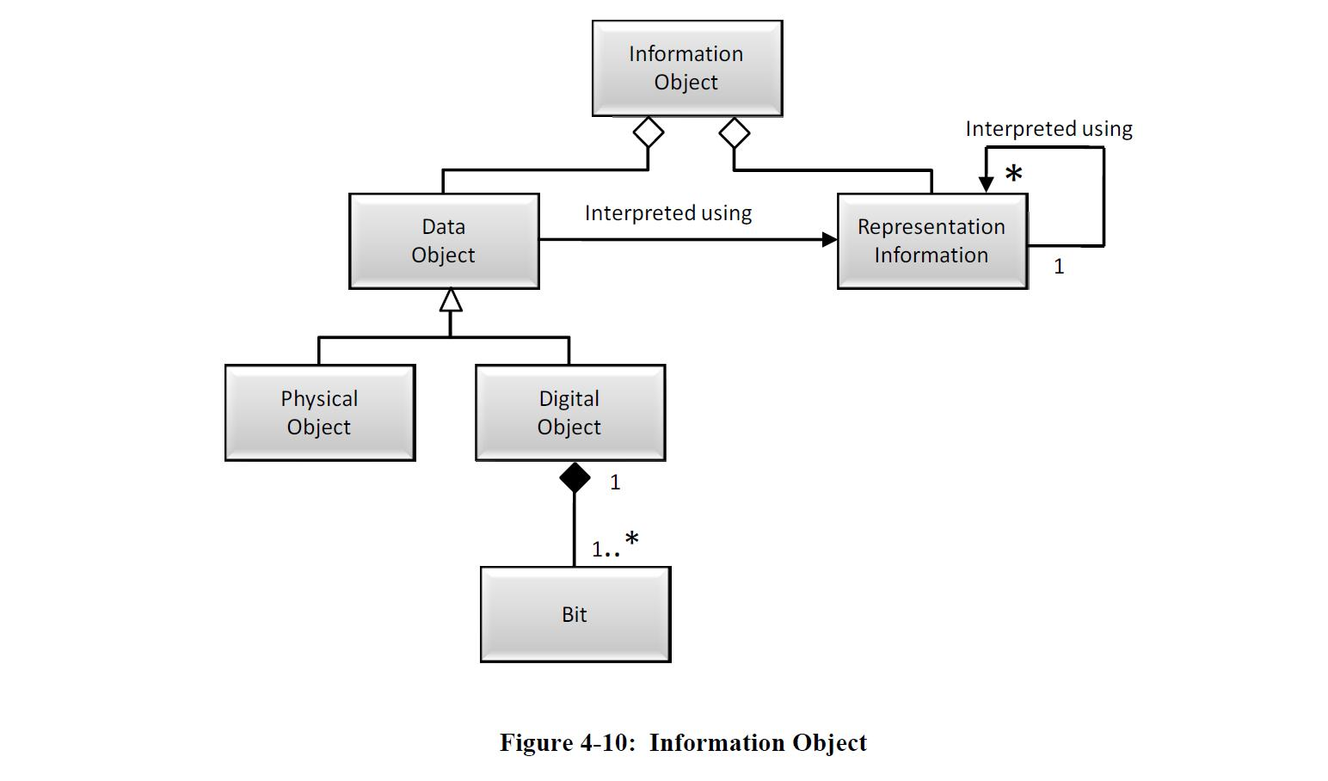
Information Architecture¹
¹ ISO 14721:2012 (CCSDSS 650.0-P-1.1) Open archival information system (OAIS) -- Reference model

Slide 7
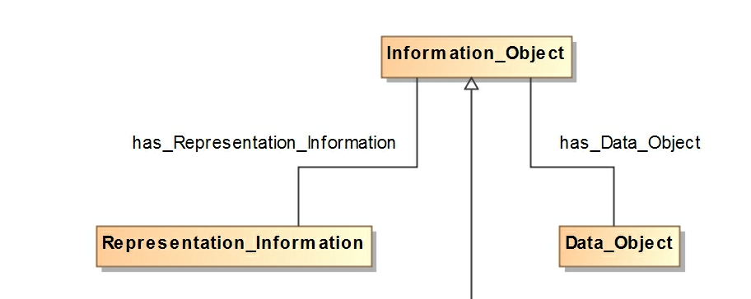
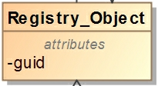
Registry Object

Slide 8
Information Categories¹
Identification - Provides a unique and immutable identifier for each data object.
Representation/Format - Provides meaning for a data object and allows it to be interpreted.
Integrity - Ensures the data object has not been unintentionally altered.
Provenance - Provides the history of the data object and is essential for authenticity and reproducibility.
Context - Describes the environment in which the data object was created.
Reference - Allows the data object to be referenced.
Access Rights - Defines the access restrictions pertaining to the data object , including the legal framework, licensing terms, and access control
Quality* - Provides a scheme for assessing and assigning a quality measure to the data object .

Slide 9
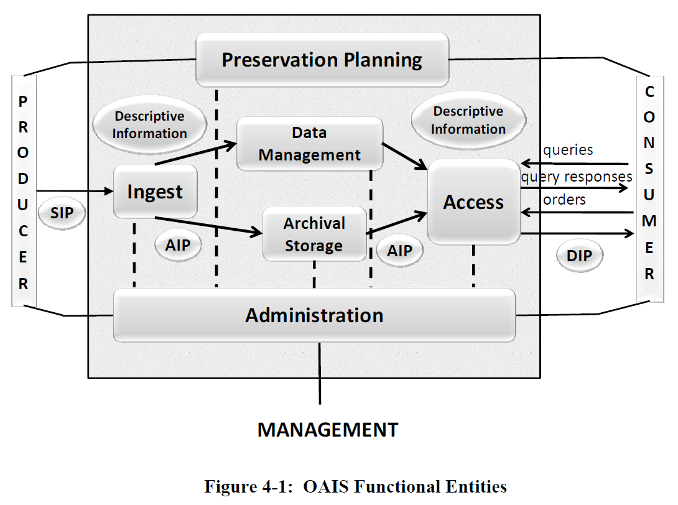
Functional Entities¹
¹ ISO 14721:2012 (CCSDSS 650.0-P-1.1) Open archival information system (OAIS) -- Reference model

Slide 10
Functional Entities¹
Ingest - Accept information objects from producers, prepares them for storage, and ensures that they become established.
Archival – Store and retrieve Information Objects.
Data Management – Maintaining administrative information, for example consumer access statistics.
Access - Make the archival information holdings and related services visible to Consumers.
Administration - Control the operation of the other functional entities.
Preservation Planning - Monitoring the environment to ensure that the information stored remains usable by the Designated Community.

Slide 11
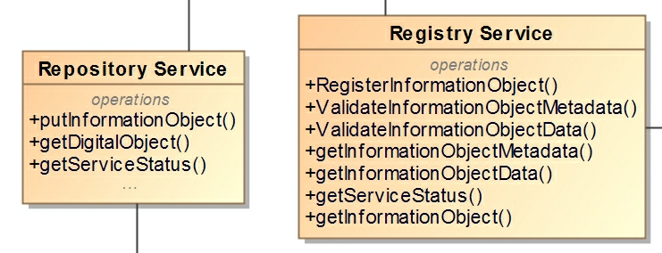
Archival Store and Retrieve Information Objects

Slide 12
Information Model Definitions
“An information model is a representation of concepts, relationships, constraints, rules, and operations to specify data semantics for a chosen domain of discourse.” ¹
It provides a sharable, stable, and organized structure of information requirements or knowledge for the domain context.
Information Modeling is an essential discipline within Data Science
¹ Lee, Y. T. 1999. Information Modeling: From Design To Implementation. In Proceedings of the Second World Manufacturing Congress, ed. S. Nahavandi and M. Saadat, 315-321. Canada/Switzerland: International Computer Science Conventions.

Slide 13
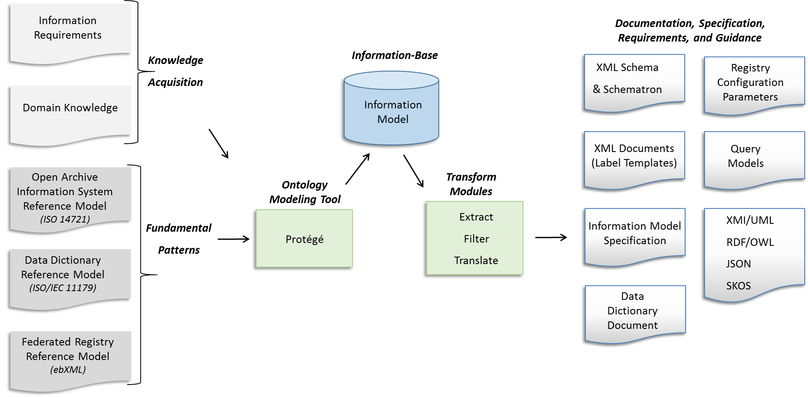
Information Model (IM)

Slide 14
Information Model Roles
Requirements: The IM is the primary source for information requirements.
Governance: A multi-level governance scheme reduces the impact of change as the science community grows and evolves.
Semantics: The IM provides named relationships to support semantic technologies
Usability: The IM provides the metadata needed to interpret and use the data.
Interoperability: The IM is designed by discipline experts to provide interoperability, at multiple levels.
Configuration: Extracts from the IM are used to configure tools and services

Slide 15
Multi-level Governance
Registration Authority
Steward
Common
Discipline
Mission
¹ ISO 14721:2003 - Open Archival Information System (OAIS) Reference Model
Notes:
.

Slide 16
Model Components Common, Discipline and Mission Dictionaries

Slide 17
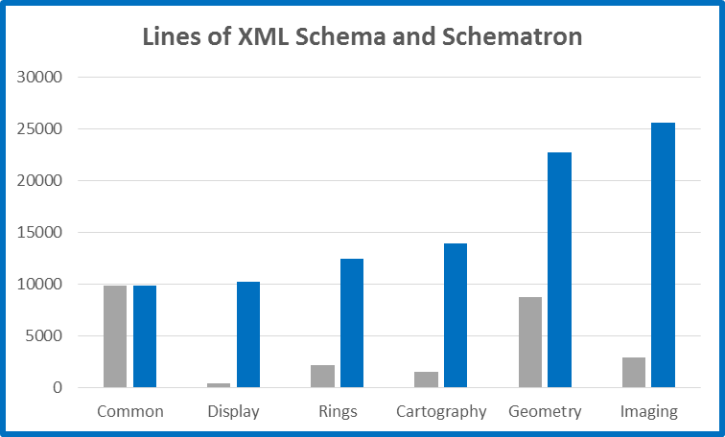
Information Requirements Generated from the Dictionaries
Common
Discipline

Slide 18
Usability
A desk assessment of PDS4 against ISO 16363¹, the instrument for assessing a repository against the OAIS Reference Model², found that 92% of the metrics of the ISO 16363 standard were satisfied
Governance and Organizational Viability
Digital Object Management
Infrastructure and Security Risk Management.
Maintain the value of the data over time
¹ ISO 16363:2012 (CCSDS 652.0-R-1) Audit and certification of trustworthy digital repositories
² ISO 14721:2012 (CCSDSS 650.0-P-1.1) Open archival information system (OAIS) -- Reference model

Slide 19
Next Steps
CCSDS Data Archive Interoperability (DAI) Working Group
Write and review CCSDS Blue Book
CCSDS Fall 2018 Technical Meetings (Spring and Fall)
Develop two working prototypes
Reference Model Review
JPL's Center for Data Science and Technology – D. Crichton
NASA Planetary Data System (PDS) System Development – S. Hardman
CCSDS Systems Architecture (SAWG) Chair – P. Shames
JPL’s Multimission Ground System and Services (MGSS) Project – C. Radulescu
Life Storage of Mission Data (LSMD) task – M. McAuley
FernUniversität in Hagen - M. Hemmje
Engineering Data Management (EDM) task – L. Jewell
Information Retrieval and Data Science Group – C. Mattmann

Slide 20
Acknowledgements
CCSDS Data Archive Interoperability (DAI) Working Group
Bruce Ambacher
Robert Downs
John Garrett
David Giaretta
Matthias Hemmje
Mike Kearney
Terry Longstreth
Don Sawyer
JPL's Center for Data Science and Technology – Dan Crichton
NASA Planetary Data System (PDS) – Sean Hardman, Ronald Joyner
JPL Principal Data Scientist, USC Adjunct Associate Professor – Chris Mattmann
JPL’s Multimission Ground System and Services (MGSS) Project – Costin Radulescu
CCSDS Systems Architecture (SAWG) Chair – Peter Shames
Life Storage of Mission Data (LSMD) task – Mike McAuley
Engineering Data Management (EDM) task – Laura Jewell
This research was carried out by the Jet Propulsion Laboratory, managed by the California Institute of Technology under a contract with the National Aeronautics and Space Administration.

Slide 21
References
Reference Model for an Open Archival Information System (OAIS), ISO 14721:2012.
Data Archive Ingest (DAI) WG Report to the CCSDS Management Council (CMC), Figure 2: Notional Data Archive Architecture, March 2017
DAI Architecture Analysis, SEA System Architecture WG, Slide 16, Alternative Standardized Archive System Architecture Deployment Option (3), May 2017
Planetary Data System PDS4 Information Model Specification, Version 1.8.0.0, March 2017.
Planetary Data System - PDS4 System Architecture Specification September 1, 2013, Version 1.3.
CCSDS Reference Architecture for Space Information Management (RASIM) CCSDS 311.0-M-1
The Semantic Planetary Data System, PV2005, Edinburgh, November 2005.
PDS-D – The Planetary Data System Distribution Subsystem. Lunar and Planetary Science XXXIV (2003)
The Planetary Data System - Distributed Inventory System, IEEE Forum on Research and Technology Advances in Digital Libraries, 1999. Proceedings.

Slide 22
Thank You Questions and Answers PDS homepage: https://pds.nasa.gov/
Acknowledgements - This research was carried out at the Jet Propulsion Laboratory, California Institute of Technology, under a contract with the National Aeronautics and Space Administration.
© 2017 California Institute of Technology. Government sponsorship acknowledged.

Slide 23
Status Continued
Utilize the Cornerstone Framework (NPO-49832) for model capture and management.
Cornerstone is the framework used to capture and manage the PDS4 Information Model.
Provides a framework for model-driven information system development
Maintains Information Model independence.

Slide 24
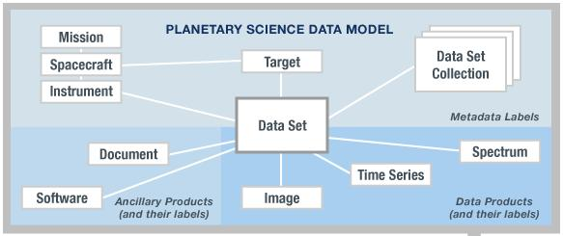
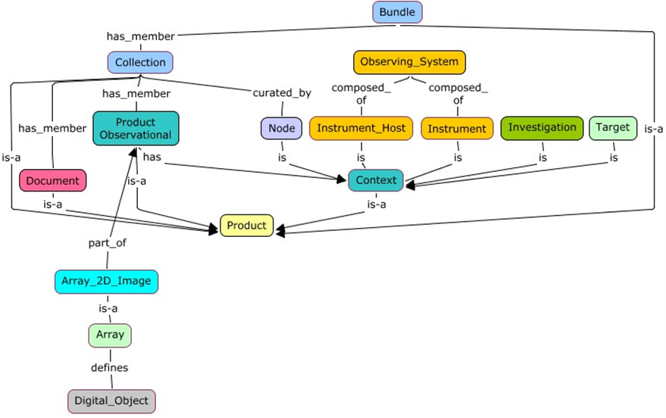
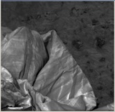
View Points
Repository View
Community’s View
Product
Tagged Data Object
(Information Object)
<local_identifier>MPFL_M_IMP_IMAGE</local_identifier>
<offset unit="byte">0</offset>
<axes>2</axes>
<axis_index_order>Last_Index_Fastest</axis_index_order>
<encoding_type>Binary</encoding_type>
<Element_Array>
<data_type>SignedMSB4</data_type>
<unit>pixel</unit>
</Element_Array>
<Axis_Array>
<axis_name>Line</axis_name>
<elements>248</elements>
<sequence_number>1</sequence_number>
</Axis_Array>
<Axis_Array>
<axis_name>Sample</axis_name>
<elements>256</elements>
<sequence_number>2</sequence_number>
</Axis_Array>
</Array_2D_Image>
Information Modeler’s View
Describes
Data Object

Slide 25
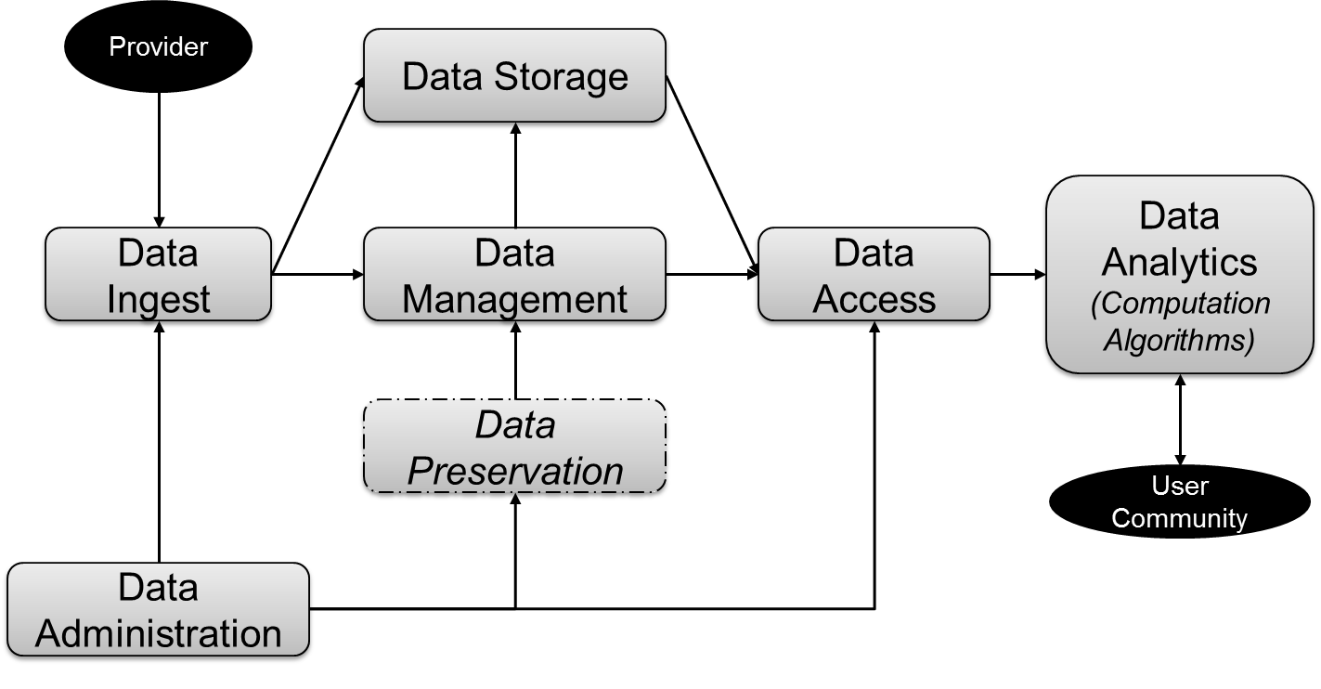
Conceptual Architecture¹
¹ ISO 14721:2012 (CCSDSS 650.0-P-1.1) Open archival information system (OAIS) -- Reference model

Slide 26
Semantics
All registry objects are first class products.
All products have a Persistent Identifier (PID)
Named relationships are used to relate objects (semantic)
data, documents, people, software, and contextual objects
Supports Linked Open Data.

