Slide 1

Community Ontology Repository (COR)
ESIP Semantic Technology Committee,
2018 Geosemantics Symposium
The Federation of Earth Science Information Partners
John Graybeal, Carlos Rueda, Felimon Gayanilo, and Janet Fredericks
Felimon Gayanilo
Systems Architect Harte Research Institute for Gulf of Mexico Studies (HRI) Texas A&M University Corpus Christi, Corpus Christi, TX

Slide 2
Additional Information…
ORR/COR Developer Workshop
Date : Thursday (11 January 2018)
Room : Glen Echo
Time : 3:10 PM – 5:00 PM
Presenter : Carlos Rueda, Beth Huffer and Lewis McGibbney
ORR concept and COR instance
Architectural details of the ORR
Git repository
Installing ORR
Using the ReST API
Development road map (also, in the Semantic Technology Committee Business Meeting, 1:30-3:00 PM, Glen Room)

Slide 3
Background
ORR (Ontology Registry and Repository)
‘Open source software developed by the Marine Metadata Interoperability (MMI) Project, and upgraded via the ‘Cross-Domain Observational Metadata for Environmental Sensing (X-DOMES), to facilitate semantic interoperability.’
MMISW GitHub: https://github.com/mmisw
COR (Community Ontology Repository)
‘An ORR instance for ESIP.’
Project: http://esipfed.github.io/cor/
COR: http://cor.esipfed.org/ont/

Slide 4
Brief History
2004: Marine Metadata Interoperability project (MMI)
“Promoting the exchange, integration and use of marine data through enhanced data publishing, discovery, documentation and accessibility.”
2008: ORR born as part of MMI’s vision for a Semantic Framework
2015: X-DOMES Project; ORR overhauled version 3
2017: ESIP Community Ontology Repository (COR)

Slide 5



NSF/EarthCube Integrative Activities: Cross-Domain Observational Metadata Environmental Sensing Network (X-DOMES)
Janet Fredericks (WHOI), Felimon Gayanilo (TAMUCC), Carlos Rueda (MBARI), Krzysztof Janowicz (UCSB)
Consulting with John Graybeal (Stanford), and Mike Botts (Botts Innovative Res.)
…develop prototypes for the application of standards-based description of environmental sensor metadata, including provenance, that is paramount to automated data discovery, access, archival, processing, as well as quality control and assessment.
Project URL: xdomes.org

Slide 6
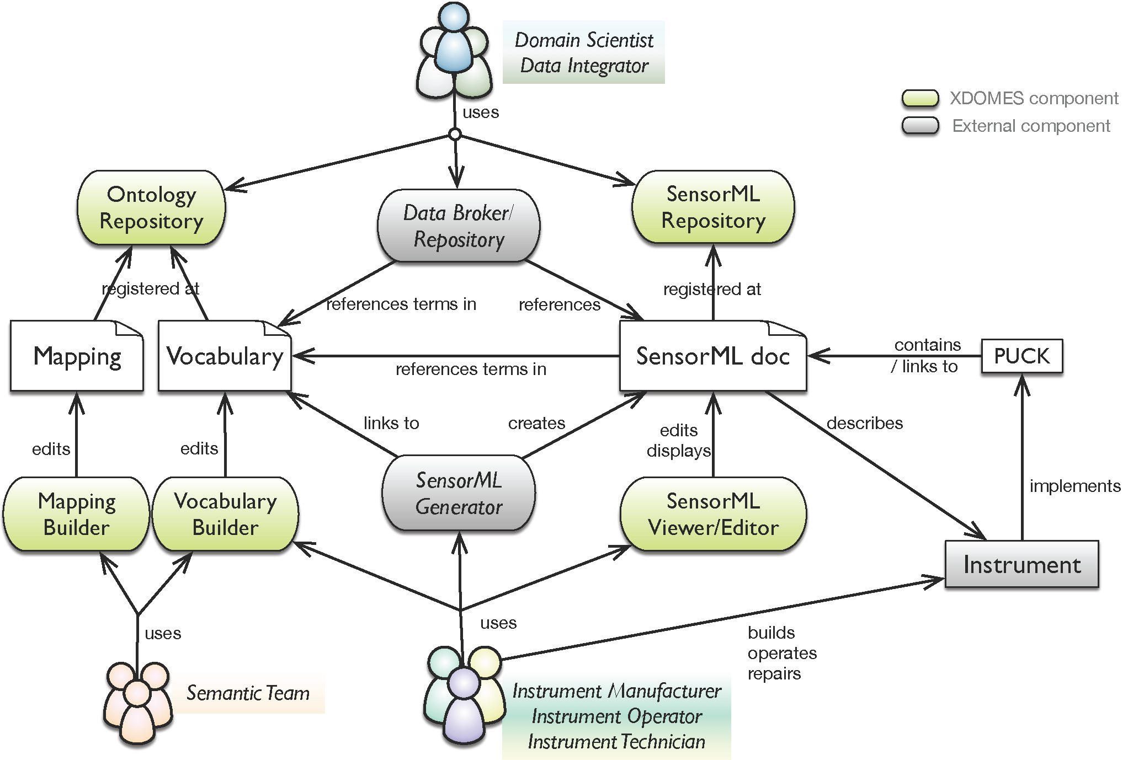
Community Standards: Semantic Web (W3C) & SensorML (OCG-SWE)
Notes:
OGC – OpenGeospatial Consortium
OGC SWE or Sensor Web Enablement - standards enable developers to make all types of sensors, transducers and sensor data repositories discoverable, accessible and useable via the Web
OGC-SWE-SensorML – Standard models and XML Schema for describing the processes within sensor and observation processing systems
Others in the SWE Framework:
Observations and Measurements (O&M) - The general models and XML encodings for observations and measurements
PUCK Protocol - Defines a protocol to retrieve a SensorML description, sensor "driver" code, and other information from the device itself, thus enabling automatic sensor installation, configuration and operation
Sensor Observation Service (SOS) – Open interface for a web service to obtain observations and sensor and platform descriptions from one or more sensors
Others:
Sensor Planning Service (SPS) – An open interface for a web service by which a client can 1) determine the feasibility of collecting data from one or more sensors or models and 2) submit collection requests.
SWE Common Data Model – Defines low-level data models for exchanging sensor related data between nodes of the OGC® Sensor Web Enablement (SWE) framework.
SWE Service Model ­– Defines data types for common use across OGC Sensor Web Enablement (SWE) services. Five of these packages define operation request and response types.

Slide 7
X-DOMES Tools
ORR instance to create fully described, resolvable semantic terms
SensorML Viewer/Editor that enables drafting of the validated OGC/SensorML documents that can be distributed by sensor manufacturers, extended and reference by field operators and data managers.
SensorML Registry and Repository (SRR) that enables SensorML documents to be referenced as URLs with version control and proper authoritative ownership

Slide 8


Community Involvement

Slide 9
The GUI
Version
Link to document
Contact Us
Sign in and account
SPARQL Search
Term Search
Global filter
Headers (+sort opt)
Facets
Links to ontologies

Slide 10
The GUI
Status
Download options
Ontology version
Metadata
General
License
Source
Other
Data
Term IRI

Slide 11
Live Demonstration
Faceted and term search
Exporting results
Uploading ontology
Creating vocabulary
The mapping concept
SPARQL examples
Help document (https://mmisw.org/orrdoc/)

Slide 12
Community Ontology Repository (COR)
ESIP Semantic Technology Committee,
2018 Geosemantics Symposium
The Federation of Earth Science Information Partners
John Graybeal, Carlos Rueda, Felimon Gayanilo, and Janet Fredericks
Thanks for coming…
Felimon Gayanilo
Systems Architect Harte Research Institute for Gulf of Mexico Studies (HRI) Texas A&M University Corpus Christi, Corpus Christi, TX

