Slide 1


Drone data & the semantic web
Lindsay Barbieri
lkbar@uvm.edu
@barbieriiv
Andrea Thomer
athomer@umich.edu
Jane Wyngaard
jwyngaar@nd.edu
@jwyngaard
https://tinyurl.com/z5gf4zr

Slide 2
Outline
Scientific sUAS data management open challenges
Quick overview of ESIP Drone Cluster & RDA sUAS Data IG goals
ESIP Laboratories project
VOCamp outcomes
ESIP Winter meeting working session invitation

Slide 3
sUAS Data IG Questions
What standard sensor calibration and use procedures need to be defined and articulated?
What best practices regarding data post processing and error analysis methodology need to be outlined?
What is the minimum metadata that needs to be collected about a scientific sUAS data capture flight?
Which formats should be used to store (meta)data in?
Which ontologies should be applied -- or need to be developed -- for sUAS (meta)data? (what we began addressing at the VOCamp)

Slide 4

Science Question / Campaign Planning
Selection of Platform & Sensors
Sensor Integration on Platform
Pre-Flight Check / Sensor Calibration
Pre Flight
Mission Planning / In field
Executing Mission: Flight & Data Collection)
Download in Field Data / Streaming
Flight
Post Flight
Post Processing
Secondary Data Products / Analysis
Fusion / Integration

Slide 5
Efforts underway
ESIP Lab Incubator project
PIs: Thomer, Huffer, Barbieri, Wyngaard
VOCamp: https://github.com/Vocamp/dronedata
P11 Berlin (21-23 March): Joint session with From Observational Data to Information IG and Research Data Collections WG

Slide 6
ESIP Lab project
Using methods inspired by systems analysis to derive a high-level minimum information framework (MIF) for drone data
Detailed documentation of 3 cases of drone-based earth science research Use cases pulled from case studies MIF as backbone/testbed for preliminary drone data ontology
Using YAMZ as a platform to vote for ontology terms (and definitions?)
Deliverables: minimum information framework for drone-based earth science; proto drone data ontology; use cases.

Slide 7
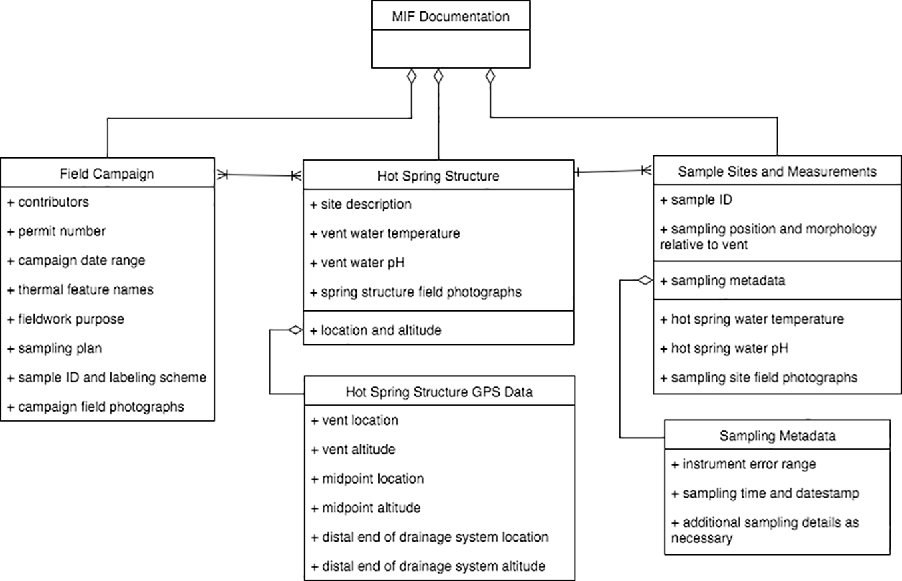
Minimum information framework - from geobiology
Palmer et al., 2017; Thomer 2017

Slide 8
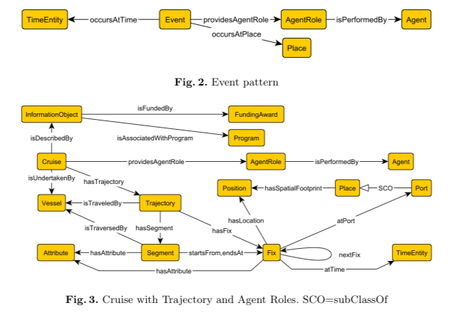
VOCamp inspiration: Geolink cruise & event patterns
http://daselab.cs.wright.edu/pub/2015-geolink-ontology.pdf

Slide 9
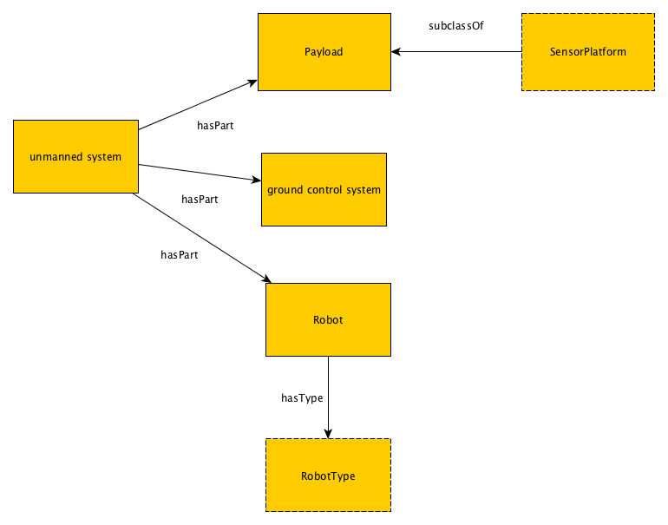
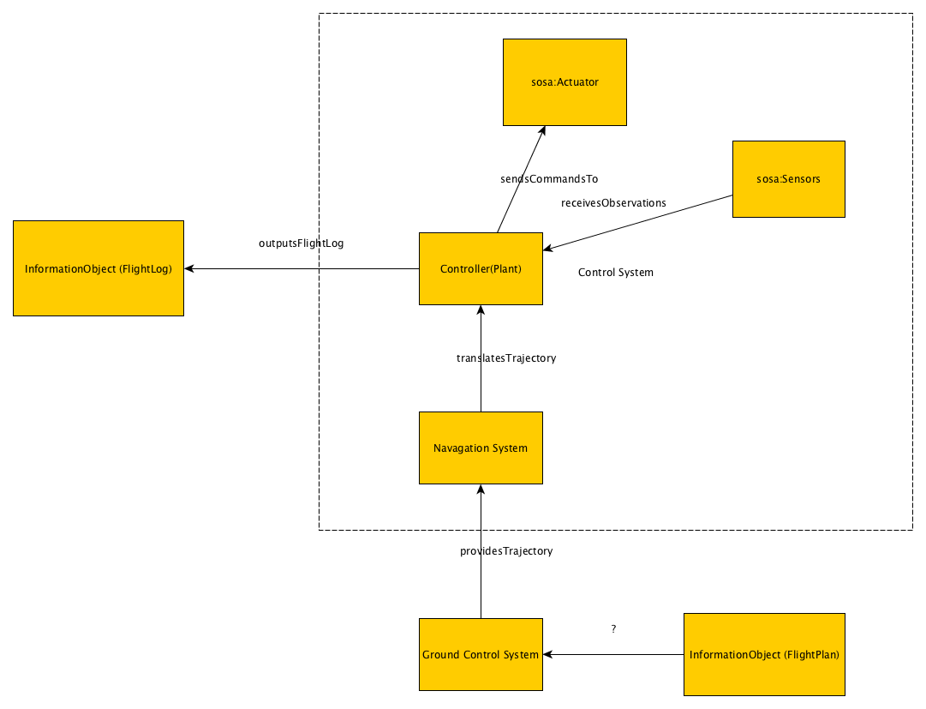
VOCamp: Unmanned System

Slide 10
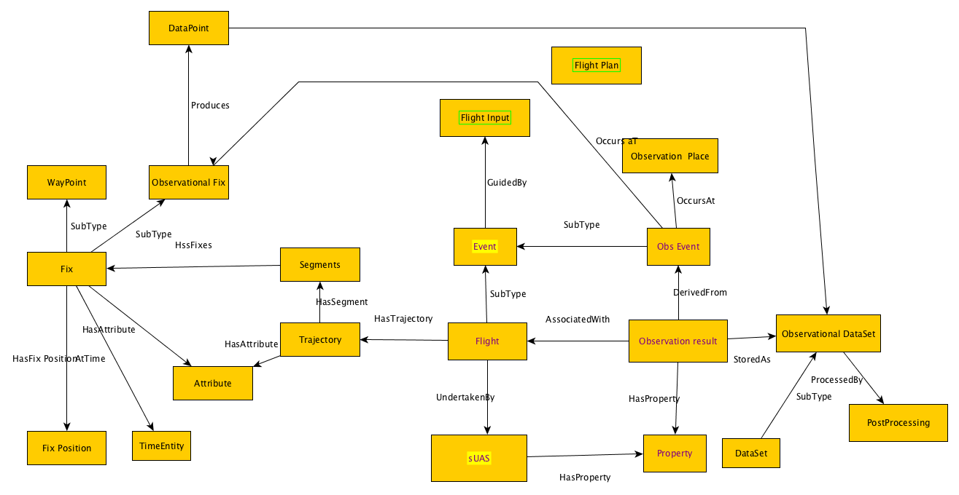
VOCamp: Flight Model

Slide 11
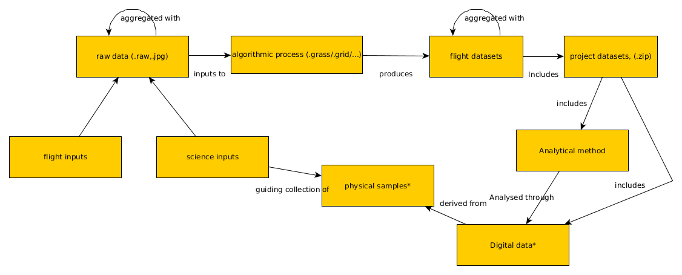
VOCamp: Results data flow

Slide 12
Aims for today?
Input wanted:
on the design patterns, and on our next steps toward a drone data ontology.
on planned work with YAMZ as part of the ESIP Lab project
On potential opportunities for pilot projects/testbeds with drone data

Slide 13
ESIP Winter meeting working session invitation
Joint session between the Semantic Web cluster and Drone Cluster: Applying semantic tech to sUAS data
Wednesday, 2:30pm

