Slide 1
Global Change Master Directory (GCMD) Keywords: A Resource for Building an Earth Science Ontology
Tyler Stevens, GCMD Science Coordinator
Geosemantic Symposium
ESIP Winter Meeting 2017
Bethesda, MD
January 10, 2017

Slide 2
Overview
GCMD Introduction
GCMD Keywords Overview
Keyword Development Process
Keyword Ontology Applications
Conclusions

Slide 3
GCMD Introduction

Slide 4
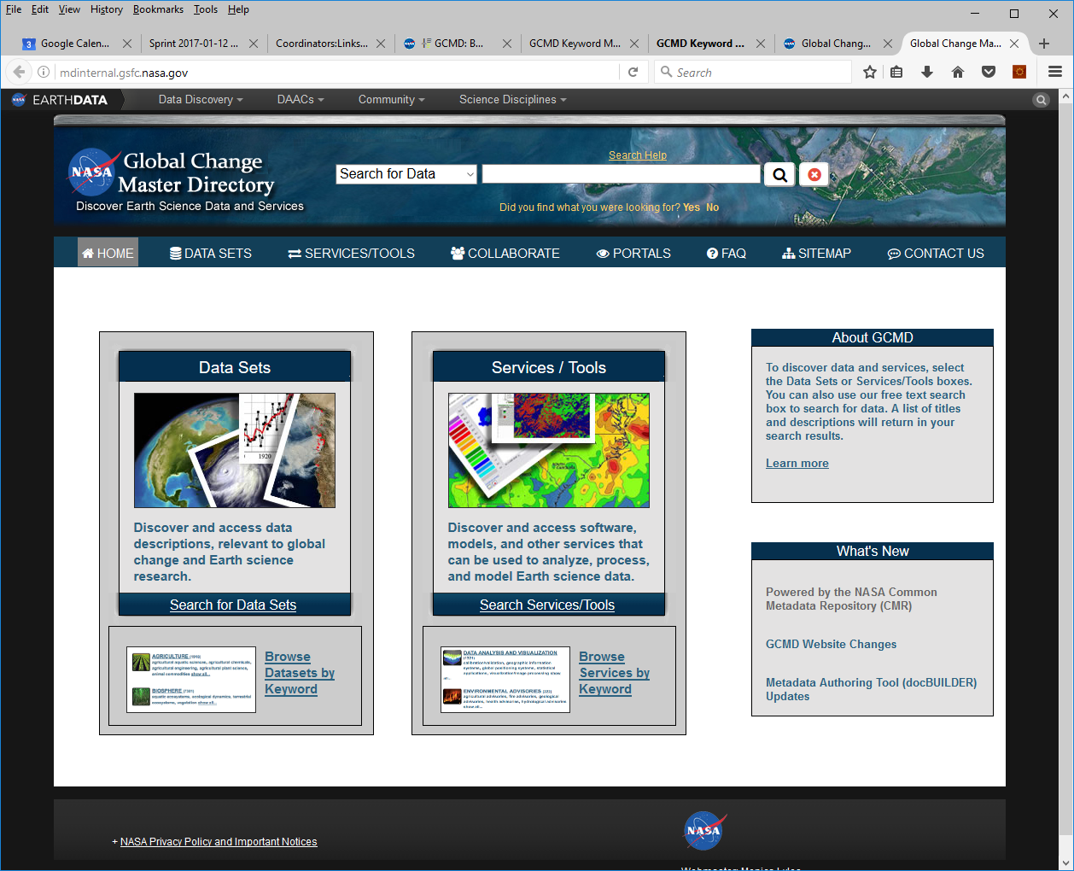
What is the GCMD?
Facilitates the discovery of Earth science data and related services.
Provides a search interface that allows users to search by free text, browse the GCMD controlled keywords, and do keyword refinements.
Powered by the NASA Common Metadata Repository (CMR), the authoritative source for NASA’s and IDN metadata.
http://gcmd.nasa.gov

Slide 5
GCMD Keywords Overview

Slide 6
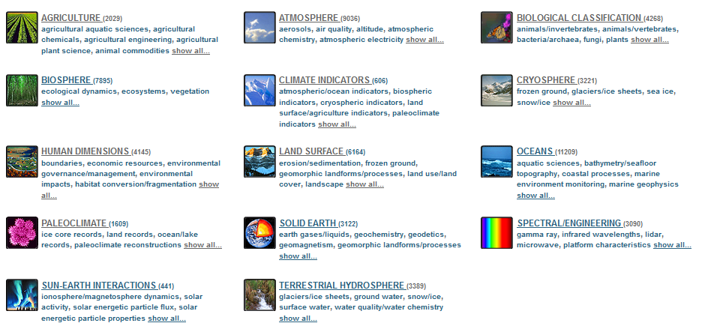
GCMD Keywords
Are a hierarchical set of controlled vocabulary covering Earth science disciplines that have been evolving for over 20 years.
Are used for describing Earth science data and services in a consistent and comprehensive manner to allow for the precise searching of collection metadata and subsequent retrieval of data.
Follow a governance process which defines the procedure for recommending additions, modifications, and/or deprecations to the keywords, and the process by which the user community will be informed of changes.
Earth Science Keywords

Slide 7
Keywords Per Category
Earth Science (2,862)
7 levels
Earth Science Services (166)
5 levels
Data Centers (3,593)
2 levels
Projects (1,657)
2 levels
Instruments/Sensors (1,481)
2 levels
Platforms/Sources (816)
2 levels
Locations (522)
6 levels
Horizontal Data Resolution (15)
1 level
Vertical Data Resolution (8)
1 level
Temporal Data Resolution (15)
1 level
URL Content Types (64)
2 levels
Chronostratigraphic Units (35)
5 levels
(# of keyword ‘concepts’ per category)

Slide 8
Keyword Structure Examples
Earth Science Category
Keyword Level | Example
Category | Earth Science
Topic | Atmosphere
Term | Weather Events
Variable Level 1 | Subtropical Cyclones
Variable Level 2 | Subtropical Depression
Variable Level 3 | Subtropical Depression Track
Detailed Variable | Subtropical Depression 7 Track
Platform/Sources Category
Keyword Level | Example
Short Name | Aqua
Long Name | Earth Observing System, Aqua

Slide 9
How Organizations Are Using GCMD Keywords
Over 50 organizations are using the keywords in the following ways:
Authoritative Vocabulary, Taxonomy, or Thesaurus
Committee on Earth Observation Satellites, Standing Committee on Antarctic Data Management (SCADM), Socioeconomic Data and Applications Center, Japan Aerospace Exploration Agency (JAXA)
Foundation for Building Ontologies
SWEET
Integration Within Metadata Catalogues
Earth Data Search Client, ORNL Mercury, NOAA One-Stop
Integration Within Metadata Curation Tools
docBUILDER, Metadata Management Tool

Slide 10
Keyword Development Process

Slide 11
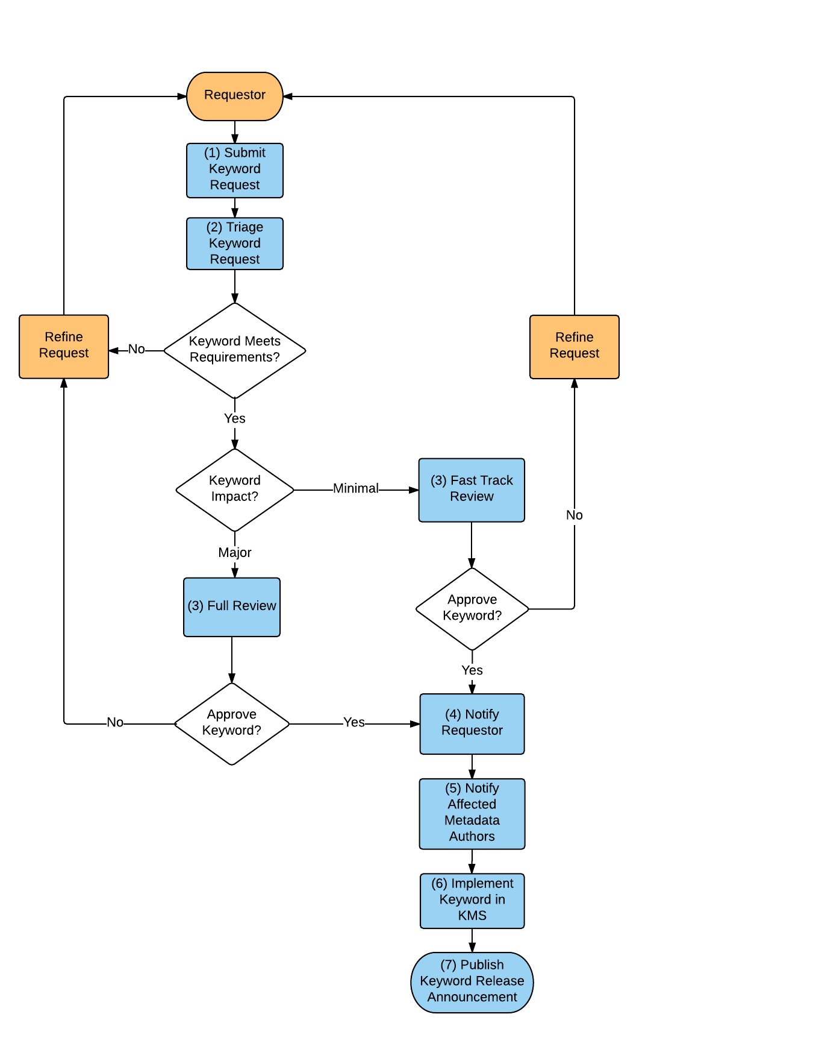
Keyword Development/Governance Process
Describes the end-to-end process of a keyword from initial request, triage, approval, notification, and implementation.
Keywords are managed using a configuration management tool - insert, update, move, delete, and relate keywords and associated definitions/references.
The Keyword Governance Process is derived from the Keyword Governance document.

Slide 12
Criteria For What Makes Good Keywords
Applicable to an established science discipline and practical to a broad range of users and metadata providers.
Composed of conventional terminology that is functional and understandable by the international community.
Should not overlap with keywords that already exist.
Parallel in scope at any level of the hierarchy.
All chosen topics, terms, and variables, at any level within the hierarchy, must be distinctive - minimizing overlap as much as possible. This will ensure a concise keyword list.
Should be logically/semantically correct.
Notes:
Note that its not a full list

Slide 13
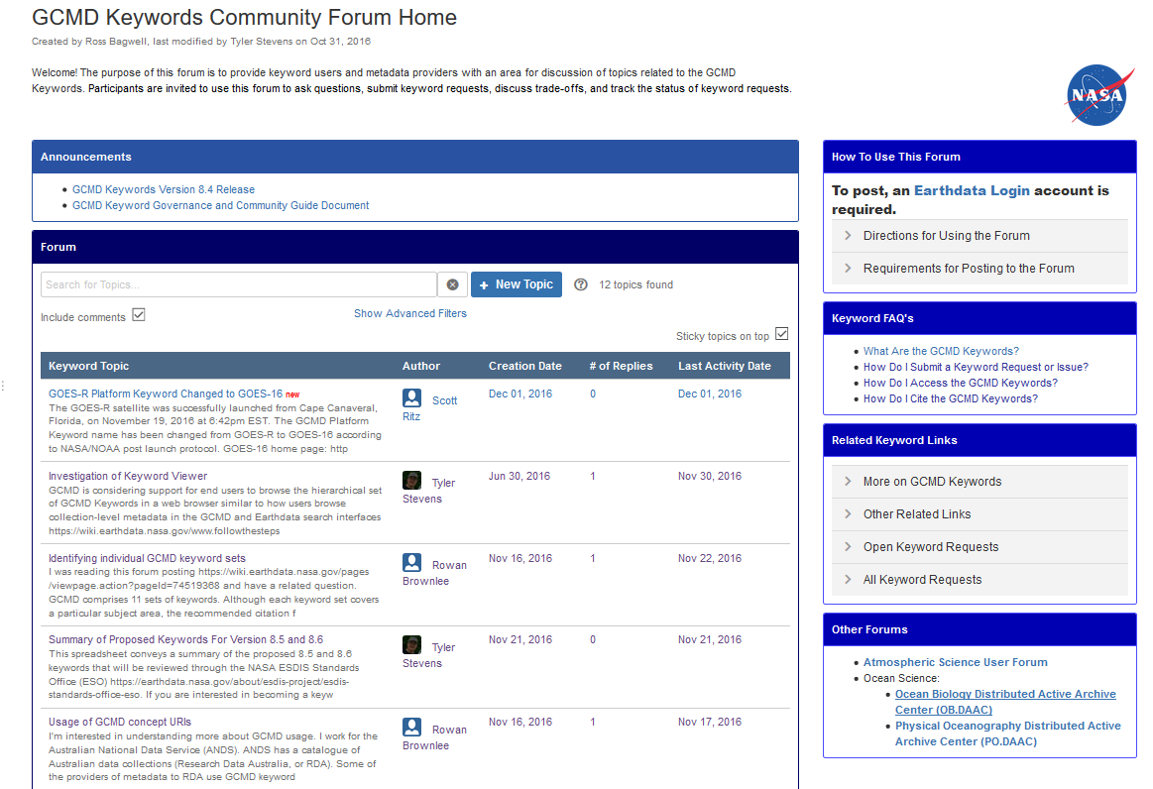

Discuss Keywords Via The Community Forum
The GCMD Keyword Community Forum provides keyword users and metadata providers with an area for discussion of topics related to the GCMD Keywords. Participants are invited to use the forum to ask questions, submit keyword requests, discuss trade-offs, and track the status of keyword requests. See http://earthdata.nasa.gov/gcmd-forum.
Have a Recommendation for a Keyword or a Question About the GCMD Keywords To Discuss?

Slide 14
Keyword Ontology Applications

Slide 15
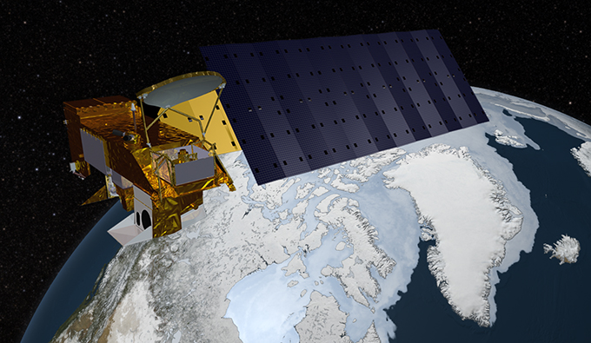
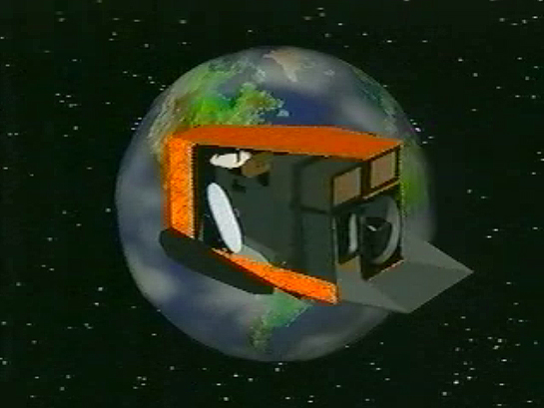
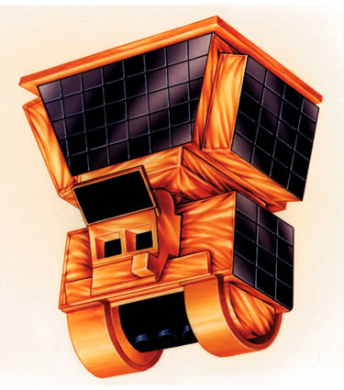
GCMD Platform-Instrument Ontology
An ontology relating Earth Observation Satellites to their associated instruments, utilizing existing GCMD keywords.
Accessible via KMS API
Applied in docBUILDER metadata authoring tool (suggests instruments based on platform selected)
Platform: Aqua
Instrument: MODIS
Instrument: Ceres

Slide 16
GCMD Ontology Implementation
Keywords are linked and related via unique identifiers known as UUIDs. Keywords are represented as SKOS Concepts (RDF).
Platform: Aqua
(UUID: ea7fd15d-190d-43f3-bdd3-75f5d88dc3f8)
Relationship Strength: 1.0
Relationship Strength: 1.0
Instrument: MODIS
(UUID: 2878f334-35dc-47a7-a3ae-8c5da1adccd3)
Instrument: CERES
(UUID: a9bd961e-1063-4f37-99b6-ecd77aa9eb40)

Slide 17
Building the Ontology
Initial effort focused on Earth Observation Satellites and their Instruments/Sensors
Encompasses most of NASA’s datasets
Relationships are strongly defined:
Instrument “A” flies on Satellite “B”
Example: MODIS flies on Aqua
Researched relationships using GCMD/IDN Metadata, product guides & catalogs, external taxonomies/ontologies, science expertise
Documented relationships in KMS
254 Platforms; 527 Instruments
Notes:
In talk, will define Ancillary Keywords

Slide 18
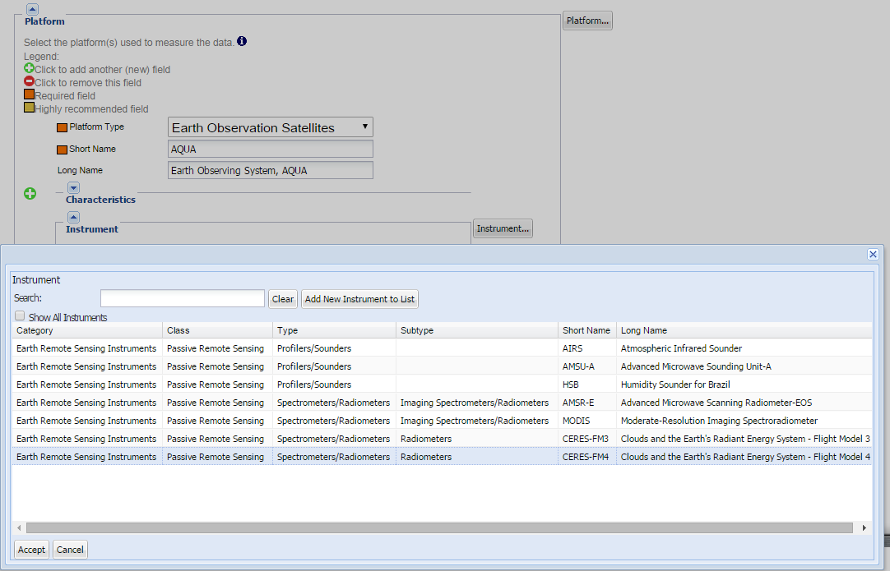
Ontology Application in Metadata Curation
Metadata Authoring
Restrict keying of Platform/Instrument fields in docBUILDER to known relationships.
Example: When Aqua is chosen as the Platform, only associated Instruments can be selected.

Slide 19
Conclusions
Strengths of Keyword Approach:
Defines a well structured hierarchy (for foundation of ontology building)
Established sets of diverse keywords across the Earth Sciences
Governance process that solicits community participation
Process for continually reviewing data products and updating keywords as needed to describe those products
Established tools for managing the keywords
Publically accessible in standardized formats
Regular keyword releases (bi-annually)
We are interested to hear how your community
may be using the GCMD Keywords.

Slide 20
Background

Slide 21
Accessing the Keywords
Background Information on the GCMD Keywords
https://earthdata.nasa.gov/about/gcmd/global-change-master-directory-gcmd-keywords
Access the Static Copy of the Keywords
https://wiki.earthdata.nasa.gov/display/CMR/GCMD+Keyword+Access
Available in CSV Format
Access the Dynamic Keyword API
http://gcmdservices.gsfc.nasa.gov/kms/capabilities?format=html
Available in SKOS/RDF/OWL/XML formats

Slide 22
Types of Support Provided by the GCMD
Provide Online Services:
GCMD Home Page
GCMD Search Interface
Portals
Support Metadata Creation Through docBuilder
Support Keyword Development and Access via KMS
Support Standards and Tools:
DIF9 and DIF10, SERF, Keywords, CMR Unified Metadata Model
QA Rules, Curation and Keyword Tools
Access CMR Database via Ingest API and Search API
Ingest and Curate Records:
From CEOS Partners, International Partners and US Agencies
Translation and Ingest Support
Curation (Automated and Manual)

Slide 23








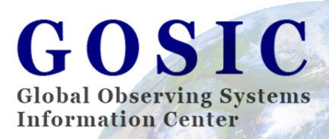









Organizations Using GCMD Keywords

