Slide 1


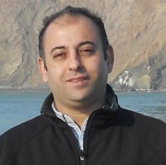
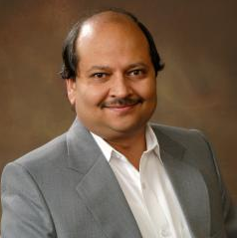
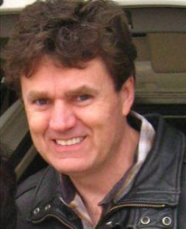
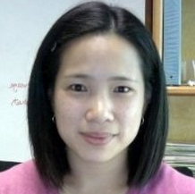
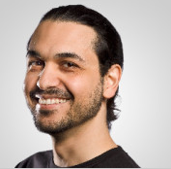
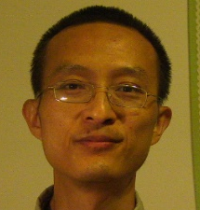
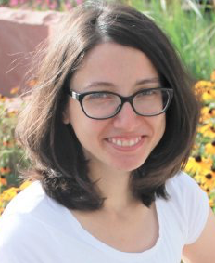





A GeoSemantic Framework for Integrating Long-Tail Data and Models
Mostafa Elag,
UIUC
Praveen Kumar, UIUC
Scott Peckham, CU
Leslie Hsu, LDEO
Luigi Marini,
NCSA
Rui Lui,
NCSA
Maria,
CU
Peishi Jiang,
UIUC
Kim Miller,
Wyoming
Yao Hu,
UIUC

Slide 2
(Long-Tail) Data-Model Interoperability Challenge
Collection
Domains
Metadata
Storage
Usage
Life cycle
Interoperability Levels
Programming Languages
Units & Time steps
Spatial Resolution
Reference/Coordinate Systems
Scientific Conventions Dependent on Science Domain
Variable names
L0: None
L1: Technical
L2: Syntactic
L3: Semantic
L4: Pragmatic
L5: Dynamics
L6: Conceptual
L7: Automatic
Data
Models
adapted from Wang, et al., 2009

Slide 3
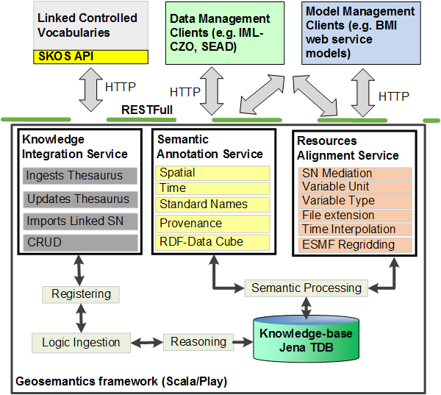
GeoSemantic Approach: OPEN API
GeoSemantics framework uses Micro-service architecture and Linked Data standards.
Semantic Annotation Service (SAS)
Annotates resources with spatiotemporal context, variable name, and provenance relationships
Automatic extractors based on the data files MIME type (e.g. GeoTIFF and CSV types)
Provides an interactive interface for manual annotation
Knowledge Integration Service (KIS)
Ingests, registers, and checks-in Controlled Vocabularies and W3C standards to the framework’s Knowledge-base
Provides semantic federated search
Resource Alignment Service (RAS)
Aligns the information profile associated with two geo-resources to ensure their semantic consistency before integration

Slide 4
GeoSemantic Approach: OPEN API
Model-as-a-service
Allows for rapid integration of heterogeneous models
Initial development using BMI enabled CSDMS models
EMELI-Web: Web based model integration engine based on Experimental Modeling Environment for Linking and Interoperability - EMELI (Peckham, 2014)
Leverage and contribute to related technologies/projects
SEAD
CLOWDER
BrownDog
IMLCZO
Demonstration
IMLCZO (Intensively Managed Landscape Critical Zone Observatory) context
SEN (Sediment Experimentalists Network)

Slide 5
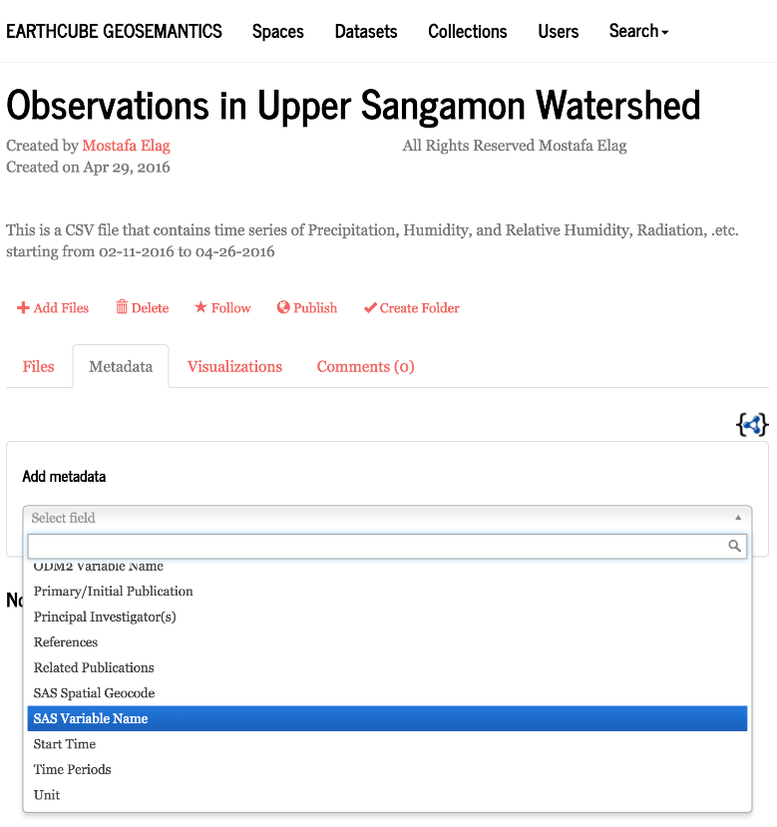
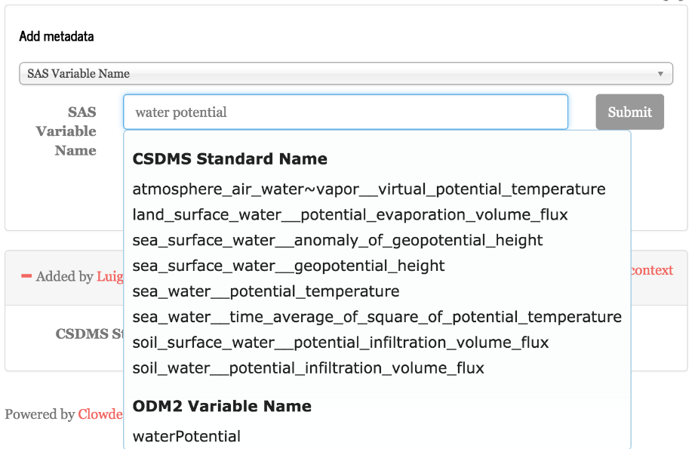
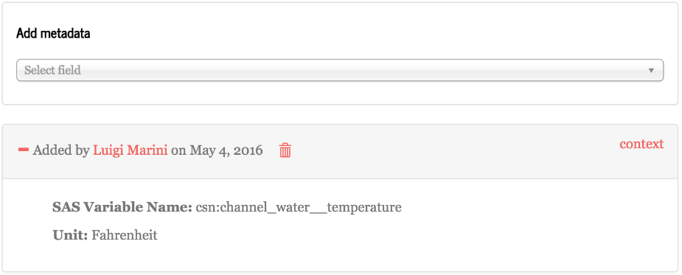
Clowder: Data Management Client
Open source data management for research: https://clowder.ncsa.illinois.edu/
User annotates files and datasets using local definitions and external standard vocabularies defined in SAS
Clowder is one example of a data management system calling SAS. Other data management system can do the same.
Clowder GUI
Web Browser
Javascript
Ajax Req
HTTP
GET
SAS
Clowder
Server
Standard Names
Data & Metadata
January 17 GeoSemantics Symposium http://www.hydrocomplexity.net

Slide 6
Summary and Future Path
GeoSemantic framework provides the services required for seamless semantic integration between data and models.
Enables model integration with distributed heterogeneous data resources
Enables library of models interoperable
Enables data discovery and synthesis, and data analytics
Going forward: address reliability and consistency challenges in a scalable environment using GeoSciences Semantic Infrastructure
Reliability: ability of a scientific workflow to execute correctly and produce scientifically expected results.
Consistency: ability of these workflows to do so in a non-contradictory manner across instantiations in multiple scientific contexts.
January 17 GeoSemantics Symposium http://www.hydrocomplexity.net

Slide 7
THANK YOU!

Slide 8
Resources
GeoSemantic Technology Descriptions (SAS, RAS, KIS, EMELI-Web, …):
http://hcgs.ncsa.illinois.edu/index.html
http://earthcube.org/group/geosemantics
January 17 GeoSemantics Symposium http://www.hydrocomplexity.net

