Slide 1
A Semantic Technologies Roadmap for Earth Science
ESIP GeoSemantics Symposium
January 8, 2018
Bhaskar Ramachandran
Terrestrial Information Systems Lab.
NASA Goddard Space Flight Center
Greenbelt, MD

Slide 2
Why do we need a semantic technologies (ST) roadmap for Earth science?
ST address the still-evolving methodological transformation regarding how meaning is addressed and handled in the digital era
Yet, consensus varies on what comprises/constitutes semantic technologies
An uneven pattern of evolution characterizes the growth of ST, which stems from the non-monolithic character of the research communities that have helped spawn them – For example: Here are the components and facets of ST research from 10 years ago

Slide 3
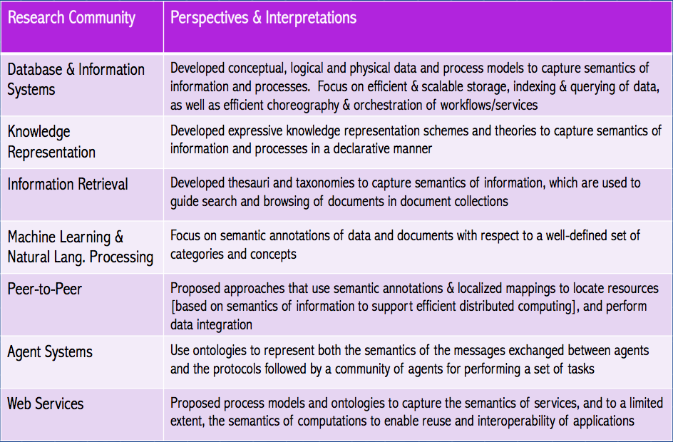
Functional components and facets of ST research
[Based on Kashyap et al., 2008]

Slide 4
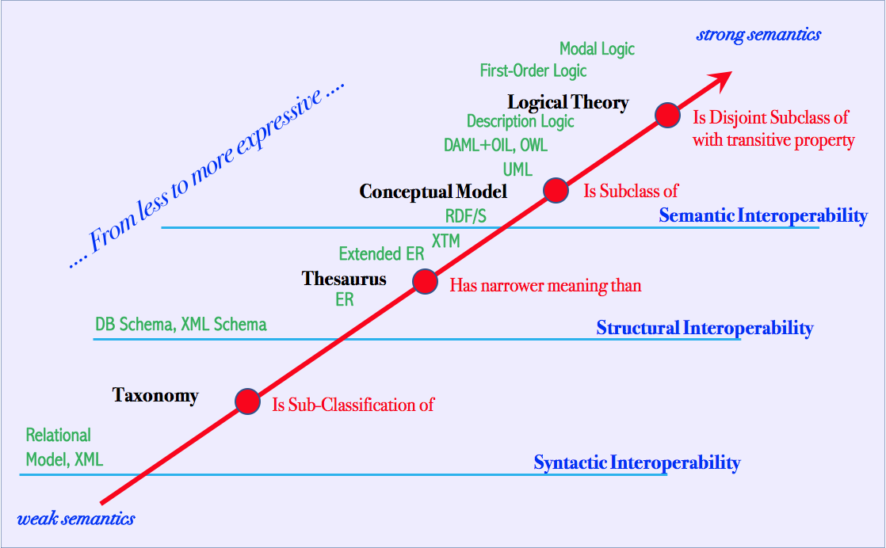
Semantic/ontology spectrum to delineate precision
[Obrst, 2008]

Slide 5
We will resume our discussion at 4:15 pm to further explore how we could focus on a variety of use-cases to demonstrate their value for Earth science ...
Please think about how your own work might contribute towards a use-case for this roadmap

Slide 6
Semantic Technologies Use-Cases
Articulate each use-case in terms of the following:
Identify semantic technology used (Ontologies, SKOS, etc.)
Type of domain data, information, and knowledge handled
Methodological frameworks used
Software/Tools used
Implementation examples
Problems encountered (polysemy, conceptualization, alignment, etc.)
Solutions applied to address the problems
Value proposition/benefits
Quality evaluation and metrics for ontologies

Slide 7
ESIP and Semantic Technologies
What is ESIP’s role in fostering semantic technologies?
Potential roles and activities that ESIP can support to help strengthen the value of semantic technologies (Governance, protocols, policies, standards, outreach, etc.)

