Slide 1

ESIP Summer Meeting 2019
3rd Annual Geosemantics Symposium
hosted by the ESIP Semantic Technology Committee
WiFi Access
Network: GTCTC-Public
(no password required)

Slide 2
Sched Details
Check out the full agenda and create your own schedule at https://sched.co/MKH5
If you personalize your schedule, Sched will send you one email daily with the schedule for the day. You can also download the Sched app on your phone for easy viewing throughout the day.

Slide 3
Goals:
This year's symposium theme is Building Harmony between Data Semantics and Machine Learning which will act as, amongst other things, a platform for Semantic Technologies and Machine Learning enthusiasts to come together in an interdisciplinary manner.
The symposium will aim to investigate and integrate data semantics as a first class citizen within the pervasive machine learning technology space.
This is an excellent opportunity for us to establish stronger connections between the ESIP Machine Learning and Semantic Technologies communities.

Slide 4
Agenda
Morning sessions: The morning features 4 30-minute guest presentations with 10 minutes for questions between presentations so please be thinking about questions. A brief coffee break is arranged for mid morning – 10AM.
Speaker presentation materials available at https://esipfed.github.io/stc/symposium/2019/symposium_schedule.html

Slide 5
Agenda
Lunch: … will start at 11:30 – 12:30.
ESIP has generously provided lunch for all on-site attendees.
We also have a lunchtime presentation from Dr. Jane Wyngaard who is leading the LANDRS: Linked-data API for Networked DRoneS initiative. This will be continuing with a full day hackathon on Tuesday, 16th.

Slide 6
Agenda
Afternoon sessions: … involve three 90-minute hands-on workshops which will take us through to 5:30PM. For those that can make it, the Drone Data API agenda will continue after 5:30 so stick around!!!
Each workshop is separated with a 15 minute coffee break.
Again, all workshop materials are available at https://esipfed.github.io/stc/symposium/2019/symposium_schedule.html

Slide 7

Agenda
Discussion: Please bring any discussion items to the following forums
SemTech Committee Business Meeting
Friday, July 19 • 11:45am - 1:15pm
OR
esip-semanticweb@lists.esipfed.org

Slide 8
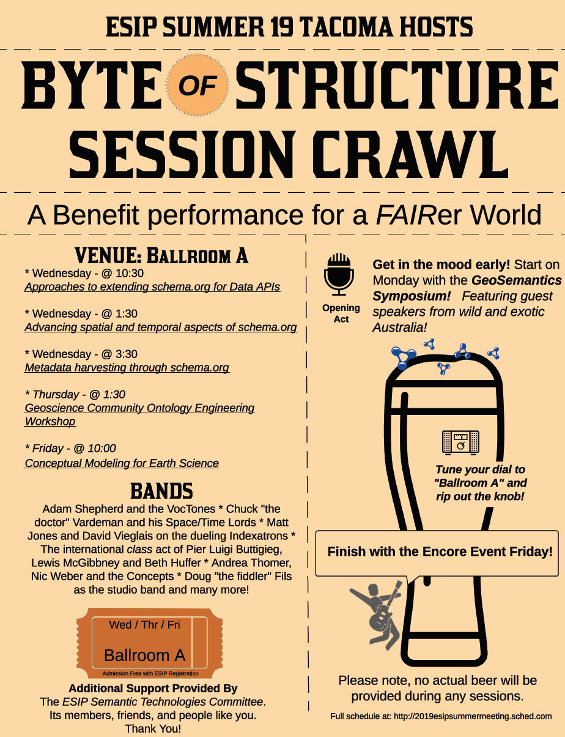

Slide 9
Acknowledgements
We are grateful to ESIP for their generous financial and logistical support, including
Coffee breaks
Boxed lunch
Venue and technical accommodations
Dan Keyes (AV Technitian), Matt Burdetsky (food and drink arrangements), you’re the best!
Guest Presenters
If you’re not already a member, please consider joining the ESIP Semantic Technology Committee
http://wiki.esipfed.org/index.php/Semantic_Technologies

Slide 10
Finally… Feedback
Feedback on todays content is extremely valuable. The aim is to continue the Geosemantics Symposium as a co-located, pre-ESIP Winter event for the foreseeable future. Without your criticisms we cannot make the event useful and relevant for attendees.
Please give your feedback on SCHED - under What did you think?
Additionally, please speak or email Beth+/Lewis

