Slide 1
A Framework to Enable Interpretation of the Data
J. Steven Hughes
Principal Computer Scientist
Jet Propulsion Laboratory
ESIP GeoSemantics Symposium
January 10th, 2017
Copyright 2010 California Institute of Technology
Government sponsorship acknowledged

Slide 2
Some Definitions
Semantics is the study of meaning focusing on relationships.
Information Model - In data engineering it is a representation of concepts and the relationships, constraints, rules, and operations for a chosen domain.
It provides a sharable, stable, and organized structure of information requirements or knowledge for the domain context.¹
[1] Y. Tina Lee (1999). "Information modeling from design to implementation" National Institute of Standards and Technology.

Slide 3
Use Cases
What Mars Reconnaissance Orbiter (MRO) High Resolution Imaging Science Experiment (HiRISE) Reduced Data Record (RDR) images have both craters and dunes?
What coordinate system was used for the HiRISE RDR images?
An anomalous artifact was found in an Engineering Data Record (EDR) image of Cydonia Mesa collected by HiRISE. For analysis the following are requested:
the calibration files used to calibrate this image
published instrument design documents.
https://en.wikipedia.org/wiki/Mars_Reconnaissance_Orbiter

Slide 4
Terms, Definitions, and Relationships
What Mars Reconnaissance Orbiter (MRO) High Resolution Imaging Science Experiment (HiRISE) Reduced Data Record (RDR) images have both craters and dunes?
What coordinate system was used for the HiRISE RDR images?
An anomalous artifact was found in an Engineering Data Record (EDR) image of Cydonia Mesa collected by HiRISE. For analysis the following are requested:
the calibration files used to calibrate this image
published instrument design documents.
Digital Object

Slide 5
Terms, Definitions, and Relationships
What are these things?
What Mars Reconnaissance Orbiter (MRO) High Resolution Imaging Science Experiment (HiRISE) Reduced Data Record (RDR) images have both craters and dunes?
What coordinate system was used for the HiRISE RDR images?
An anomalous artifact was found in an Engineering Data Record (EDR) image of Cydonia Mesa collected by HiRISE. For analysis the following are requested:
the calibration files used to calibrate this image
published instrument design documents.

Slide 6
Terms, Definitions, and Relationships
How are these things related to the data?
What Mars Reconnaissance Orbiter (MRO) High Resolution Imaging Science Experiment (HiRISE) Reduced Data Record (RDR) images have both craters and dunes?
What coordinate system was used for the HiRISE RDR images?
An anomalous artifact was found in an Engineering Data Record (EDR) image of Cydonia Mesa collected by HiRISE. For analysis the following are requested:
the calibration files used to calibrate this image
published instrument design documents.
collected
by
derived from
identified in

Slide 7
The Information Model (IM)
The Information Model provides the information requirements for the system
Defines the terms in the community and their relationships
Improves consistency and interoperability and reduces ambiguity
Establishes an overarching federated governance model for the metadata
Provides common, discipline, and local governance
Localizes changes and allows extensions as the community evolves
Promotes model independence
Is effectively the “corner-stone” of the “information model-driven” design paradigm
Allows the system to be configured by and to respond to the information model (information requirements)
Enables agile development
Handles diversity
Accommodates new instruments, observation types, data, …
Reduce the impact of changes on the system

Slide 8
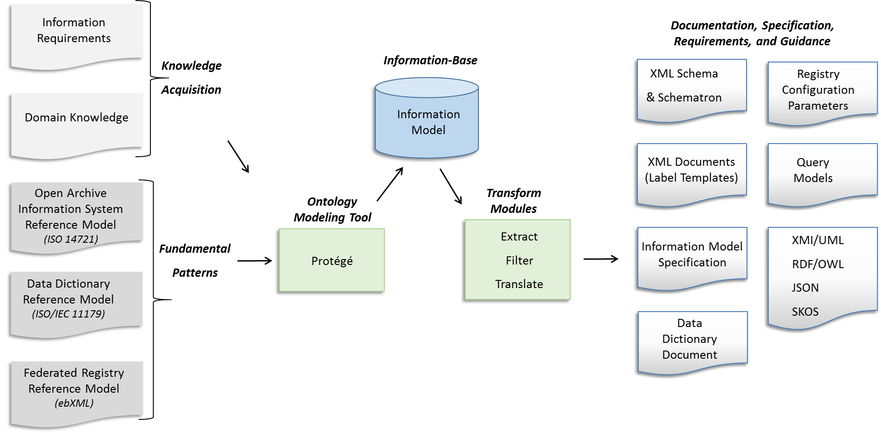
Components of the Framework

Slide 9
Input
Foundational Principles
Open Archival Information System Reference Model (OAIS-RM)
Data Dictionary Reference Model
Federated Registry Reference Model
Community-Specific Input
Information Requirements
Domain Knowledge

Slide 10
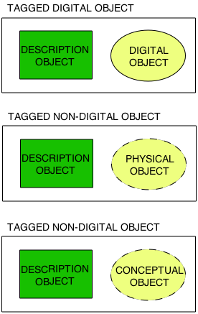
Open Information Archive System (OAIS) Reference Model
Information Object¹
digital object: An object which is real data — for example, a binary image of a redwood tree.
physical object: An object which is physical or tangible – for example the planet Saturn and the Venus Express magnetometer.
conceptual object: An object which is intangible – for example the Cassini mission and NASA’s strategic plan for solar system exploration.
¹Open Archival Information System (OAIS) Reference Model - ISO 14721:2003

Slide 11
Data Management¹
Information Object Model¹
Description Object
Management
digital object: An object which is real data — for example, a binary image of a redwood tree.
physical object: An object which is physical or tangible – for example the planet Saturn and the Venus Express magnetometer.
conceptual object: An object which is intangible – for example the Cassini mission and NASA’s strategic plan for solar system exploration.
¹Open Archival Information System (OAIS) Reference Model - ISO 14721:2003

Slide 12
Data Object Management
Information Object Model¹
Description Object
Management
Data Object Management
digital object: An object which is real data — for example, a binary image of a redwood tree.
physical object: An object which is physical or tangible – for example the planet Saturn and the Venus Express magnetometer.
conceptual object: An object which is intangible – for example the Cassini mission and NASA’s strategic plan for solar system exploration.
¹Open Archival Information System (OAIS) Reference Model - ISO 14721:2003

Slide 13
Information Categories¹
Identification
Identification information provides a unique and immutable identifier for any information object that is to be discovered and accessed.
Representation/Format
Representation information allows a data object to be interpreted. This includes describing the data format.
Integrity (Fixity)
Integrity information ensures the information object has not been unintentionally altered.
Provenance
Provence Information provides the history of the data and is essential for authenticity. It must include the provider.
Context
Context information provides additional information that describes the environment in which the data object was created. For example, context information may describe instruments or light sources.
Reference
Reference information allows the information objects to be referenced. Identification information is a subset of Reference Information.
Access Rights
Access Rights information identifies the access restrictions pertaining to the data, including the legal framework, licensing terms, and access control; provider provided access and distribution conditions, and specifications for rights enforcement measures.

Slide 14
Data Dictionary Reference Model²
Governance Entities¹
Registration Authority
Steward
Namespace
Common
Governance
Levels
Discipline
Project
²ISO/IEC 11179:2003 - Volume 3 – Metadata Registry Specification

Slide 15
Registry Reference Model
ebXML (Electronic Business XML) - Standardizes the secure exchange of data
Defines key properties of a federated registry
registry database schema
registry object (generic)
Extensions: products, granules, etc
First class objects
digital, physical, and conceptual
common registry services
tracking/locate/retrieval
core attributes
identification (e.g. <logical_identifier>)
versioning (e.g. <version_identifier>)

Slide 16
Information Requirements
The community’s Requirements and Policies set the foundation for the information requirements.
1. The System will provide expertise to guide and assist missions, programs, and individuals to organize and document digital data supporting the institutions goals in science exploration.
1.4 Archiving Standards: The system will have archiving standards for science data
1.4.1 The system will define a standard for organizing, formatting, and documenting science data
1.4.2 The system will maintain a dictionary of terms, values, and relationships for standardized description of science data
1.4.3 The system will define a standard grammar for describing science data
1.4.4 The system will establish minimum content requirements for a data set (primary and ancillary data)
1.4.5 The system will, for each mission or other major data provider, produce a list of the minimum components required for archival data
1.4.6 The system will develop, publish and implement a process for managing changes to the archive standards
1.4.7 The system will keep abreast of new developments in archiving standards

Slide 17
Domain Knowledge
The experiential (first hand) information about things of interest known by experts in the domain.
Information about the “things” that should be collected and associated with the data to make and keep it useful.
The data and their structures (representation information)
The context within which the data was used and collected
Investigations/Missions/Campaigns
Observing Systems/Instruments
Personnel
Data collection targets of interest

Slide 18
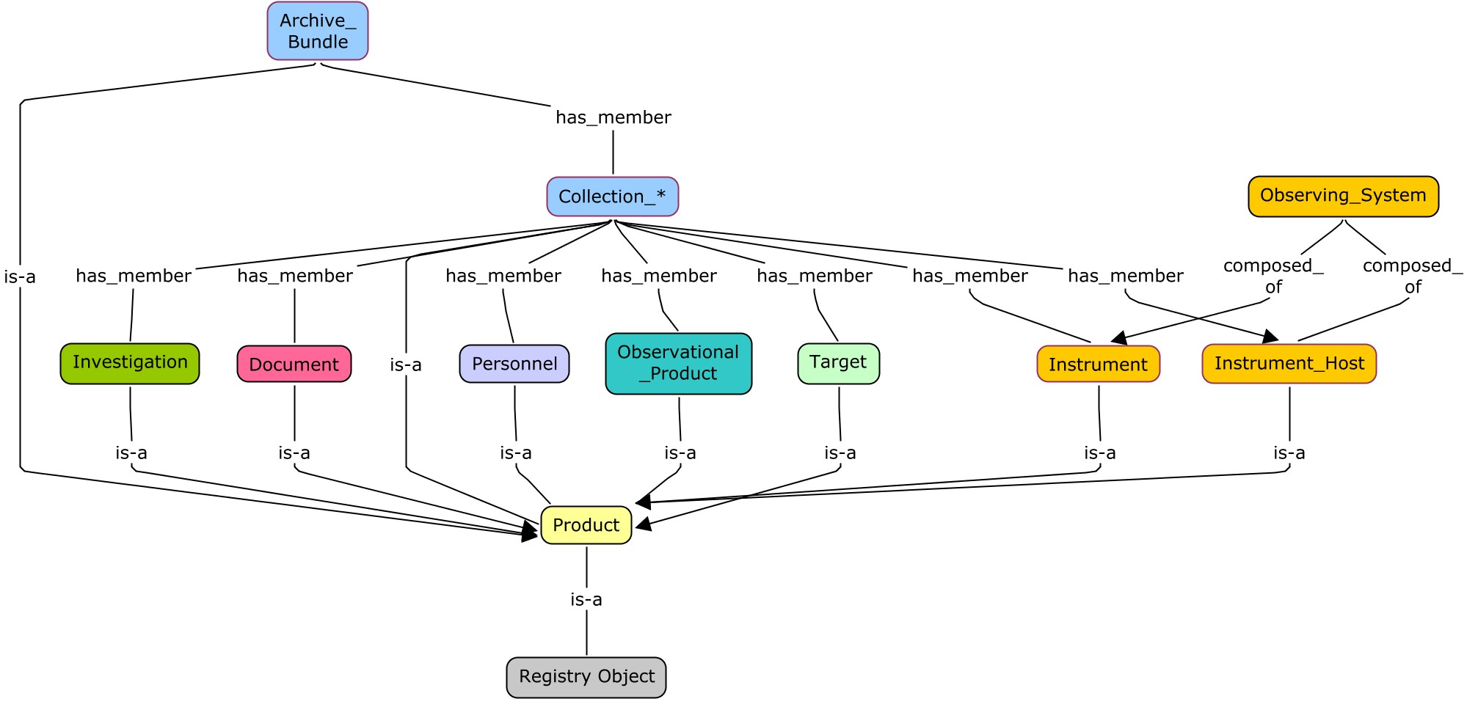
Domain Knowledge

Slide 19
Process

Slide 20
The Information Model Database
All “things of interest” are defined in an object modeling tool.
All objects and their attributes and relationships.
Typically an ontology modeling tool is used
Necessary but not necessarily sufficient
A master database is created by merging the object model(s) and the data dictionary.
The contents of the master database is filtered and written to system files in various formats.
Used by the data providers, registry, harvester, search engine, validator and other system tools and services.

Slide 21
Output

Slide 22
XML Schema and Schematron Files
<xs:complexType name="Array"> <xs:annotation> <xs:documentation>The Array class defines a homogeneous N-dimensional array of scalars. … </xs:annotation> <xs:complexContent> <xs:extension base="pds:Byte_Stream"> <xs:sequence> <xs:element name="offset" type="pds:offset" minOccurs="1" maxOccurs="1"> </xs:element> <xs:element name="axes" type="pds:axes" minOccurs="1" maxOccurs="1"> </xs:element> <xs:element name="axis_index_order" type="pds:axis_index_order" minOccurs="1“ … <xs:element name="description" type="pds:description" minOccurs="0" maxOccurs="1"> … <xs:element name="Element_Array" type="pds:Element_Array" minOccurs="1“ … <xs:element name="Axis_Array" type="pds:Axis_Array" minOccurs="1“ … …
<sch:pattern> <sch:rule context="pds:Array/pds:axis_index_order"> <sch:assert test=". = ('Last Index Fastest')"> The attribute pds:axis_index_order must be equal to the value 'Last Index Fastest'.</sch:assert>

Slide 23
Product Label Template
Identification_Area
Logical_Identifier
Version_Id
Common
Area
Observation_Area
Time_Coordinates Discipline_Area
Primary_Result_Summary Mission Area
Investigation_Area
Observing_System
Target_Identification
Reference_List
Internal_Reference
External_Reference
File_Area_Observational
File
Header
Array_2d_Image

Slide 24
The Framework at Work
What Mars Reconnaissance Orbiter (MRO) High Resolution Imaging Science Experiment (HiRISE) Reduced Data Record (RDR) images have both craters and dunes?
Spacecraft, instruments, digital images, documentation, and calibration files are all defined and related in the information model as classes.
Labeled objects are created, validated and ingested into the registry.
All registered objects are considered first-class that can be tracked, located and retrieved..
The Imaging Atlas (catalog) uses semantics from the information model and harvested metadata from labeled objects to provide field- and facet-based search.
Image content annotations were generated using a visual salience landmark detector plus a deep learning neural network classifier.
Enables Image Atlas to provide content-based search for HiRISE RDR images of Mars

Slide 25
Semantics at Work
What coordinate system was used for the HiRISE RDR images?
Coordinate systems are defined as a class (with subclasses) in a discipline level cartography model
The label for the image indicates that the coordinate system used is planetocentric latitude and east positive longitude direction.
An anomalous artifact was found in an Engineering Data Record (EDR) image of Cydonia Mesa collected by HiRISE. For analysis the following are requested:
the calibration files used to calibrate this image
published instrument design documents.
Documents are either referenced as registered objects or via bibliographic citations.
Features are classified and defined in a feature catalog.

Slide 26
Thank You! PDS4 Documents https://pds.jpl.nasa.gov/pds4/doc/index.shtml

Slide 27
Backup

Slide 28
Data Dictionary Schema
Data Element
Name
Submitter, Steward
Definition
Namespace
Source of definition
Change log
Version
Concept
Alternate Names
Definition in different natural languages
Classification
Unit of measurement
Effective Dates
Value Domain
Permissible Value
Value Meaning
Submitter, Steward
Definition
Cardinality
Source of definition
Change log
Version
Concept
Character Set
Representation
Minimum and Maximum Value
Minimum and Maximum Length
Alternate encodings
Effective Dates

Slide 29
Documentation Links
PDS4 Documents: https://pds.jpl.nasa.gov/pds4/doc/index.shtml
IM Spec: https://pds.jpl.nasa.gov/pds4/doc/im/v1/index_1700.html
DD (html): https://pds.jpl.nasa.gov/pds4/doc/dd/v1/PDS4_PDS_DD_1700.html
DD (pdf): https://pds.jpl.nasa.gov/pds4/doc/dd/v1/PDS4_PDS_DD_1700.pdf
Release Notes: https://pds.jpl.nasa.gov/pds4/doc/im/v1/PDS4Build7a_Release_1700_160928.pdf
XSD: https://pds.jpl.nasa.gov/pds4/schema/released/pds/v1/PDS4_PDS_1700.xsd
SCH: https://pds.jpl.nasa.gov/pds4/schema/released/pds/v1/PDS4_PDS_1700.sch
XML: https://pds.jpl.nasa.gov/pds4/schema/released/pds/v1/PDS4_PDS_1700.xml
JSON: https://pds.jpl.nasa.gov/pds4/schema/released/pds/v1/PDS4_PDS_JSON_1700.JSON
OWL/RDF: https://pds.jpl.nasa.gov/pds4/schema/released/pds/v1/PDS4_PDS_OWL_1700.rdf

Slide 30
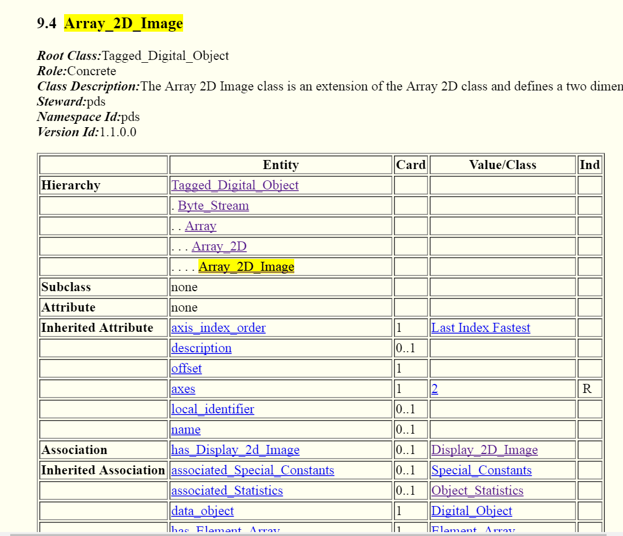
Information Model Specification

Slide 31
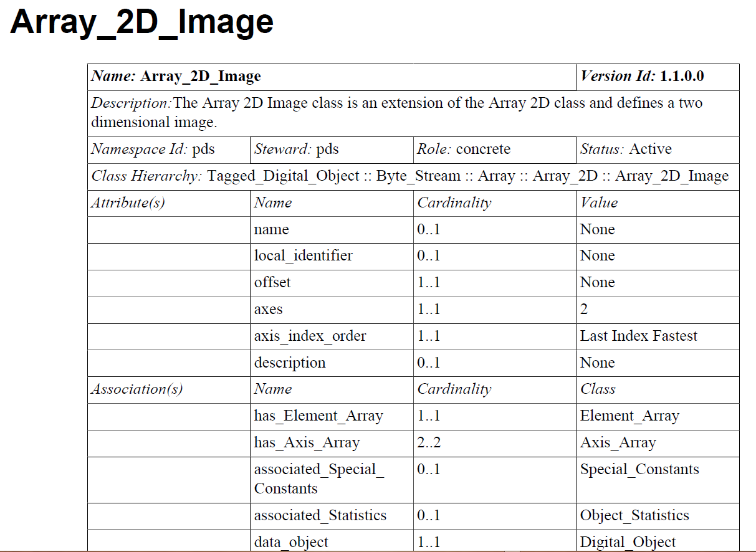
Data Dictionary Document (pdf and html formats)

Slide 32
JSON File (Tool Configuration)
"class": {
"identifier": "0001_NASA_PDS_1.pds.Array_2D_Image" ,
"title": "Array_2D_Image" ,
"registrationAuthorityId": "0001_NASA_PDS_1" ,
"nameSpaceId": "pds" ,
"steward": "pds" ,
"versionId": "1.1.0.0" ,
"description": "The Array 2D Image class is an extension of the Array 2D class and …
, "associationList": [
{"association": {
"identifier": "0001_NASA_PDS_1.pds.Array.pds.offset" ,
"title": "offset" ,
"isAttribute": "true" ,
"isChoice": "false" ,
"isAny": "false" ,
"minimumCardinality": "1" ,
"maximumCardinality": "1" ,
"classOrder": "1010" ,
"attributeId": [
"0001_NASA_PDS_1.pds.Array.pds.offset"
]
}
}

Slide 33
XML Product Templates and Labels
<Product_Observational
<Identification_Area>
<logical_identifier>urn:nasa:pds:example.dph.sampleproducts:exampleproducts:array2d_image …
<version_id>1.0</version_id>
<title>MARS PATHFINDER LANDER Experiment</title>
<Array_2D_Image>
<local_identifier>MPFL-M-IMP_IMG_GRAYSCALE</local_identifier>
<offset unit="byte">0</offset>
<axes>2</axes>
<axis_index_order>Last Index Fastest</axis_index_order>
<Element_Array>
<data_type>UnsignedMSB2</data_type>
<unit>data number</unit>
<scaling_factor>1</scaling_factor>
<value_offset>0</value_offset>
</Element_Array>
<Axis_Array>
<axis_name>Line</axis_name>
<elements>248</elements>
<sequence_number>1</sequence_number>
</Axis_Array>
<Axis_Array>
<axis_name>Sample</axis_name>
<elements>256</elements>
<sequence_number>2</sequence_number>

Slide 34
Registry Configuration Parameters
reg_object_type: Product_Observational
metadata: {
slot1: start_date_time
slot2: stop_date_time
slot3: version_id
slot4: title
slot5: product_class
slot6: logical_identifier
slot7: alternate_title
slot8: alternate_id
slot9: version_id
}

Slide 35
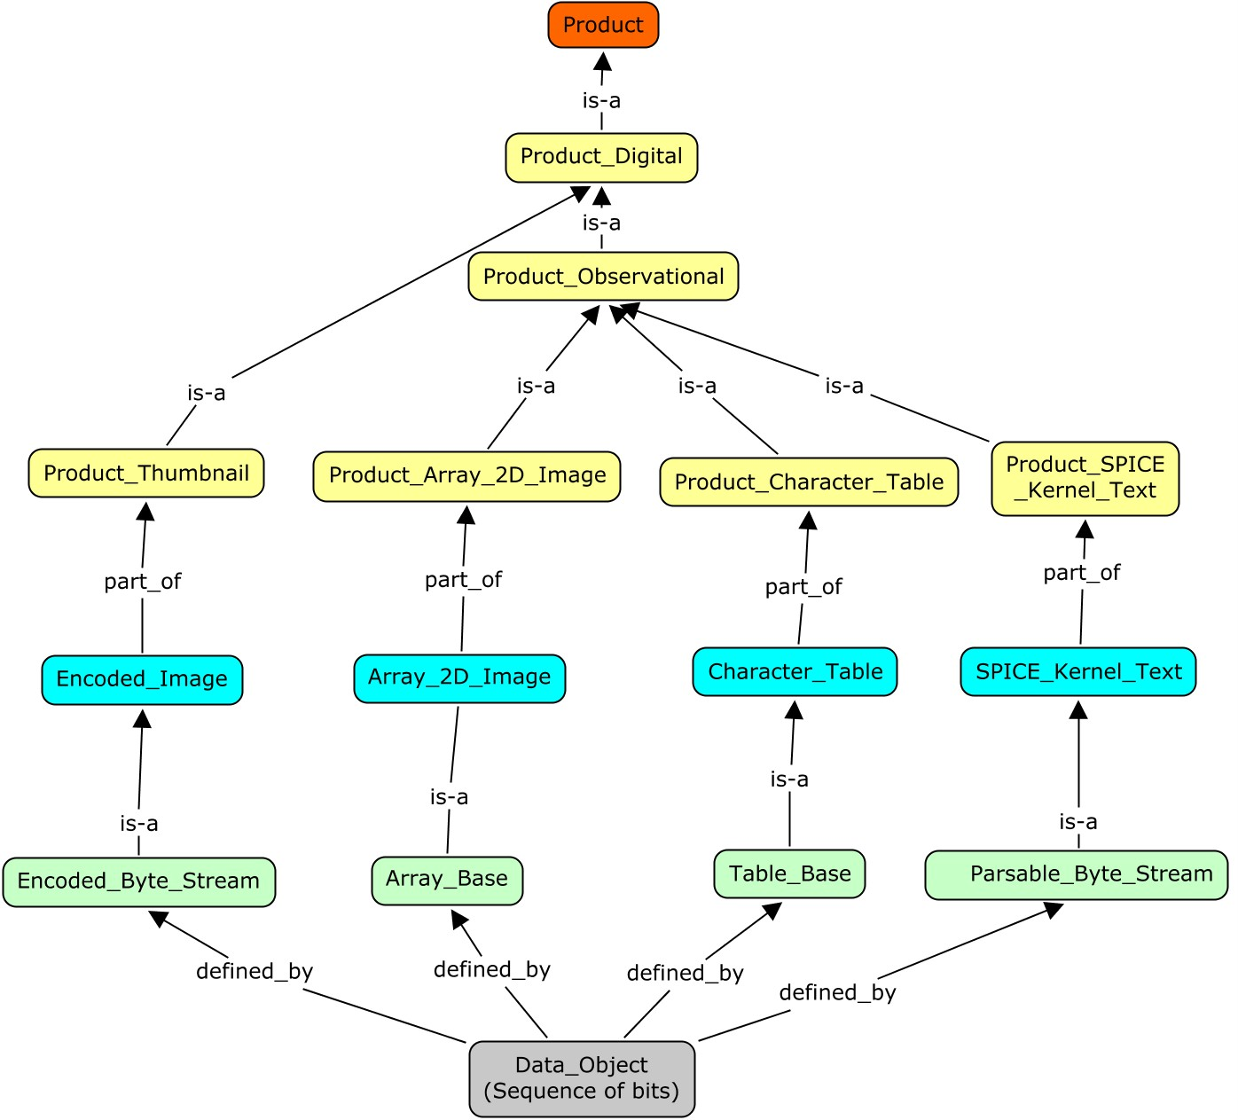
Product Concept Map

Slide 36
Domain Knowledge and Information Objects
Information Object

Slide 37
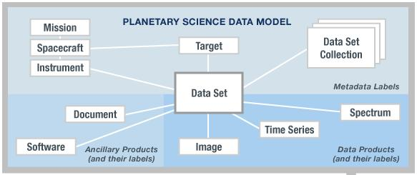
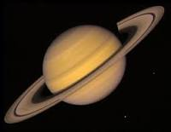
From Information Model to Product Label
Information
Model
Product
Used to
Create
Tagged Data Object
(Information Object)
<local_identifier>MPFL_M_IMP_IMAGE</local_identifier>
<offset unit="byte">0</offset>
<axes>2</axes>
<axis_index_order>Last_Index_Fastest</axis_index_order>
<encoding_type>Binary</encoding_type>
<Element_Array>
<data_type>SignedMSB4</data_type>
<unit>pixel</unit>
</Element_Array>
<Axis_Array>
<axis_name>Line</axis_name>
<elements>248</elements>
<sequence_number>1</sequence_number>
</Axis_Array>
<Axis_Array>
<axis_name>Sample</axis_name>
<elements>256</elements>
<sequence_number>2</sequence_number>
</Axis_Array>
</Array_2D_Image>
Validates
XML
Schema
Expressed As
Extracted/Specialized
Data Element
has
Describes
Class
Planetary Science
Data Dictionary
Data Object

Slide 38
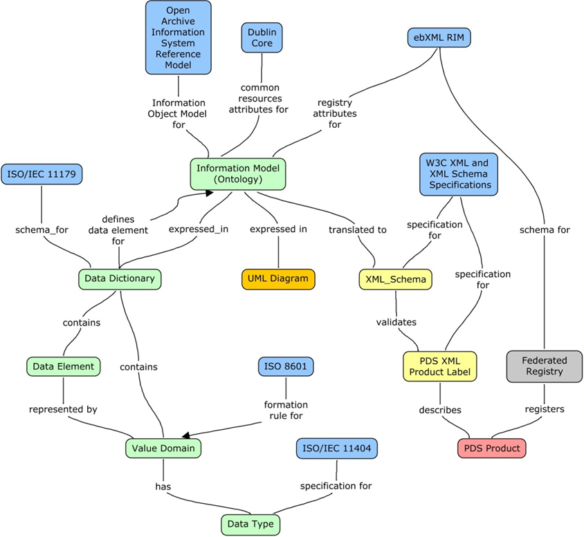
Reference Models

