Slide 1
GeoSemantics Panel
ESIP Winter Meeting 2017

Slide 2
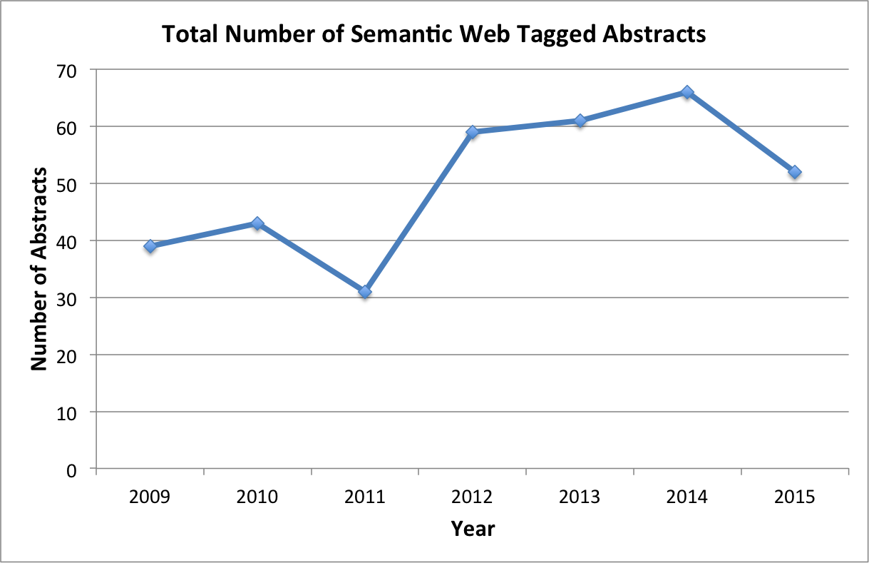
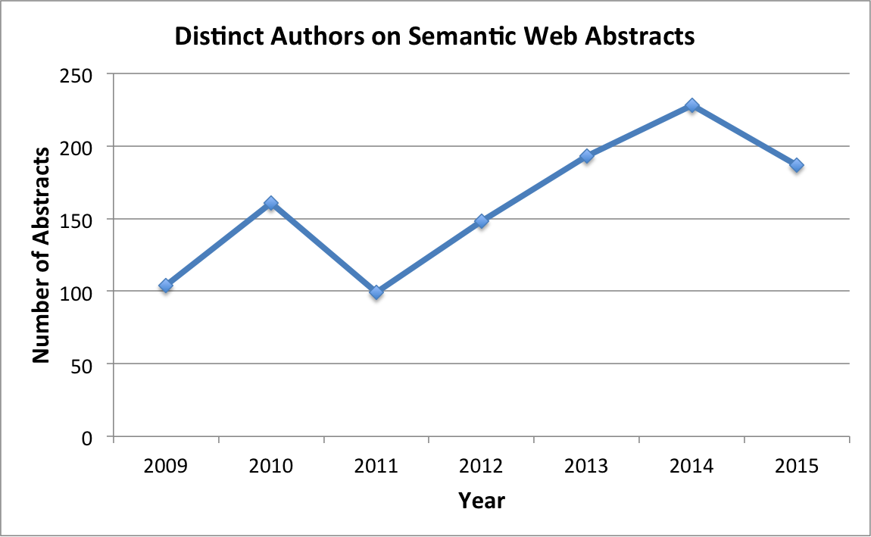
Where is the semantic geoscience community?
Source: Narock and Wimmer (2016), https://authors.elsevier.com/a/1UFjWMMTPPJEp
http://dx.doi.org/10.1016/j.cageo.2016.12.008

Slide 3
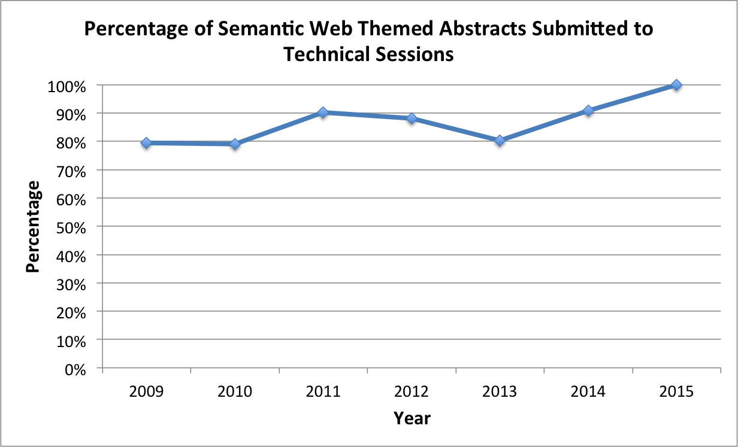
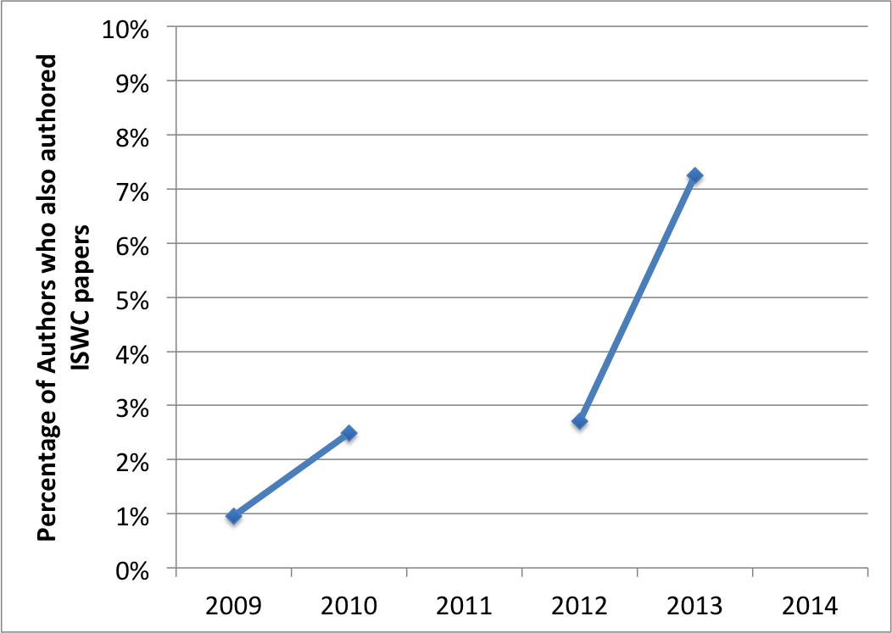
Where is the semantic geoscience community?
Source: Narock and Wimmer (2016), https://authors.elsevier.com/a/1UFjWMMTPPJEp
http://dx.doi.org/10.1016/j.cageo.2016.12.008

Slide 4
Where is the semantic geoscience community?
There are indications that semantic geoscience research is in the technical development and evaluation phase with limited production systems in domain science
Overlap between AGU (geoscience) and ISWC (broader Semantic Web community) is minimal; yet, an upward trend is evident
The semantic geoscience community is currently focused on lightweight semantics and integration of scientific datasets
Few advanced topics in Sem Web research (i.e. logics and rules) have yet to make their way to the geosciences
Supports the notion that Semantic Web research results often take a long time before domain-specific uptake
Possibly leading to a noteworthy drag and, at worst, the adoption of outdated (or even failed) methods and paradigms

Slide 5
Is the sky falling?
No
Semantic geoscience is a new field and much of this is to expected
Leadbetter (2015) - we were not “born semantic”
Our data systems predate the Semantic Web
We don’t use Semantic Technologies throughout the data lifecycle from collection to dissemination.
Quantifying this (to the extend possible) and regular check-ins across the broad community can focus us and provide a path forward

Slide 6
What would I like to see?
A focused integration
With the broader semantic web community (non-geo)
With domain geo-scientists (What is the value proposition?)
Increased communication across our respective groups
A new web site?
Slack?
OSF preprint server?
Some consolidation of resources

Slide 7
What can ESIP provide?
Help with consolidation of resources
ESIP Ontology Portal (registry and repository)
A forum for periodic meetups and community gatherings
A rotating community symposium?

