Slide 1

Using Semantics, Machine Learning, & Data Science for Personalized Health Care Guidance
Anne Hunt, PhD
Director, Product, Data Intelligence Platform

Slide 2
Topics
What is personalized healthcare guidance?
Our data basics
Challenges
Summary and the future
Notes:
Overview of Castlight app (maybe go into a few more details, such as what is the Genius feature)
Data basics: anatomy of a claim in an ontological representation, then the big picture of claims, eligibility, providers, and basic versus inferrred data
Detailed challenges
- claims matching
- provider data normalization
Conclusion

Slide 3
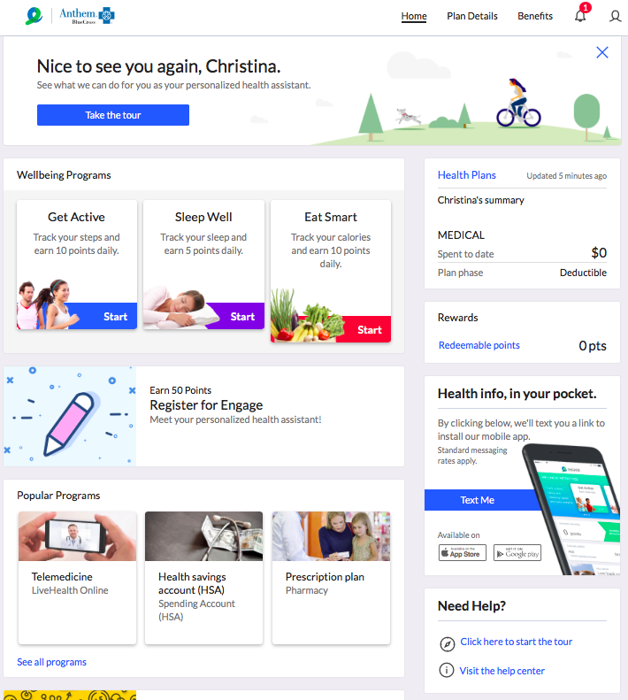

Slide 4
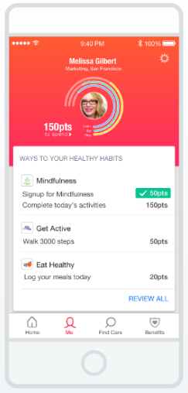
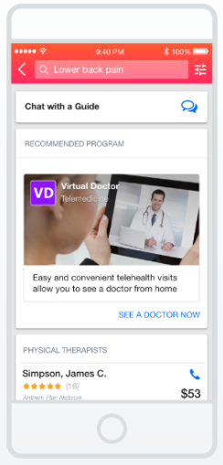
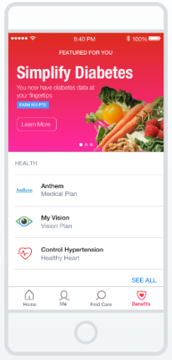
Personalized healthcare guidance
Stay Healthy
Access Care
Manage Conditions
Notes:
The Castlight app:
Engages users with motivating experiences that help them stay healthy
Helps users access the right care for their needs, guiding them to the highest quality lower cost options
Identifies conditions that need extra attention and guides people to the best programs and conditions

Slide 5
Castlight Genius
Predicts which people are likely to:
consider back surgery,
get diagnosed with diabetes,
suffer from anxiety,
consider pregnancy,
And other.
We reach out with helpful messaging.

Slide 6
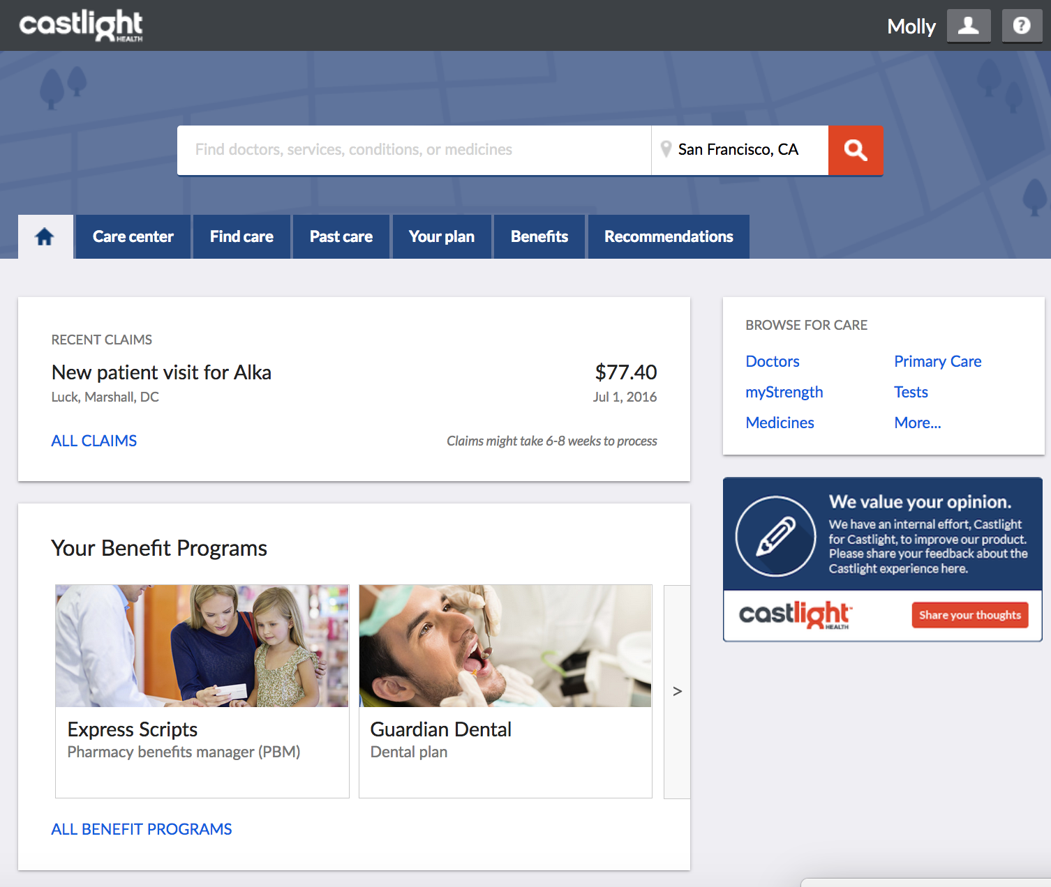
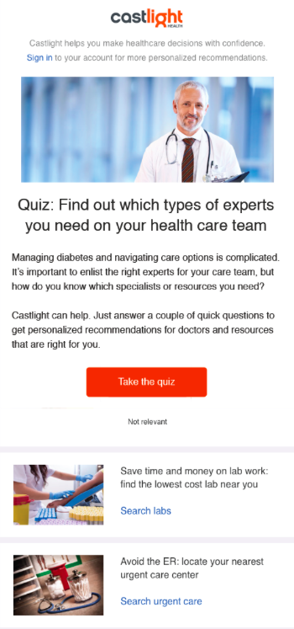
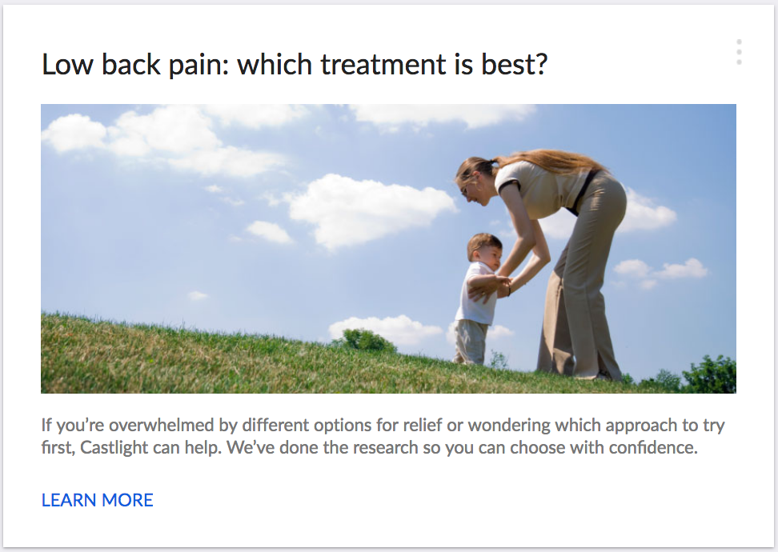
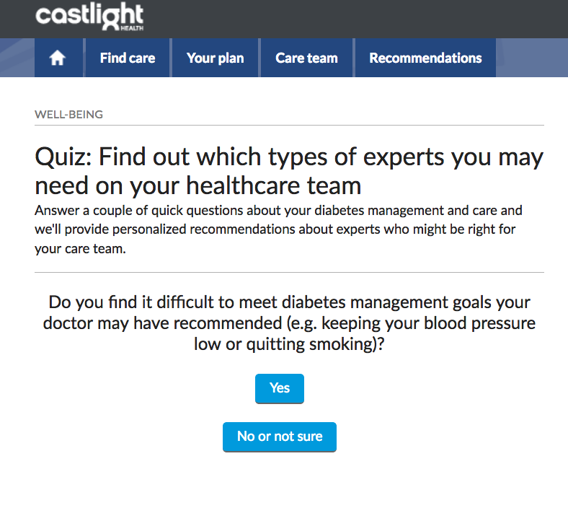
Examples
Segment: New low back pain
Goal: Avoid unnecessary MRI, consider physical therapy if appropriate
Segment: Uncontrolled diabetes, at risk for complications
Goal: Find a high-quality PCP add to care team, if particularly hard to manage, consider endocrinologist

Slide 7
Disclaimer
All statements about technologies used at Castlight are conceptual and visionary --

Slide 8
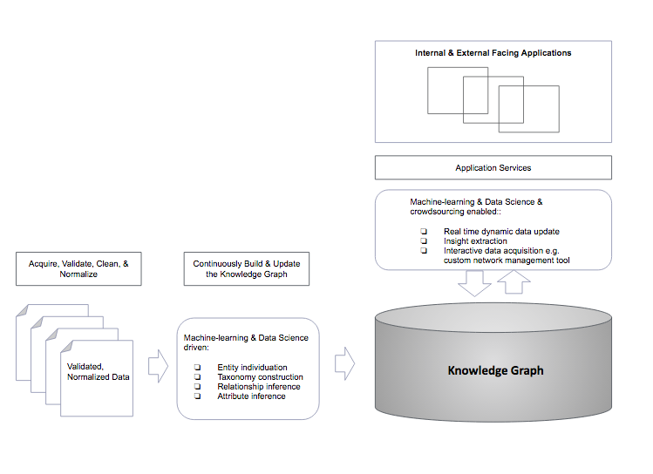
How Structured Data & ML Work Together
Notes:
… to deliver the desired experienc

Slide 9
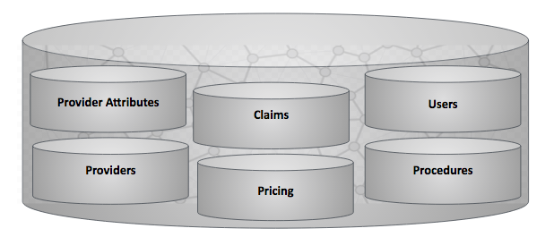
Data Basics: Types of Data
Notes:
These are the kinds of data we have access to and use for personalized healthcare guidance.
The CSLT knowledge graph includes
Providers (doctors, hospitals, facilities)
Provider attributes both given and inferred (quality data, locations, phone numbers, specialties) and most importantly networks
Claims
Prices (inferred)
Users: eligibility data
Procedures

Slide 10
Data Basics: How they all relate
Speciality
Provider
Procedure
Condition
Drug
Practitioner
Hospital
Facility
Lab
Urgent Care
EmergencyRoom
Example Rules
subclassOf Practitioner Provider
subclassOf Hospital Provider
implies (and (performsProcedure ?pract ?proc) (isa ?proc Neurosurgery)) (hasSpecialty ?pract Neurosurgeon)
Example learning (or inferred data)
Every claim for a certain type of procedure at a certain type of lab is evidence that that type of lab performs that procedure (in general).
The amount paid in the past for a certain type of procedure at a certain type of provider can be used to predict how much you would pay for a similar procedure at a similar provider
Notes:
Lots of caveats!
Types of entities relate the way you expect them to
We can use the rules to infer things about instances in a default kind of way. Sometimes you see things you don’t expect in the data, so that’s where we use evidence (such as claims) to make educated guesses
What type of facility it is and what it should be compared to is sometimes difficult to know

Slide 11
Data Basics: Anatomy of a Claim
02.08.2016
claim01
patient01
procedure01
diagnosis01
provider01
Notes:
There are up to 4 procedures on each claim. They can be something like “office visit”. What we get on the claim is an ICD code. In the application we show a CSLT procedure (mapped from the CPT codes).
There are up to 4 diagnosis codes on each claim. These can be either ICD 9 or ICD 10.
There are other bits of data on the claims, but we don’t use it all
CPT Codes for Procedures: https://www.ama-assn.org/practice-management/cpt-current-procedural-terminology
ICD Codes: https://www.ama-assn.org/practice-management/icd-10-hcpcs-and-ruc-resources

Slide 12
Challenges
Entity disambiguation
Which provider is mentioned on the claim?
Which patient is the claim for?
Provider networks
Which providers are associated with supplemental data?
Which providers are in which networks?
Complex network definitions

Slide 13
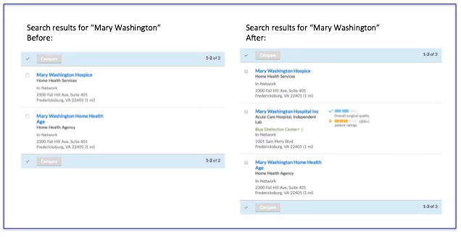
Example: Provider Entity Resolution
Notes:
Key talking points:
We load fresh provider data every week from about 40-50 payers and a total of over 60 data sources
Blues providers: about 25M records (individual practitioners, facilities, groups, hospitals)
UHC providers: 16M records
There are many duplicates: for example about 10 – 20 % of Anthem records may sometimes represent duplicates.
Across different data sources the same provider can be metioned many times
Finding a duplicate can be difficult: Dr. John Smith (the person), versus Dr. John Smith’s Office (a practice or group, with multiple doctors participating)
People care which one it is! For exmample a good review might be for the practice, not the doctor

Slide 14
How Structured Data & ML Work Together
Notes:
On example – we use ML to create models that allow us to deduplicate while quickly associating many data sources together.

Slide 15
Questions?

