Slide 1








ToolMatch Sprint: be part of the geoinformation blueshift!
[A sprint for knowledge elicitation]
Summer Meeting 2016
Thursday, July 21st
Organizers: Nancy, Beth, Chris, Soren, and Brandon
Notes:
Thanks for attending our sprint.
first, background and history
*

Slide 2
ToolMatch: an extremely brief history
Initially spawned as an ESIP Funding Friday proposal
moved to ESIP Products & Services Testbed Funding
Many contributors through the life of the project:
Matthew Ferritto (initial proposal)
Nancy Hoebelheinrich
Chris Lynnes
Anirudh Prabhu
Patrick West
brandon whitehead
Soren Scott
Beth Huffer
Notes:
Data collection content requires stricter matching than matching based on data collection characteristics
example: Given rainfall or topology measurements, determine which tools within a hydrological model can be used with that data content
Match to tools that the model as a whole might not be able to match

Slide 3

ToolMatch: an extremely brief history
Ferret
?
Airs Level 2 Standard Retrieval
is compatible
is not compatible
is compatible if…
is compatible but…
is compatible with a script that…
Notes:
first two suggest native compatability; second is often related to data format

Slide 4
ToolMatch: an extremely brief history
Ferret
?
Airs Level 2 Standard Retrieval
?
QGIS
?
Panoply
Notes:
what about other tools? which tools can I use with Airs?

Slide 5

ToolMatch: an extremely brief history
Airs Level 2 Standard Retrieval
?
?
SEG-Y
?
Shapefile
Notes:
Obverse

Slide 6
ToolMatch: fast forward
Interesting, and useful.
Data collection content requires a deeper description than general matching
How might adding tool “capabilities” affect the utility of this type of service?
example: given data set X, which tool(s) are available that will support the creation (and/or viewing) of a Hovmoller diagram?
Notes:
peel back the layers; data product can be viz from OPeNDAP but not a different type of server. what are the data types? what are the conventions?
example: Given rainfall or topology measurements, determine which tools within a hydrological model can be used with that data content
Match to tools that the model as a whole might not be able to match

Slide 7
ToolMatch: fast forward
Going a bit further…
How might increasing the level of detail (i.e. richer semantic descriptions) afford advanced reasoning capabilities?
example: which tool(s) will allow me to create an animated map of atmospheric H₂0 by combining data from weather stations and imagery from multiple satellites available via OPeNDAP and THREADS?
Notes:
From this, we hope to model “critical” features in greater detail (increased granularity). The richer semantics will provide increased reasoning capability via a web service. These services is (or, will be) designed to provide machine-aided discovery of tools and data to Earth scientists of all backgrounds and levels.
visualise (next slide)

Slide 8
ToolMatch: fast forward
Visualization Tool
Data Collection
Swath
Is A
Is A
has Data Structure
AIRS.2010.08.11.095.L2
linearly Plots
has Data Format
Panoply
HDF4
supports File Format
Notes:
Swath == irregular grid structure; can panoply plot all irregular grids, or is this a f of data format (or some other variable)
Statement: AIRS2010.08.11.095.L2 is a data set.
Statement: AIRS… grid structure is a Swath.
Statement: AIRS… data format is HDF4.
Statement: Panoply can plot AIRS2010.08.11.095.L2 linearly
Q: If we see a lot of assertions like these, can we generalize them to say that Panoply can visualize *any* swath data in HDF format as a line plot?

Slide 9
so… what is this sprint about?
Sharing statements about experiences!
What collection of entities – data formats, data collections, tools, visualizations, filetypes, etc. – have you worked with?
What has worked?
What has worked well?
What, despite your best efforts, did not?
What has been unclear?
- it might have worked if…
- according to the documentation it should work, but…
Notes:
Be more descriptive here (from Soren)
what is the incompatiblity?

Slide 10
example statements: simple
HDF-EOSS is a data format
NetCDF4Classic is a data format
GeoTIFF is a data format for image files
Panoply could not serialize SEG-Y files
PyDAP is a Data Server
web mapping service (WMS) is a data access protocol
an animated map is a type of visualization
Notes:
I mostly use data from Giovanni because….

Slide 11
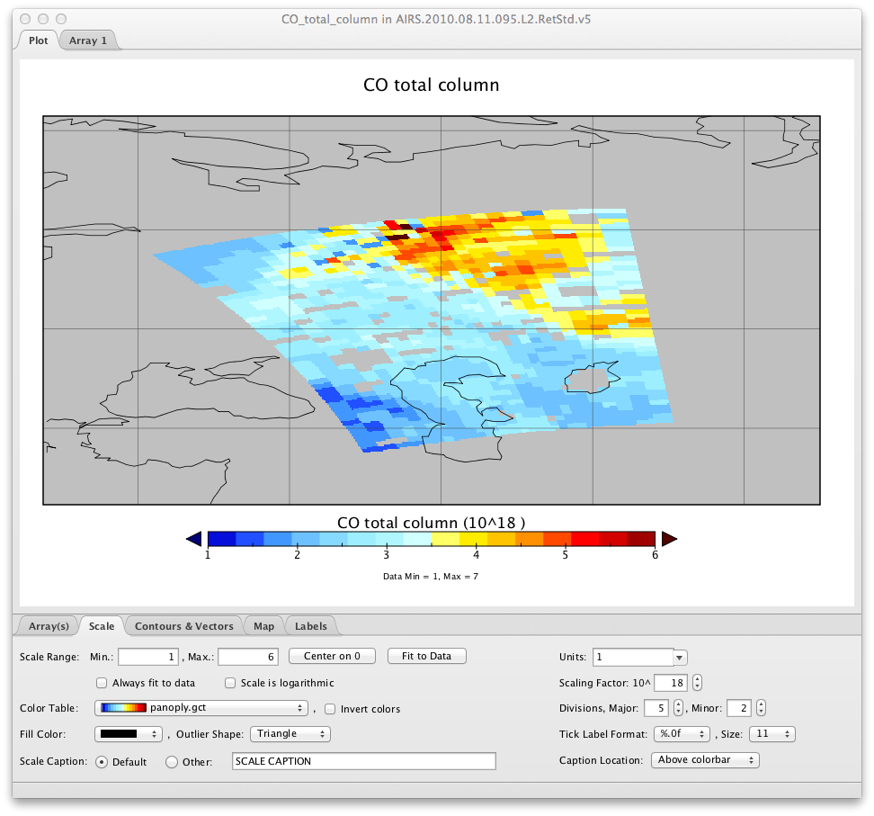
Panoply: can visualize swath data via OPeNDAP as a “map”

Slide 12
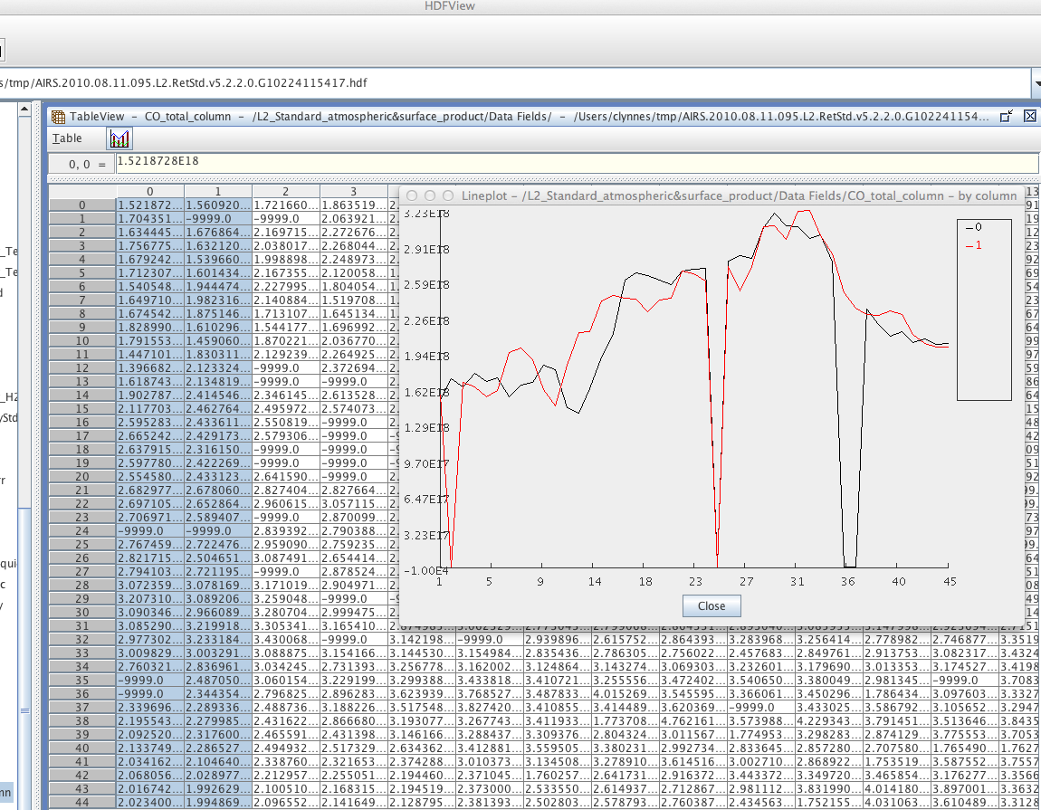
HDFView: can visualize swath data HDF format as Line Plots

Slide 13
example statements: specific
R could not serialize a complex array with null values derived
from an OMI level 3 data file
QGIS can read in HDF5 files – if the header is configured
without a depth value, and any special characters are removed.
I was able to get IDV to serialize a SEG-Y file, but the depth and time values were inverted.
Notes:
Be more descriptive here (from Soren)

Slide 14
discuss!
Please discuss your experiences, both positive and negative
Please do also add your experiences to the titanpad as you have time (not just this afternoon).
titanpad.com/nmagt9H23e
Please be as explicit, and descriptive, as possible!
Share the link with your colleagues!
Notes:
(often we use language that is slightly ambiguous, or interpreted differently across two communities of practice—so ask questions, be descriptive, and don’t be put off by others inquiring further.)

Slide 15

Questions?

Slide 16
Thank you!
Follow Our Progress!
Current ToolMatch Service web site:
http://toolmatch.esipfed.org/index.php
ToolMatch on github: https://github.com/ESIPFed/Toolmatch
ToolMatch ontology on github: https://github.com/ESIPFed/toolmatch-ontology
ESIP ToolMatch wiki page: http://wiki.esipfed.org/index.php/ToolMatch
ESIP on the Web: esipfed.org@ESIPFed

