Slide 1







ToolMatch Sprint: be part of the geoinformation blueshift!
[A sprint for knowledge elicitation]
Summer Meeting 2016
Thursday, July 21st
Organizers: Nancy, Brandon, Soren, Beth, Chris
Notes:
add NASA and Ronin Inst.?
*

Slide 2
ToolMatch: an extremely brief history
Initially spawned as a Funding Friday proposal
moved to Products & Services Testbed Funding
Many contributors through the life of the project:
Matthew Ferritto (initial proposal)
Nancy Hoebelheinrich
Chris Lynnes
Anirudh Prabhu
Patrick West
brandon whitehead
Soren Scott
Notes:
Data collection content requires stricter matching than matching based on data collection characteristics
example: Given rainfall or topology measurements, determine which tools within a hydrological model can be used with that data content
Match to tools that the model as a whole might not be able to match

Slide 3
ToolMatch: an extremely brief history
Ferret
?
Airs Level 2 Standard Retrieval
is not compatible
is compatible
is compatible if…
is compatible but…
is compatible with a script that…
Notes:
first two suggest native compatability; second is often related to data format

Slide 4
ToolMatch: an extremely brief history
Ferret
?
Airs Level 2 Standard Retrieval
?
QGIS
?
Panoply
Notes:
first two suggest native compatability; second is often related to data format

Slide 5

ToolMatch: an extremely brief history
Airs Level 2 Standard Retrieval
?
?
SEG-Y
?
Shapefile
Notes:
first two suggest native compatability; second is often related to data format

Slide 6
ToolMatch: fast forward
Interesting, and useful.
How might adding tool “capabilities” affect the utility of the budding service?
example: given data set X, which tool(s) are available that will support the creation (and/or viewing) of a Hovmoller diagram?
Notes:
Data collection content requires stricter matching than matching based on data collection characteristics
example: Given rainfall or topology measurements, determine which tools within a hydrological model can be used with that data content
Match to tools that the model as a whole might not be able to match

Slide 7
ToolMatch: fast forward
Going a bit further…
How might increasing the level of detail (i.e. richer semantic descriptions) afford advanced reasoning capabilities?
example: which tool(s) will allow me to create an animated map of atmospheric H20 by integrating data from weather stations as well as multiple satellites, which is available via OPeNDAP and THREADS?
Notes:
In order to get to a richer semantic description (i.e. increasingly descriptive concepts/classes and relationships) we want glean descriptions of user experiences. From this, we hope to model “critical” features in greater detail (increased granularity). The richer semantics will provide increased reasoning capability via a web service. These services is (or, will be) designed to provide machine-aided discovery of tools and data to Earth scientists of all backgrounds and levels.

Slide 8
Visualization Tool
Data set
Swath
Is a
Grid Structure
AIRS.2010.08.11.095.L2
Panoply
linearlyPlots
HDF4Format
Statement: AIRS2010.08.11.095.L2 is a data set.
Statement: AIRS… grid structure is a Swath.
Statement: AIRS… data format is HDF4.
Statement: Panoply can plot AIRS2010.08.11.095.L2 linearly
Q: If we see a lot of assertions like these, can we generalize them to say that Panoply can visualize *any* swath data in HDF format as a line plot?

Slide 9
so… what is this sprint about?
Statements about experiences
re: what worked for you?
What, despite your best efforts, did not?
What has been unclear?
What data or tool have you had trouble locating?
Notes:
Be more descriptive here (from Soren)

Slide 10
example statements: simple
ERRDAP is a Data Server
PyDAP is a Data Server
OPeNDAP is a Data Server
DOI is an identifier for data and publications
HDF4 is a data format
Notes:
Be more descriptive here (from Soren)

Slide 11
example statements: simple
HDF-EOSS is a data format
NetCDF4Classic is a data format
web mapping service (WMS) is a data access protocol
an animated map is a type of visualization
Notes:
Be more descriptive here (from Soren)

Slide 12
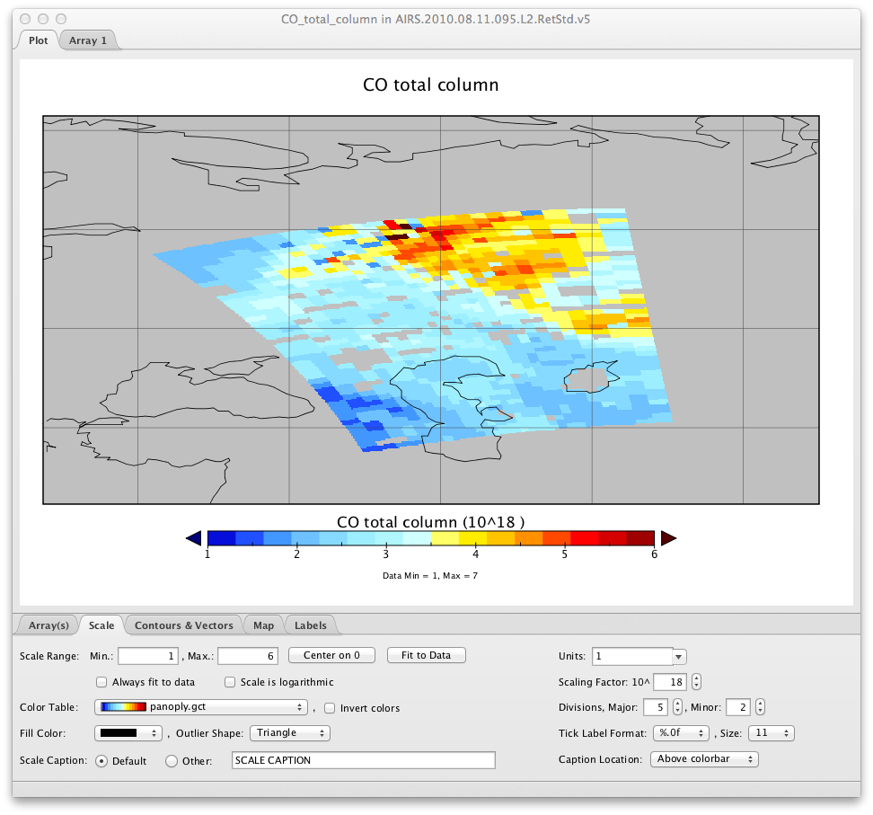
Panoply: can visualize swath data via OPeNDAP as a “map”

Slide 13
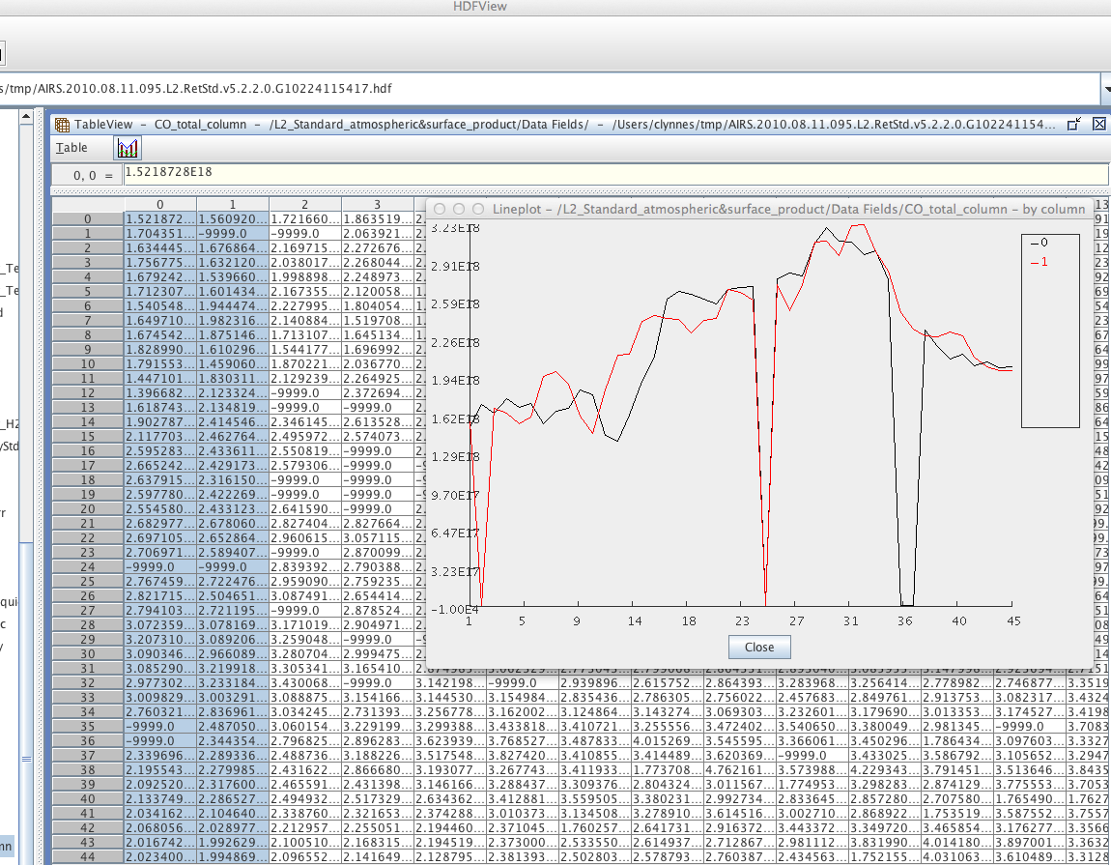
HDFView: can visualize swath data HDF format as Line Plots

Slide 14
example statements: standard
GeoTIFF is a data format for image files
Panoply could not serialize SEG-Y files
Notes:
Be more descriptive here (from Soren)

Slide 15
example statements: specific
R could not serialize a complex array with null values derived
from an OMI level 3 data file
QGIS can read in HDF5 files – if the header is configured
without a depth value and any special characters are removed.
Notes:
Be more descriptive here (from Soren)

Slide 16
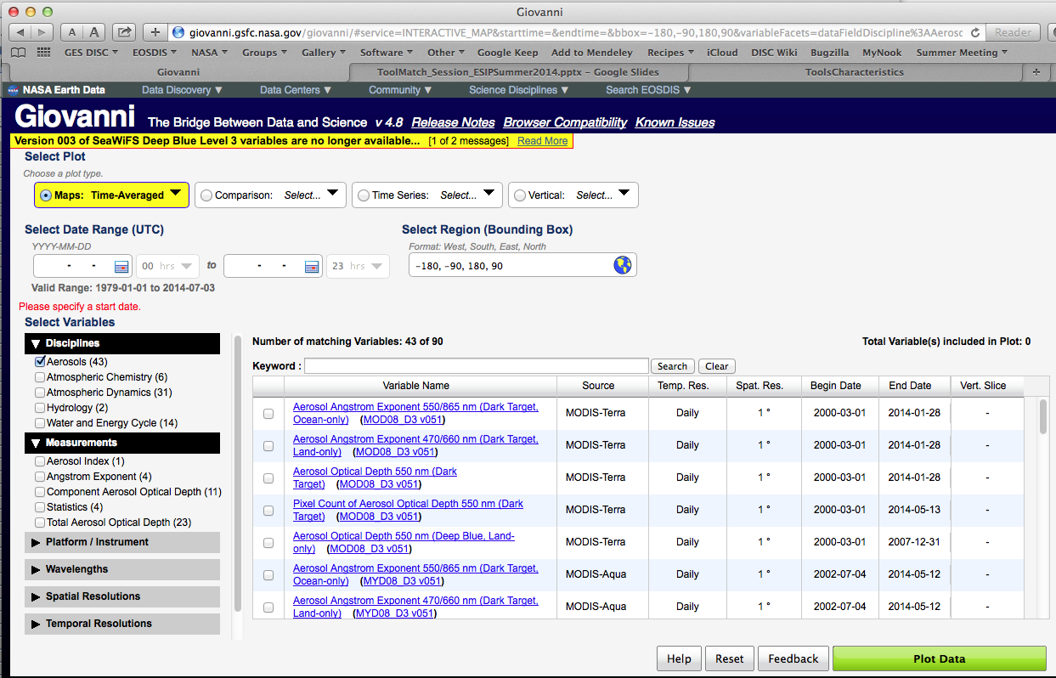
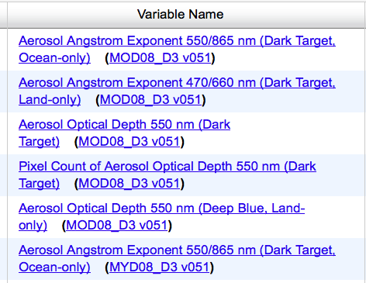
Giovanni: which datasets are available?

Slide 17

Questions?

Slide 18
discuss!!
Please discuss your experiences, both positive and negative
Please do also add your experiences to the titanpad as you have time.
Please be as explicit, and descriptive, as possible!
(often we use language that is slightly ambiguous, or interpreted differently across two communities of practice—so ask questions, be descriptive, and don’t be put off by others inquiring further.)
Notes:
Be more descriptive here (from Soren)

Slide 19
Thanks!
Follow Our Progress!
ToolMatch Service web site:
http://toolmatch.esipfed.org/index.php:
ToolMatch on github: https://github.com/ESIPFed/Toolmatch
ToolMatch ontology on github: https://github.com/ESIPFed/toolmatch-ontology
ESIP ToolMatch wiki page: http://wiki.esipfed.org/index.php/ToolMatch
ESIP on the Web: esipfed.org@ESIPFed

Slide 20
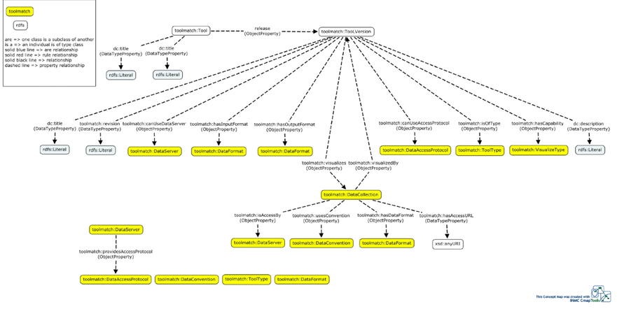
ToolMatch Ontology – Tool (partial view)
https://toolmatch.hackpad.com/Updates...-TWD8xXXknCz

Slide 21
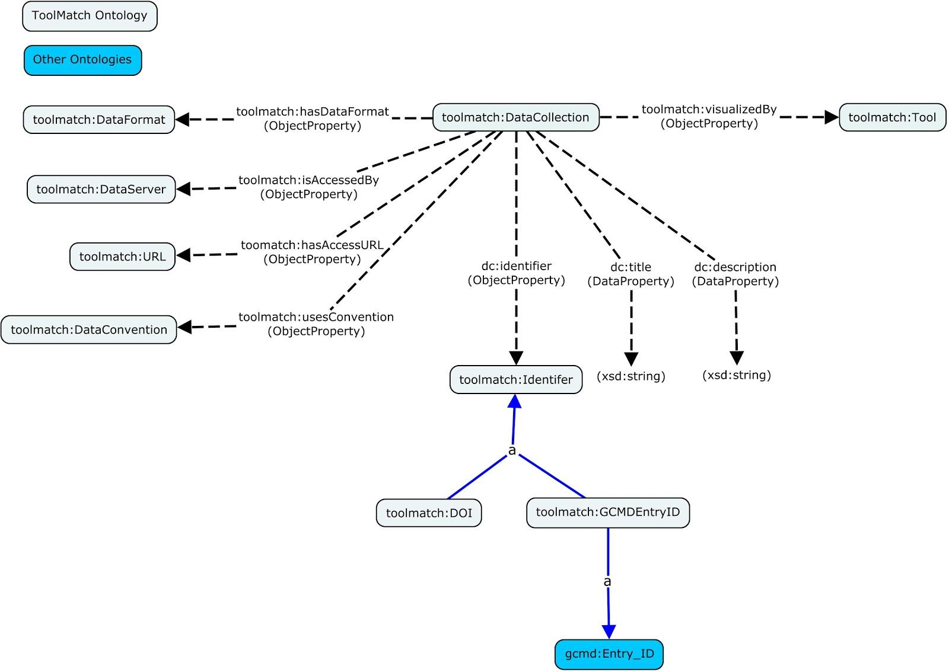
ToolMatch Ontology - Data Collection (partial view)
http://toolmatch.esipfed.org/ont_cmap

Slide 22
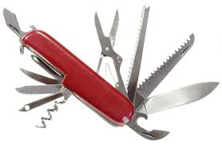
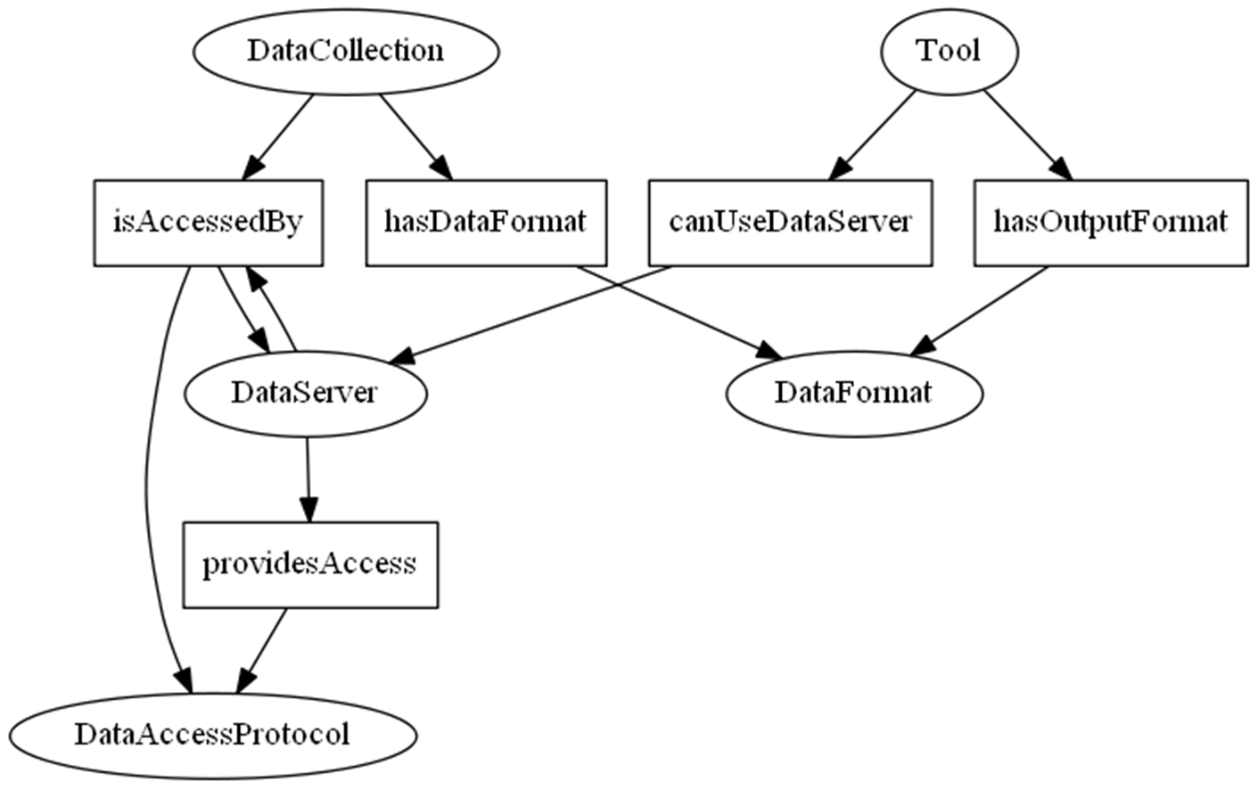
Current matching capability:
http://pushingsocial.com/wp-content/uploads/2013/12/social-media-tools-swiss-knife.jpg
Notes:
Given a data set or collection, reveal which tools are compatible.
Example #1: I just downloaded an AIRS Level 2 Standard Retrieval file. How can I look at it?
Example #2: I just located an OPeNDAP URL for an OMI Level 3 data file. What tool will let me extract a subset from it?
2) Given a tool or tool set, reveal compatible data sets and/or collections.
The Semi-general Web Service Example: What data collections are available in the Giovanni tool?
The Decision Support Tool Example: Which Sea Surface Height datasets can be used in the __[generic]____ coastal inundation tool?

