Slide 1
暑期学习成果汇报
汇报人：朱奕晟

Slide 2
目录
1
2
3
4
朴素贝叶斯法
决策树模型
逻辑斯蒂回归模型
最大熵模型

Slide 3

1
1
朴素贝叶斯法
生成模型
$$P\left(Y=\left.c_{k}\right|X=x\right)=\frac{P\left(Y=c_{k}\right)⋅P\left(X=\left.x\right|Y=c_{k}\right)}{P\left(X=x\right)}$$
$$y=f\left(x\right)=argmax\frac{P(Y=c_{k})\prod_{j}{P(X^{\left(j\right)}=x^{\left(j\right)}|Y=c_{k})}}{\sum_{k}{P(Y=c_{k})\prod_{j}{P(X^{\left(j\right)}=x^{\left(j\right)}|Y=c_{k})}}}$$
$$y=argmaxP(Y=c_{k})\prod_{j}{P(X^{\left(j\right)}=x^{\left(j\right)}|Y=c_{k})}$$
Part one

Slide 4
1
朴素贝叶斯法
featureNum = 784
classNum = 10
Py = np.zeros((classNum, 1))
for i in range(classNum):
Py[i] = ((np.sum(np.mat(trainLabelArr) == i)) + 1) / (len(trainLabelArr) + 10)
Py = np.log(Py)
Px_y = np.zeros((classNum, featureNum, 2))
for i in range(len(trainLabelArr)):
label = trainLabelArr[i]
x = trainDataArr[i]
for j in range(featureNum):
Px_y[label][j][x[j]] += 1
for label in range(classNum):
for j in range(featureNum):
Px_y0 = Px_y[label][j][0]
Px_y1 = Px_y[label][j][1]
Px_y[label][j][0] = np.log((Px_y0 + 1) / (Px_y0 + Px_y1 + 2))
Px_y[label][j][1] = np.log((Px_y1 + 1) / (Px_y0 + Px_y1 + 2))
Part one

Slide 5
1
朴素贝叶斯法
prior_probability = np.zeros(class_num) # 先验概率
conditional_probability = np.zeros((class_num,feature_len,2)) # 条件概率
for i in range(len(train_labels)):
label = train_labels[i]
prior_probability[label] += 1 for j in range(feature_len):
conditional_probability[label][j][img[j]] += 1
for i in range(class_num):
for j in range(feature_len):
pix_0 = conditional_probability[i][j][0]
pix_1 = conditional_probability[i][j][1]
probalility_0 = (float(pix_0)/float(pix_0+pix_1))*1000000 + 1
probalility_1 = (float(pix_1)/float(pix_0+pix_1))*1000000 + 1 conditional_probability[i][j][0] = probalility_0
conditional_probability[i][j][1] = probalility_1
对数or放大？ +1放在哪？
Part one

Slide 6
2
Part two
1
朴素贝叶斯法
决策树模型
2
决策树模型
3
逻辑斯蒂回归模型
4
最大熵模型

Slide 7


2
决策树模型
熵：
$$H\left(X\right)=−\sum_{i=1}^{n}{p_{i}\log{p_{i}}}$$
信息增益（对应ID3算法）：
$$g\left(D,A\right)=H\left(D\right)−H\left(\left.D\right|A\right)$$
信息增益比（对应C4.5算法）：
$$g_{R}\left(D,A\right)=\frac{9\left(D⋅A\right)}{H_{A}\left(D\right)}$$
决策树损失函数
$$C_{α}\left(T\right)=C\left(T\right)+α\left|T\right|$$
其中
$$C\left(T\right)=\sum_{t=1}^{\left|T\right|}{N_{t}H_{t}\left(T\right)}$$
Part two

Slide 8

2
决策树模型
$$C_{α}\left(T\right)=C\left(T\right)+α\left|T\right|$$
|T|代表决策树的复杂程度，是仅跟深度有关还是和叶子节点的数量有关？
Part two

Slide 9
2
决策树模型
def createTree(*dataSet):
Epsilon = 0.1
trainDataList = dataSet[0][0]
trainLabelList = dataSet[0][1]
print('start a node', len(trainDataList[0]), len(trainLabelList))
classDict = {i for i in trainLabelList}
if len(classDict) == 1:
return trainLabelList[0]
if len(trainDataList[0]) == 0:
return majorClass(trainLabelList)
Ag, EpsilonGet = calcBestFeature(trainDataList, trainLabelList)
if EpsilonGet < Epsilon:
return majorClass(trainLabelList)
treeDict = {Ag:{}}
treeDict[Ag][0] = createTree(getSubDataArr(trainDataList, trainLabelList, Ag, 0))
treeDict[Ag][1] = createTree(getSubDataArr(trainDataList, trainLabelList, Ag, 1))
return treeDict
Part two

Slide 10
2
决策树模型
ε=0.05 运行时间：318s 准确率：86.9%
ε=0.1 运行时间：254s 准确率：85.89%
ε=0.15 运行时间：226s 准确率：84.47%
ε=0.2 运行时间：195s 准确率：81.2%
ε=0.25 运行时间：161s 准确率：74.91%
ε=0.3 运行时间：89s 准确率：45.41%
ε应该如何选择，是否应该交叉验证，如何避免过拟合
Part two

Slide 11
3
THREE
3
ONE
TWO
FOUR
1
2
4
朴素贝叶斯法
决策树模型
最大熵模型
逻辑斯蒂回归模型
Part three

Slide 12
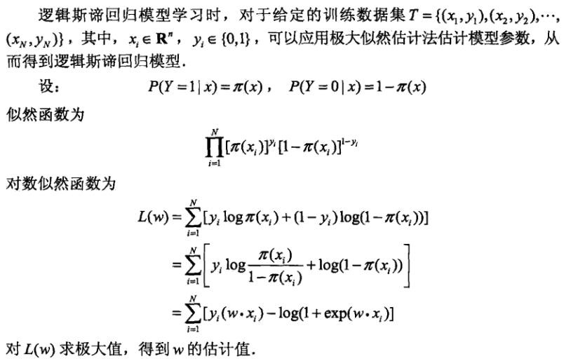


3
逻辑斯蒂回归模型
二项逻辑斯谛回归模型
$$\log{\frac{P\left(Y=\left.1\right|x\right)}{1−P\left(Y=\left.1\right|x\right)}}=w⋅x$$
$$P\left(Y=\left.1\right|x\right)=\frac{\exp\left(w⋅x\right)}{1+\exp\left(w⋅x\right)}$$
模型参数估计：极大似然估计
O
C
多项逻辑斯谛回归模型
$$P\left(Y=\left.k\right|x\right)=\frac{\exp\left(w_{k}⋅x\right)}{1+\sum_{k=1}^{K−1}{\exp\left(w_{k}⋅x\right)}},$$
$$k=1,⋯,K−1$$
$$P\left(Y=\left.K\right|x\right)=\frac{1}{1+\sum_{k=1}^{K−1}{\exp\left(w_{k}⋅x\right)}}$$
Part three

Slide 13
4
TWO
THREE
3
ONE
FOUR
2
4
1
决策树模型
逻辑斯蒂回归模型
最大熵模型
朴素贝叶斯法
Part four

Slide 14
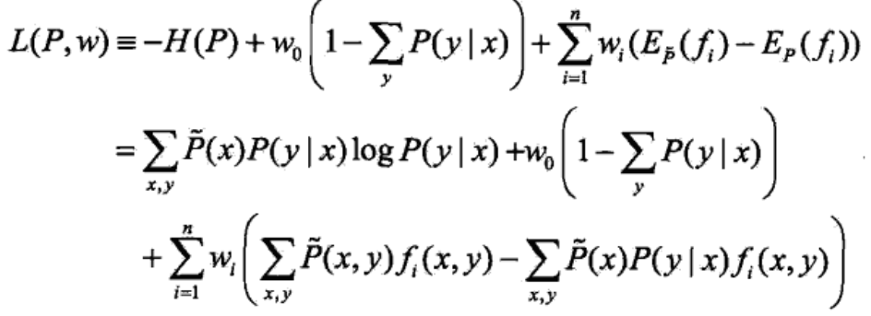


4
最大熵模型
条件熵：
$$H\left(P\right)=−\sum_{x,y}{\tilde{P}\left(x\right)P\left(\left.y\right|x\right)\log{P\left(\left.y\right|x\right)}}$$
令L导数等于0得到最大熵模型一般形式：
$$P_{w}\left(\left.y\right|x\right)=\frac{1}{z_{w}\left(x\right)}\exp\left(\sum_{i=1}^{n}{w_{i}f_{i}\left(x,y\right)}\right)$$
其中，
$$w=\arg{\max{L_{\tilde{P}}\left(P_{w}\right)}}=\log{\prod{P{\left(\left.y\right|x\right)}^{\tilde{P}\left(x,y\right)}}}$$
$$Z_{w}\left(x\right)=\sum_{y}{exp⁡(\sum_{i=1}^{n}{w_{i}f_{i}}(x,y))}$$
O
拉格朗日乘子法求H(P)最大值
C
Part four

Slide 15
4
最大熵模型
def createSearchDict(self):
'''
创建查询字典
xy2idDict：通过(x,y)对找到其id,所有出现过的xy对都有一个id
id2xyDict：通过id找到对应的(x,y)对
'''
xy2idDict = [{} for i in range(self.featureNum)]
id2xyDict = {}
index = 0
for feature in range(self.featureNum):
for (x, y) in self.fixy[feature]:
xy2idDict[feature][(x, y)] = index
id2xyDict[index] = (x, y)
index += 1
return xy2idDict, id2xyDict
为什么要用两个字典将xy对和id关联起来，前面的算法都是直接进行训练的
O
C
Part four

Slide 16
4
最大熵模型
def maxEntropyTrain(self, iter = 500):
for i in range(iter):
iterStart = time.time()
Epxy = self.calcEpxy()
#使用的是IIS，所以设置sigma列表
sigmaList = [0] * self.n
for j in range(self.n):
sigmaList[j] = (1 / self.M) * np.log(self.Ep_xy[j] / Epxy[j])
self.w = [self.w[i] + sigmaList[i] for i in range(self.n)]
iterEnd = time.time()
print('iter:%d:%d, time:%d'%(i, iter, iterStart - iterEnd))
O
C
IIS迭代法的迭代步长是变化的，为什么要这么设置，有什么优点
Part four

Slide 17
Thanks
希望老师和同学们能提出宝贵的意见和建议

