Slide 1

ESMValTool community workshop November 19-21
Welcome!

Slide 2
Housekeeping
Inclusive community, please respect the views of others
Online format: use Teams hand to join discussion, use chat
Agenda: https://github.com/ESMValGroup/Community/discussions/192
Each item has a lead person, who will introduce and facilitate that discussion
Overall chair for mornings are Alistair (Tue / Thurs) and Birgit (Wed): responsible for keeping us to time

Slide 3
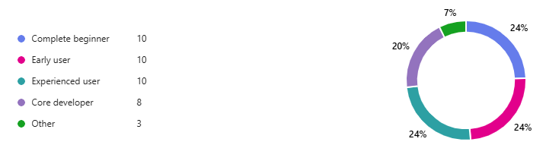
ESMValTool experience levels

Slide 4
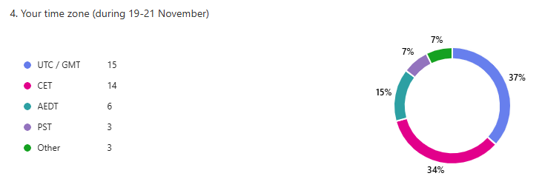
Participant time zones

Slide 5
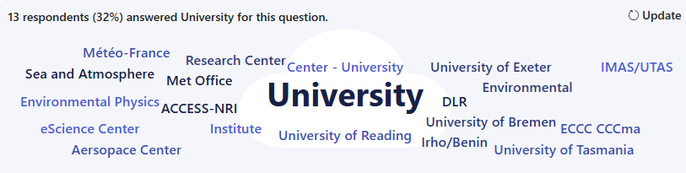

Slide 6
Documentation review and split
@rbeucher: The current documentation is difficult to navigate and would benefit from a comprehensive review. I also see ESMValCore and ESMValTool as two distinct tools, each with unique roles and value:
ESMValCore is maintained by the core developers and adheres more closely to development standards. It is optimised, curated, and highly useful for reducing boilerplate code in model evaluation scripts. We’ve even begun using its processors in other Python workflows, demonstrating its broader applicability.
ESMValTool, on the other hand, evolves more organically through community contributions and serves a different purpose. A collection of diagnostics.
I understand that the initial decision to brand both under a single name (ESMValTool, encompassing both ESMValCore and ESMValTool) was intended to minimise user confusion. However, I now believe that a clearer distinction between them would actually improve clarity. By highlighting their individual roles, we can better showcase the strengths of each tool while maintaining coherence in documentation and communication.

