Slide 1
Update on ESMValTool governance

Slide 2
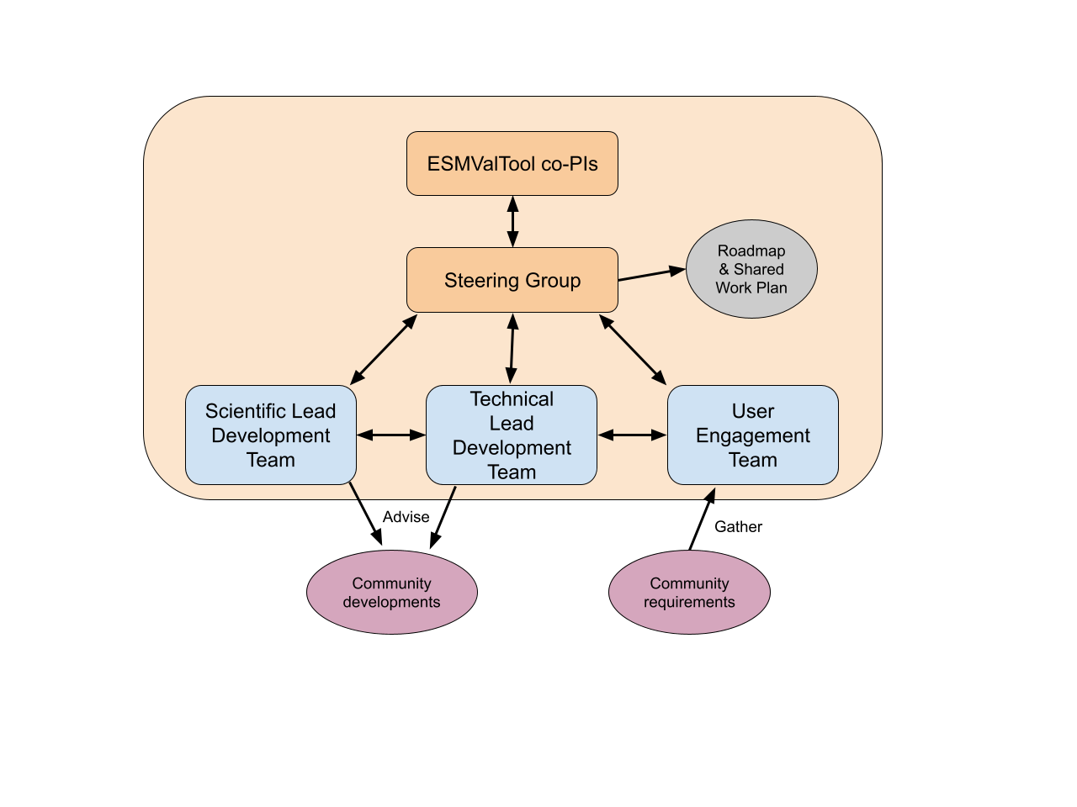
ESMValTool consortium
Consortium members will:
contribute 1FTE to ESMValTool development
vote on steering group, to decide strategic direction of development
co-PIs: DLR & Met Office
co-chair steering group, and deciding vote
visible leaders of the consortium

Slide 3
Consortium Agreement
A legal document to formalise the above arrangement
Ensures that all parties working to a common understanding
Agrees approach to take in the event of a dispute
Legal agreement has undergone a few technical iterations to ensure it works for all
Currently awaiting confirmation that latest changes are acceptable
Expecting to sign in December 2024

Slide 4
Contributor License Agreement
All contributors will need to sign the CLA before PR’s can be merged
Why? Protect the consortium partners from:
Action by a contributor for distributing their code without permission
Action from a 3rd party rights owner if contributor doesn’t own rights
Theo Geddes successfully tested implementation of "CLA assistant"
This integrates smoothly with GitHub so that user just clicks a button on their first submission

