Slide 1
Update on ESMValTool governance

Slide 2
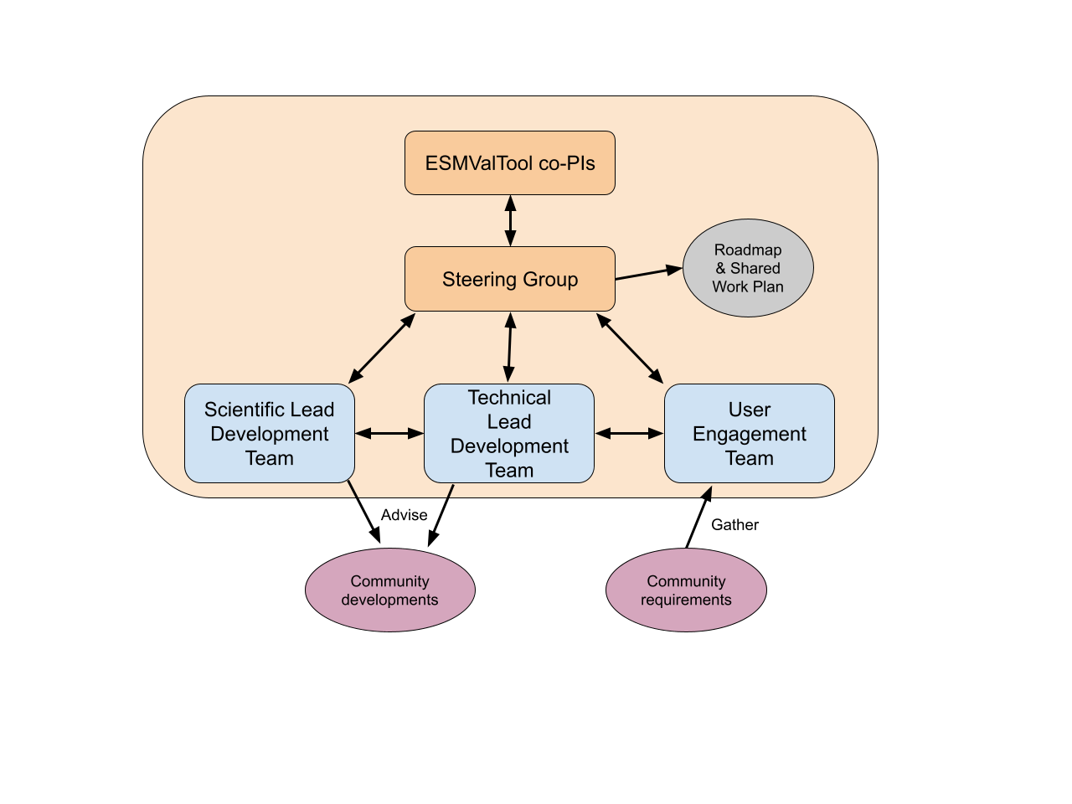
ESMValTool consortium
Consortium members will:
contribute 1FTE to ESMValTool development
vote on steering group, to decide strategic direction of development
co-PIs: DLR & Met Office
co-chair steering group, and deciding vote
visible leaders of the consortium
Status:
iterating consortium agreement with members (DLR, MetO, NERC, BCS, SMHI, NLeSC)

Slide 3
Status of Consortium Agreement
May 2022: Consortium Agreement with partners for review
Oct 2022: 3 partners ready to sign; 3 under review
June 2023: 4 partners ready to sign*, 2 under review
Technical legal changes are being negotiated, which will need to be reviewed by all parties
(*) Subject to re-assessment of funding prospects at time of signing

Slide 4
Contributor License Agreement
All contributors will need to sign the CLA before PR’s can be merged
Why? Protect the consortium partners from:
Action by a contributor for distributing their code without permission
Action from a 3rd party rights owner if contributor doesn’t own rights
Theo has successfully tested implementation of CLA assistant
Ask Theo if you’d like to see a demo of the setup (dashboard)
Constraint – can only be managed by one GitHub user
Solution: create a new user just for CLA management

Slide 5
ENES-RI

Slide 6
Proposal on ENES-RI – ESMValTool relationship
Treat ESMValTool as a “service” in ENES-RI
Aim to align ESMValTool strategy / workplan with the wider ENES-RI strategy
Ensuring that components of the Research Infrastructure “play nice” with each other
Establish advisory / observer links between governance structures
Consortium members treat their 1FTE as an in-kind contribution to ENES-RI (if they become members of both)

