Slide 1
how ECCC operationalizes ESMValTool for extreme event attribution
Elizaveta Malinina (GitHub @malininae)
with contributions of: Karen Garcia Perdomo
Megan Kirchmeier-Young
Nathan Gillett
Konstantinos Minelaou
ESMValTool workshop talk 05/28/2024

Slide 2
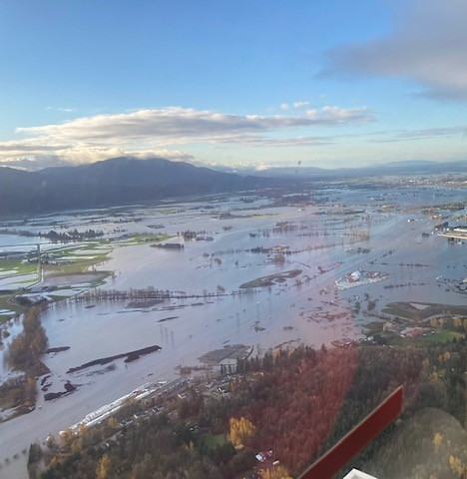
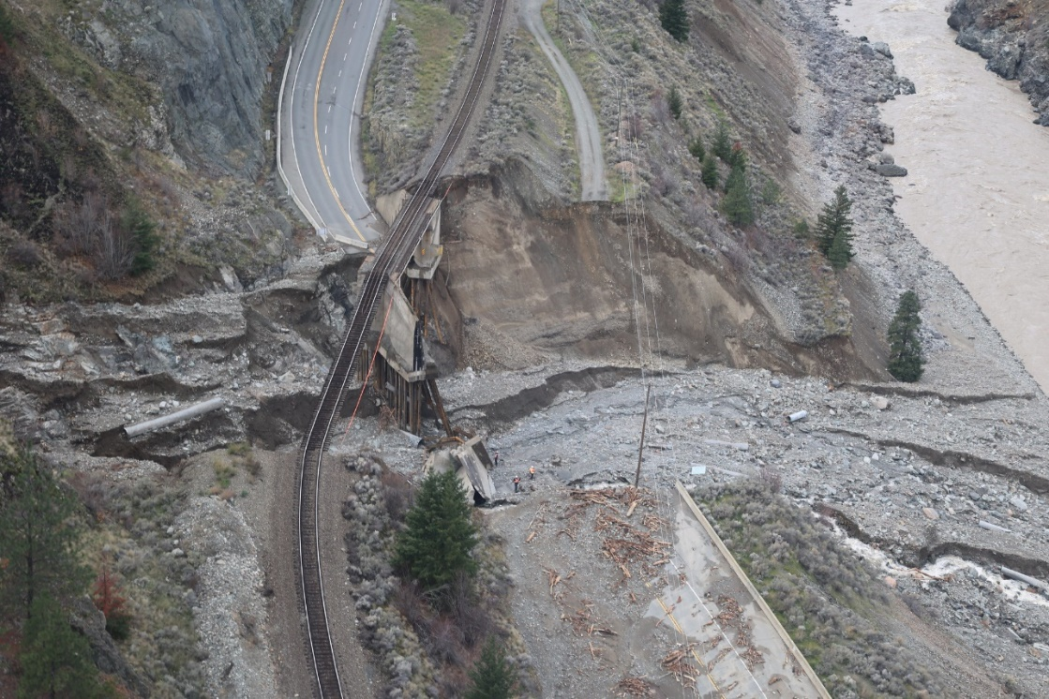
Background
Highway 1 - Abbotsford
Event attribution is a rapidly emerging area of climate science
In particular, rapid event attribution is important right after the event, so the risk information could be use in case infrastructure has been damaged
Under the National Adaptation Strategy ECCC has been tasked to create an extreme event attribution system
Highway 1 near Lytton
B.C. Ministry of Transportation
and Infrastructure | Flickr, CC BY

Slide 3


Background
ECCC has done already published two types of CMIP6 analysis: the 2021 BC heatwave (tasmax) and the November 2021 BC floods (pr), the 2022 storm Fiona (sfcWindmax) to be submitted this summer
Used the same approach:
Create annual maximum timeseries from OBS
Fit GEV distribution, get OBS return period
Analyze three climates in CMIP6 multi model ensemble and calculate return periods
Calculate attributable risk due to climate change

Slide 4
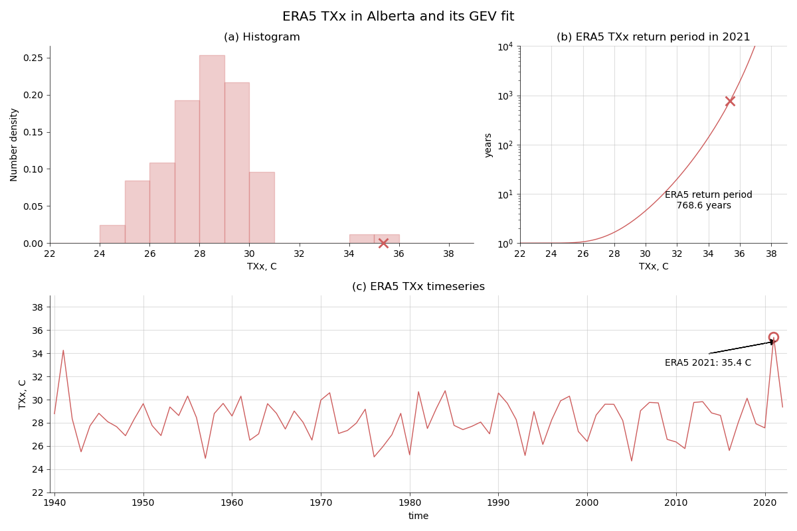
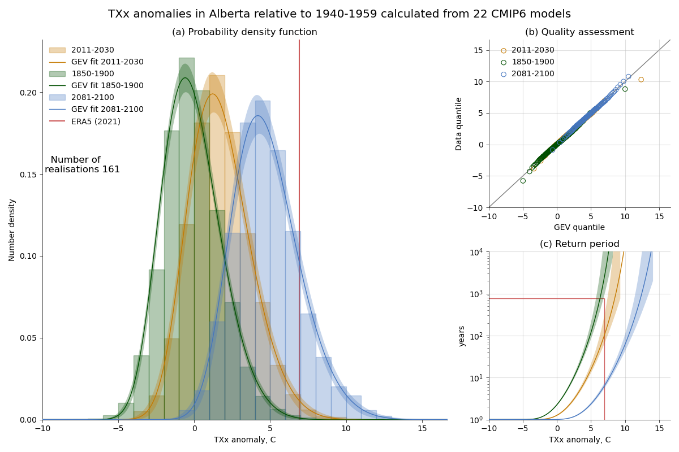
Example of output
ERA5 analysis
CMIP6 analysis
Malinina & Gillett (2024)

Slide 5

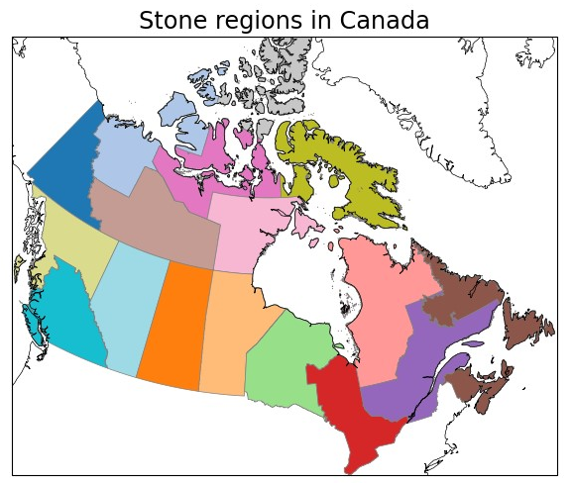
Current Code
The analysis works relatively well with the annual maxima
Last year, CCCma got request to analyze the heatwave in early spring 2023 in Alberta
Diagnostic had to be adjusted to allow for the selection of the parts of the month
First prototype: to automate current recipe/diagnostic combo for the first prototype

Slide 6
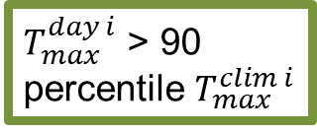
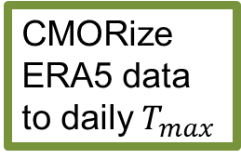
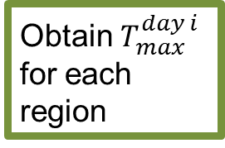
Algorithm
1am UTC (every day) load ERA5 data
No?
END
CMORize ERA5 data to daily $T_{max}$
Obtain $T_{max}^{day i}$ for each region
$T_{max}^{day i}$ > 90 percentile $T_{max}^{clim i}$
State a warm day
cmorize_era.py
create_attribution_recipes.py
load_era.py
ESMValTool recipe: recipe_observational_analysis_heatwave.yml
Do the runs for TXx (TX3x) exist?
Identify days of TXx, TX3x
Calculate the HW duration (L)
Notify team, e.g., by email though GitLab
Combine the output to a html
Pull from the database
Run the TXx (TX3x) recipes
Save the output paths to a database
ESMValTool recipe: recipe_{region}_extremes_{variable}_.yml
combine_outputs.py
temporary_attribution_recipes_run.py
6

Slide 7
Steps
Step # | hcron job | Process script | Duration | Queue
1 | load_era (0:0 UTC) | load_era.py | up to 10 h | dev_daemon
2 | cmorize_era (10:01 UTC) | cmorize_era.py | 15 mins | development 1 cpu, 50Gb
3 | create_attr_recipes (10:20 UTC) | create_attribution_recipes.py | 10 mins | development, 1 cpu, 20Gb
4 | run_attribution (10:35 UTC) | temporary_attribution_recipes_run.py (initiates esmvaltool run for each region) | each 4:40 h | development, each 27 cpus, 185Gb
5 | create_html (16:00 UTC) | combine_outputs.py | 2 mins | development, 1 cpu, 5Gb
So far running like cron jobs, will be put onto the cylc workflow in the next few months

Slide 8
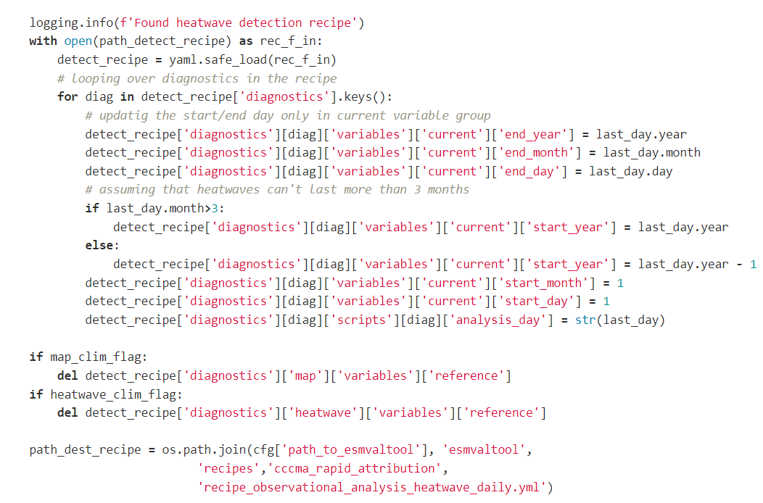
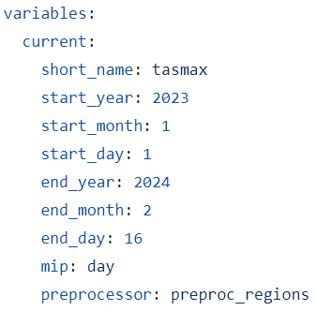
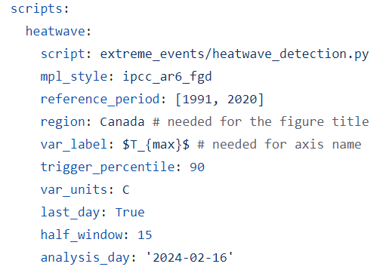
Code Snippets
to change

Slide 9
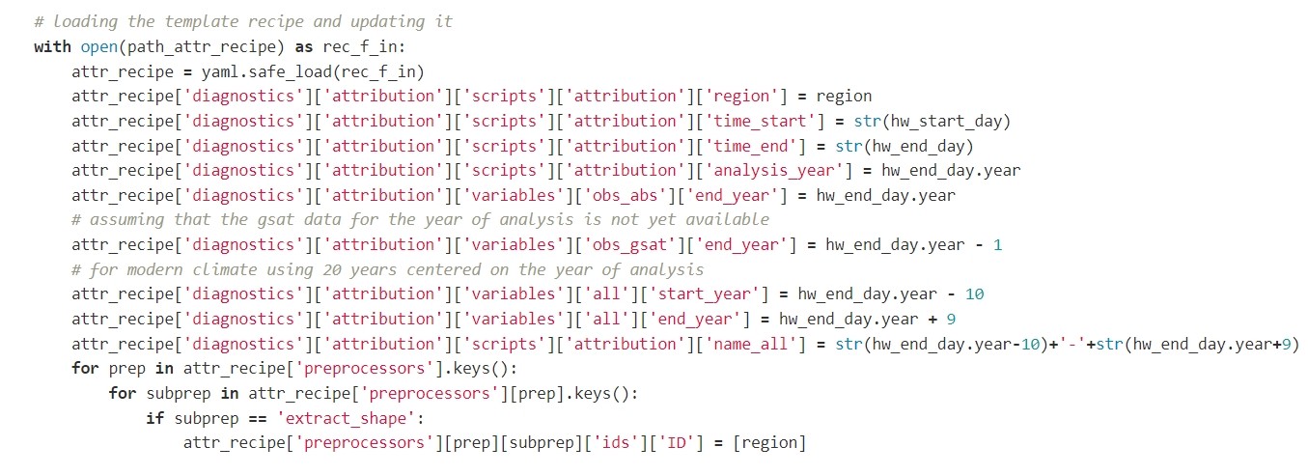
Code Snippets

Slide 10
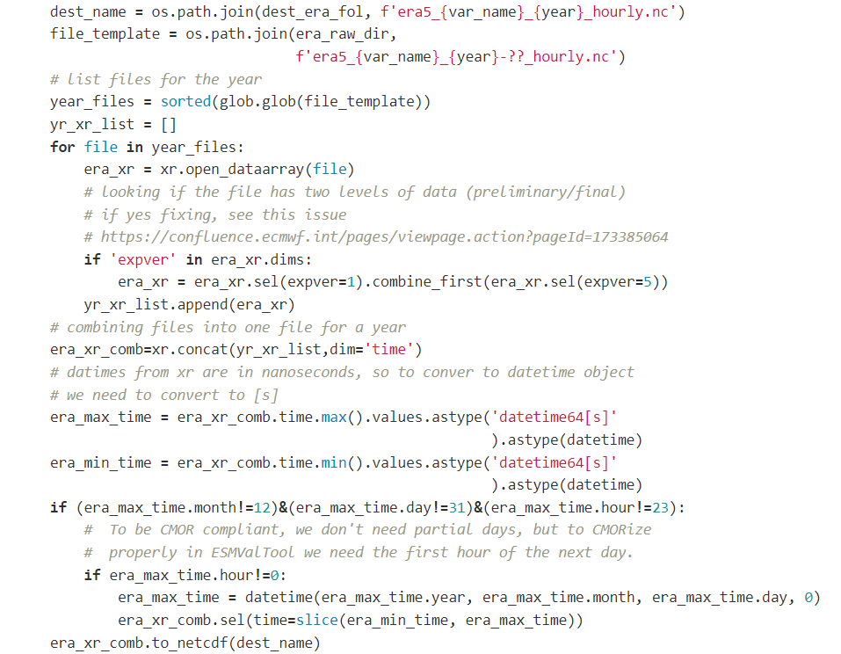
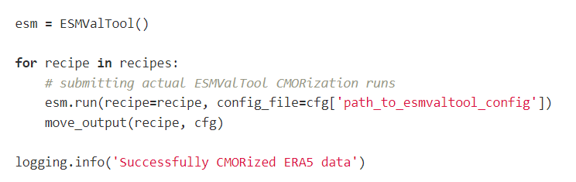
CODE SNIPPETS
ERA CMORization preparation
Running ESMValTool from the python script

Slide 11
Current issues (Why not yet in Main?)
Environment (!!!):
Additions: era5cli, SQLAlchemy, climextremes (Python wrapper and R package)
Need to re-write the code:
Move to classes
Ideally, separate the OBS and CMIP6 analysis and just pass dates and return periods
Different diagnostics need different dask settings, can be used now
Re-use pre-processed parts when recipe changed
Clunky way to re-write recipes by machine

Slide 12
Questions/suggestions or Code review are highly appreciated!

Slide 13
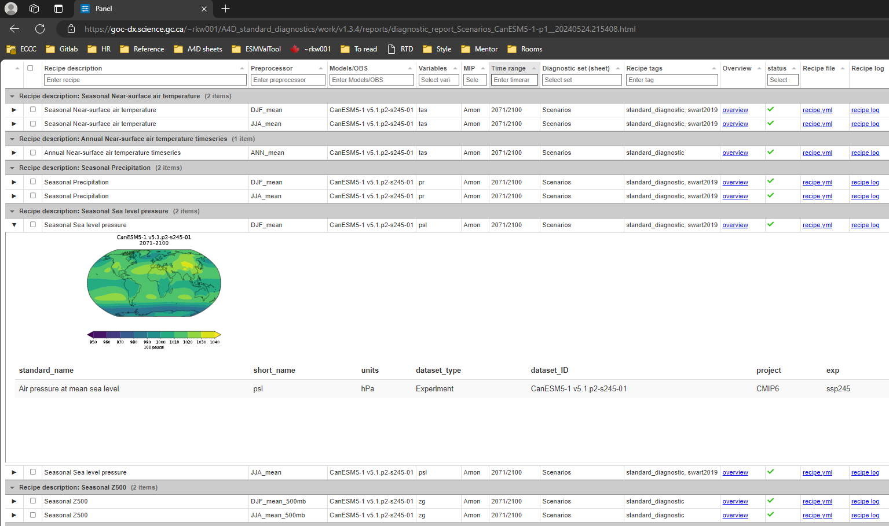
Python wrapper of ESMValTool to write/run recipes, and organize output
A slide from Kristi Webb

