Slide 1
intake, zarr, and high resolution model data
ESMValTool workshop, 27.-29.05.2024

Slide 2
Outline
Intake
zarr
high resolution model data

Slide 3
Intake
What is Intake?
A Python library for data cataloging, see https://intake.readthedocs.io/en/latest/index.html
Aims at:
describe your data declaratively
gather data sets into catalogs
search catalogs and services to find the right data you need
load, transform and output data in many formats
work with third party remote storage and compute platforms
Why should ESMValTool be able to use Intake?
Projects like to distribute their model date using intake catalogues (e.g. EERIE, NextGEMS)
Intake catalouge for ESGF (intake_esm, intake_stac, or intake_esgf): see Consider using the intake-esm library · Issue #31 · ESMValGroup/ESMValCore (github.com)
Issues using intake in ESMValTool?
Needs a nontrivial python environment, including intake, aiohttp + more
Most examples show finding and reading data using intake
Example notebook: /work/bd1083/b380216/ESMValTool_workshop2024/test_intake.ipynb
Run intake in the ESMValTool with information from the recipe?
Run an independent utility with intake to get the necessary information for config_user, config_developer, and recipe from intake catalogues?

Slide 4
zarr
What is zarr?
A format for the storage of chunked, compressed, N-dimensional arrays, see https://zarr.dev/, Zarr-Python — zarr 0.1.dev50 documentation
see https://github.com/ESMValGroup/ESMValCore/discussions/1621
Why should ESMValTool be able to read zarr?
Popular for cloud storage
Model groups start to distribute their data as zarr (EERIE, NextGEMS)
Several netCDF files (e.g. all variables of a CMIP model) can be concatenated into one zarr file preserving all information (incl. meta data)
Potential issues reading zarr with ESMValTool?
Several netCDF files (e.g. all variables of a CMIP model) can be concatenated into one zarr file …
Example notebook: /work/bd1083/b380216/ESMValTool_workshop2024/test_zarr.ipynb

Slide 5
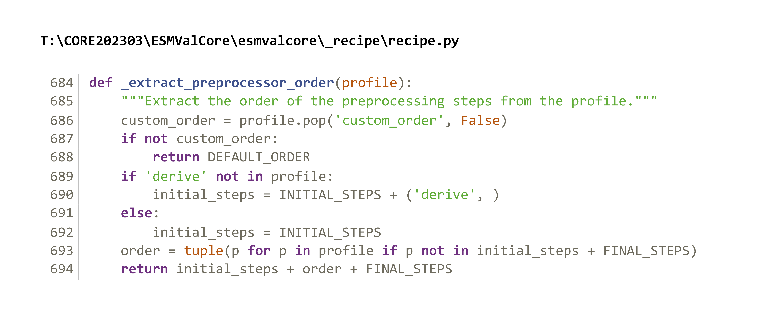
High resolution model data
Which spatial resolutions do we need?
CMIP6: 1-2°; CMIP7: 0.25°?; HighResMIP: 25km
ERA5: 0.25°; ERA5-Land: 0.1°
NextGEMS: 3km (storm resolving)
EERIE: 5-20km (Ocean: eddy permitting: ¼°; eddy resolving: 1/12°)
Future: km-scale model data (1km)?
Special issues with high resolution data
Extract regions before anything else is done? (also before deriving variables)?*
Weights for regridding (precalculated, reuse)?
Memory/Dask?
Others issues?
*After checking the code in esmvalcore/_recipe/recipe.py, I would assume this is already possible with „custom_order“?
custom_order is not well documented (missing at https://docs.esmvaltool.org/projects/ESMValCore/en/latest/api/esmvalcore.preprocessor.html#preprocessor-functions and only shortly described at https://docs.esmvaltool.org/projects/ESMValCore/en/latest/recipe/overview.html#recipe-section-preprocessors)

Slide 6
High resolution model data
Which spatial resolutions do we need?
CMIP6: 1-2°; CMIP7: 0.25°?; HighResMIP: 25km
ERA5: 0.25°; ERA5-Land: 0.1°
NextGEMS: 3km (storm resolving)
EERIE: 5-20km (Ocean: eddy permitting: ¼°; eddy resolving: 1/12°)
Future: km-scale model data (1km)?
Special issues with high resolution data
Extract regions before anything else is done? (also before deriving variables)?*
Weights for regridding (precalculate, reuse)?
Memory/Dask?
Weights for regridding
Calculating weights is time demanding
Often several model experiments share the same grid
Sometimes weights or tools to calculate weights (e.g. using CDO) are available for model data
It is possible, cache regridding weights in memory for some regridding schemes, see https://docs.esmvaltool.org/projects/ESMValCore/en/latest/recipe/preprocessor.html#reusing-regridding-weights
Would it be possible to save and read in precalculated model weights?
See also Add xESMF regridder by bouweandela · Pull Request #2433 · ESMValGroup/ESMValCore (github.com)

