Slide 1
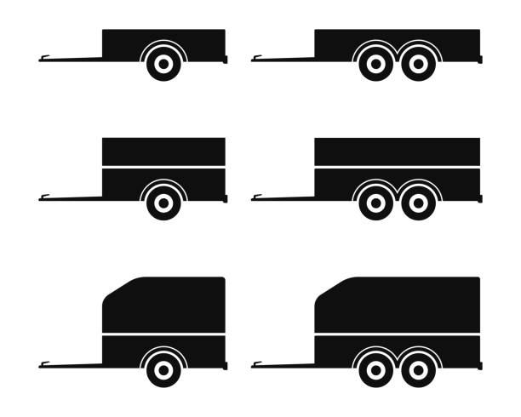
ESMValTool long-term strategy
Google doc

Slide 2

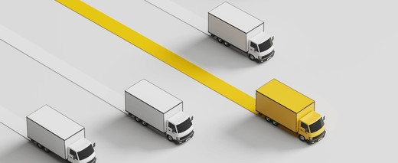
Why?
Resource sustainability: Support and inform long-term funding opportunities
Software sustainability: Build a common vision for ways of working that we want to sustain or evolve towards
Alignment: Build a common vision for future capabilities

Slide 3
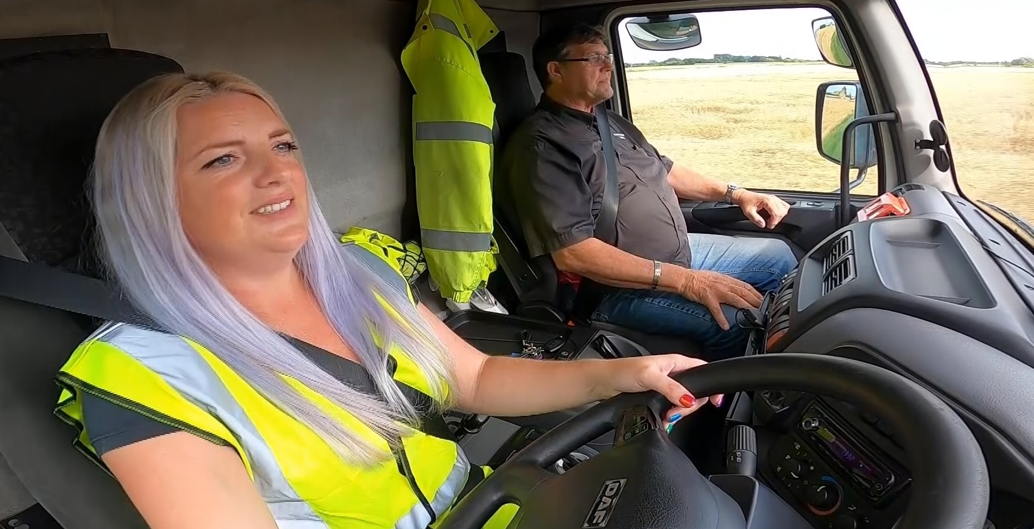
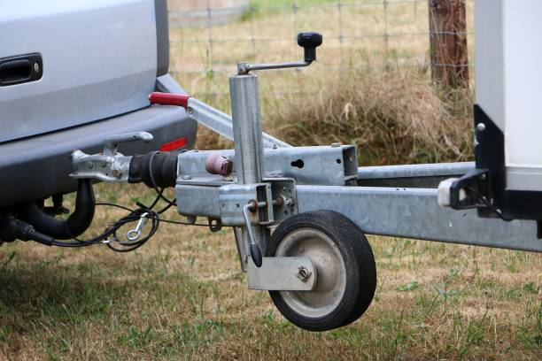

What (and who) is it for?
ESMValTool consortium partners:
Build / document a common understanding of our ambitions and helping to align annual work plans with our shared goals.
ESMValTool stakeholders, including user representatives and developers of Earth system modelling research infrastructures:
How will ESMValTool operate within the wider ecosystem and facilitate the exploitation of Earth observation and model data.
Funding bodies:
provide evidence that specific proposals align with a community vision for Earth system model evaluation and analysis.

Slide 4

It is not…
A development roadmap – it doesn’t spell out which individual developments will be targeted at which release
A plan – it doesn’t say how much effort is needed, who will undertake it & when
↑↑↑↑ These things are also important but should be managed separately and updated more frequently

Slide 5
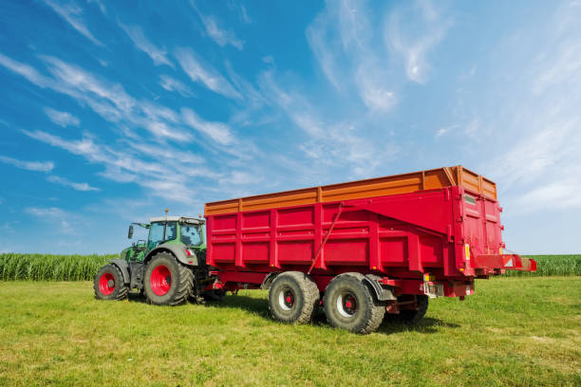
What does it set out
The scientific challenges for Earth system data analysis
Impact on the Earth system community
Software sustainability
New capabilities
Exascale computing and high-resolution models
Support for more model and data types
Optimising exploitation of observations including observational uncertainties
Support for expansion for artificial intelligence methods in modelling and evaluation

Slide 6
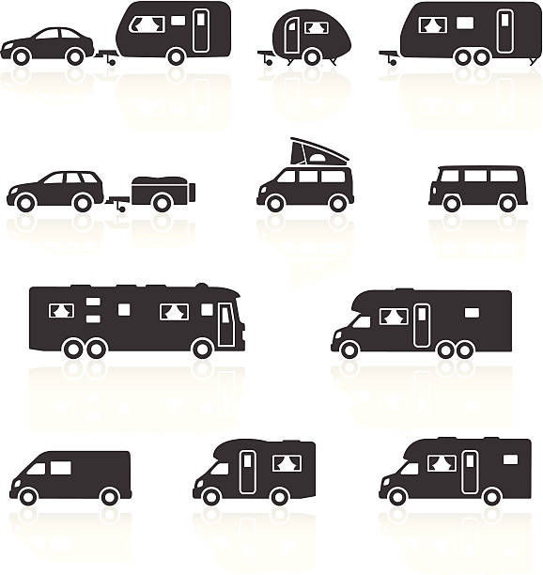
Meta questions
Degree of focus. Currently very broad. This has pros and cons.
Lenses of prioritisation: urgency, importance

Slide 7
Please add your comments to the Google doc

