Slide 1

Autonomous System Provider Authorisation
New tool for routing security
Carlo Berto | ESNOG | October 2026
Notes:
Hello and good morning,
My name is Carlo and today I’m going to talk about

Slide 2
Current Routing Security

Slide 3
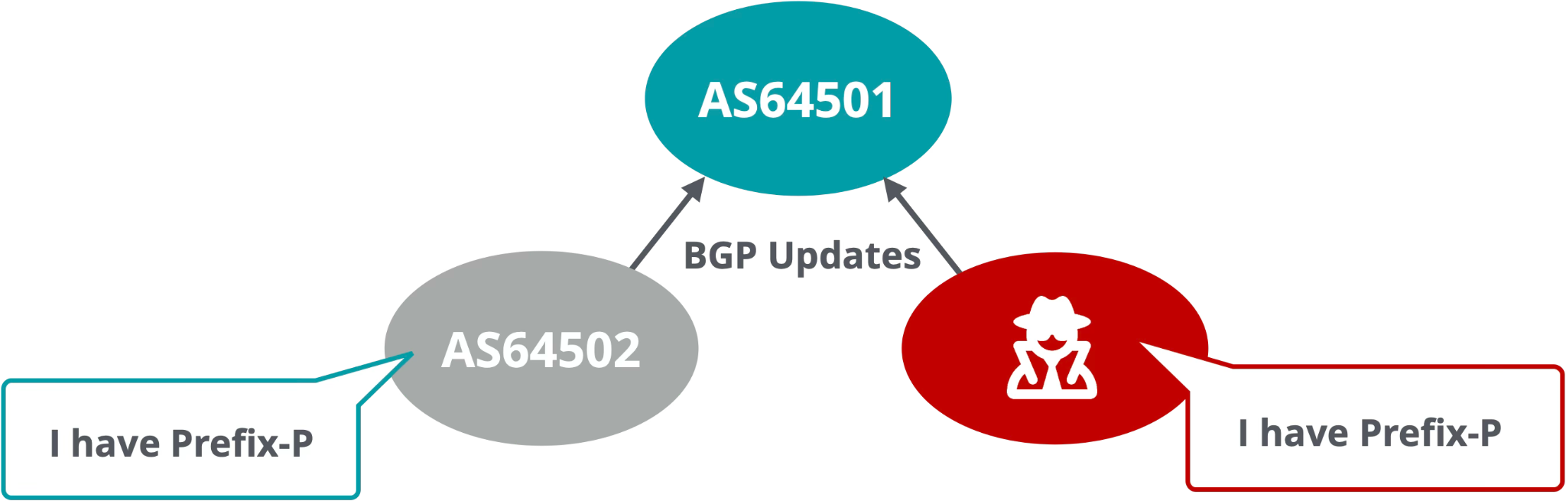
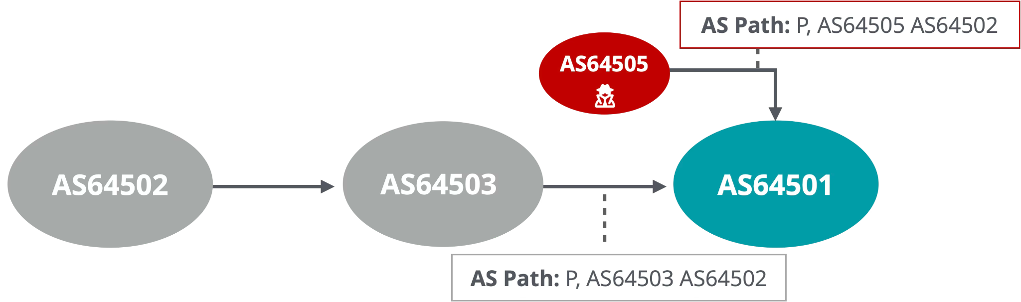
The Need for Routing security
BGP is based on trust
Plain-text protocol without authentication or encryption
Any Autonomous System can announce any prefix
Any router can spoof attributes like AS path

Slide 4
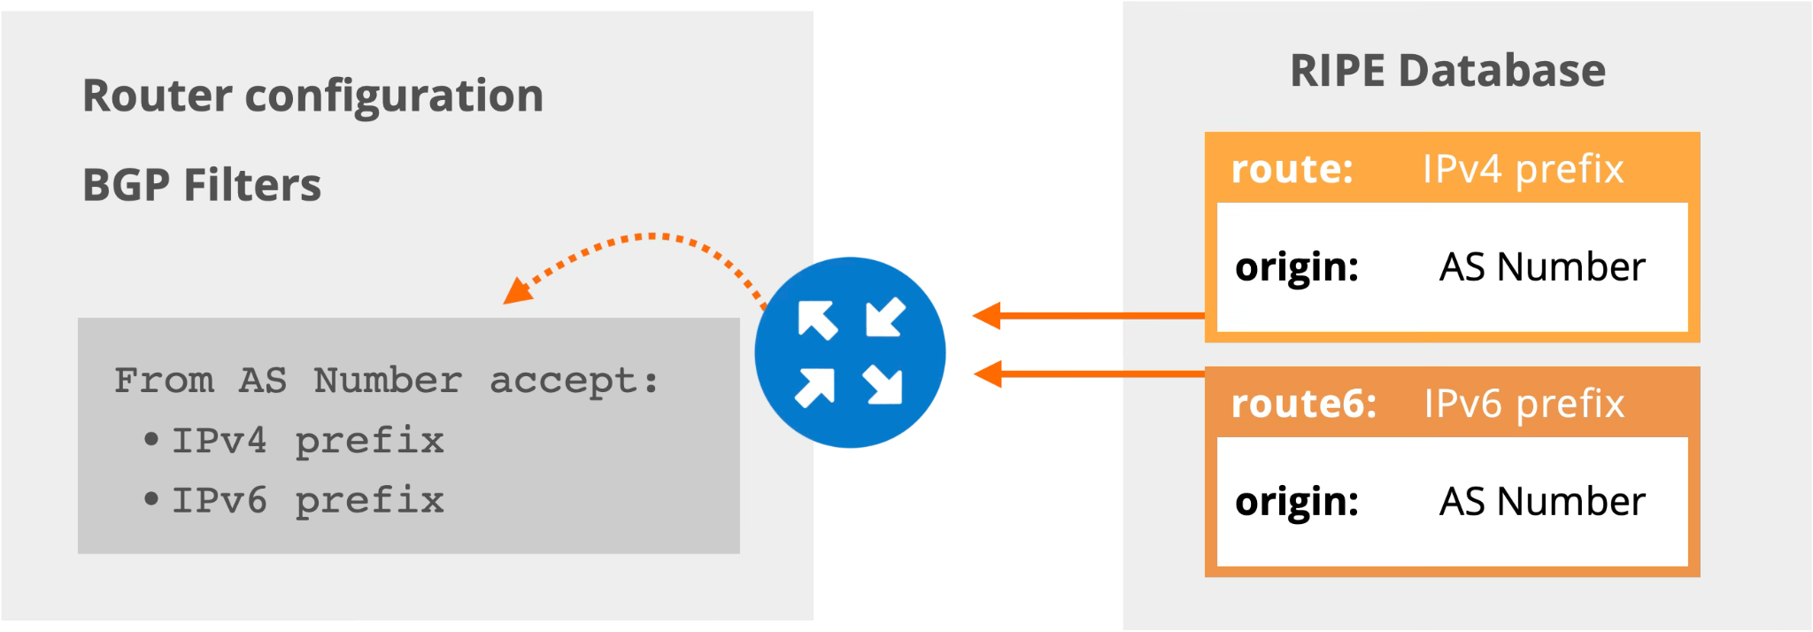
Internet Routing Registries
Route objects bind prefixes to Autonomous Systems

Slide 5
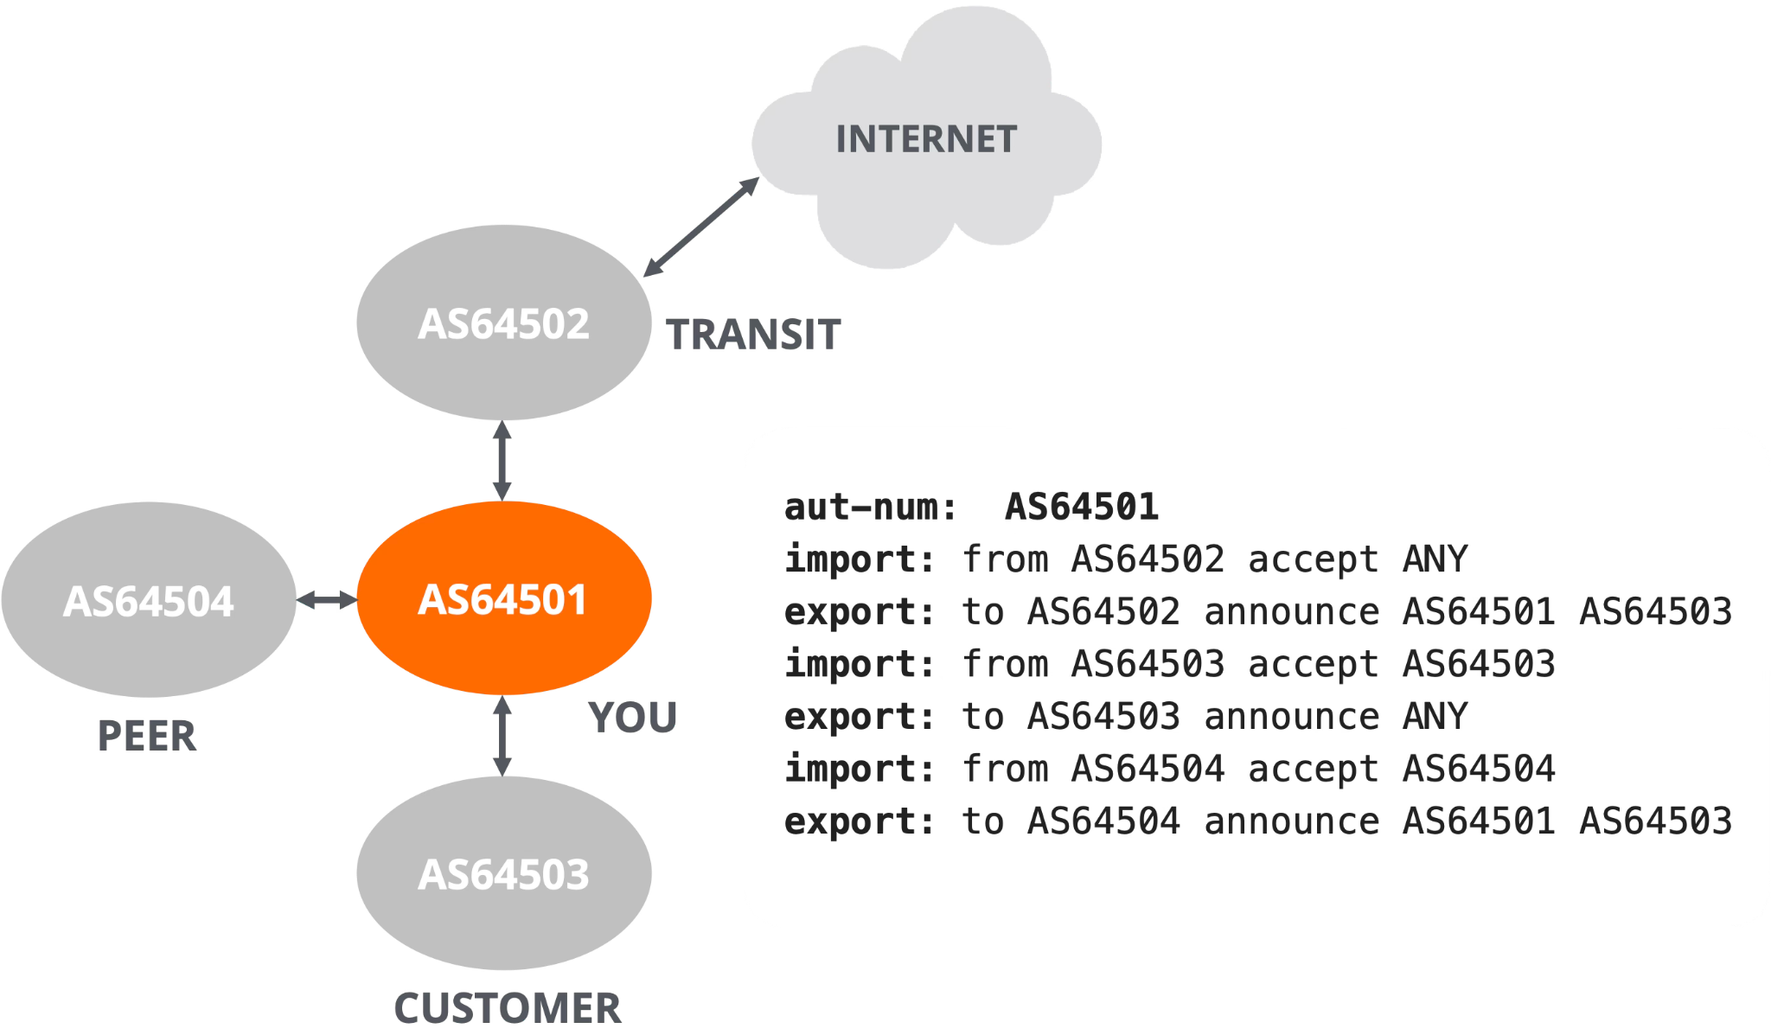
Internet Routing Registries
Aut-num objects describe the routing policy
(Provider)

Slide 6

Internet Routing Registries
The Limits of the IRR system
Multiple inconsistent databases
Limited holdership checks
Stale data
You download plaintext data from random sources on the Internet and put them into the configuration of your routers to make the Internet more secure. What could possibly go wrong?
https://irrexplorer.nlnog.net/

Slide 7
Resource Public Key Infrastructure

Slide 8
Resource Public Key Infrastructure (RPKI)
What is RPKI?
A security framework for the Internet
Verifies the association between resource holders and their resources
  Attaches digital certificate to IP addresses and AS numbers
  Does not contain other information about the holders (no PII)
Growing list of use cases:
  BGP Origin Validation (BGP OV)
  Autonomous System Provider Authorisation (ASPA)
  BGPsec

Slide 9
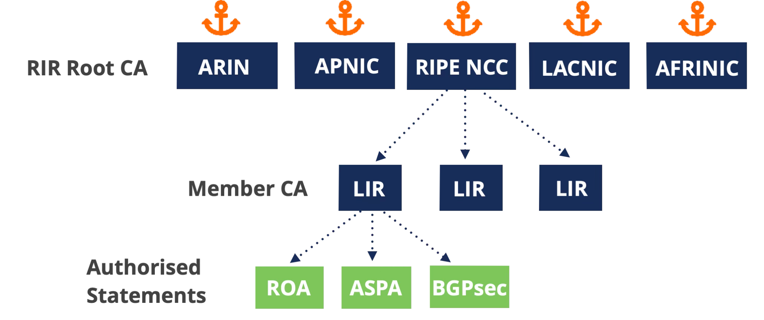
RPKI
RPKI in a nutshell
Resource holders get certificate from their RIRs
  It contains the list of resources
Holders can create digitally signed objects:
  ROA for authorizing an Autonomous System to originate a prefix
  ASPA for authorising Provider Autonomous Systems
  BGPsec router certificates
Network operators use validated data for filtering BGP announcements

Slide 10
Resource Public Key Infrastructure
RPKI is not just Origin Validation
Route Origin Validation is the first and most popular service of RPKI
It prevents misorigination or more specific hijacks
It does not protect against AS path spoofing
It does not prevent route leaks that preserve AS path

Slide 11
Autonomous System Provider Authorisation

Slide 12
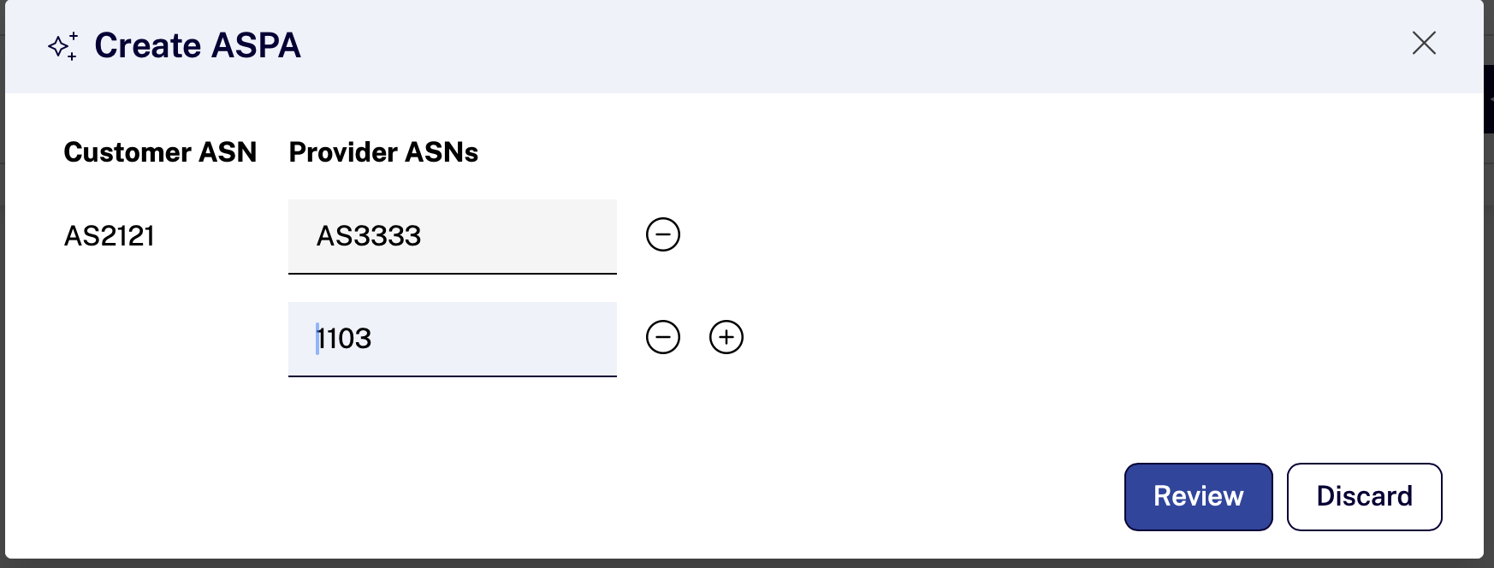
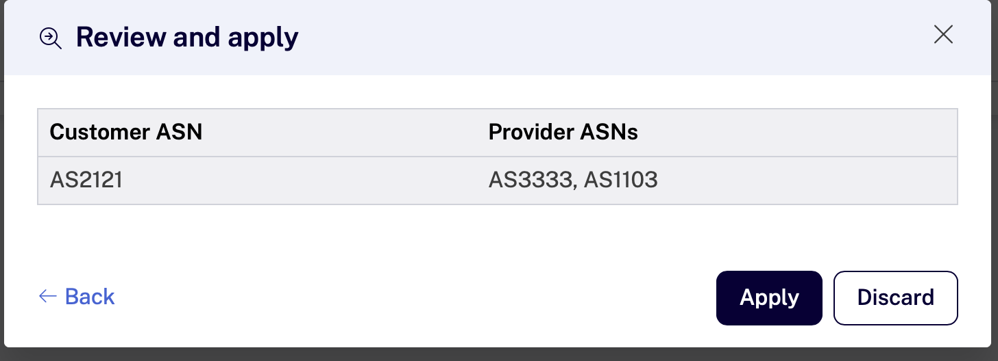
Autonomous System Provider Authorisation (ASPA)
ASPA Object
Object issued by a holder of a AS number
Contains a set of Provider AS numbers
Must be signed by a RPKI certificate proving holdership of the client AS number

Slide 13
ASPA
Upstream path validation
Downstream path validation
For BGP sessions with customers and peers
Simpler and stricter
Only up-ramp is allowed
For BGP sessions with transit providers
Allows one up-ramp (to the transit provider) and one down-ramp (to your network)
Tier-1
Peer
YOU
ISP
ISP
Stub
Stub
Stub
YOU

Slide 14
Upstream validation

Slide 15
Upstream Validation in Detail
Plausible, well… Not Implausible Paths
Each AS-to-AS hop is verified as:
  Provider
  Not Provider
  No Attestation
  (no ASPA exists for customer AS)

Slide 16
ASPA Verification - Routes from Customers
Spoofed origin AS
Given:
192.0.2.0/24 => AS4
AS4 => [ AS2 ]
AS1 sees 1 3 5 4 192.0.2.0/24
AS1 knows:
AS3 is a customer session - Upstream validation is used
AS5 is “Not Provider” for AS4
Therefore this is invalid.
AS1
AS2
AS3
AS4
AS5
“AS4”
192.0.2.0/24
192.0.2.0/24

Slide 17
ASPA Verification - Routes from Customers
Or.. perhaps just a leak?
Given:
192.0.2.0/24 => AS4
AS4 => [ AS2 ]
AS1 sees 1 3 5 4 192.0.2.0/24
AS1 knows:
AS3 is a customer session - Upstream validation is used
AS5 is “Not Provider” for AS4
Therefore this is invalid.
Note: it does not matter if it’s an accidental leak, or malicious spoofing.
AS1
AS2
AS3
AS4
peer
AS5
192.0.2.0/24

Slide 18
Downstream validation

Slide 19
Valley Free Routing - Routes from Providers
Up, to the side and then down
Tier-1
transit
Tier-1
transit
Data should never flow Up-Down-Up
ASPA can detect valleys in the AS path using the “Downstream” validation algorithm
Provider
Provider
Provider
Provider
Stub
Stub
Stub
Stub
Stub

Slide 20
How ASPA Finds Valleys in AS Paths
Downstream Path validation algorithm
Each AS-to-AS hop is verified as:
  Provider
  Not Provider
  No Attestation
The longest Up-ramp is found starting from the origin ASN until a “Not Provider” relation is encountered
The longest Down-ramp is found starting from local ASN until a “Not Provider” relation is encountered
The path is only plausible if:
  The Up and Down ramps meet at adjacent peers, or
  The Up and Down ramps (partially) overlap
One or more hops between Up and Down ramps are valleys, such paths are invalid
If “No Attestation” is encountered, the path is unknown. Otherwise it is valid.

Slide 21
Valley Free Routing
Valley Free Examples
up
Tier-1
transit
Provider
Provider
Provider
Provider
down
up
Stub
You
Stub
You
down
192.0.2.0/24
192.0.2.0/24

Slide 22
Valley Free Routing
Not Valley Free - Leak by adjacent peer
Given:
192.0.2.0/24 => AS5
AS1 => [ AS0 ] # provider free
AS2 => [ AS1 ]
AS4 sees 4 1 3 2 5 192.0.2.0/24
AS3 is “Not Provider” for AS2
Up: 2 5
AS3 is “Not Provider” for AS1
Down: 4 1
AS3 is a valley, therefore this is invalid.
AS1
down
AS2
AS3
AS4
up
valley
AS5
192.0.2.0/24

Slide 23
Valley Free Routing
Not Valley Free - Leak to second Transit
Given:
192.0.2.0/24 => AS6
AS1 => [ AS0 ] # provider free
AS2 => [ AS0 ] # provider free
AS5 sees 5 2 4 1 3 6 192.0.2.0/24
AS4 is “Not Provider” for AS1
Up: 1 3 6
AS4 is “Not Provider” for AS2
Down: 5 2
AS4 is a valley, therefore this is invalid.
AS1
AS2
AS3
AS4
AS5
up
down
valley
AS6
AS7
192.0.2.0/24

Slide 24
ASPA in the
RPKI Dashboard

Slide 25
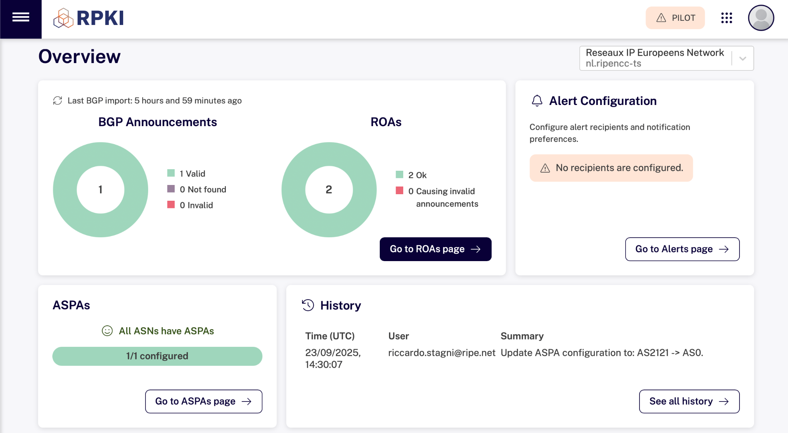
Overview Page

Slide 26
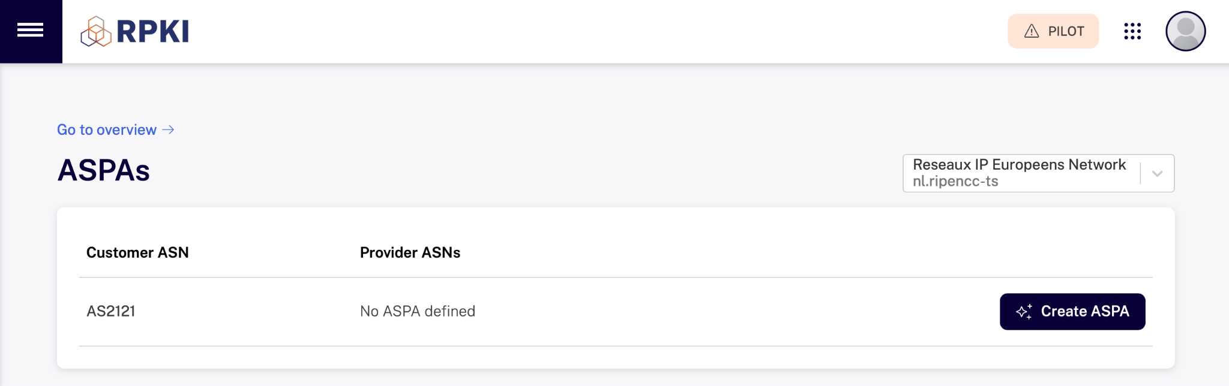
Manage ASPAs
ASPA configuration options are only shown for the AS number(s) you hold

Slide 27
Create / Review ASPAs
You need to check which providers to include, there are no suggestions

Slide 28
Which Providers Should Go on Your ASPA Objects?
All your providers!
  Including backup ones even if they are not visible in AS path at the moment
Not your lateral peers
  Unless those peers that can act as your Provider
Also include non-transparent route servers of IXP
  Otherwise the non-transparent route server AS would be considered a valley
Make this the part of your IRR update procedure

Slide 29
ASPA in the Routers

Slide 30
From Signing to Router
RPKI
Repository
Router
RPKI
CAs
(RPKI dashboard)
RPKI
Validator
sign &
publish
validate
rtr
protocol
Same deployment model as BGP Origin Validation

Slide 31
ASPA Validation Deployment
It’s a sharp tool
As with BGP Origin Validation: reject invalid, do not just lower preference
Use “Upstream Path Validation” for your customers and peers
Use “Downstream Path Validation” for your providers
But it’s early days
Not yet available on many routers, talk to your vendor!
Probably wise to start by logging
Warn customers if they did not include you as a provider

Slide 32



?
Questions
& Comments
cberto@ripe.net
Notes:
Approx 2k aspa’s https://radar.cloudflare.com/routing/rpki#rpki-aspa-deployment
1.3k RIPE NCC
500 ARIN
APNIC and LACNIC less than 100 both

