Slide 1
Attorney Form Builder

Slide 2
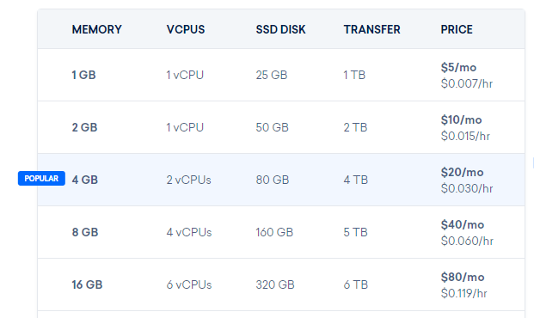
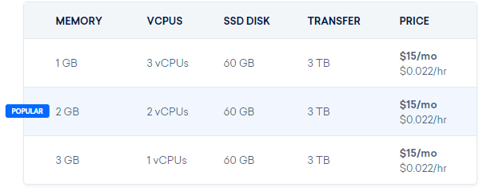
Server Details and Costs
Notes:
Slide for Morgan

Slide 3
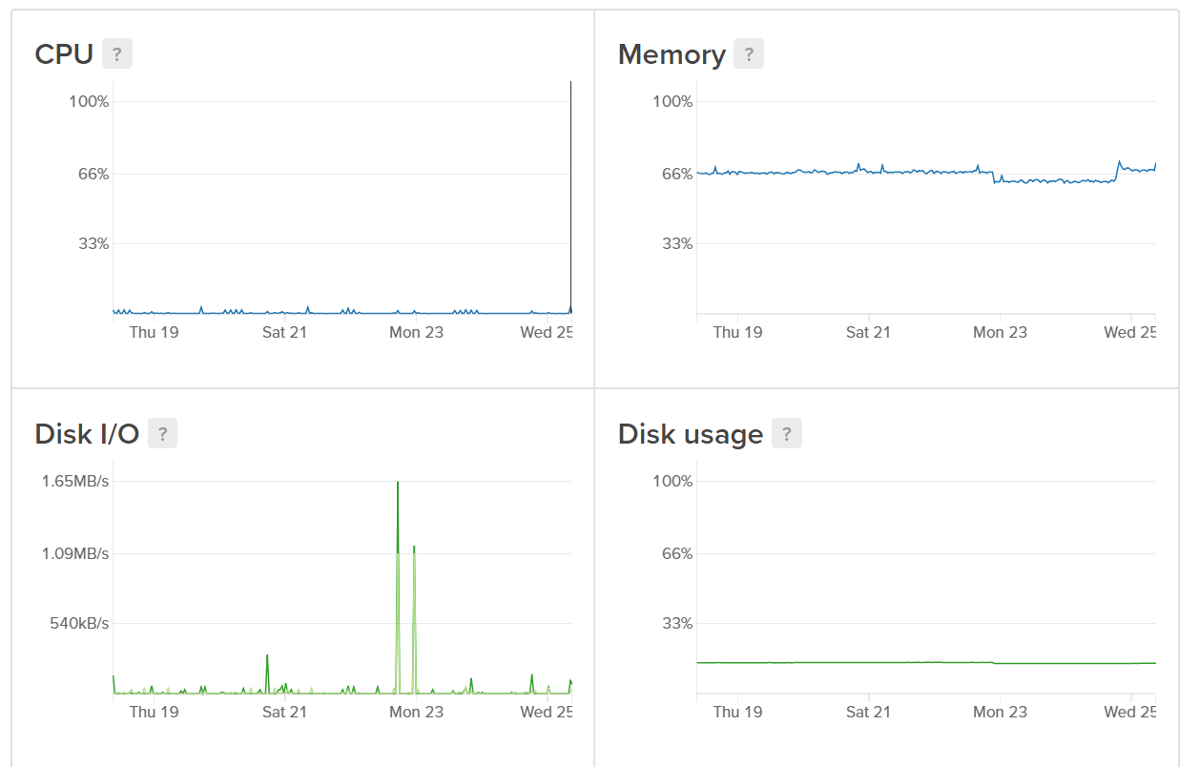
Notes:
Slide for Morgan

Slide 4
Server Details and Costs
Notes:
Slide for Morgan

Slide 5
Software requirements
Apache web server
MariaDB
Express web server for Node.js
Notes:
All of this software is available for free, so the only recurring cost for running the application would be the server hosting costs.

Slide 6
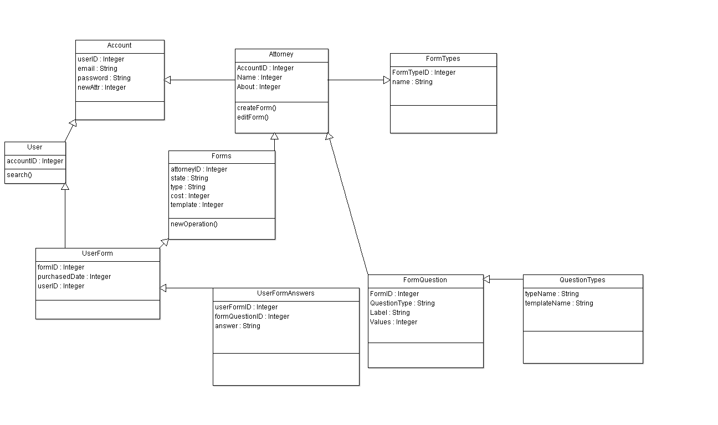
UML Model
Notes:
Morgan will upload UML here, Matt can speak to them

Slide 7
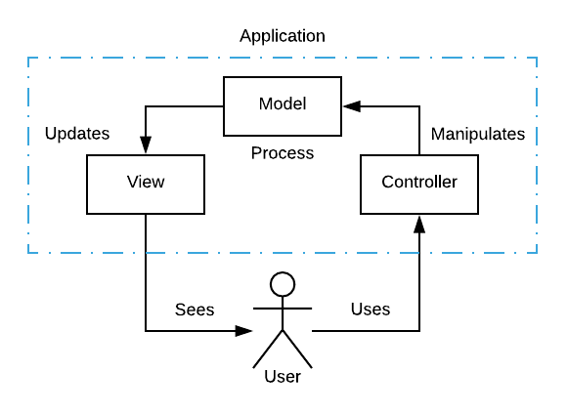
Model-View-Controller Pattern
Application and GUI are designed and built with the user in mind.
User uses the controller to manipulate the model
Model updates the view
User sees the updated view
Pattern repeats as needed

Slide 8
Code Extensibility
NodeJS backend
expressJS, NPM
React frontend
Component system, becoming industry standard
Notes:
npm gives access to massive repository of hundreds of thousands open source packages
component system forces practices like modular components and loosely coupled design

Slide 9
QA Methods
Code Testing
End-to-End & Unit
User Testing
Non-technical user
Code Writing Best Practices
Descriptive naming for classes, methods and variables
Code is easy to read for future maintainability
Version Control
Github
Notes:
Slide for Stephanie - Mocha for testing, issues with transpiling the react ES6 javascript so coverage calculations were done by hand. Morgan conducted user testing and adjusted the user documentation accordingly, Everyone followed best practices while writing code so a new developer can see what the code is doing for maintenance. Github with different branches was used for version control.

Slide 10
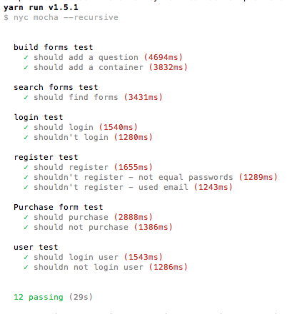
Mocha Testing Framework
End to End Tests
Create Account
Login
Form Search
Build Form
Unit Tests
User Login
Purchase Form
Notes:
Stephanie will cover testing. Mocha testing framework runs on Node.js, which this project is using. Use the command yarn run and the tests automatically run in the terminal. Manual coverage calculations put our coverage at 90.36% covering every .js class.

Slide 11
Continuous Integration & Delivery
Github - github.com/ESOF423/attorney-form-builder
Code changes are committed & pushed to repository
Generates continuous deployment key
Travis CI - travis-ci.org
Monitors Github using the deployment key
Deploys updates automatically
Notes:
Local developers update the code at a local level, they commit those changes to their local repository. Changes can then be pushed to the Github repository. When Travis sees a change it deploys the new code to the project.

Slide 12
Product Demonstration
http://server.redstone.lab:8080
Notes:
Matt will demo

